Slide 1
ADAPT PERSONA MAPPING
CFO:
Priorities and Challenges
Moving into 2023

Slide 2

Most popular ways to use these slides
01
02
Build Compelling Business Cases & Assets
Create Thought-Leadership Content
Powerful local market data designed for you to plug straight into your own assets and make your job that much easier.
Gain the buy-in and trust you need by using our local market expertise to build robust justifications and amplify your messaging.
Reference ADAPT’s unique
data and Analyst commentary
to build out your own content and demonstrate local market expertise.
03
04
05
Empower & Align Your Teams
Add to an Internal Strategy Document
Enhance Your Internal Training Sessions
Inform and align your stakeholders and teams with insights from a trusted independent source designed to help ensure you’re all operating from the same page.
Save time and substantiate your internal documents with local fact-based data and insights that backs up your strategy and cuts through.
Ensure your team is across the
latest insights by integrating the insights within this document
into team meetings or formal
training sessions.

Slide 3
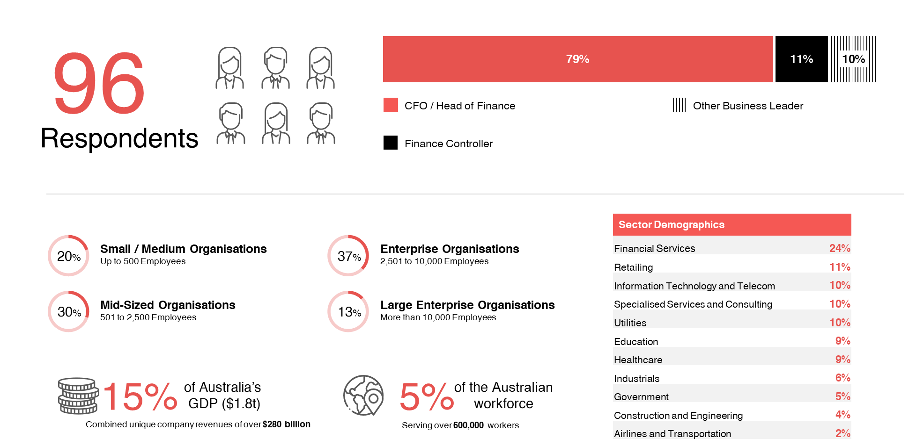
ADAPT CFO Surveys Published in 2022

Slide 4
The CFO’s Business Priorities, Execution Barriers and Investments
ADAPT Analyst Commentary
The following slides present our key findings for this persona. We describe their business priorities, execution barriers, and investment priorities.
Our findings for this persona also cover how CFOs evaluate technology initiatives and the top finance transformations expected in 2023.
These findings are available in the Persona Mapping section of the ADAPT Research Portal.
In 2022, ADAPT surveyed 96 Chief Financial Officers (CFOs) from Australian-based organisations.
52% of respondents work for companies with more than 2,500 employees. In total, the respondents represent organisations that employ 5% of the Australian workforce and contribute 15% to Australia’s $1.9 trillion Gross Domestic Product (GDP).

Slide 5
To ensure that new initiatives deliver value to the organisation, CFOs should foster improved collaboration with other departments. Choosing strategically financed projects to add continuous value will assist in building a more effective and future-proof organisation.
CFOs have an increased focus on attracting and retaining talent compared to pre-COVID 19. However, the CFO should engage with other business areas and provide guidance on the broader impact of talent shortages.
CFOs have a high focus on building a data-driven organisation. In 2023, top-performing CFOs will focus their investments on transforming data into insights. By moving from records to advisory, these CFOs will use a mix of traditional and modern metrics to safeguard value and ensure business growth.
The CFO’s Business Priorities, Execution Barriers and Investments
Key Takeaways
ADAPT finds that the modern CFO has
a critical role in the strategic direction of
an organisation.
Increasingly, CFOs are required to demonstrate high degrees of digital fitness to assist their organisations in modernising and evaluating their digital initiatives.

Slide 6
CFO 2022:
Top 10 Business Priorities

Slide 7
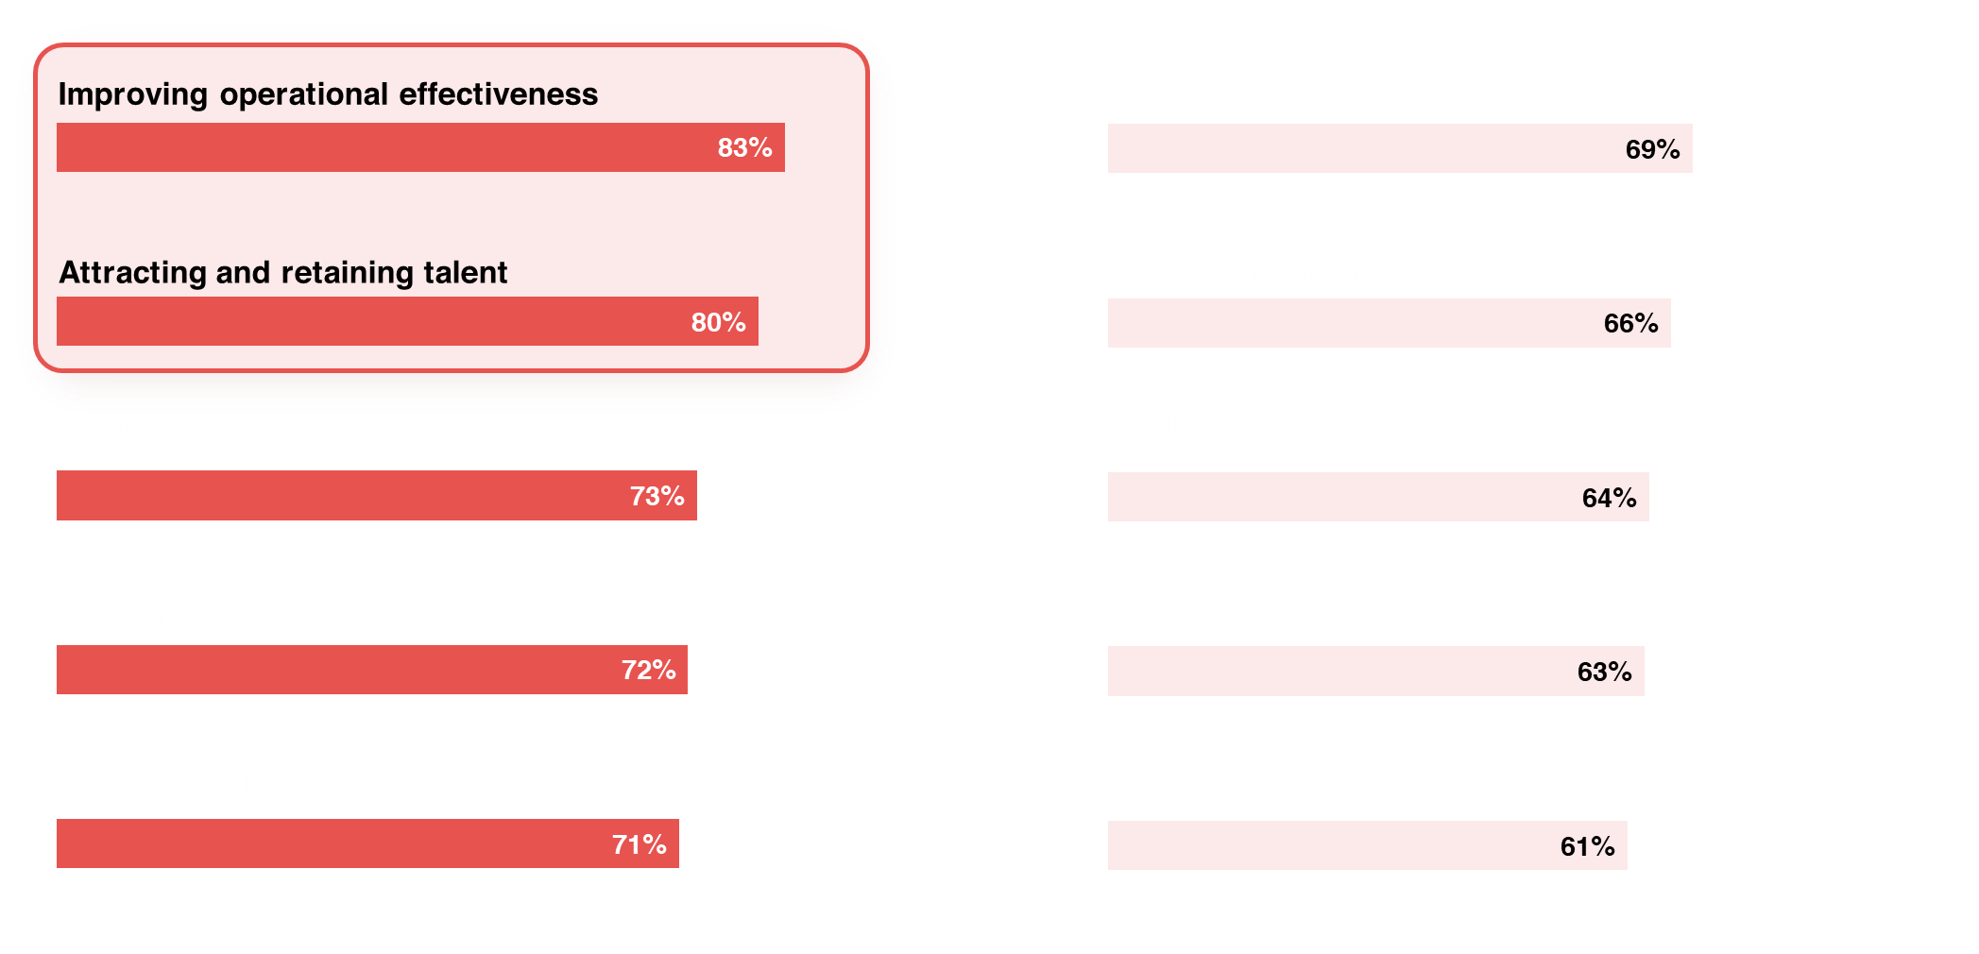
Top Business Priorities for CFOs in 2022
Source: CFO Edge Survey November 2022: 92 CFOs and Heads of Finance

Slide 8
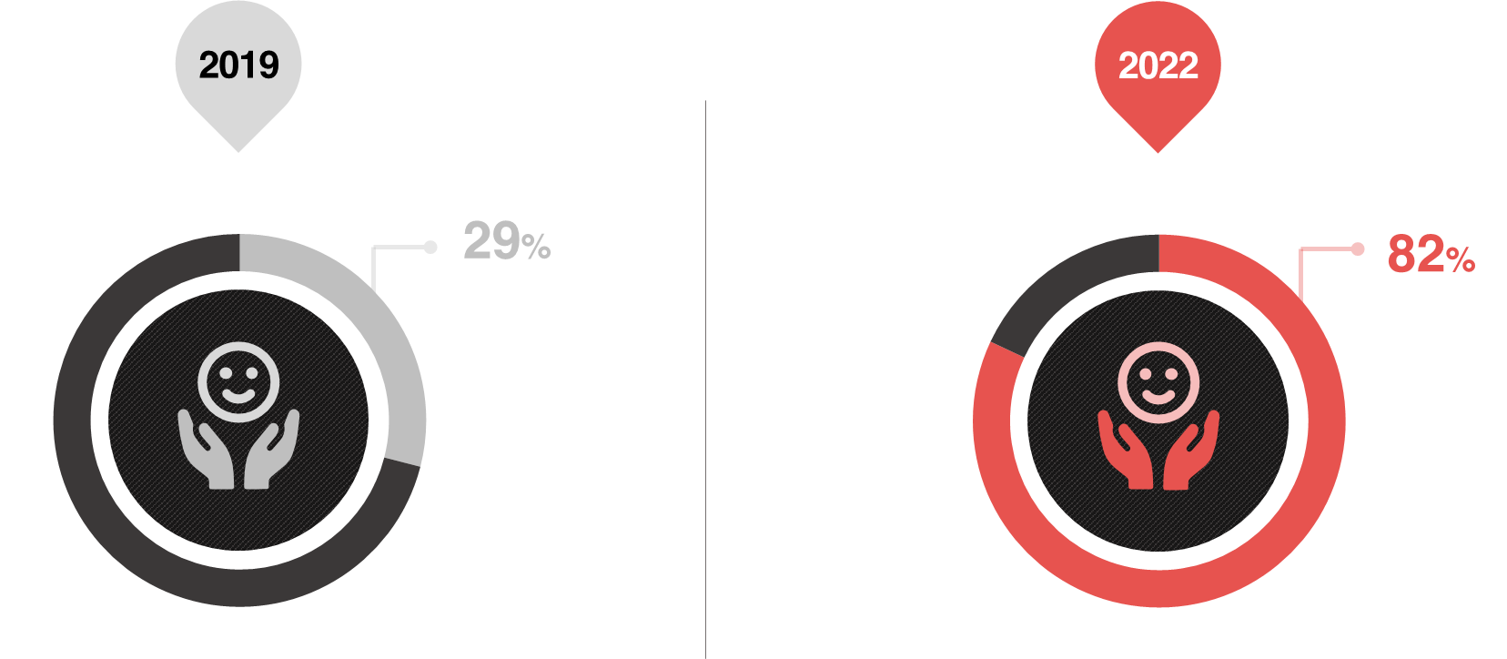
Major Shift in Attracting and Retaining Talent as a CFO Business Priority
Source: ADAPT CFO Survey Nov 2019, CFO Survey Nov 2022: 162 CFOs and Heads of Finance

Slide 9

CFO 2022: Business Priorities
Analyst Commentary
73% of CFOs are focused on building a data-driven organisation. Financial planning, analysis and management accounting are inherently mathematical disciplines.
  An ADAPT Market Trends report, published in August 2020, describes the CFOs role in helping the organisation become data-driven.
By emphasising the role of data in decision-making, CFOs can:
  Leverage automation to reduce time and remove human error.
  Improve forecasting and predictions in financial decisions.
  Promote the right organisational decisions that have the best return on investment.
We investigate how CFOs can shift finance perceptions from records-keeper to insights producer in an ADAPT Best Practices report, published in June 2021.
The top priority for CFOs in 2023 will be improving operational effectiveness. Increasing operational effectiveness requires a combination of methods to make better use of available resources.
The top two business priorities of improving operational effectiveness and talent management are closely related.
We explore talent management strategies in two ADAPT Market Trends reports, published in February 2022 and June 2022.
  Before COVID-19, only 29% of CFOs regarded attracting and retaining talent as a core priority. From November 2022, this had risen sharply to 82%.
  This sharp rise demonstrates the role CFOs can play in ensuring the business is operating as effectively and efficiently as possible.
  CFOs can help achieve the right outcomes, supported by the right technologies, delivered at the right cost.

Slide 10
CFO 2022: Challenges and
Competing Priorities

Slide 11
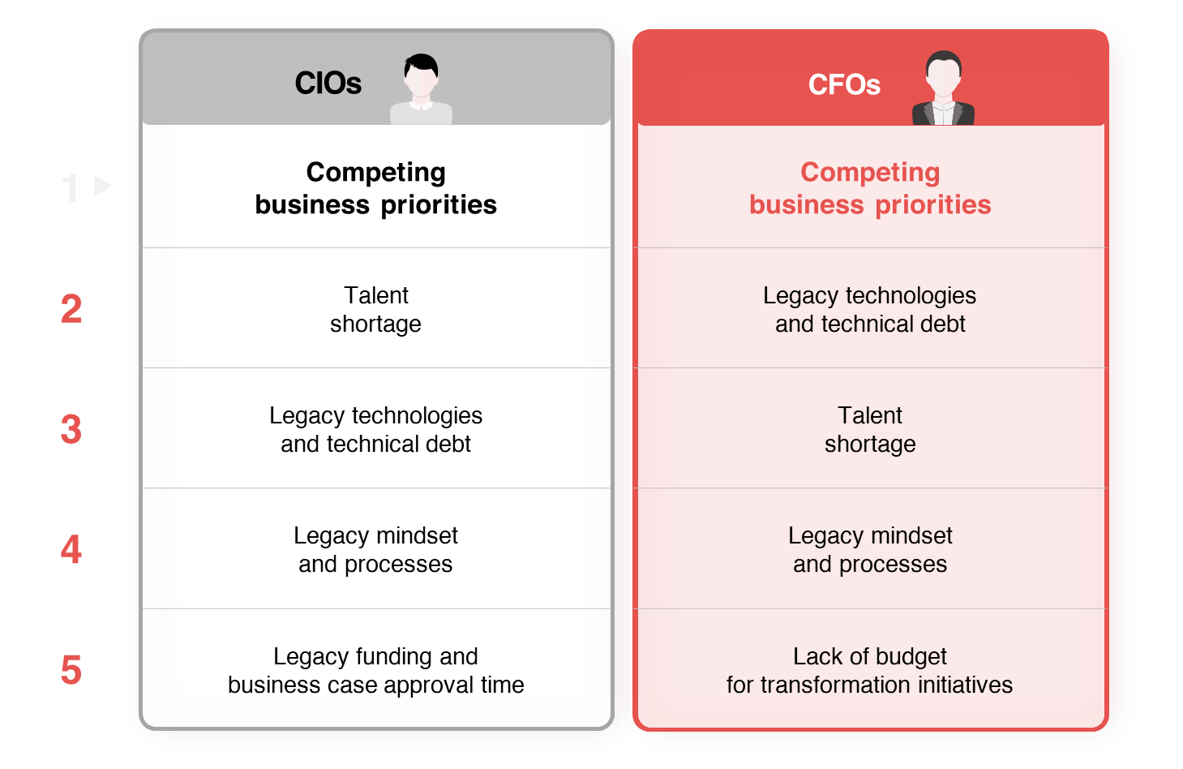
Barriers to Technology Projects for CIOs and CFOs
Source: ADAPT CIO Survey 2022, CFO Survey Nov 2022: 215 CIOs and CFOs

Slide 12
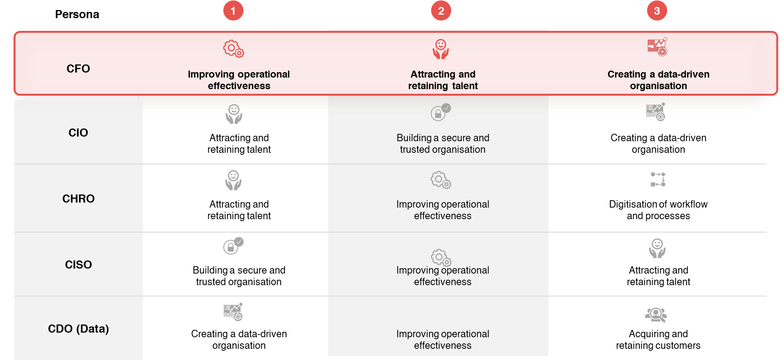
Top Business Priorities Across Personas
Source: ADAPT Edge Surveys in 2022: 740 Australian Business Executives

Slide 13
Challenges and Competing Priorities
Analyst Commentary
CFOs list competing business priorities as the most significant inhibitor to technology initiatives. The sentiment is also shared by CIOs, who also listed competing priorities as their primary barrier to delivering technology projects.
Reviewing the top three business priorities of Australian business executives, these personas are highly aligned in:
  wanting the right mix and depth of talent
  pursuing operational effectiveness in people, procedural, and technology strategies
  becoming data-driven, through shared culture and understanding.
In many Australian enterprise organisations, the CFO is slightly higher on the hierarchy than technology personas. As a senior executive, the CFO can help cultivate a culture of collaboration for better technology and business outcomes.
Technology initiatives are hindered by legacy mindsets, processes, and technology. An ADAPT Expert Presentation, published in September 2022, reveals the strategies of highly modernised organisations. These organisations are creating value by effectively implementing change.
To mature the organisation’s ability to create value through modernisation, CFOs should prioritise funding based on:
  The extent of business impact caused by outdated technologies and processes.
  Current and predicted effectiveness in capturing value from operations, customers and ecosystems.
  The impact of digitisation in ensuring profitability and improving experiences for customers and employees.
We explore the metrics that will matter in an ADAPT Best Practices report, published in June 2021.

Slide 14
CFO Investment
Priorities for 2023

Slide 15
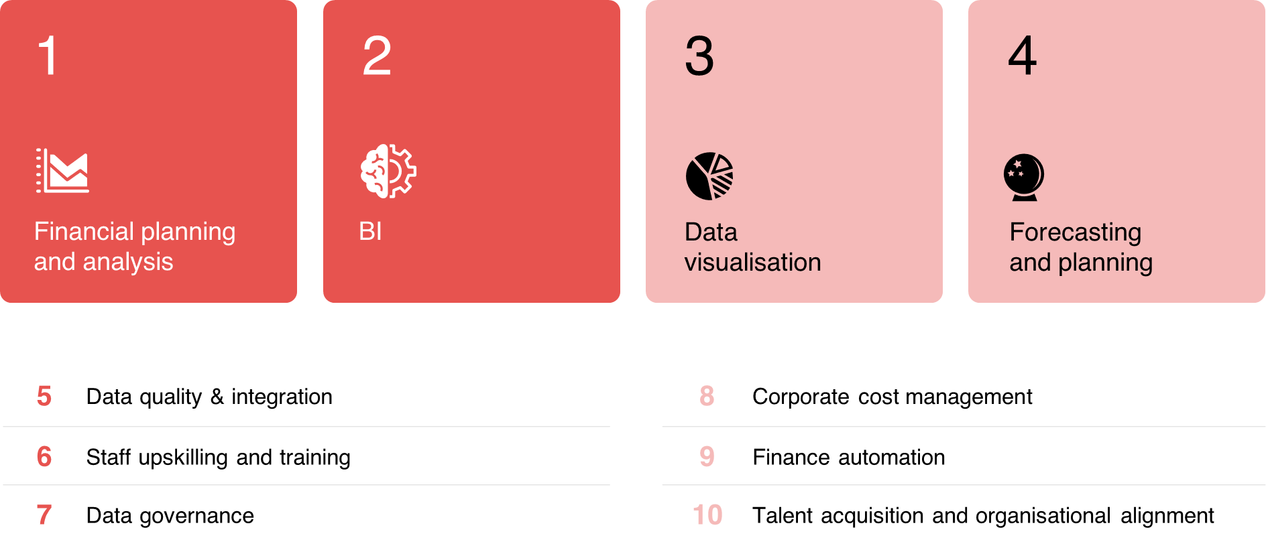
Top 10 Investment Priorities for 2023
Source: ADAPT CFO Survey November 2022: 82 CFOs and Heads of Finance

Slide 16
CFO Investment Priorities for 2023
Analyst Commentary
Six of the top ten investment priorities for CFOs over the next 12 months are data-centric initiatives reinforcing the high focus on being a data-driven organisation. Many of the data priorities listed are the same as the investment highlights by Chief Digital Officers (CDOs) in an ADAPT Persona Mapping report, published in July 2022.
This raises two high-value alignment opportunities for CFOs and CDOs to collaborate on the following:
  Digital transformation in the financial department whereby the CDO consults the CFO on initiatives to streamline financial operations.
  CFOs recognise the need for data transformation as a broader organisational problem. The CFO can collaborate with digital teams to provide strategic financing advice for building a unified data strategy.
Talent management, training and automation address the top 2 business priorities of attracting the best talent and improving operational effectiveness. Providing employees with the necessary skills for their careers as well as introducing automation to make work more interesting are ways to improve employee retention.
An ADAPT Market Trends report, published in August 2022, discusses three areas to invest in to improve the connected workplace. Organisations are affected by talent shortages beyond the finance department. These recruitment, onboarding, training, and staffing of projects challenges also affect the CFO.
To address these issues, CFOs can invest in digital technologies to:
  Keep the business operating despite talent constraints.
  Help employees invest their time and energy in engaging work that connects directly business value creation.
  Harness these benefits to ensure talent retention.

Slide 17

Additional resources you can access
Members of ADAPT’s Research & Advisory platform have access to an entire suite of market leading content, insights and resources
to help you execute in your role. For any assistance or to request access to premium features contact your Account Manager here.
Community Case Studies & Interviews
Market Trend Reports
Live Access to ADAPT Analysts
Access a library of fact-based actionable insights, deep dives
on ANZ business & IT trends.
Case studies detailing the successes and challenges of projects and initiatives.
Through live ADAPT analyst market briefings and Q&A sessions
Downloadable Data & Insights
Industry Expert Presentations
Bespoke Analysis of ADAPT Data
Elevate your business cases with downloadable market and industry data.
Watch keynotes or read distilled 1-page executive summaries from our Edge Events.
Receive custom cuts and analysis of ADAPT proprietary data.
Premier Executive Community
Dedicated Account Manager & Impact Assessments
Dedicated Analyst Briefing
Unlock access to our exclusive network of Australia’s leading technology and business executives.
Your Account Manager will ensure you and your team are getting the most out of your subscription.
Leverage a dedicated briefing with an ADAPT analyst to help validate your strategies.
*Inclusions may vary depending on subscription level.

