Slide 1


ADAPT Tech Trends
The need for greater costs
intelligence in Australia
Shane Hill – Principal Research Analyst at ADAPT

Slide 2

Demonstrating value

Slide 3
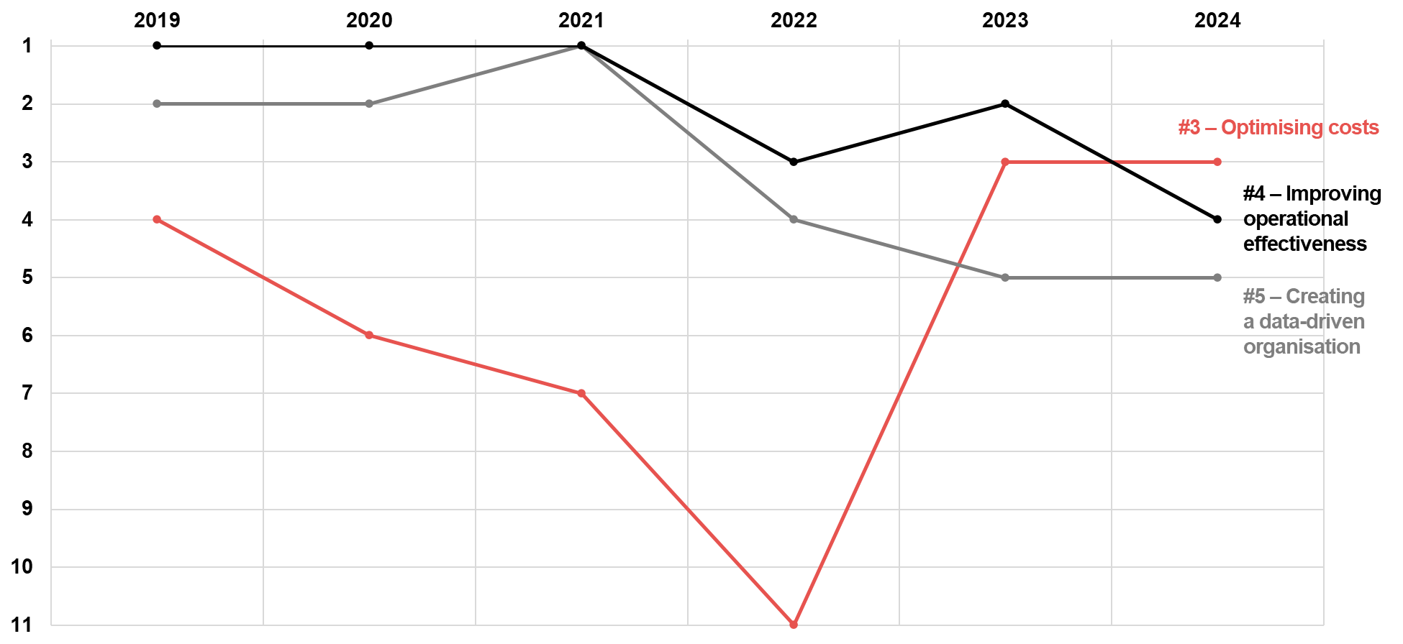
CIOs are prioritising cost optimisation, being effective and using data to do so
Source: ADAPT CIO Edge Surveys in 2019 to 2024. Sample Size: 893 Australian CIOs

Slide 4
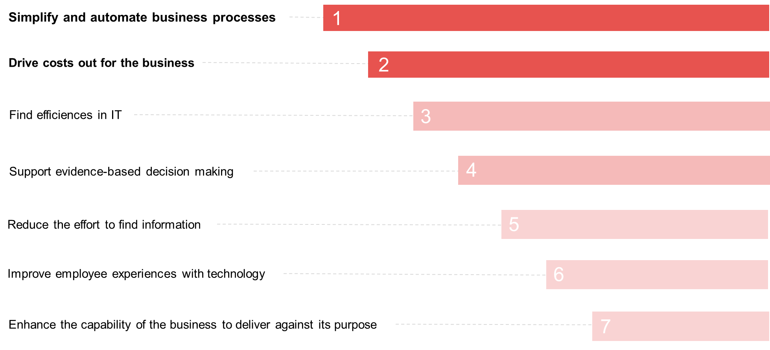
What are your operational priorities?
Source: ADAPT Costs Intelligence Study in Mar and Apr 2024. Sample Size: 20 Australian CIOs and CFOs

Slide 5
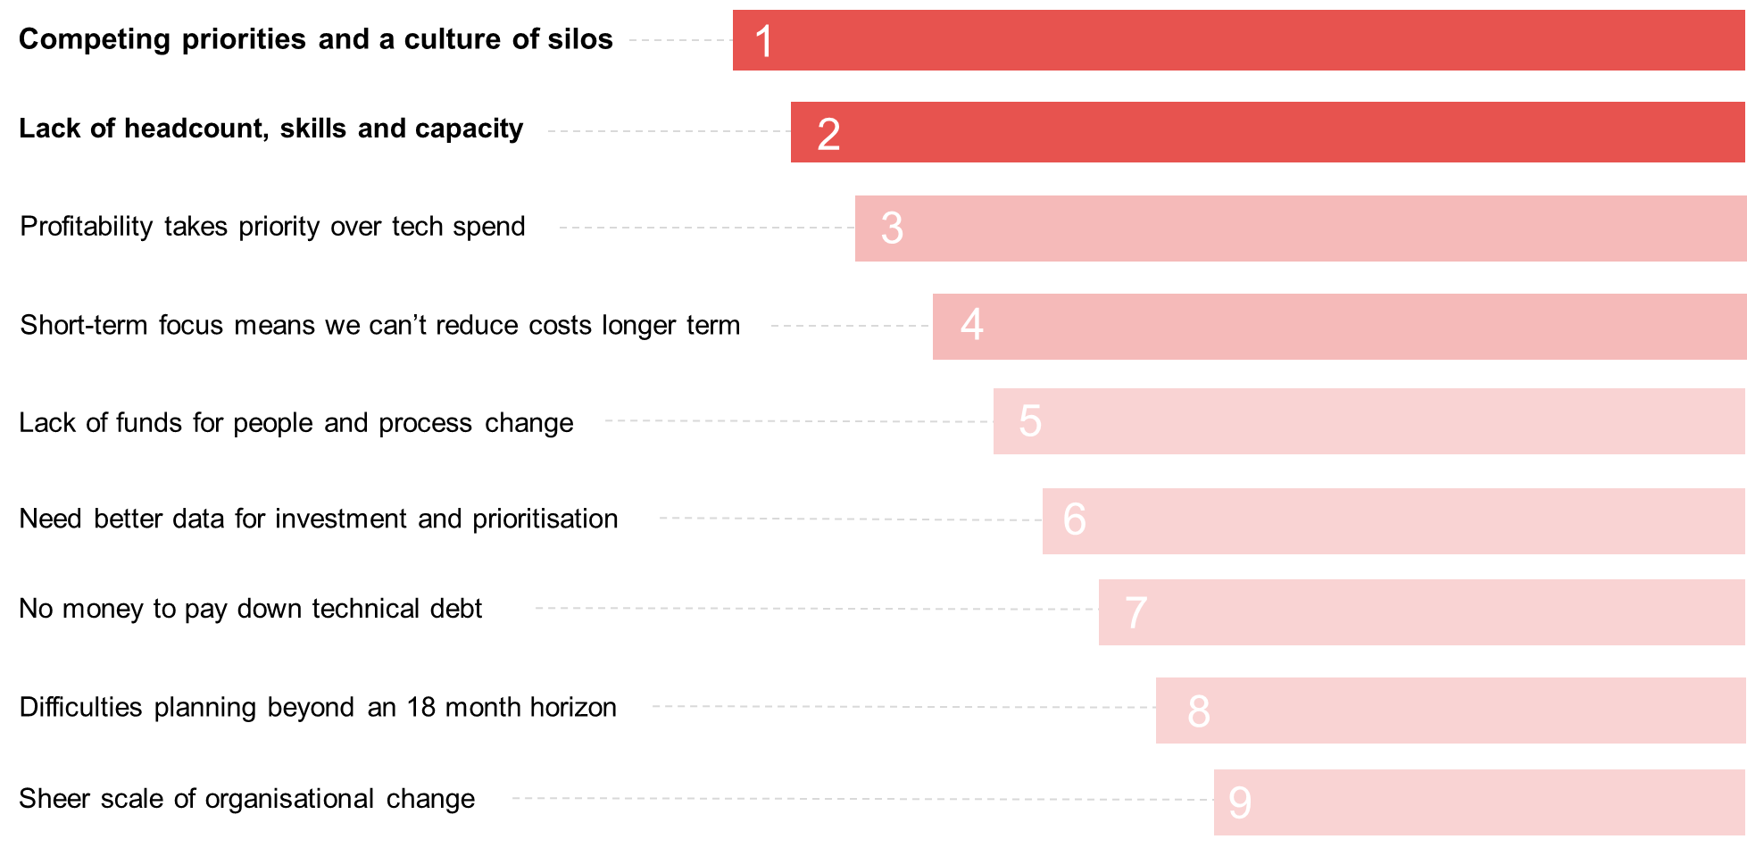
When demonstrating value, what’s holding you back?
Source: ADAPT Costs Intelligence Study in Mar and Apr 2024. Sample Size: 20 Australian CIOs and CFOs

Slide 6
Getting costs
and value visibility

Slide 7
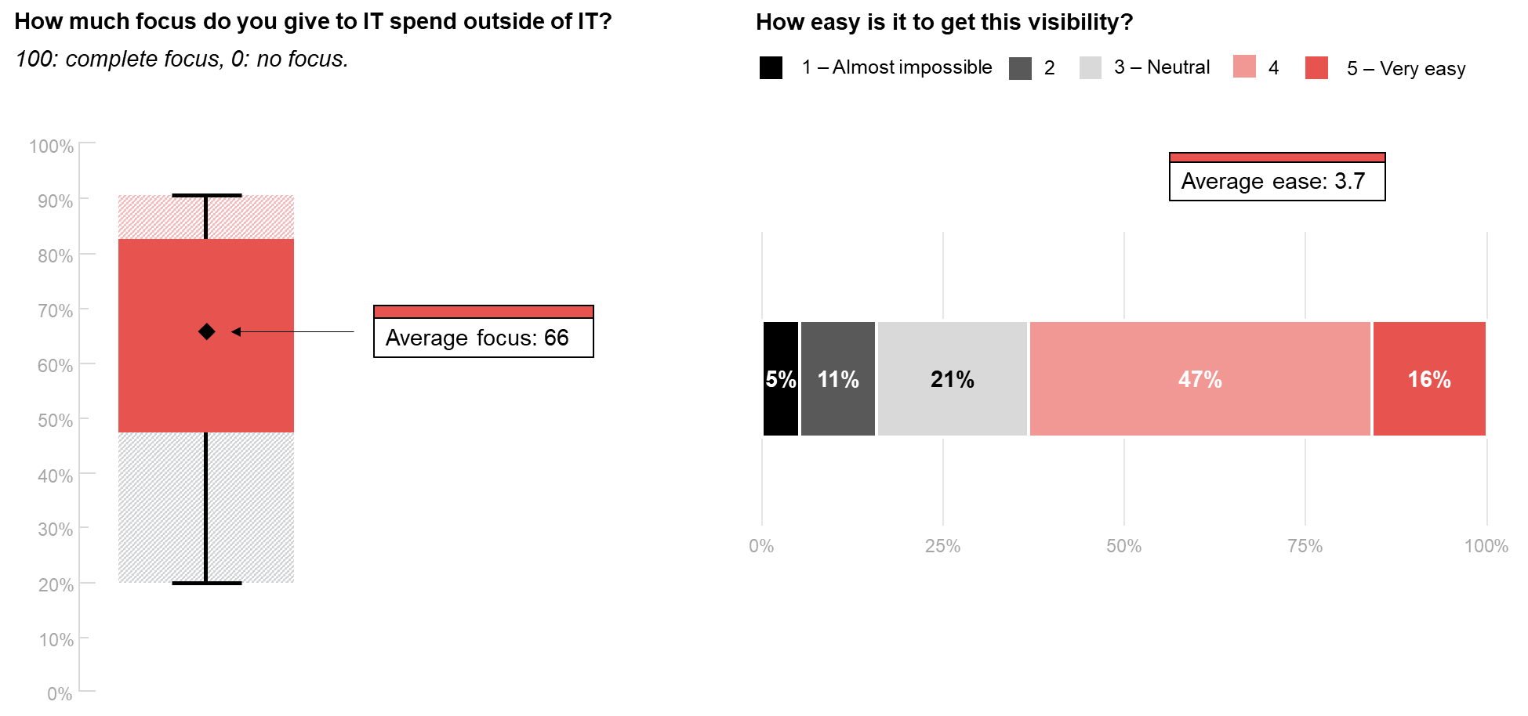
The focus for and ease of getting visibility of IT spend outside IT
Source: ADAPT Costs Intelligence Study in Mar and Apr 2024. Sample Size: 20 Australian CIOs and CFOs

Slide 8
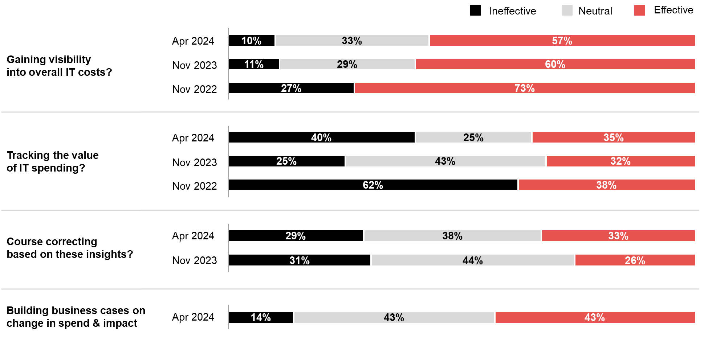
Are you effectively …
Source: ADAPT CFO Edge Surveys in Nov 2022 and Nov 2023, Costs Intelligence Study in Mar and Apr 2024. Sample Size: 188 Australian CIOs and CFOs

Slide 9
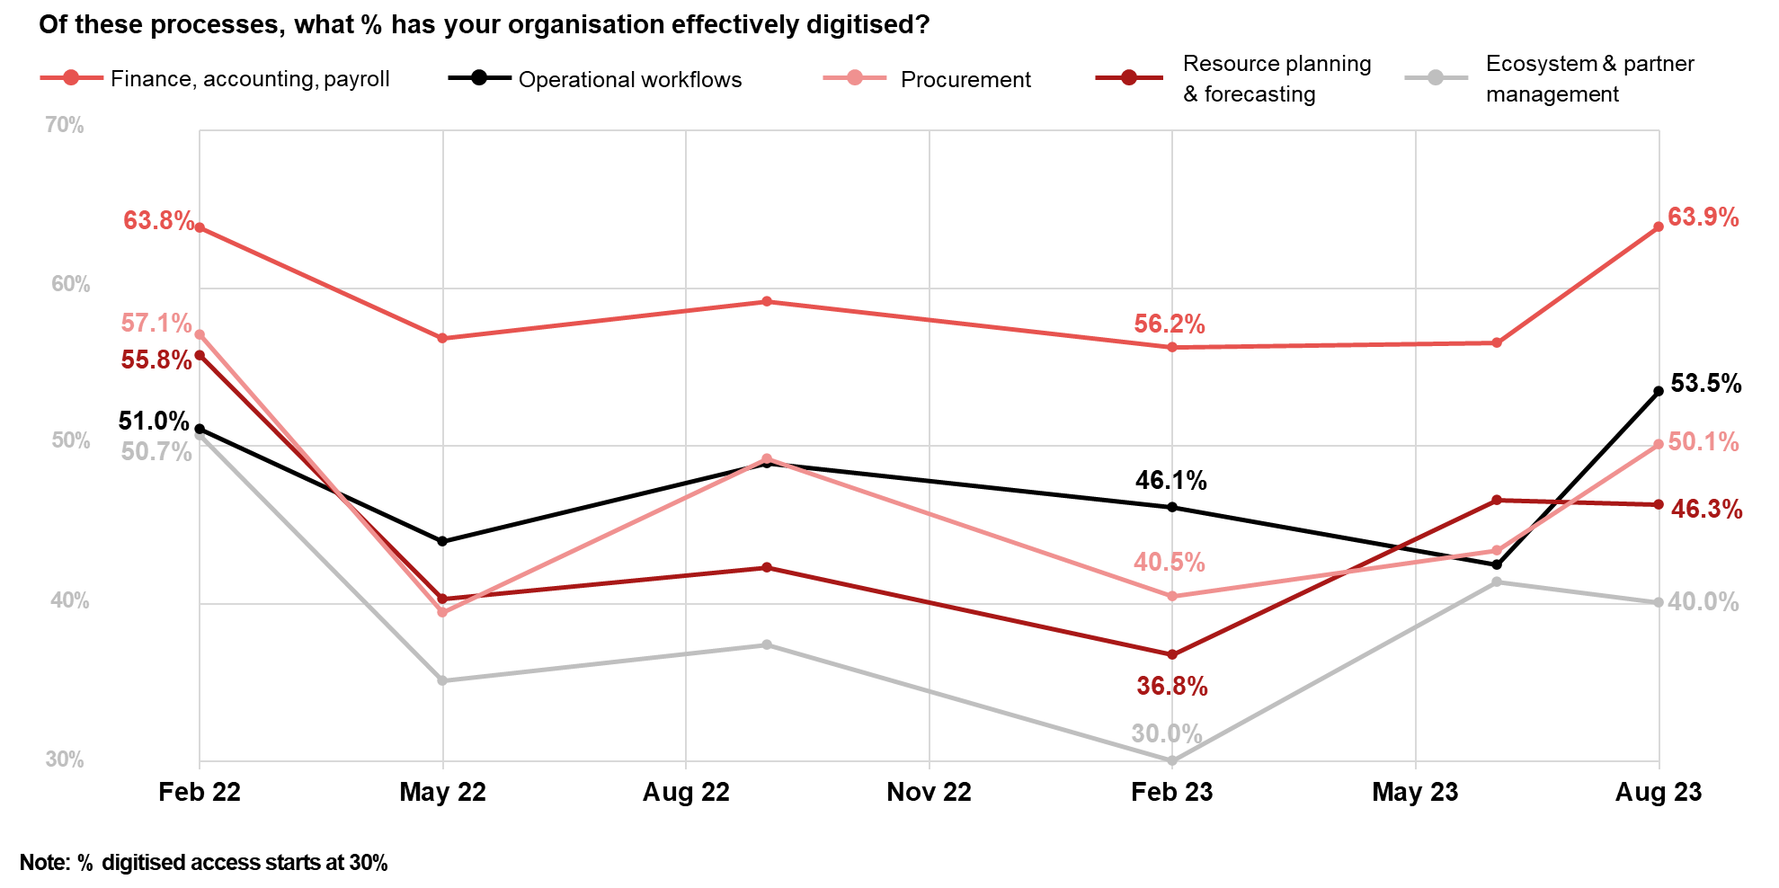
Better process digitisation could save time and money – and create better visibility
Source: ADAPT CIO and Digital Edge Surveys from Feb 2022 to Aug 2023. Sample size: 680 Australian CIOs and CDOs.

Slide 10
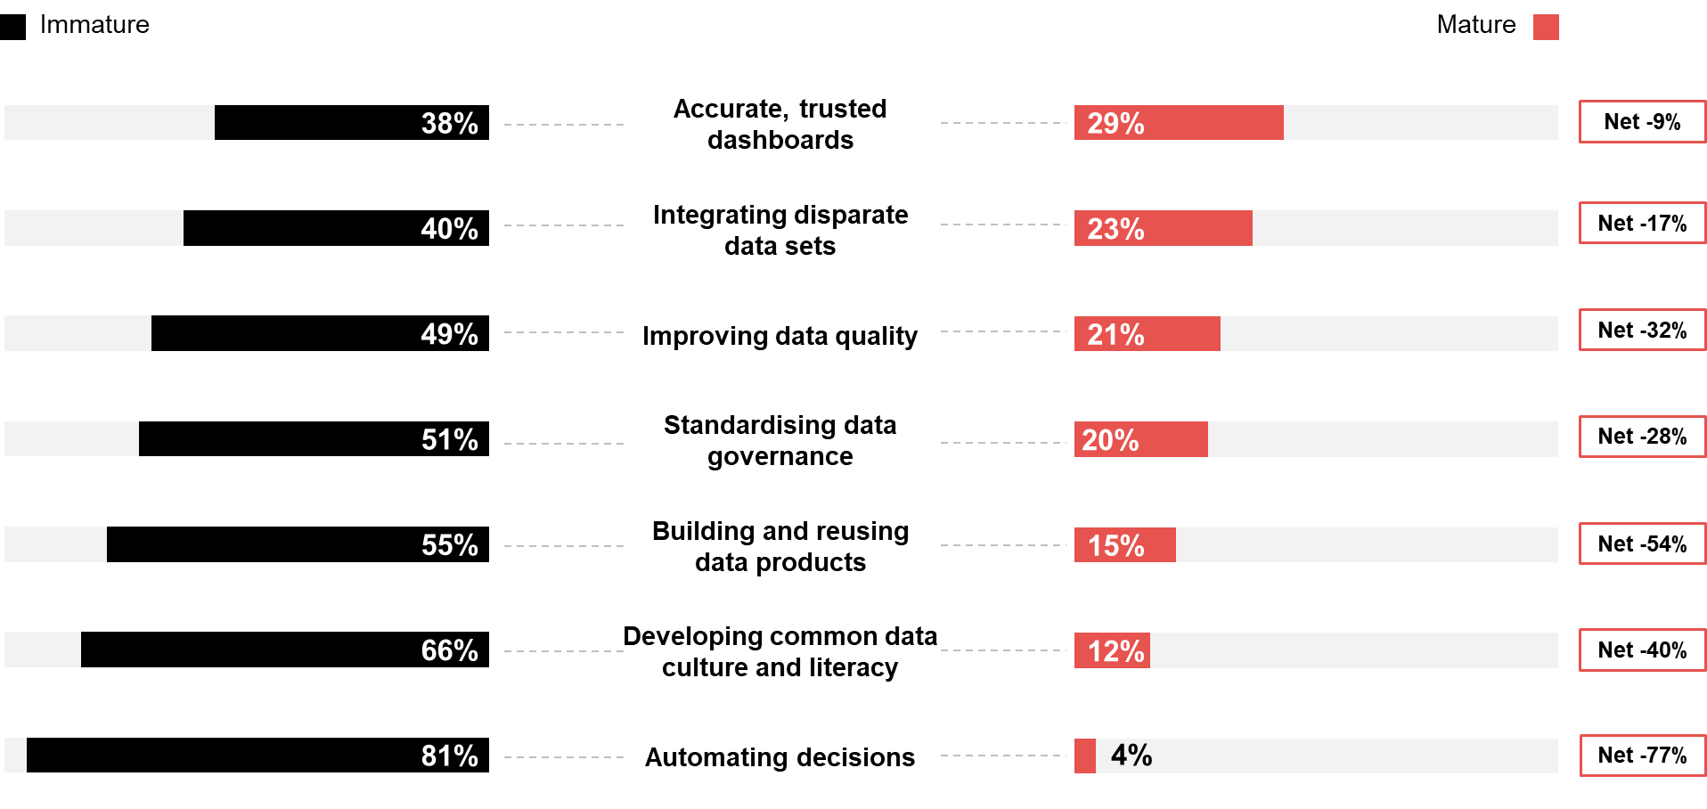
Maturing data foundations can help with costs intelligence
Source: ADAPT CIO and Data & AI Edge Surveys in Feb and May 2024. Sample Size: 294 Australian CIOs and CDAOs

Slide 11
Investing for the future

Slide 12
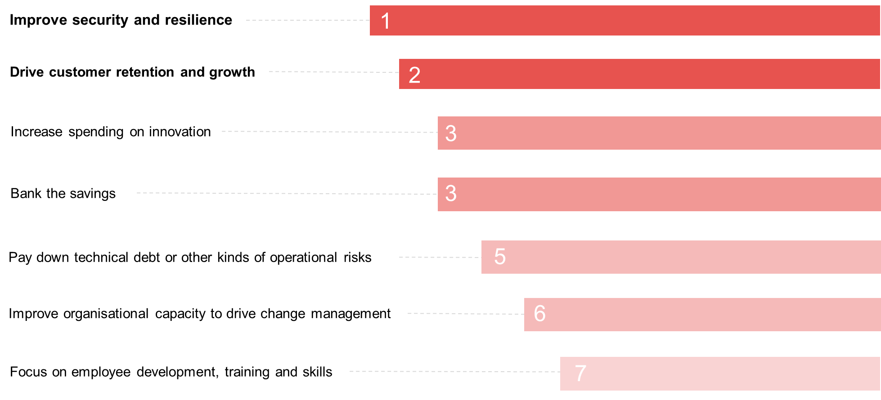
Reinvesting for the future – what are your priorities?
Source: ADAPT Costs Intelligence Study in Mar and Apr 2024. Sample Size: 20 Australian CIOs and CFOs

Slide 13
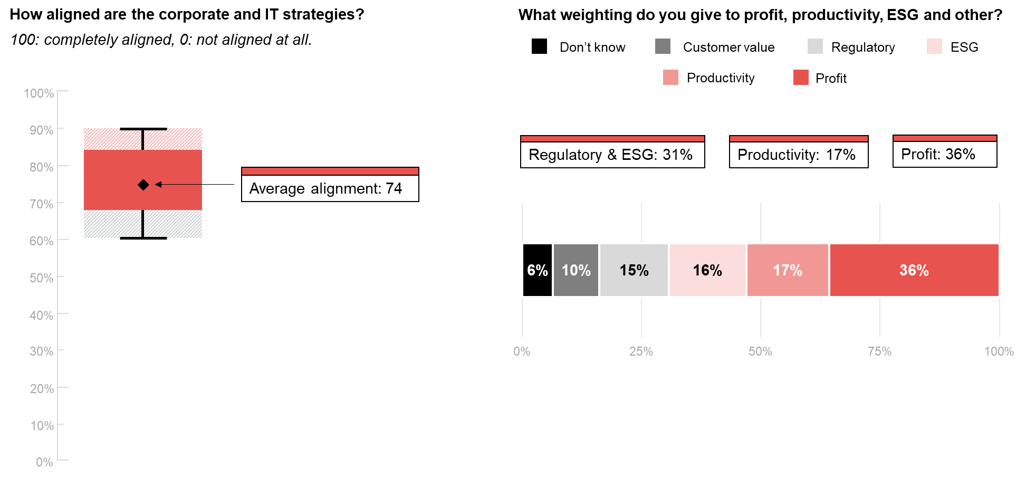
Aligning strategy and weighing the choices for the future
Source: ADAPT Costs Intelligence Study in Mar and Apr 2024. Sample Size: 20 Australian CIOs and CFOs

Slide 14
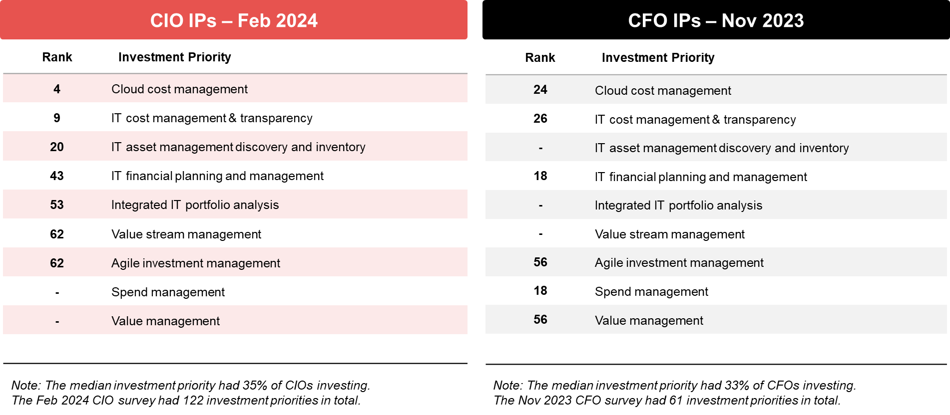
Investment priorities (IPs) of Australian CIOs and CFOs
Source: ADAPT CFO and CIO Surveys in Nov 2023 and Feb 2024. Sample Size: 253 Australian CIOs and CFOs

Slide 15
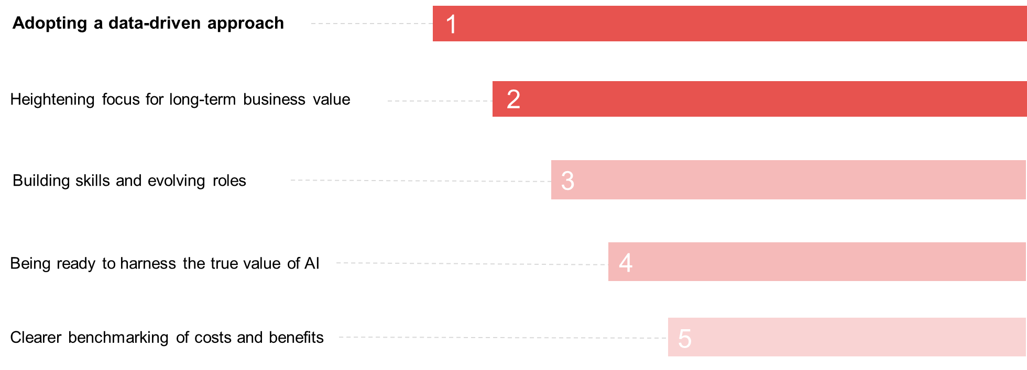
Finally, what’s the most critical thing you need to make progress?
Source: ADAPT Costs Intelligence Study in Mar and Apr 2024. Sample Size: 20 Australian CIOs and CFOs

Slide 16
Further information

Slide 17

About ADAPT
ADAPT is a specialist Research & Advisory firm providing local market insights and benchmarking data
to Australia and New Zealand’s senior technology and business community.
Since 2011, we’ve been empowering the leaders of the region’s top enterprise and government organisations
to stay at the forefront of modern trends and build for the future. Our industry leading conferences, private roundtable events and custom research projects equip business leaders with the knowledge, relationships, inspiration and tools they need to make better strategic decisions.
adapt.com.au | hello@adapt.com.au
Data Validation
Results contained in this report (Report) are based on survey responses as provided by our clients and publicly available information. ADAPT does not subject the data contained in the Report to audit or review procedures or any other testing to validate the accuracy or reasonableness of the data provided by the participating clients. While we do not manipulate the survey responses, we do make an effort to identify outlier data or conflicting results that could lead to misinterpretations before the preparation of the Report.
Intended Use of the Report
The Report is designed to help technology executives in Australia and New Zealand make independent decisions regarding financial, resourcing and operational performance matters. The information and data contained in the Report are provided as is and are for information purposes only. They are not intended or implied to be recommendations and in no event will ADAPT be liable for any decisions or actions taken in reliance of the results obtained through the use of the information and/or data contained in the Report.
Research MSA and Privacy Policy
The Report and any other information provided by ADAPT is subject to the Research and Advisory Master Services Agreement and the ADAPT Privacy Policy.

Slide 18




Additional resources you can access
Members of ADAPT’s Research & Advisory platform have access to an entire suite of market leading content, insights and resources to help you execute in your role. For any assistance contact your Account Manager in the help section.
Community Case Studies & Interviews
Case studies detailing the successes and challenges of projects and initiatives.
Market Trend Reports Access a library of fact-based actionable insights, deep dives on ANZ business & IT trends.
Live Access to ADAPT Analysts
Through live ADAPT analyst market briefings and Q&A sessions
Downloadable Data & Insights
Elevate your business cases with downloadable market and industry data.
Industry Expert Presentations
Watch keynotes or read distilled 1-page executive summaries from our Edge Events.
Bespoke Analysis of ADAPT Data
Receive custom cuts and analysis of ADAPT proprietary data.
Premier Executive Community
Unlock access to our exclusive network of Australia’s leading technology and business executives.
Dedicated Account Manager & Impact Assessments
Your Account Manager will ensure you and your team are getting the most out of your subscription.
Dedicated Analyst Briefing
Leverage a dedicated briefing with an ADAPT analyst to help validate your strategies.
*Inclusions may vary depending on subscription level.

