Slide 1




ADAPT Persona Map
CFOs adopting a strategic,
data-driven approach to tech decisions while optimising costs
Honey Mari Gay
Junior Data Analyst at ADAPT

Slide 2
In this report, you’ll find insights into how Australian CFOs deliver value by becoming more strategic and data-driven in tech decisions at an optimised cost. The key areas of focus in this report are:
Improved strategic, data-driven decisions are crucial to optimise costs and increase revenues
This leads to delivering better modernisation outcomes by aligning with technology initiatives.
Strategic tech decisions enables CFOs to invest in cost-effective technology while maintaining quality. High data literacy is also essential for managing legacy tech and debt cost reduction.
Greater investment in financial strategy and risk management areas
To maintain tighter control over spending, investing in robust expenditure management is crucial.
Effective governance is essential for better compliance while maximising AI and data value.
CFOs also require sustainable finance practices to elevate maturity in managing financial risks.
Bigger budgets are needed to maintain cyber security infrastructure for finance operations
Both IT and people budgets are substantial, reflecting the need to drive technology
initiatives and retain top financial talent.
The allocation for AI suggests a stronger focus on immediate AI deployment
rather than on long-term innovation initiatives.
Legacy systems and tech debt costs inhibit the ability to secure enough funding
Budget changes may introduce prioritisation challenges, emphasising the need
for cost optimisation.
Enhanced visibility into technology costs and value is essential for reducing tech debt.
Additionally, stronger collaboration among finance, IT, and product teams is vital to
effectively manage cloud costs and maximise value.
Persona Mapping: CFO
Key takeaways
In 2024, the top 2 goals of Australian CFOs
are to optimise costs and boost revenues.
Eight of the top 10 initiatives focus on modernising tech, with the remaining
two focused on cost optimisation and
vendor management.
Expenditure management is the top
investment priority. ESG reporting
and compliance is number 2.
In terms of budget impact, cyber security significantly overshadows governance,
risk management, and compliance (GRC),
while AI dominates the innovation budget.
Despite these budget impacts, the primary execution barrier for CFOs remains a lack
of funding.

Slide 3

Goals and initiatives

Slide 4
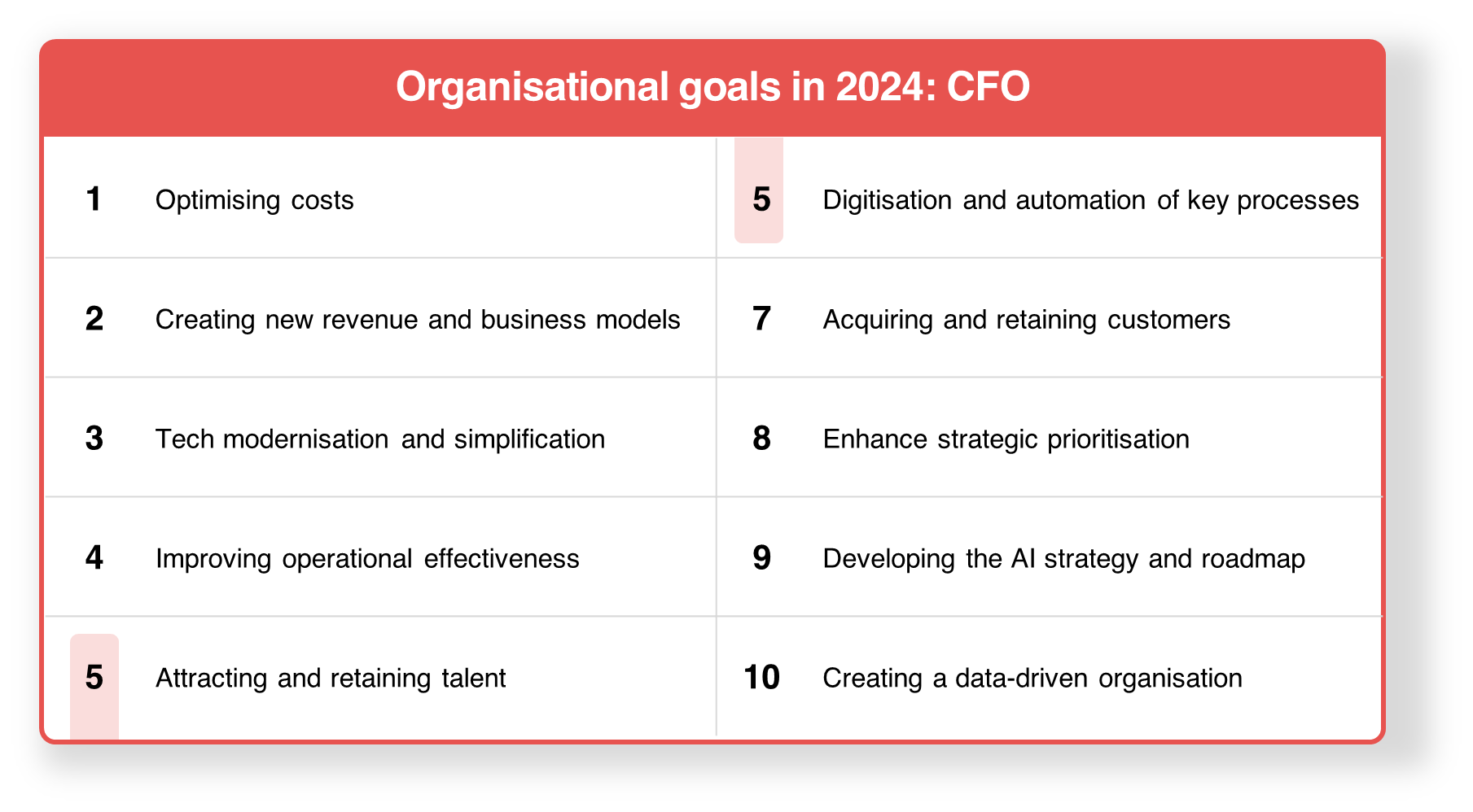
CFOs' organisational goals in 2024
ADAPT CFO Edge Survey in Nov 2024. Sample size: 98 Australian CFOs

Slide 5
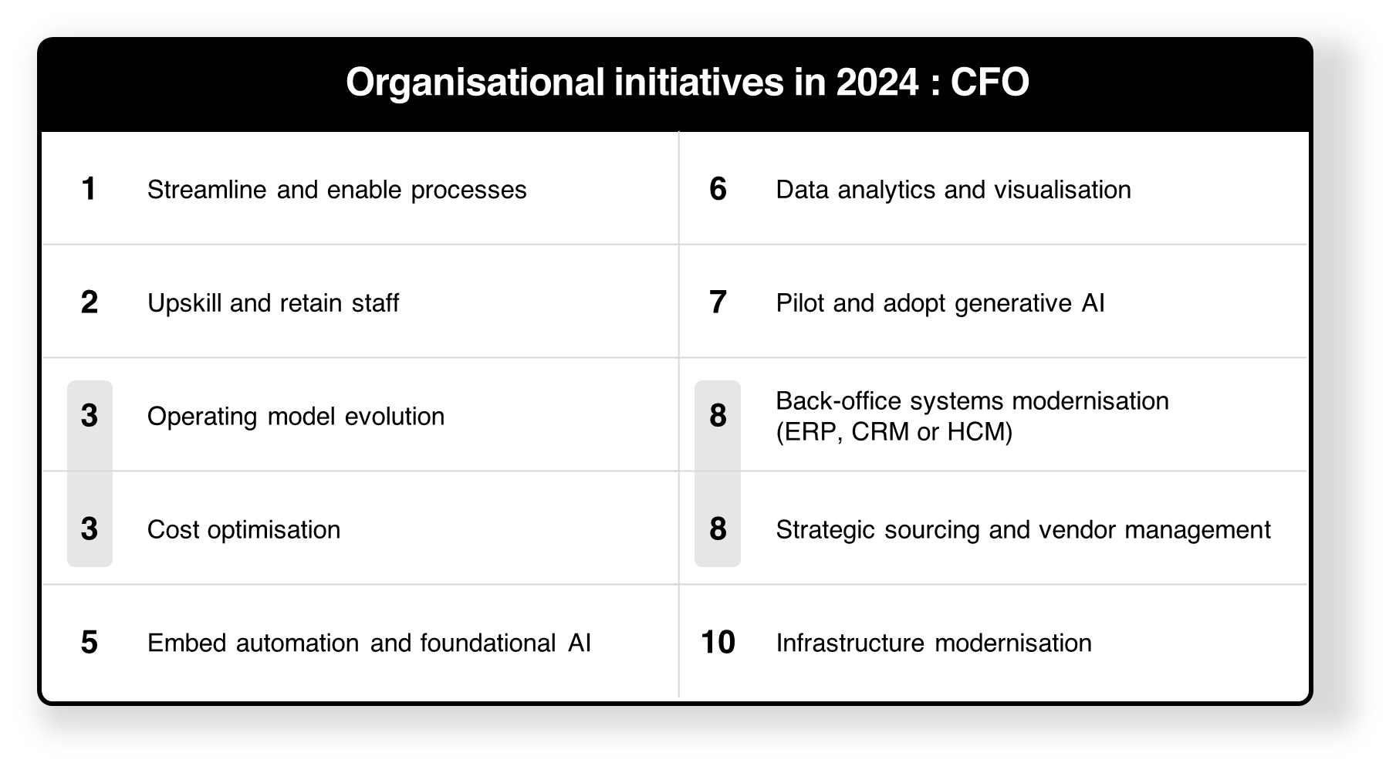
CFOs' organisational initiatives in 2024
ADAPT CFO Edge Survey in Nov 2024. Sample size: 95 Australian CFOs

Slide 6
Optimising costs while becoming strategic and data-driven in tech decisions
Australian CFOs aim for cost optimisation to boost revenue growth. This indicates a greater
need to maximise return on IT investment.
To deliver value, there is a high priority to modernise legacy tech, improve operational
effectiveness, maintain talent, automate key processes and attract new customers. A strong AI
strategy is also essential for enhancing operational efficiency and enabling data-driven decisions
while optimising costs.
As CFOs become more strategic and data-driven, this enables a better alignment
of organisational goals and technology initiatives.
Balancing cost optimisation with technology-based initiatives
While 81% of organisations claim it’s difficult to reduce technical debt, CFOs must strike
a balance between modernising tech and delivering financial expectations (refer to slide 11).
This helps organisations drive tech initiatives while managing expenditures. Upskilling and
retaining top talent is also crucial to enable expertise and flexibility.
Creating new operating models can drive cost optimisation by investing in cost-effective technology. This includes automation/AI, modernised systems and infrastructure, and data analytics platforms.
Strategic sourcing vendor management as a top initiative
This aligns with the need to address vendor management challenges (ranked as the #9 barrier)
and ensure vendor compliance. Greater alignment between vendor capabilities and modernisation goals is crucial for delivering cost-effective technology solutions without compromising quality.
Additionally, CFOs aim to connect strategic sourcing with organisational sustainability
and governance commitments. This relates to priorities #2, #5, and #10 on the investment agenda.
Persona Mapping: CFO
Optimising costs while being strategic and data-driven
The top goal of Australian CFOs in 2024
is to optimise costs.
Better alignment of organisational goals
and tech initiatives comes from driving
strategic and data-driven tech decisions.
Eight of the top 10 initiatives focus on tech modernisation and simplification.
CFOs prioritise strategic sourcing and vendor management more than other tech executives.

Slide 7
Funding and investment

Slide 8
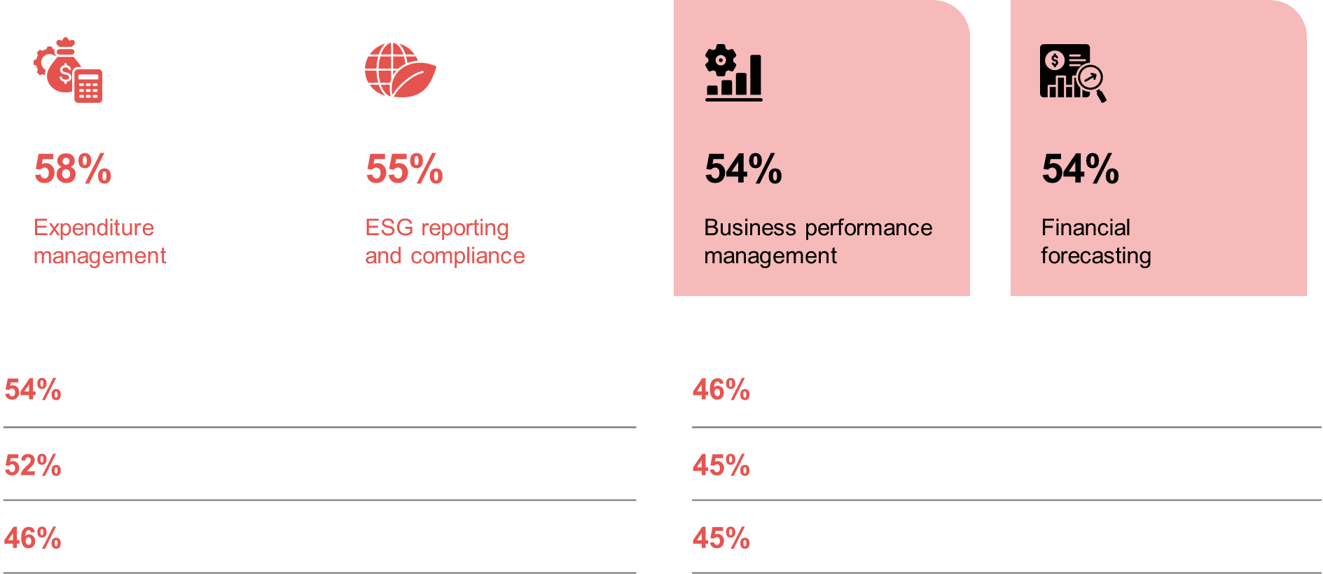
CFOs' investment priorities in the next 12 months
ADAPT CFO Edge Survey in Nov 2024. Sample size: 96 Australian CFOs

Slide 9
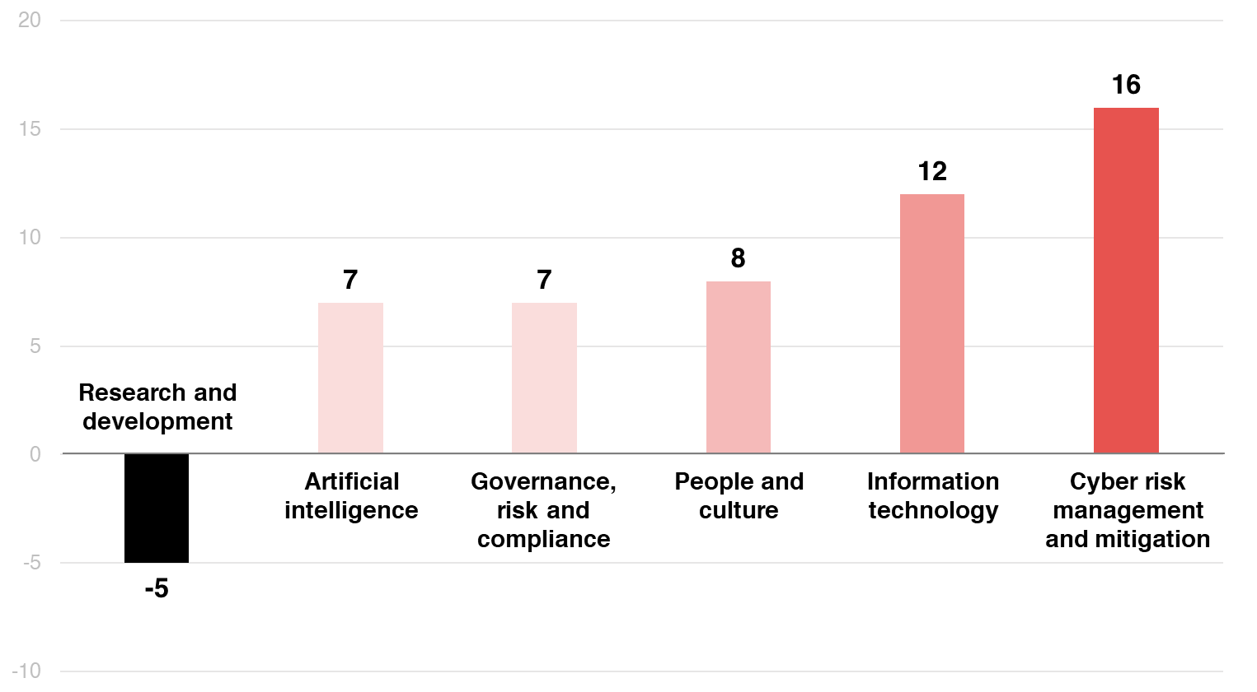
Macroecomic impact on budget allocation
The hype around
AI has resulted in the reduction of funds required for the research and development of innovative products and services.
ADAPT CFO Edge Survey in Nov 2024. Sample size: 76 Australian CFOs

Slide 10
Managing expenditures for better financial health
Australian CFOs are focused on establishing a robust expenditure management system to reduce costs, optimise resources, and enhance spending visibility while preventing overspending. This remains a top investment priority, as it directly influences the organisation's financial health and growth potential.
Investing in this area is closely linked to the impact of IT costs, reflecting the significant spending required to support technology initiatives.
ESG compliance relates to governance and risk management practices
ADAPT insights reveal that 68% of CFOs demonstrate high maturity in financial risk management.
With governance, risk, and compliance (GRC) having an equal budget impact as AI, the strong
emphasis on ESG reporting and compliance spending aligns with the need to mitigate financial
risks through AI and data governance.
Investing in cyber risk mitigation aligns with its impact on budget allocation
The increased funding reflects the growing maturity of CFOs in managing cyber risks.
Enhancing cyber security infrastructure relevant to financial operations often requires substantial budgets, as infrastructure protection remains the largest expenditure area in IT security, according
to CISOs. As a result, CFOs have identified cyber security as a top priority in budget adjustments.
Reducing R&D budgets to optimise costs and focus more on AI
At the same time, R&D budgets are being reduced to optimize costs and prioritise AI investments.
This shift underscores CFOs' focus on cost optimisation, often at the expense of long-term
R&D initiatives. Furthermore, the hype surrounding AI has redirected innovation budgets.
Effective deployment of AI technologies, such as generative AI, requires the right platforms,
data, and skilled personnel to ensure scalability and impact.
Persona Mapping: CFO
Funding and investment
The top investment priority (IP) of Australian CFOs is expenditure management. This stems from the need to optimise costs.
ESG reporting and compliance is the #2 IP.
Cyber risk management and mitigation has the highest impact on budget allocation for CFOs.
The reduction in the R&D budget indicates
a stronger focus on short-term cost control instead of long-term innovation.

Slide 11
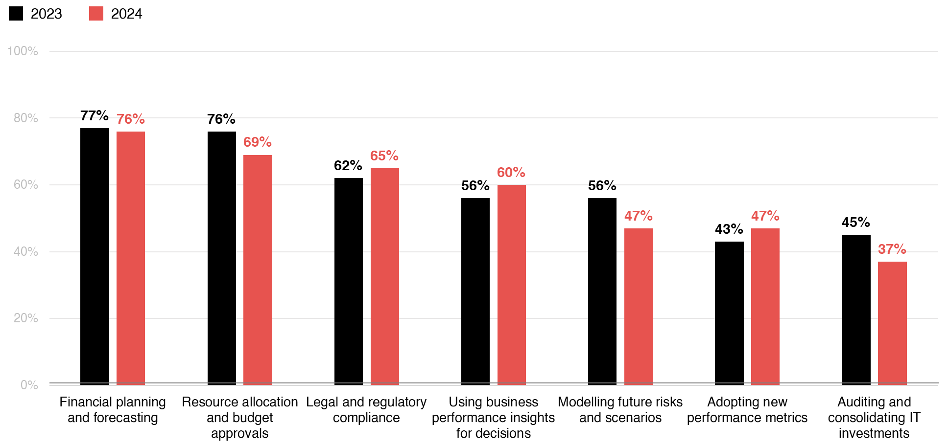
Finance is still most prepared to deliver on traditional competencies
CFOs’ strategic role in tech decisions grew at a rate of
29% over the past 12 months.
Source: ADAPT CFO Edge Surveys in Nov 2023 and Nov 2024. Sample size: 166 Australian CFOs (86 in 2024)

Slide 12
Business performance management as a top 3 investment priority
The need for modernised tech, streamlined processes and improved capabilities drives a stronger
focus on business performance. This leads to better financial outcomes by improving experiences.
These include delivering value that meets customer expectations and strengthening operational efficiency through seamless operations and increased productivity.
Maximising the value of AI and data through effective governance
Organisations with strong AI governance tend to be more effective at mitigating AI-related risks
and complying with ethical regulations. An ADAPT Expert Presentation (Oct 2024) highlights the
need to select appropriate frameworks and foster a data-centric culture to adhere to AI ethics.
Effective data governance is crucial for high data quality and adherence to compliance with data requirements. Organisations with a data-driven culture who prioritise privacy and long-term ethical decisions tend to generate significant financial returns. View an ADAPT Expert Presentation (Oct 2024).
Elevated budgets for talent retention and IT investment management
CFOs recognise the need to invest in talent attraction and retention to effectively bridge workforce
skill gaps and cultural barriers (refer to slide 14).
High data literacy is crucial for better decision-making in managing legacy systems and technical
debt reduction efforts. This helps CFOs develop strategic approaches and improve resource allocation.
Finance is still the most prepared to deliver on traditional competencies
This indicates a greater focus on core financial responsibilities, limited resources (#1 barrier),
and compliance with regulatory changes.
Persona Mapping: CFO
Delivering financial expectations
Higher investment in business performance management aligns with the need to deliver better financial outcomes.
CFOs tend to prioritise investing in AI
governance more than other executives.
Instead, other executives see the need
for better data governance.
The budget impact for people aligns
with the #5 goal, #2 initiative and #8 IP.
The first three areas of financial
expectations align with the #2 and #4 IPs.

Slide 13
Execution barriers,
FinOps and technical debt

Slide 14
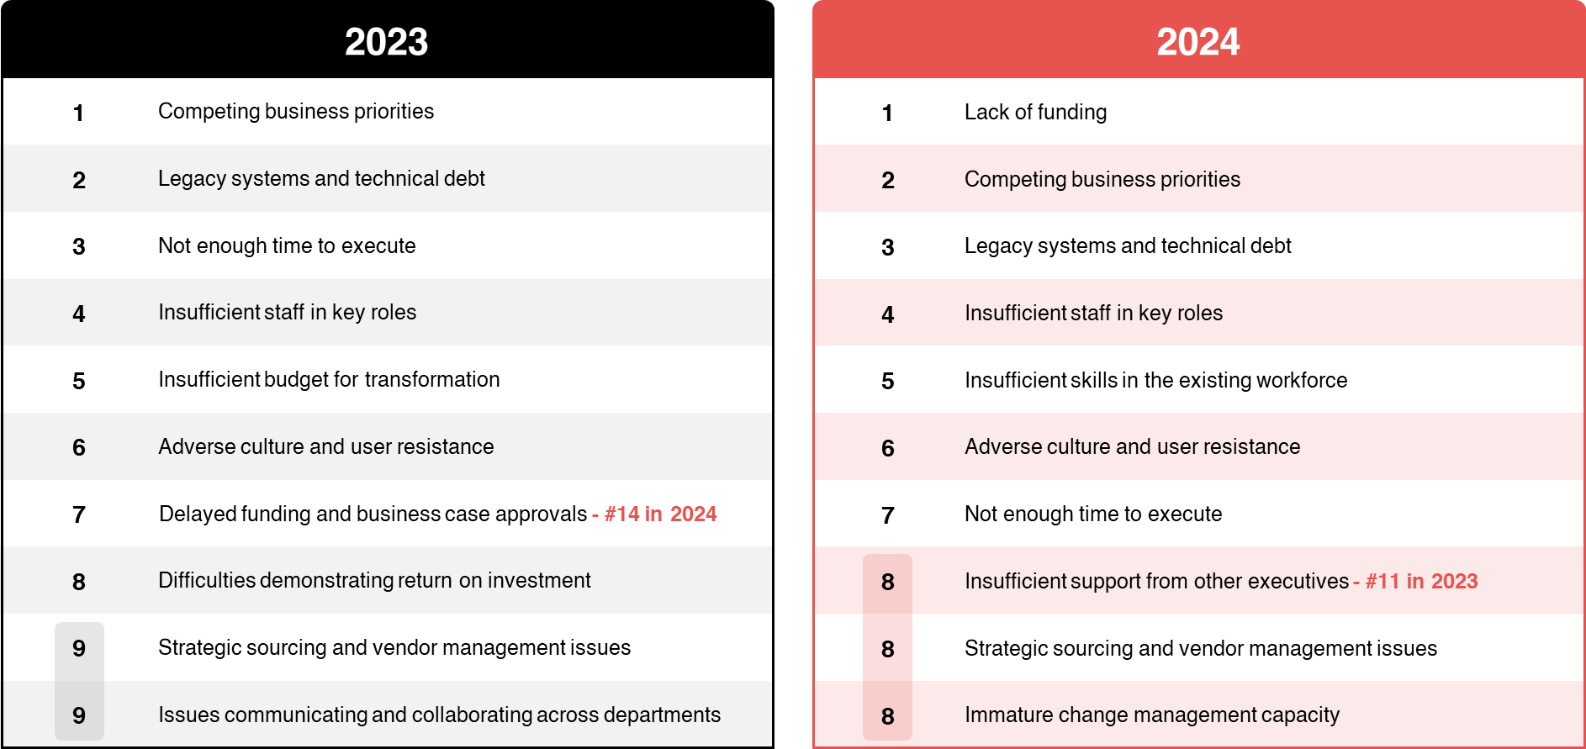
CFOs' main execution barriers in 2023 and 2024
Source: ADAPT CFO Edge Surveys in Nov 2023 and Nov 2024. Sample size: 172 Australian CFOs (96 in 2024)

Slide 15
Insufficient funding is driven by the budget impact of IT and cyber risk mitigation
CFOs' funding constraints are linked to budget reallocations for cyber risk mitigation,
IT management (refer to slide 10), and the growing priority placed on IT expenditures.
Modernising legacy systems often requires significant resources and efforts which can be
costly and complex. When there is not enough time to execute, complexity may delay efforts
to reduce tech debt.
Additional sources are explored in two ADAPT Persona Map reports one for CIOs
and the other for infrastructure leaders.
Getting more support from other executives for better resource allocation and prioritisation
Budget impact changes may create prioritisation challenges, particularly with the need to
optimise costs. Organisational change management can also lead to conflicts when
allocating resources for new initiatives.
Competing business priorities arise from addressing staff shortages, skills gaps, and resistance
to change, while managing the costs of talent attraction and retention.
Therefore, fostering a data-driven culture is essential to align financial and organisational goals.
The success of this strategy is significantly enhanced with greater support from other executives.
Strategic sourcing and vendor management challenges
Organisations that struggle with vendor management often lack visibility into vendor performance and compliance. According to ADAPT survey data, CFOs prioritise vendors that offer reliable deployment commitments at optimised costs.
Building the right partnership model with vendors is crucial to addressing these challenges.
Persona Mapping: CFO
Execution barriers
Similar to other executives, CFOs also
struggle to secure sufficient funding to
deliver financial expectations.
The #2 execution barrier for CFOs is the ability
to manage competing business priorities.
Like CDOs, CFOs struggle to manage strategic sourcing and vendor management issues.

Slide 16
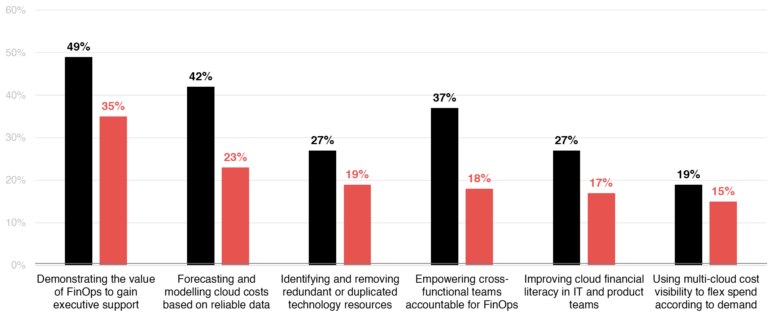
Maturity of FinOps areas
2023
2024
Organisations are finding it increasingly challenging to elevate their maturity across
all areas of FinOps.
Source: ADAPT CFO Edge Surveys in Nov 2023 and Nov 2024. Sample size: 143 Australian CFOs (67 in 2024)

Slide 17
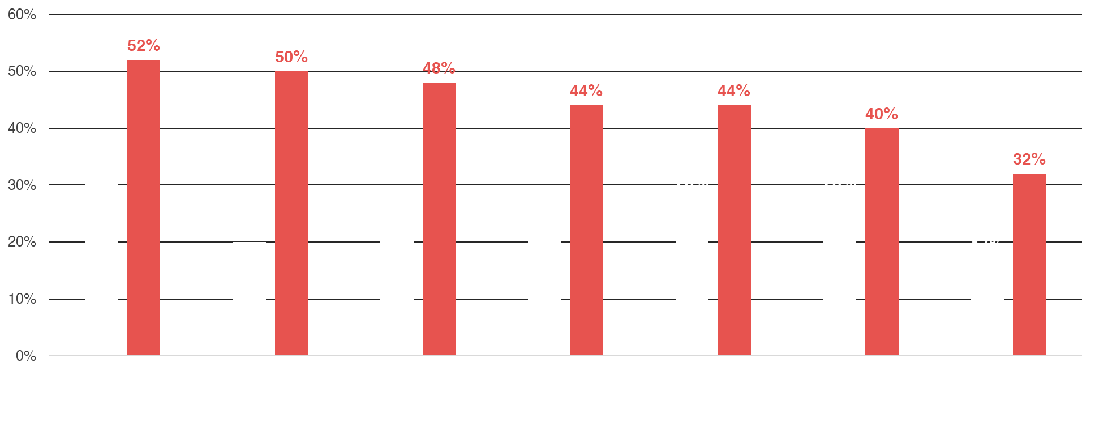
Top critical barriers when managing the costs and value of cloud in 2023 and 2024
2023
2024
Cloud value expectations are often unrealistic due to a lack
of technical and cost visibility.
Source: ADAPT CFO Edge Surveys in Nov 2023 and Nov 2024. Sample size: 140 Australian CFOs (66 in 2024)

Slide 18
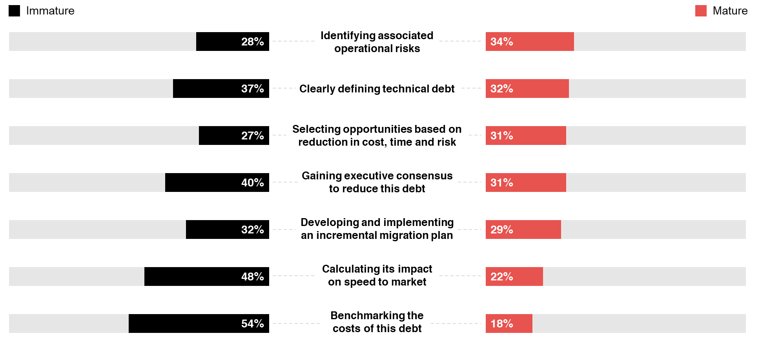
Maturity of technical debt areas
ADAPT CFO Edge Survey in Nov 2024. Sample size: 68 Australian CFOs

Slide 19
Cloud cost visibility and cloud financial literacy
The lack of cloud cost visibility stems from organisations' inability to effectively track costs.
ADAPT insights show that visibility into technology costs and value has decreased over the
past two years, according to CFOs.
Challenges in cloud financial literacy arise from insufficient collaboration. ADAPT insights also reveal that effective collaboration between IT and finance enhances cloud financial literacy by a factor of 1.8x.
Forecasting and modeling cloud costs with reliable data
While the decision-makers are increasingly evidence-based, with an average of 61%,
some organisations struggle to use reliable data for forecasting and modelling cloud costs.
The lack of technical and cost visibility often leads to unrealistic cloud value expectations.
As a result, CFOs are heavily investing in financial forecasting (refer to slide 8).
Technical debt reduction
Only 19% of organisations report being mature in reducing tech debt costs. CFOs need to focus
more on defining, benchmarking, and calculating the impact of tech debt. Gaining executive consensus and creating an incremental migration plan are also critical in reducing tech debt costs.
Demonstrating the value of FinOps to gain executive support
CFOs face challenges in demonstrating the value of FinOps due to difficulties in achieving
cross-functional alignment. Empowering collaboration between finance, IT, and product teams
is essential for effectively managing cloud costs in FinOps.
View an ADAPT Expert Presentation (Aug 2024) on the importance of FinOps to gain
cloud cost visibility.
Persona Mapping: CFO
Challenges to elevate maturity in FinOps and technical debt areas
CFOs are becoming more immature
in every FinOps area.
Executives are yet to grasp how FinOps
can address cloud cost and visibility issues.
Despite becoming more evidence-based, some CFOs struggle to derive reliable data insights.
While some CFOs believe they can mostly identify operational risks, more efforts are needed to reduce tech debt costs.
Some CFOs say they are most effective at demonstrating the value of FinOps.

Slide 20
Survey demographics

Slide 21
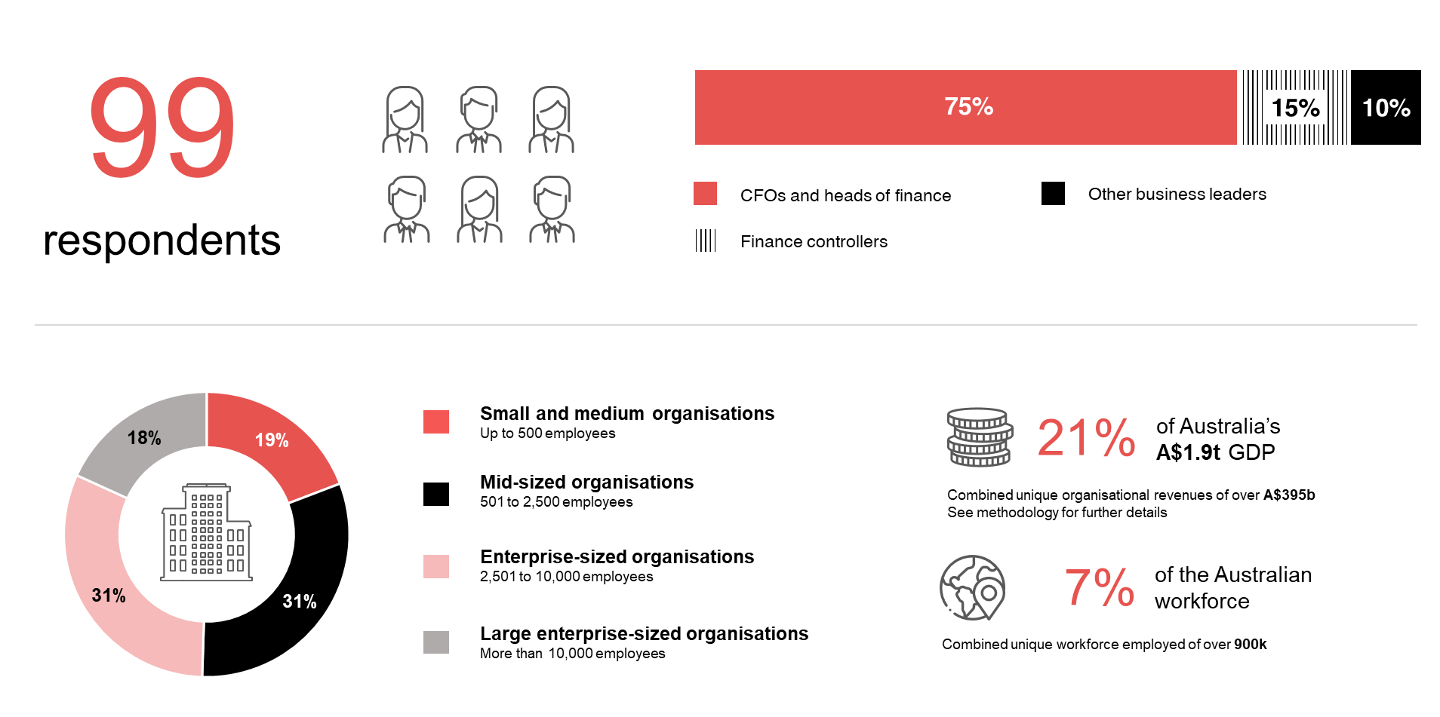
Survey demographics: Australian CFOs in 2024

Slide 22
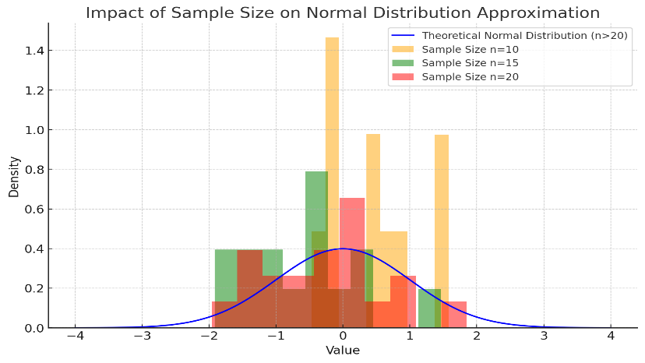
For sector, segment and persona comparisons
Central limit theorem a fundamental concept in statistics that determines when a sample size is large enough
to be considered reliable. There are different formulas and some debate amongst statisticians about the appropriate sample size. For industry comparisons or other subset analyses, a sample size of ( n > 20 ) is generally considered acceptable for drawing meaningful insights. This threshold aligns with common statistical practices, where a
sample size of 20 to 30 is generally the minimum needed to assume a normal distribution of the data.
Sample sizes below 20, but equal to or greater than 15
When the sample size is between 15 and 20, while not fully representative, it can still offer valuable insights
into trends. These statistics should be viewed as indicative, highlighting general directions in industry efforts
or barriers to investment but treated with some caution due to the smaller number of observations.
Sample sizes less than 15, but greater or equal to 10
For samples between 10 and 15, the data provides a snapshot guideline only. While such small samples can
show early trends, it's important to recognise that this does not guarantee future respondents will reflect the same trends. For instance, while 100% of respondents in a sample of 10 might invest in AI, it would be unrealistic to assume this pattern will hold as the sample size grows. However, if the sample size increases to 20, it is unlikely
that the trend will change drastically, and the next 10 respondents will have no investment.
ADAPT Data Analytics:
Notes on sample sizes
Why does sample size matter?
Each set of statistics is unique with measures,
distribution, variance and sample size. It is generally accepted in statistics that as sample size increases, analysts make fewer assumptions about the data, resulting in statistics that more accurately represent the truth.
ADAPT endeavours to provide transparency of sample size, whereby we provide a source on data slides with
the number of respondents and the survey where those respondents come from. In data and insights slide decks, ADAPT usually provides some insight on the breakdown
of the demographics at the end of the slide deck.
To protect privacy, ADAPT does not release lists
of individual respondents to surveys.

Slide 23

About ADAPT
ADAPT is a specialist Research & Advisory firm providing local market insights and benchmarking data
to Australia and New Zealand’s senior technology and business community.
Since 2011, we’ve been empowering the leaders of the region’s top enterprise and government organisations
to stay at the forefront of modern trends and build for the future. Our industry leading conferences, private roundtable events and custom research projects equip business leaders with the knowledge, relationships, inspiration and tools they need to make better strategic decisions.
adapt.com.au | hello@adapt.com.au
Data Validation
Results contained in this report (Report) are based on survey responses as provided by our clients and publicly available information. ADAPT does not subject the data contained in the Report to audit or review procedures or any other testing to validate the accuracy or reasonableness of the data provided by the participating clients. While we do not manipulate the survey responses, we do make an effort to identify outlier data or conflicting results that could lead to misinterpretations before the preparation of the Report.
Intended Use of the Report
The Report is designed to help technology executives in Australia and New Zealand make independent decisions regarding financial, resourcing and operational performance matters. The information and data contained in the Report are provided as is and are for information purposes only. They are not intended or implied to be recommendations and in no event will ADAPT be liable for any decisions or actions taken in reliance of the results obtained through the use of the information and/or data contained in the Report.
Research MSA and Privacy Policy
The Report and any other information provided by ADAPT is subject to the Research and Advisory Master Services Agreement and the ADAPT Privacy Policy.

Slide 24




Additional resources you can access
Members of ADAPT’s Research & Advisory platform have access to an entire suite of market leading content, insights and resources to help you execute in your role. For any assistance contact your Account Manager in the help section.
Community Case Studies & Interviews
Case studies detailing the successes
and challenges of projects and initiatives.
Market Trend Reports Access a library of fact-based actionable insights, deep dives on ANZ business & IT trends.
Live Access to ADAPT Analysts
Through live ADAPT analyst market briefings and Q&A sessions
Downloadable Data & Insights
Elevate your business cases with downloadable market and industry data.
Industry Expert Presentations
Watch keynotes or read distilled 1-page executive summaries from our Edge Events.
Bespoke Analysis of ADAPT Data
Receive custom cuts and analysis of ADAPT proprietary data.
Premier Executive Community
Unlock access to our exclusive network of Australia’s leading technology and business executives.
Dedicated Account Manager & Impact Assessments
Your Account Manager will ensure you and your team are getting the most out of your subscription.
Dedicated Analyst Briefing
Leverage a dedicated briefing with an ADAPT analyst to help validate your strategies.
*Inclusions may vary depending on subscription level.

