Slide 1





ADAPT TECHNOLOGY TRENDS
Evaluating and financing tech-driven organisational change
Gabby Fredkin
Head of Data and Analytics at ADAPT
Honey Mari Gay
Junior Data Analyst at ADAPT

Slide 2
Technology Trends: Tech-driven finance
Confidence in delivering financial expectations
CFOs report that their finance teams are largely prepared to excel in traditional competencies.
These include financial planning and forecasting, resource allocation and budget approvals,
as well as legal and regulatory compliance.
CFOs are taking on a significantly more strategic role in technology decisions compared to previous years. This shift is driven by an increased focus on expense management to ensure technology investments deliver measurable value.
Effectiveness in measuring the spend of technology
In 2024, CFOs have gained better visibility into IT costs, but more needs to be done to track
IT spending value. Issues such as duplicated technology expenditures, driven by fragmented finance processes and disparate applications, contribute to these challenges.
As CFOs aim for cost optimisation, 40% of tech spending is wasted due to inadequate funding, competing priorities, legacy systems, and technical debt.
Cloud and FinOps challenges
  CFOs identify their top barrier to managing cloud costs and value as the additional expenses incurred from addressing architecture or engineering inefficiencies. This is due to a lack of visibility into the value derived from tech investments in some organisations.
  CFOs must establish clear fiscal responsibility and accountability. Enhanced compliance measures and improved cloud financial literacy are also essential for success.
Key takeaways
ADAPT's 2024 CFO Edge Survey revealed insights into evaluating and financing
tech-driven organisational change.
In this report, you'll find insights into:
The confidence of finance teams to meet
financial expectations.
How effective organisations are when
it comes to measuring tech spend.
The challenges CFOs face when managing
cloud costs as they elevate their FinOps
maturity to gain more value from
these services.

Slide 3

Confidence in delivering financial expectations

Slide 4
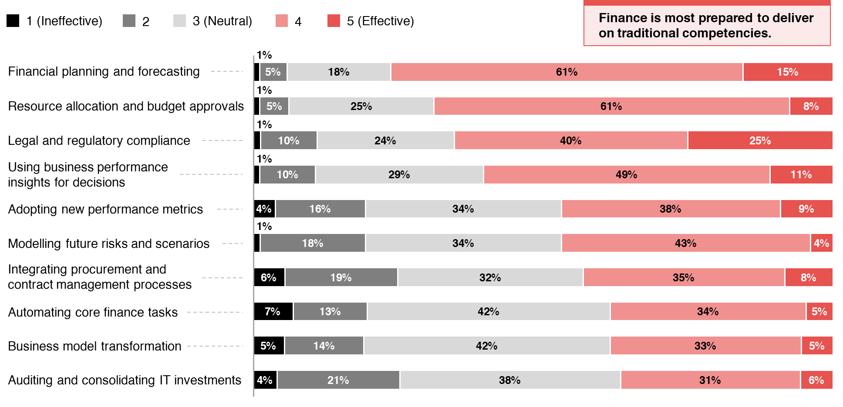
Finance to deliver on the following expectations in 2025
ADAPT CFO Edge Survey in Nov 2024. Sample size: 86 Australian CFOs

Slide 5
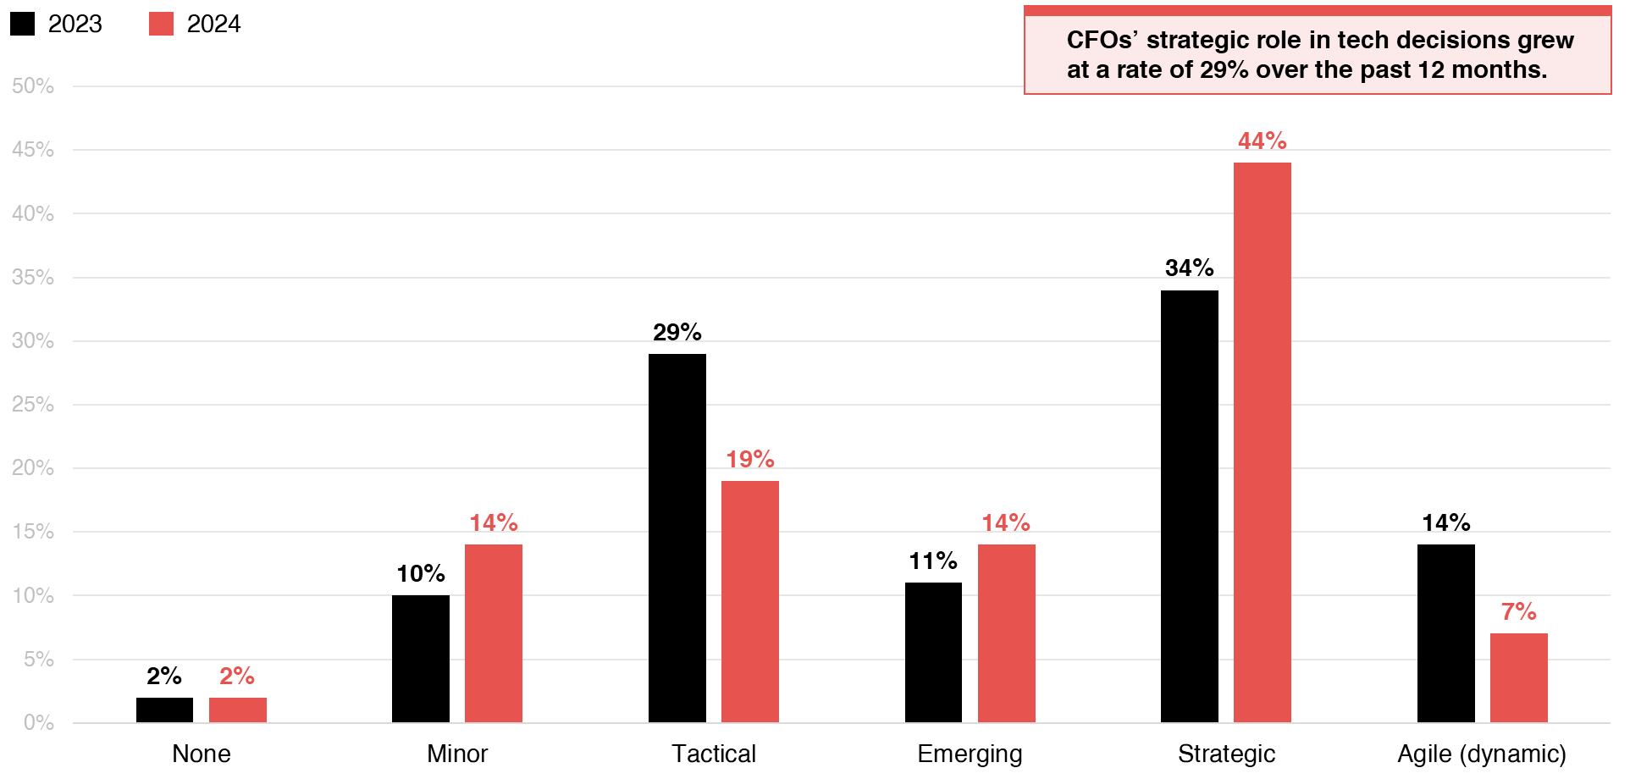
Role of finance in evaluating the business case for technology-enabled outcomes?
Source: ADAPT CFO Edge Surveys in Nov 2023 and Nov 2024.Sample size: 171 Australian CFOs (88 in 2024)

Slide 6
Finance teams are mostly prepared to deliver financial planning and forecasting
This reflects the high maturity of most Australian CFOs in managing financial risks and their
substantial investment in financial forecasting, ranked as the #4 investment priority.
The maturity of handling financial risk can be explained by the preparedness of CDAOs
to comply with regulatory requirements.
Allocating resources and budget approvals
As CFOs take on a more strategic role in technology decisions, they focus on aligning resources to modernise technology while optimising costs. With significant investments in audit and risk management, it is crucial to adjust spending priorities to mitigate financial risks and preserve financial health.
CFOs also ensure resource allocation adheres to legal and regulatory requirements. This provides visibility into tech costs and value, which makes budget approval processes transparent and compliant.
Adopting new performance metrics and modelling future risks and scenarios
Modern performance metrics are important for CFOs to capture tech costs and reduce technical debt.
Due to high investment in ESG compliance (#2 IP), there is also a greater need for metrics that track the financial impact of sustainable practices. Despite most organisations finding it difficult to model future scenarios, finance teams are preparing to model future risks and scenarios.
CFOs are playing a far more strategic role in tech decisions than in prior years
Driving tech decisions helps CFOs ensure that tech investments deliver measurable value.
Aside from expenditure management, business performance management and financial reporting, tech decisions also influence other organisational goals. This makes driving strategic alignment important.
Technology Trends: Finance delivery
Confidence in
delivering financial expectations
According to Australian CFOs, finance
is still most prepared to deliver these
3 financial expectations:
Financial planning and forecasting.
Resource allocation and budget approvals.
Legal and regulatory compliance.
To better align with evolving operating
models, it is crucial to adopt modern
performance metrics and incorporate risk
and scenario modeling.
CFOs’ strategic role in tech decisions grew
at a rate of 29% over the past 12 months.

Slide 7
Effectiveness in measuring
technology spend

Slide 8
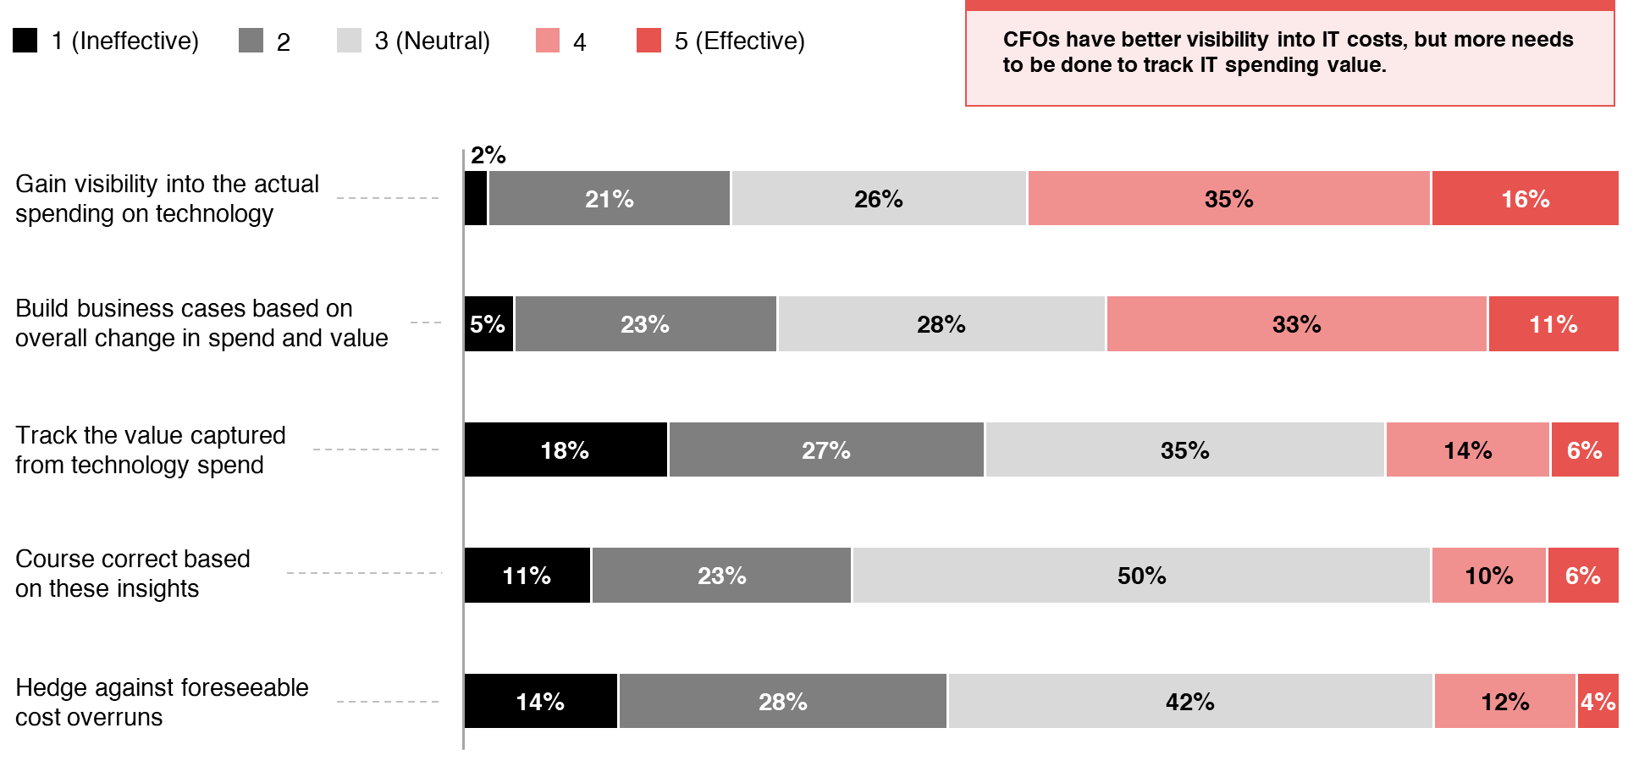
Effectiveness in measuring tech spend
ADAPT CFO Edge Survey in Nov 2024. Sample size: 88 Australian CFOs

Slide 9
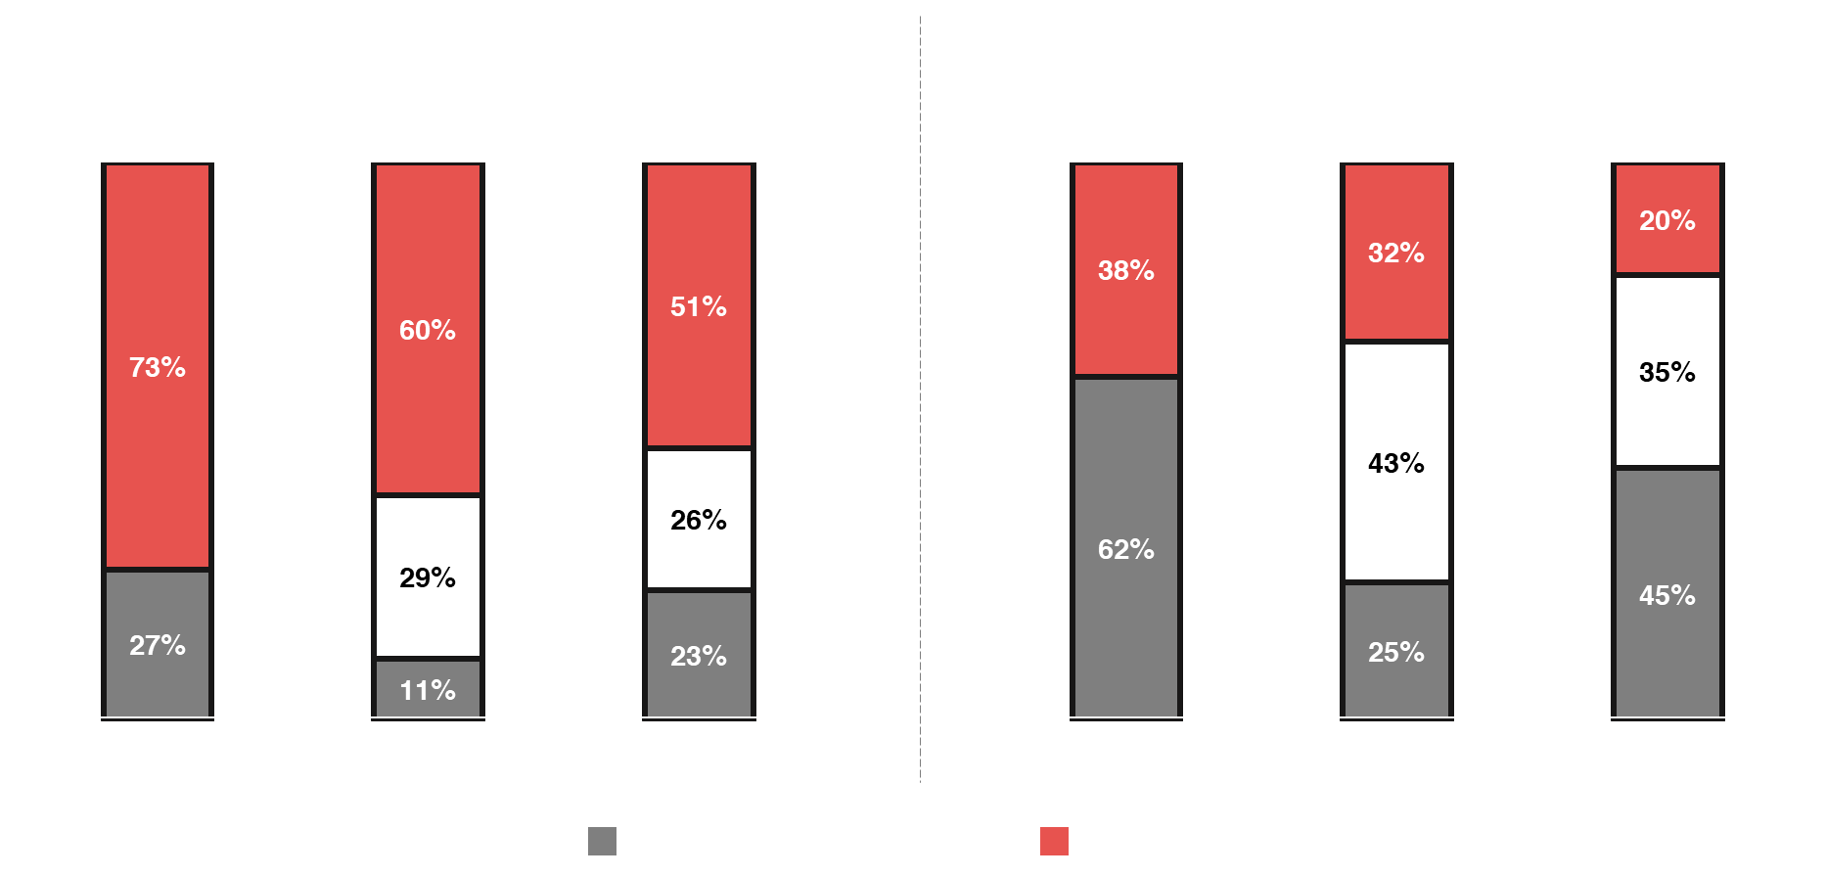
Visibility into tech costs and value has deteriorated over the past 2 years
Source: ADAPT CFO Edge Surveys in Nov 2022, Nov 2023 and Nov 2024. Sample size: 256 Australian CFOs

Slide 10
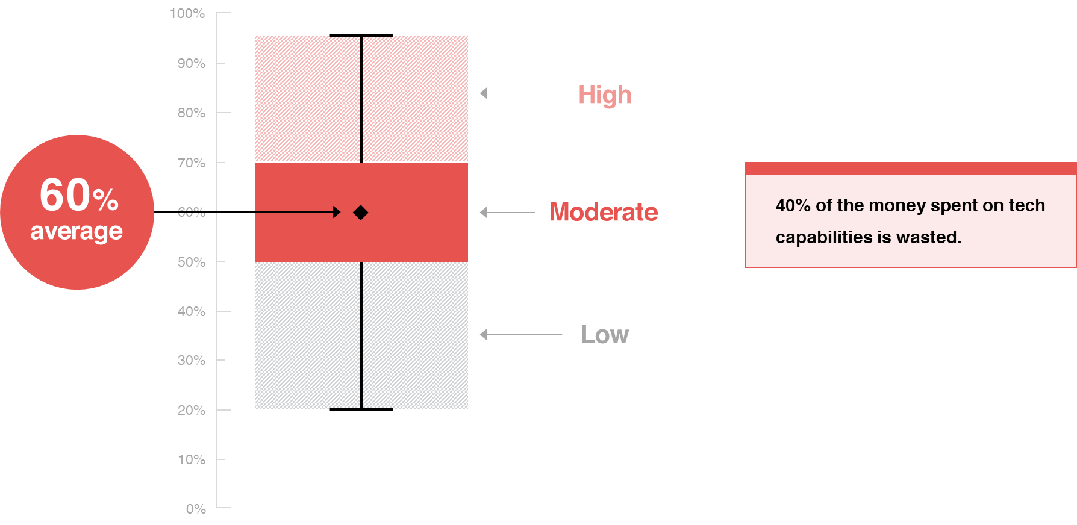
What % of the organisation’s current technology capabilities are adopted and in use?
ADAPT CFO Edge Survey in Nov 2024. Sample size: 69 Australian CFOs

Slide 11
CFOs have better visibility into IT costs, but more needs to be done to track IT spending value
CFOs effectively gain tech cost visibility due to a greater focus on overseeing cost control measures (#1 IP). However, they struggle to quantify the value of tech investments and costs.
This is caused by duplicated technology spending, driven by fragmented finance processes
and applications that fail to provide a single source of truth for benchmarking (refer to slide 14).
Visibility into tech costs and value deteriorated over the past 2 years
While cost visibility has declined, what was considered effective visibility two years ago may
no longer be sufficient. CFOs now seek deeper insights.
Additionally, as organisations adopt chargeback models, the complexity increases, but these models are more effective in revealing where technology is adding value.
Spend and value on business cases require maturity in hedging against foreseeable
cost overruns
Although some CFOs are effective at building business cases, they often face challenges
in preventing cost overruns due to limited control over cross-functional execution.
This stems from unclear fiscal responsibility and business accountability, ineffective collaboration between IT and finance and inconsistent cost forecasting and reporting (refer to slide 13).
40% of the money spent on tech capabilities is wasted
While CFOs aim to optimise costs, competing priorities (#2 barrier) may restrict their ability to fully use budgets for tech resources leading to insufficient money to fund other initiatives (#1 barrier).
Additionally, factors such as restrictive legacy systems and tech debt costs contribute to the limitations CFOs face, preventing them from fully using resources (#3 barrier).
Technology Trends: Measuring tech spend
Effectiveness in measuring tech spend
CFOs have better visibility into IT costs,
but more needs to be done to track the
value gained from tech spend.
Visibility into tech costs and value deteriorated over the past 2 years.
Building business cases for spend and value requires maturity in hedging against foreseeable cost overruns.
Cautious spending on new technology may lead CFOs to withhold full investment in resources unless they can see clear value.

Slide 12
Cloud and
FinOps challenges

Slide 13
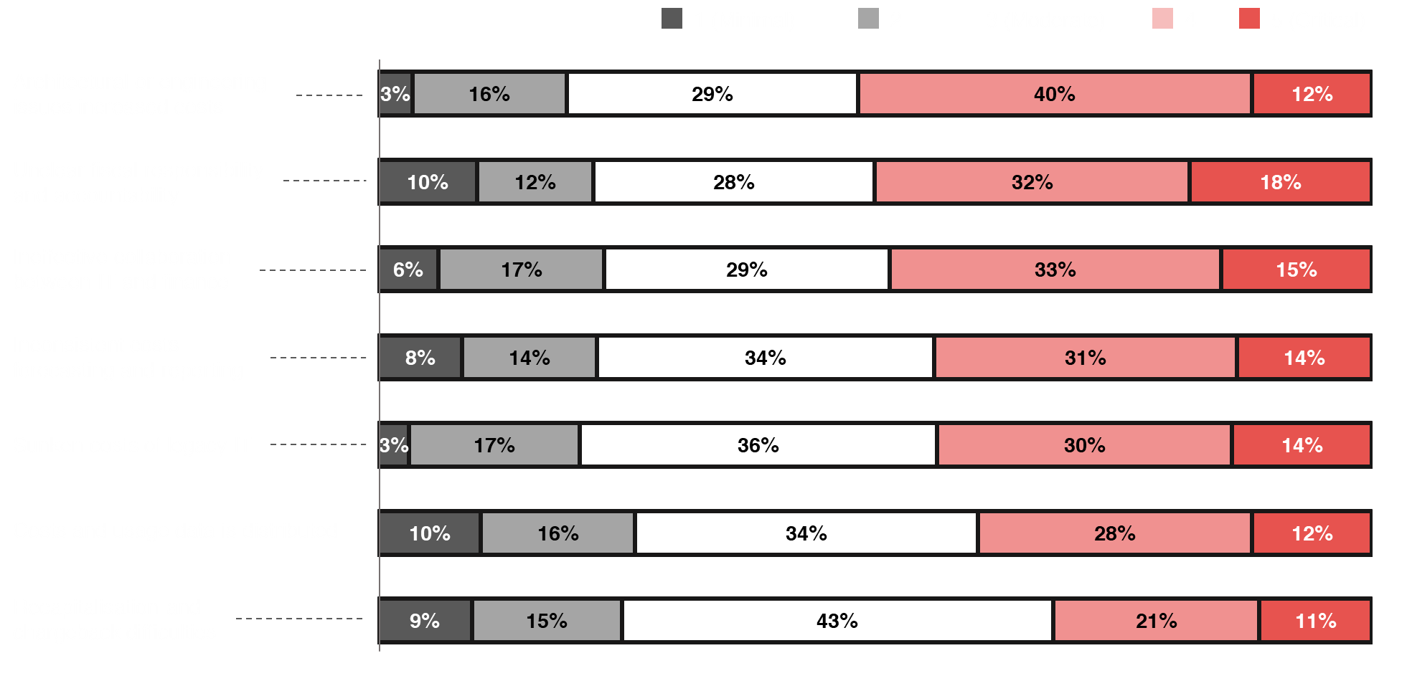
Top critical barriers when managing the costs and value of cloud
ADAPT CFO Edge Survey in Nov 2024. Sample size: 66 Australian CFOs

Slide 14
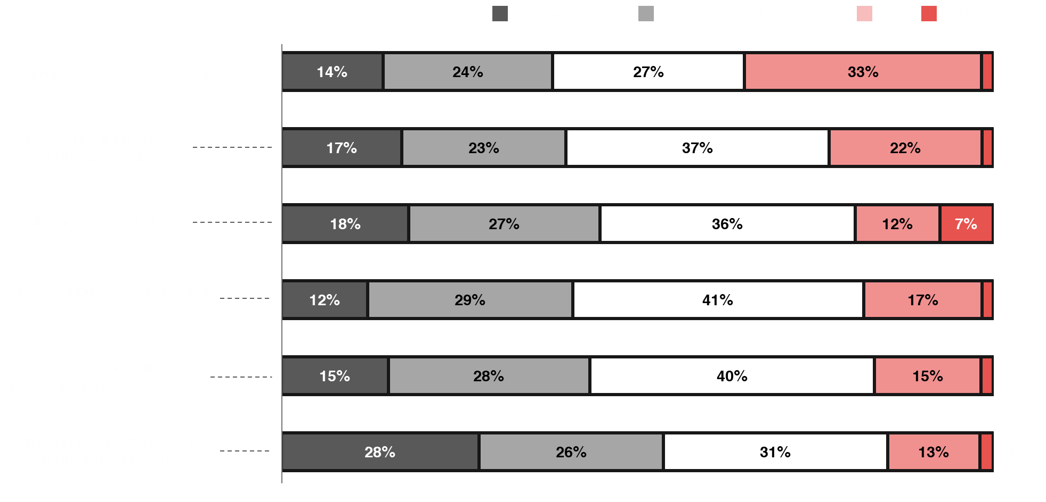
Organisational maturity with Finops
ADAPT CFO Edge Survey in Nov 2024. Sample size: 67 Australian CFOs

Slide 15
Cloud cost challenges stem from a lack of funding
With lack of funding being the #1 barrier for CFOs, significant cost challenges also arise. These include architecture and engineering expenses, as well as sunk costs from legacy systems and data usage.
Some organisations struggle with consistent cost forecasting due to insufficient visibility in tracking
the value derived from tech spending.
Establishing a clear fiscal responsibility and business accountability
This suggests a greater need to promote cross-functional collaboration and implement robust
financial reporting and monitoring systems.
More effective collaboration between IT and finance helps organisations establish clear fiscal responsibility and business accountability. Improved compliance is also essential to reduce risks
and promote responsibility by ensuring adherence to financial regulations.
Cost visibility and tech debt issues arise from the inability to track tech spending
Many CFOs require more strategic actions to improve visibility into cloud costs and reduce tech debt.
This is due to the inability of many organisations to track the value of tech spending.
Therefore, greater efforts are needed to leverage data for effective cloud cost forecasting
and modeling.
Improving cloud financial literacy for better decision-making in managing cloud costs and value
To demonstrate the value of FinOps effectively, organisations require high financial literacy among product and IT teams. As FinOps combines financial management and processes, it requires more collaboration and shared financial understanding across departments.
This enables CFOs to create more cost-effective decisions and to optimise cloud costs and value.
Technology Trends: Cloud and FinOps
Cloud and FinOps challenges
The #1 critical barrier for CFOs in managing cloud costs and value is
the additional expense of addressing architectural or engineering issues.
CFOs lack the visibility and
collaboration needed to realise
cloud value expectations.
This results in a lack of visibility
into cloud costs and hampers efforts
to reduce tech debt.
Some CFOs believe they need to implement more strategic actions
to demonstrate the value of FinOps.

Slide 16
Survey demographics

Slide 17
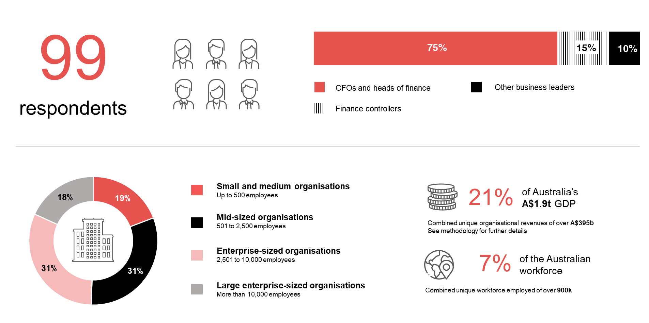
Survey demographics: Australian CFOs in 2024

Slide 18
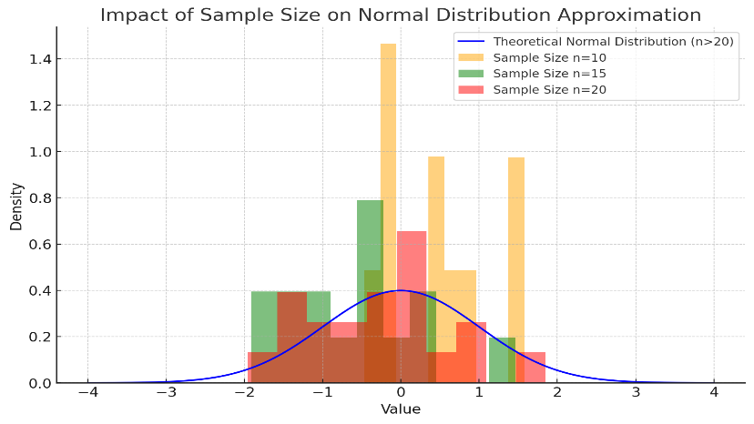
For sector, segment and persona comparisons
Central limit theorem a fundamental concept in statistics that determines when a sample size is large enough
to be considered reliable. There are different formulas and some debate amongst statisticians about the appropriate sample size. For industry comparisons or other subset analyses, a sample size of ( n > 20 ) is generally considered acceptable for drawing meaningful insights. This threshold aligns with common statistical practices, where a
sample size of 20 to 30 is generally the minimum needed to assume a normal distribution of the data.
Sample sizes below 20, but equal to or greater than 15
When the sample size is between 15 and 20, while not fully representative, it can still offer valuable insights
into trends. These statistics should be viewed as indicative, highlighting general directions in industry efforts
or barriers to investment but treated with some caution due to the smaller number of observations.
Sample sizes less than 15, but greater or equal to 10
For samples between 10 and 15, the data provides a snapshot guideline only. While such small samples can
show early trends, it's important to recognise that this does not guarantee future respondents will reflect the same trends. For instance, while 100% of respondents in a sample of 10 might invest in AI, it would be unrealistic to assume this pattern will hold as the sample size grows. However, if the sample size increases to 20, it is unlikely
that the trend will change drastically, and the next 10 respondents will have no investment.
ADAPT Data Analytics:
Notes on sample sizes
Why does sample size matter?
Each set of statistics is unique with measures,
distribution, variance and sample size. It is generally accepted in statistics that as sample size increases, analysts make fewer assumptions about the data, resulting in statistics that more accurately represent the truth.
ADAPT endeavours to provide transparency of sample size, whereby we provide a source on data slides with
the number of respondents and the survey where those respondents come from. In data and insights slide decks, ADAPT usually provides some insight on the breakdown
of the demographics at the end of the slide deck.
To protect privacy, ADAPT does not release lists
of individual respondents to surveys.

Slide 19

About ADAPT
ADAPT is a specialist Research & Advisory firm providing local market insights and benchmarking data
to Australia and New Zealand’s senior technology and business community.
Since 2011, we’ve been empowering the leaders of the region’s top enterprise and government organisations
to stay at the forefront of modern trends and build for the future. Our industry leading conferences, private roundtable events and custom research projects equip business leaders with the knowledge, relationships, inspiration and tools they need to make better strategic decisions.
adapt.com.au | hello@adapt.com.au
Data Validation
Results contained in this report (Report) are based on survey responses as provided by our clients and publicly available information. ADAPT does not subject the data contained in the Report to audit or review procedures or any other testing to validate the accuracy or reasonableness of the data provided by the participating clients. While we do not manipulate the survey responses, we do make an effort to identify outlier data or conflicting results that could lead to misinterpretations before the preparation of the Report.
Intended Use of the Report
The Report is designed to help technology executives in Australia and New Zealand make independent decisions regarding financial, resourcing and operational performance matters. The information and data contained in the Report are provided as is and are for information purposes only. They are not intended or implied to be recommendations and in no event will ADAPT be liable for any decisions or actions taken in reliance of the results obtained through the use of the information and/or data contained in the Report.
Research MSA and Privacy Policy
The Report and any other information provided by ADAPT is subject to the Research and Advisory Master Services Agreement and the ADAPT Privacy Policy.

Slide 20




Additional resources you can access
Members of ADAPT’s Research & Advisory platform have access to an entire suite of market leading content, insights and resources to help you execute in your role. For any assistance contact your Account Manager in the help section.
Community Case Studies & Interviews
Case studies detailing the successes
and challenges of projects and initiatives.
Market Trend Reports Access a library of fact-based actionable insights, deep dives on ANZ business & IT trends.
Live Access to ADAPT Analysts
Through live ADAPT analyst market briefings and Q&A sessions
Downloadable Data & Insights
Elevate your business cases with downloadable market and industry data.
Industry Expert Presentations
Watch keynotes or read distilled 1-page executive summaries from our Edge Events.
Bespoke Analysis of ADAPT Data
Receive custom cuts and analysis of ADAPT proprietary data.
Premier Executive Community
Unlock access to our exclusive network of Australia’s leading technology and business executives.
Dedicated Account Manager & Impact Assessments
Your Account Manager will ensure you and your team are getting the most out of your subscription.
Dedicated Analyst Briefing
Leverage a dedicated briefing with an ADAPT analyst to help validate your strategies.
*Inclusions may vary depending on subscription level.

