Slide 1





ADAPT TECHNOLOGY TRENDS
The importance of delivering customer and employee experiences
Gabby Fredkin
Head of Data and Analytics at ADAPT
Honey Mari Gay
Junior Data Analyst at ADAPT

Slide 2
In this report, you’ll find insights into:
Enabling better customer experience
Complexity often affects the ability of organisations to unify engagement
and enhance experience.
To drive consistency, digitising processes relevant to customer support is crucial.
Greater quality of customer services stems from a better understanding of customers’ needs.
Balancing privacy and experience is also important while maintaining compliance.
How to drive greater employee experience
Too many collaboration tools often create difficulties in locating relevant information.
More effort is needed to reduce legacy systems and tech debt.
Enable better automation and integration of digital tools.
Effective cross-functional collaboration is also essential for enabling the sharing of ideas
and fostering innovation.
The importance of digital operating models for uplifting employee experience
  This highlights the significance of a well-defined purpose and clear values in fostering employee commitment and enhancing performance.
  When there is a lack of understanding of purpose and support for training and upskilling, employees may struggle to adapt to changes and new ways of working.
Technology Trends: Experiences
Key takeaways
ADAPT’s Digital Edge Survey (2024) reveals insights into how Australian Chief Digital Officers (CDOs) are delivering exceptional experiences for both customers and employees.
52% of Australian CDOs agree that many customers experience inconsistencies due
to complexities.
53% of organisations say their employees collaborate in a hybrid workplace effectively but struggle to automate and adopt digital tools.
62% of organisations report that they require a better understanding of purpose and value to drive better employee experience.

Slide 3

Customer experience

Slide 4
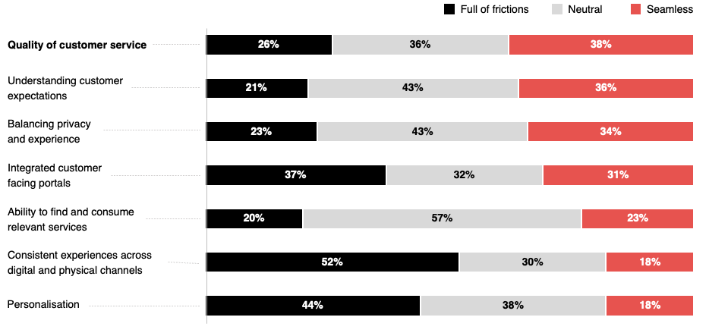
How seamless is the customer experience according to these measures?
Source: ADAPT Digital Edge Survey in October 2024 : 61 Australian CDOs

Slide 5
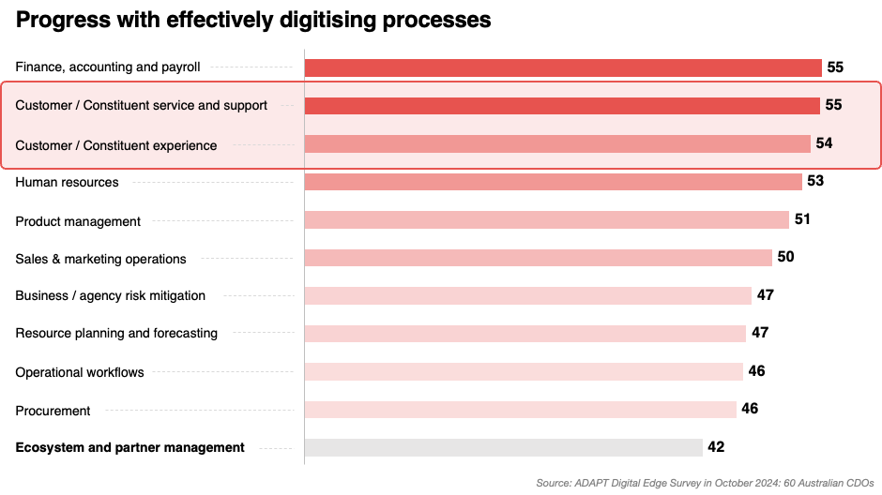

Slide 6
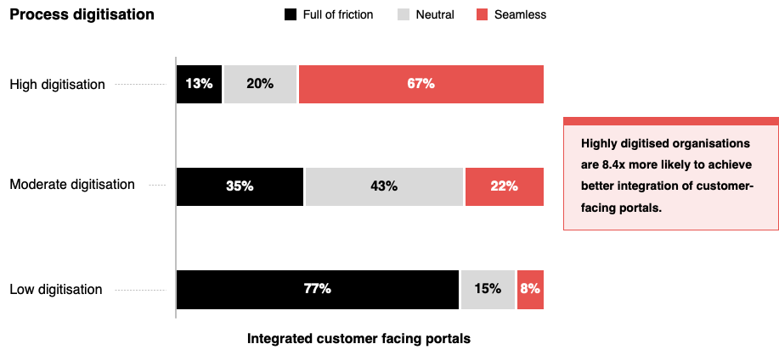
Digitisation as it relates to integrating customer facing portals
Source: ADAPT Digital Edge Survey in October 2024: 51 Australian CDOs

Slide 7
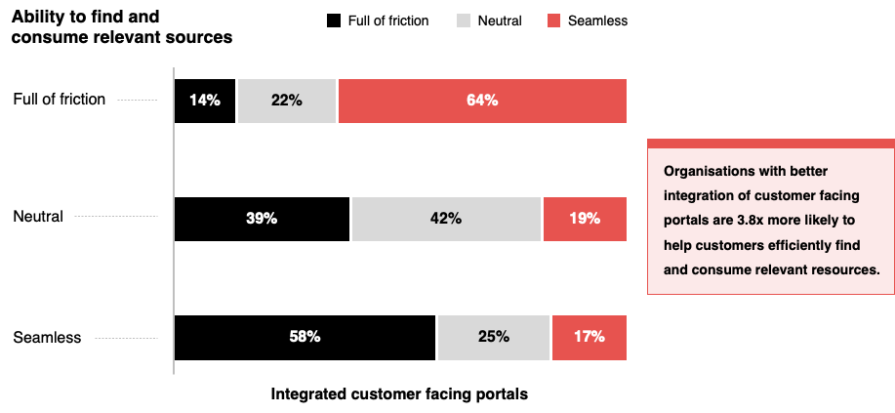
Consuming relevant sources as it relates to integrating customer facing portals
Source: ADAPT Digital Edge Survey in October 2024 : 60 Australian CDOs

Slide 8
Higher digitisation of customer experience and support drives consistency and personalisation
Organisations with complex platform integrations often struggle to unify engagement channels and improve experiences. Hence, digitising key processes relevant to customer support is important.
Creating a single customer view is also crucial to develop a greater understanding of customer expectations. This allows organisations to tailor customer solutions and personalise experiences.
Further sources are discussed in an ADAPT Tech Trend report (Mar 2022).
Aligning customer needs and experiences for greater quality of customer service
Organisations that personalise experiences tend to create services that cater to customers’
needs and invest in AI and digital tools to deliver better experiences.
Additionally, developing effective customer channels is essential to ensure customers
can reach support through their preferred methods.
This approach provides consistent experiences while capturing customer value,
ultimately improving the quality of service.
Ability to find and consume relevant services as a challenge to deliver
Better integration of customer-facing portals helps customers find and consume relevant services.
However, this can become challenging when organisations struggle to balance digital innovation
with customers’ needs. Therefore, effectively executing a digital experience strategy is essential.
Balancing privacy and experience while being compliant
Prioritising anonymisation and opt-in features allows organisations to build customer trust while respecting privacy concerns. Achieving a balance between privacy and experience must adhere to regulatory compliance. This approach helps organisations avoid overstepping customer boundaries while customising services and experiences. Refer to an ADAPT CISO Persona Map report (Oct 2024).
Technology Trends:
Customer experience
Delivering customer experiences
52% of Australian CDOs report that many customers experience inconsistencies
across digital and physical channels.
This issue arises from difficulties in
personalising experiences and integrating customer portals.
Organisations are most effective at providing quality services for their customers.
However, 57% of organisations state that customers are neutral about finding and consuming relevant services.
Additionally, better compliance is crucial
to achieving a balance between privacy
and experience.

Slide 9
Employee experience

Slide 10
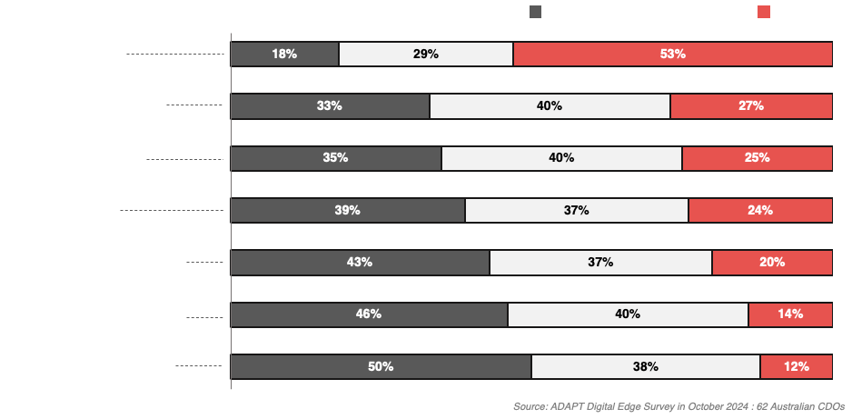
How seamless is the employee experience in the following areas?

Slide 11
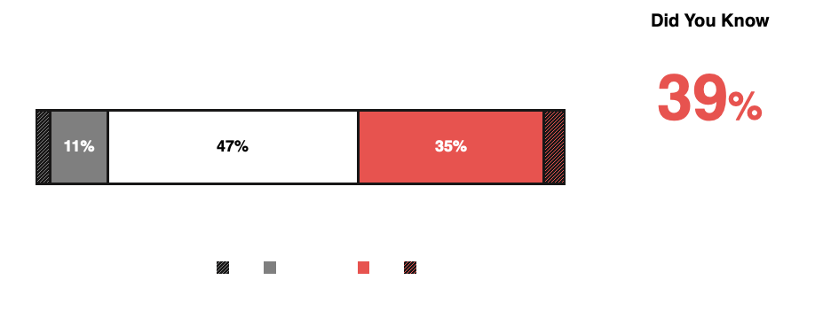
How well are you managing cross-functional collaboration?
Source: ADAPT Digital Edge Survey in October 2024: 74 Australian CDOs

Slide 12
Technology Trends:
Employee experience
Ensuring a hybrid workplace that aligns with workforce requirements
Aside from delivering greater customer experiences, higher investment priorities in collaboration tools enables a seamless experience in a hybrid workplace. However, too many collaboration technologies
can lead to data dispersed across systems. This makes it difficult to locate relevant information.
Therefore, it is important for CDOs to securely architect a hybrid model that aligns with hybrid workforce requirements. Refer to an ADAPT Digital Roundtable (Jan 2023).
Issues in automation and digital tool integration are caused by legacy systems and tech debt
An ADAPT CDO Persona Map report (Nov 2024) indicates legacy systems and tech debt as a top 4 barrier to digital execution. These challenges can lead to complexities in process automation.
While CDOs are most effective at building a collaborative hybrid workplace, integrating automation
and redefining workflows to exploit digital tools can also be difficult due to legacy technologies.
Being effective in sharing ideas requires well-managed cross-functional collaboration
The inability to share ideas across organisations is driven by limited cross-functional collaboration.
ADAPT insights reveal that 47% of CDOs state they are either managing cross-functional collaboration
well or poorly. Organisations may also struggle to foster a culture where employees feel comfortable contributing ideas and obtaining approvals due to an adverse culture and insufficient executive support.
Difficulty finding time with subject matter experts may relate to insufficient staff in key roles
An ADAPT Community Interview (Sep 2024) highlights the importance of prioritising the hiring of individuals who can bridge the gaps between business requirements and technological possibilities.
Delivering employee experiences
53% of Australian CDOs say their
employees are highly effective in
collaborating in a hybrid workplace.
However, a lot of collaborative tools can
make locating relevant information difficult.
Many organisations find it difficult
to automate key processes and
redefine workflows.
Many employees experience either friction or seamlessness when sharing ideas and finding time with subject matter experts.

Slide 13
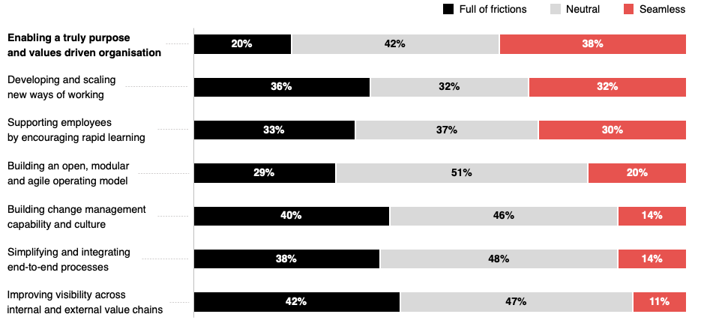
How seamless is the organisation’s digital operating model?
Source: ADAPT Digital Edge Survey in October 2024: 51 Australian CDOs

Slide 14

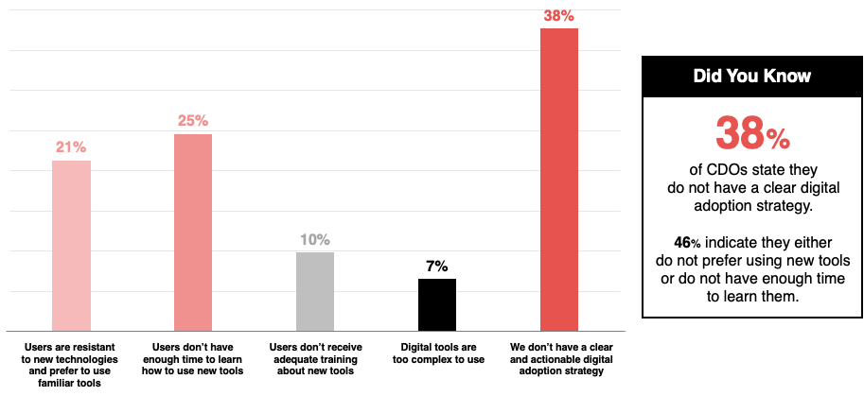
Critical barrier stopping users fully using the organisation’s digital tools
Source: ADAPT Digital Edge Survey in October 2024: 61 Australian CDOs

Slide 15
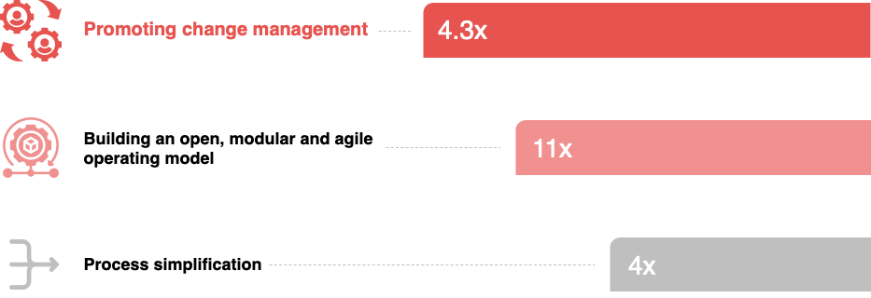
Most significant factors that drive new ways of working according to CIOs and CDOs
ADAPT CIO and Digital Edge Surveys in Feb, Aug and Oct 2024. Sample size: 294 Australian CIOs and CDOs

Slide 16
Technology Trends:
Employee experience
Enabling a purpose- and value-driven organisation to drive better employee performance
Organisations with a well-defined purpose can foster a culture of belonging. Employees tend to
drive higher levels of commitment and performance when they feel connected to a sense of purpose.
ADAPT survey findings reveal that as CDOs prioritise broad-based digital transformation, 38% state the lack of a clear digital adoption strategy inhibits their users from fully using digital tools.
Driving clear purpose and values are crucial for encouraging rapid learning and digital tool adoption.
Developing effective new ways of working
This can become problematic when there is a lack of understanding of an organisations purpose
and value, coupled with insufficient support for adequate training and upskilling. Consequently,
this creates resistance to change.
ADAPT finds CIOs' and CDOs' views on driving new ways of working relate to building an open, modular and agile operating model, promoting change management and process simplification.
These factors enable effective new ways of working at a rate of 11x, 4.3x and 4x, respectively.
Simplifying processes for greater visibility
ADAPT insights highlight that organisations with simplified and integrated processes tend
to improve visibility across internal and external value chains at a rate of 12.8x.
Frictions in simplifying and integrating processes can be attributed to ineffective digitisation.
Partnerships between CIOs and CDOs are crucial to identify key areas that require changes
and integration. For further details, refer to an ADAPT Market Trend report (Sep 2024).
Delivering digital operating models
When it comes to delivering digital operating models, most Australian CDOs report experiencing either friction or seamlessness.
This also relates to many organisations
facing challenges in delivering employee experience (EX) areas.
38% of CDOs describe their organisations
as purpose- and value-driven.
36% of organisations struggle to develop
new ways of working.
Only 11% of Australian organisations
are effective in improving visibility across
value chains.

Slide 17
Survey demographics

Slide 18
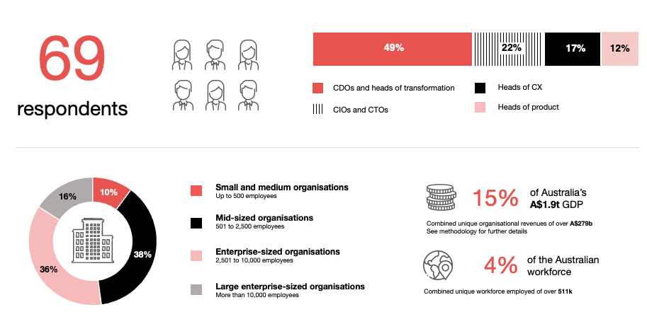
Survey demographics: Australian CDOs in 2024

Slide 19

For sector, segment and persona comparisons
Central limit theorem a fundamental concept in statistics that determines when a sample size is large enough
to be considered reliable. There are different formulas and some debate amongst statisticians about the appropriate sample size. For industry comparisons or other subset analyses, a sample size of ( n > 20 ) is generally considered acceptable for drawing meaningful insights. This threshold aligns with common statistical practices, where a
sample size of 20 to 30 is generally the minimum needed to assume a normal distribution of the data.
Sample sizes below 20, but equal to or greater than 15
When the sample size is between 15 and 20, while not fully representative, it can still offer valuable insights
into trends. These statistics should be viewed as indicative, highlighting general directions in industry efforts
or barriers to investment but treated with some caution due to the smaller number of observations.
Sample sizes less than 15, but greater or equal to 10
For samples between 10 and 15, the data provides a snapshot guideline only. While such small samples can
show early trends, it's important to recognise that this does not guarantee future respondents will reflect the same trends. For instance, while 100% of respondents in a sample of 10 might invest in AI, it would be unrealistic to assume this pattern will hold as the sample size grows. However, if the sample size increases to 20, it is unlikely
that the trend will change drastically, and the next 10 respondents will have no investment.
ADAPT Data Analytics:
Notes on sample sizes
Why does sample size matter?
Each set of statistics is unique with measures,
distribution, variance and sample size. It is generally accepted in statistics that as sample size increases, analysts make fewer assumptions about the data, resulting in statistics that more accurately represent the truth.
ADAPT endeavours to provide transparency of sample size, whereby we provide a source on data slides with
the number of respondents and the survey where those respondents come from. In data and insights slide decks, ADAPT usually provides some insight on the breakdown
of the demographics at the end of the slide deck.
To protect privacy, ADAPT does not release lists
of individual respondents to surveys.

Slide 20

About ADAPT
ADAPT is a specialist Research & Advisory firm providing local market insights and benchmarking data
to Australia and New Zealand’s senior technology and business community.
Since 2011, we’ve been empowering the leaders of the region’s top enterprise and government organisations
to stay at the forefront of modern trends and build for the future. Our industry leading conferences, private roundtable events and custom research projects equip business leaders with the knowledge, relationships, inspiration and tools they need to make better strategic decisions.
adapt.com.au | hello@adapt.com.au
Data Validation
Results contained in this report (Report) are based on survey responses as provided by our clients and publicly available information. ADAPT does not subject the data contained in the Report to audit or review procedures or any other testing to validate the accuracy or reasonableness of the data provided by the participating clients. While we do not manipulate the survey responses, we do make an effort to identify outlier data or conflicting results that could lead to misinterpretations before the preparation of the Report.
Intended Use of the Report
The Report is designed to help technology executives in Australia and New Zealand make independent decisions regarding financial, resourcing and operational performance matters. The information and data contained in the Report are provided as is and are for information purposes only. They are not intended or implied to be recommendations and in no event will ADAPT be liable for any decisions or actions taken in reliance of the results obtained through the use of the information and/or data contained in the Report.
Research MSA and Privacy Policy
The Report and any other information provided by ADAPT is subject to the Research and Advisory Master Services Agreement and the ADAPT Privacy Policy.

Slide 21




Additional resources you can access
Members of ADAPT’s Research & Advisory platform have access to an entire suite of market leading content, insights and resources to help you execute in your role. For any assistance contact your Account Manager in the help section.
Community Case Studies & Interviews
Case studies detailing the successes
and challenges of projects and initiatives.
Market Trend Reports Access a library of fact-based actionable insights, deep dives on ANZ business & IT trends.
Live Access to ADAPT Analysts
Through live ADAPT analyst market briefings and Q&A sessions
Downloadable Data & Insights
Elevate your business cases with downloadable market and industry data.
Industry Expert Presentations
Watch keynotes or read distilled 1-page executive summaries from our Edge Events.
Bespoke Analysis of ADAPT Data
Receive custom cuts and analysis of ADAPT proprietary data.
Premier Executive Community
Unlock access to our exclusive network of Australia’s leading technology and business executives.
Dedicated Account Manager & Impact Assessments
Your Account Manager will ensure you and your team are getting the most out of your subscription.
Dedicated Analyst Briefing
Leverage a dedicated briefing with an ADAPT analyst to help validate your strategies.
*Inclusions may vary depending on subscription level.

