Slide 1





ADAPT TECHNOLOGY TRENDS
Process Simplification
Gabby Fredkin
Head of Data and Analytics at ADAPT
Honey Mari Gay
Junior Data Analyst at ADAPT

Slide 2
ADAPT defines process simplification as: “The strategic approach of reducing complexity in business operations by eliminating redundant steps, automating workflows, and integrating systems. It focuses on improving efficiency, reducing costs, and enhancing agility by streamlining processes to achieve faster, more predictable, and scalable outcomes.”
In this report, you’ll find insights into:
The factors that are crucial for effective process simplification
These involve digital skills and mindsets, IT business delivery outcomes such as developing new ways of working and using technology to reduce cost, and course correcting based on insights.
  Digital skills and mindsets: Organisations that excel in process simplification tend to have higher average levels of executive digital savviness, employee digital fitness, and executives’ recognition of technology’s importance to business outcomes.
  New ways of working, better insights and lower costs through tech: To be better at process simplification, organisations also require effectiveness in new ways of working,
  driving insights for course-correcting and using tech to reduce business costs.
  Other significant attributes
    Aside from new ways of working, process simplification also needs enhanced collaboration
    across departments and improved visibility across internal and external value chains.
Technology Trends: Process simplification
Key takeaways
ADAPT’s 2025 CIO Survey identified key attributes that drive effective process simplification.
In 2025, 43% of Australian organisations are effective in simplifying and integrating processes, 38% are neutral and 19% are ineffective.
ADAPT has developed a network diagram illustrating how key attributes contribute to
process simplification.
Additionally, 3x3 and 2x2 matrices have been developed to analyse three factors. These matrices demonstrate how probability shifts in process simplification when two factors change while the third remains constant.

Slide 3

Simplifying and integrating
end-to-end processes

Slide 4
Simplifying and integrating end-to-end processes
Source: ADAPT CIO Edge Survey in Feb 2025. Sample size: 186 Australian CIOs

Slide 5
Simplifying and integrating end-to-end processes network diagram
Source: ADAPT CIO Edge Survey in Feb 2025. Sample size: 186 Australian CIOs

Slide 6
Weights calculation of ADAPT’s process simplification network diagram
Categorical rates of impact. The weight of each one-way relationship is calculated as the ratio of the percentage of the effective outcome given compared to the ineffective outcome in the ADAPT sample.
Numerical rates of impact. The weight is computed as the ratio of the average attribute value
of the high-level outcome over the average attribute value of the low-level outcome.
The following shows the calculation of categorical and numerical rates of impact
Categorical rates of impact: Consider developing and scaling new ways of working
as an attribute and being effective at process simplification as an outcome.
  If 23% of organisations are effective at developing and scaling new ways of working but ineffective in process simplification, and 72% of organisations are effective at process simplification and new ways of working (see slide #12),then the weight is calculated as 72/23 which is equal to 3.1.
  The result is interpreted as how much more effective an organisation is in the outcome when they succeed in the attribute compared to when they do not. For example, organisations are 3.1x more effective at process simplification when they successfully develop and scale new ways of working.
Numerical rates of impact: Consider average executive digital savviness as an attribute
and process simplification as an outcome.
  If the average percentage of digitally savvy executives for organisations that are ineffective
  and effective in process simplification is 42% and 56%, respectively (see slide #8), then the
  weight is calculated as 56/42 which is equal to 1.3.
  The result is interpreted as the number of times the outcome is better when the attribute
  value of the effective outcome is higher than that of the ineffective outcome.
Technology Trends: Process simplification
How to read the diagram
ADAPT's CIO Edge Survey in Feb 2025 identified the factors that matter for being better at simplifying and integrating processes.
ADAPT developed this network diagram by first cleaning and analysing the data and identifying the strongest statistical correlation(s).
With this information, ADAPT then calculated the weights to uncover the effect of the attributes on the outcomes.

Slide 7
Digital skills and mindsets

Slide 8

Process simplification with digital skills and mindsets
ADAPT CIO Edge Survey in Feb 2025. Sample size: 186 Australian CIOs

Slide 9
Process simplification as it relates to executives’ perception of IT's importance to business outcomes
ADAPT CIO Edge Survey in Feb 2025. Sample size: 186 Australian CIOs

Slide 10
Promoting digital skills and mindsets in a digital era
An ADAPT Community Interview (Nov 2024), discusses the importance of fostering an entrepreneurial mindset supported by strong leadership, culture and risk management.
This mindset empowers employees to innovate within their organisations, helps them stay competitive, and promotes customer-centric thinking in a fast-paced digital world.
The following key points describe how digital skills and mindsets enable better process simplification.
Driving digital savviness of executives
Executives with higher degrees of digital savviness tend to drive a digital-first mindset. They recognise the importance of digital solutions and align their development with future market needs.
Organisations with highly digitally savvy executives often promote cohesive digital progress by fostering a culture of innovation that drives employees to embrace modernisation and simplification.
Empowering employees to become digitally fit
Employees with strong digital skills adopt AI and digital tools more quickly, helping organisations minimise friction and resistance when integrating and simplifying processes.
Highly digitally fit employees also reduce reliance on IT support, allowing executives to focus on broader strategic goals and process simplification rather than addressing digital skills gaps.
Promoting the importance of tech to business outcomes among executives
Executives with a strong understanding of technology leverage advanced analytics and AI for automation and data-driven decision-making. With robust governance, they can establish standardised processes for simplification while embedding security from the start. This approach enhances organisational efficiency in process simplification while ensuring digital resilience.
Technology Trends: Process simplification
Digital skills and mindsets
ADAPT defines:
  Digital savviness as the “ability of executives and the Board to sustain advantage through digital strategy and enablement.”
  Digital fitness as the “capability of employees to rapidly learn new digital tools and use data to productively execute in their role.”
ADAPT finds that organisations who are effective in process simplification have higher degrees of:
executive digital savviness
employee digital fitness
executives’ recognition of technology’s importance to business outcomes.

Slide 11
New ways of working,
better insights and
lower costs

Slide 12
Process simplification as it relates to IT business delivery
ADAPT CIO Edge Survey in Feb 2025. Sample size: 186 Australian CIOs

Slide 13
Process simplification as it relates to course correcting based on insights
ADAPT CIO Edge Survey in Feb 2025. Sample size: 186 Australian CIOs

Slide 14
Developing new ways of working
New ways of working are crucial in process simplification by supporting agile and flexible work models.
This suggests a greater need to enhance digital skills and increase tech awareness. Some practical actions for future work are detailed in an ADAPT Best Practices report (Jan 2022).
Developing new ways of working also requires effective use of insights for course-correcting. ADAPT finds that organisations that course-correct are 4.7x more effective at new ways of working.
Leveraging insights to course correct
An ADAPT Expert Presentation (Jun 2023) emphasises that to become data-driven means the decision-making process is guided by data. Data insights reveal inefficiencies and redundancies in processes, helping CIOs prioritise areas for simplification. Additionally, continuous course correction ensures organisations stay compliant with regulatory changes
For further insights relating to driving process excellence when simplifying compliance, refer to an ADAPT Best Practices report (Sep 2024).
Using technology to reduce business costs
While aiming for cost optimisation (#3 goal), CIOs must ensure they are simplifying processes
(#1 goal) to lower operational costs. Additionally, ADAPT finds that adopting new ways of working helps reduce costs through technology—and vice versa, as cost reductions can drive the adoption of innovative work practices (see slide #5).
Some Australian organisations use tech to cut costs and simplify processes for better
experiences. For example, Commonwealth Bank of Australia, Suncorp Group and Telstra.
Technology Trends: Process simplification
New ways of working,
better insights and
lower costs
ADAPT finds that organisations effective in process simplification are also better at:
developing and scaling new ways of working
using insights for course correcting
using technology to continually reduce
costs for the business.

Slide 15
Process simplification matrix

Slide 16
Process simplification when developing new ways of working is neutral
ADAPT CIO Edge Surveys in Aug 2024 and Feb 2025. Sample size: 282 Australian CIOs

Slide 17
Process simplification when enhancing collaboration across organisational departments is neutral
ADAPT CIO Edge Surveys in Aug 2024 and Feb 2025. Sample size: 282 Australian CIOs

Slide 18
Process simplification when improving visibility across internal and external value chains is neutral
ADAPT CIO Edge Surveys in Aug 2024 and Feb 2025. Sample size: 282 Australian CIOs

Slide 19
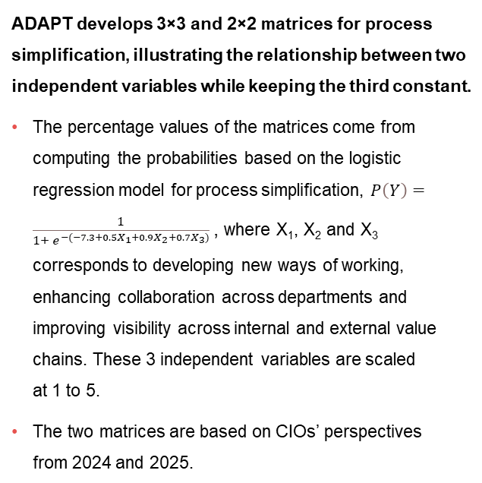
The following provides steps on how to read the 3x3 matrix table for process simplification:
Example: Better collaboration and visibility while keeping new ways of working constant
While keeping new ways of working neutral,
  Third row. Organisations that are ineffective in enhancing collaboration and improving visibility will have a 4% (first column) probability of being effective in process simplification. If they are still ineffective in enhancing collaboration but neutral and effective in improving visibility, they will have an 11% (second column) and 31% (third column) success rate of being better at process simplification, respectively.
Second row. If they are neutral in enhancing collaboration but either ineffective, neutral or effective in improving visibility, they will have a 9% (first column), 25% (second column) or 55% (third column) chance of being effective in process simplification, respectively.
First row. If they are effective in enhancing collaboration but ineffective in improving visibility, they will have a 23% (first column) chance of being better at process simplification. If they are still effective in enhancing collaboration but neutral in improving visibility, they will have a 50% (second column) success rate of effective process simplification. If they are both effective in enhancing collaboration and improving visibility, they will have a 76% (third column) chance of being effective.
The 2x2 matrix table for process simplification where new ways of working are neutral
Second row. Organisations that are not effective in enhancing collaboration and improving visibility will have a 9% (first column) probability of being better at process simplification. If they are still not effective in enhancing collaboration but effective in improving visibility, they will have a 39% (second column) chance of being effective at process simplification.
First row. If they are not effective in enhancing collaboration but effective in improving visibility, they will have a 32% (first column) chance of being effective at process simplification. If they are both effective in enhancing collaboration and improving visibility, they will have a 76% (second column) chance of being effective.
Technology Trends: Process simplification
How to read the 3x3
and 2x2 matrices
ADAPT develops 3×3 and 2×2 matrices for process simplification, illustrating the relationship between two independent variables while keeping the third constant.
The percentage values of the matrices come from computing the probabilities based on the logistic regression model for process simplification, $P\left(Y\right)=\frac{1}{1+ e^{−(−7.3+0.5X_{1}+0.9X_{2}+0.7X_{3})}}$, where X₁, X₂ and X₃ corresponds to developing new ways of working, enhancing collaboration across departments and improving visibility across internal and external value chains. These 3 independent variables are scaled
at 1 to 5.
The two matrices are based on CIOs’ perspectives
from 2024 and 2025.

Slide 20
Better collaboration and visibility while keeping new ways of working neutral
Enhancing collaboration and visibility increases the likelihood of effective process simplification
to 76%, compared to just 4% without these efforts.
Organisations that prioritise collaboration and maintain visibility can adapt to changes more
quickly, positioning themselves better for process simplification.
Stronger collaboration fosters cross-functional alignment, ensuring that process improvements align with organisational goals. Additionally, shared visibility across departments helps prevent inefficiencies caused by siloed decision-making during process changes.
More effective in new ways of working and visibility while keeping collaboration neutral
Effectiveness in developing new ways of working and improving visibility leads to a 71% success rate in simplifying processes, compared to just 5% without these efforts.
New ways of working often encourages stronger collaboration. However, limited visibility across internal and external value chains can prevent employees from understanding the complete picture.
Therefore, it is crucial for organisations to have clear internal visibility to promote transparency across departments and gain a better understanding of internal operations.
More effective in new ways of working and collaboration while making visibility neutral
Being more effective in developing new ways of working and enhancing collaboration increases
the probability of successful process simplification to 67%, compared to just 6% otherwise.
Even when organisations excel at developing new ways of working, weak cross-departmental collaboration can lead to siloed processes and inefficiencies.
This makes process simplification challenging. Therefore, new ways of working
must be reinforced to ensure seamless, integrated processes.
Technology Trends: Process simplification
Process simplification matrix
ADAPT finds that organisations have:
A 76% probability of excelling in process simplification when they effectively enhance cross-departmental collaboration and improve visibility across internal and external value chains while remaining neutral in developing new ways of working.
A 71% probability when they focus on developing new ways of working and improving visibility while remaining neutral in enhancing collaboration.
A 67% probability when they prioritise new ways of working and enhancing collaboration while remaining neutral in improving visibility.

Slide 21
Survey demographics

Slide 22
Survey demographics: Australian CIOs in 2025

Slide 23
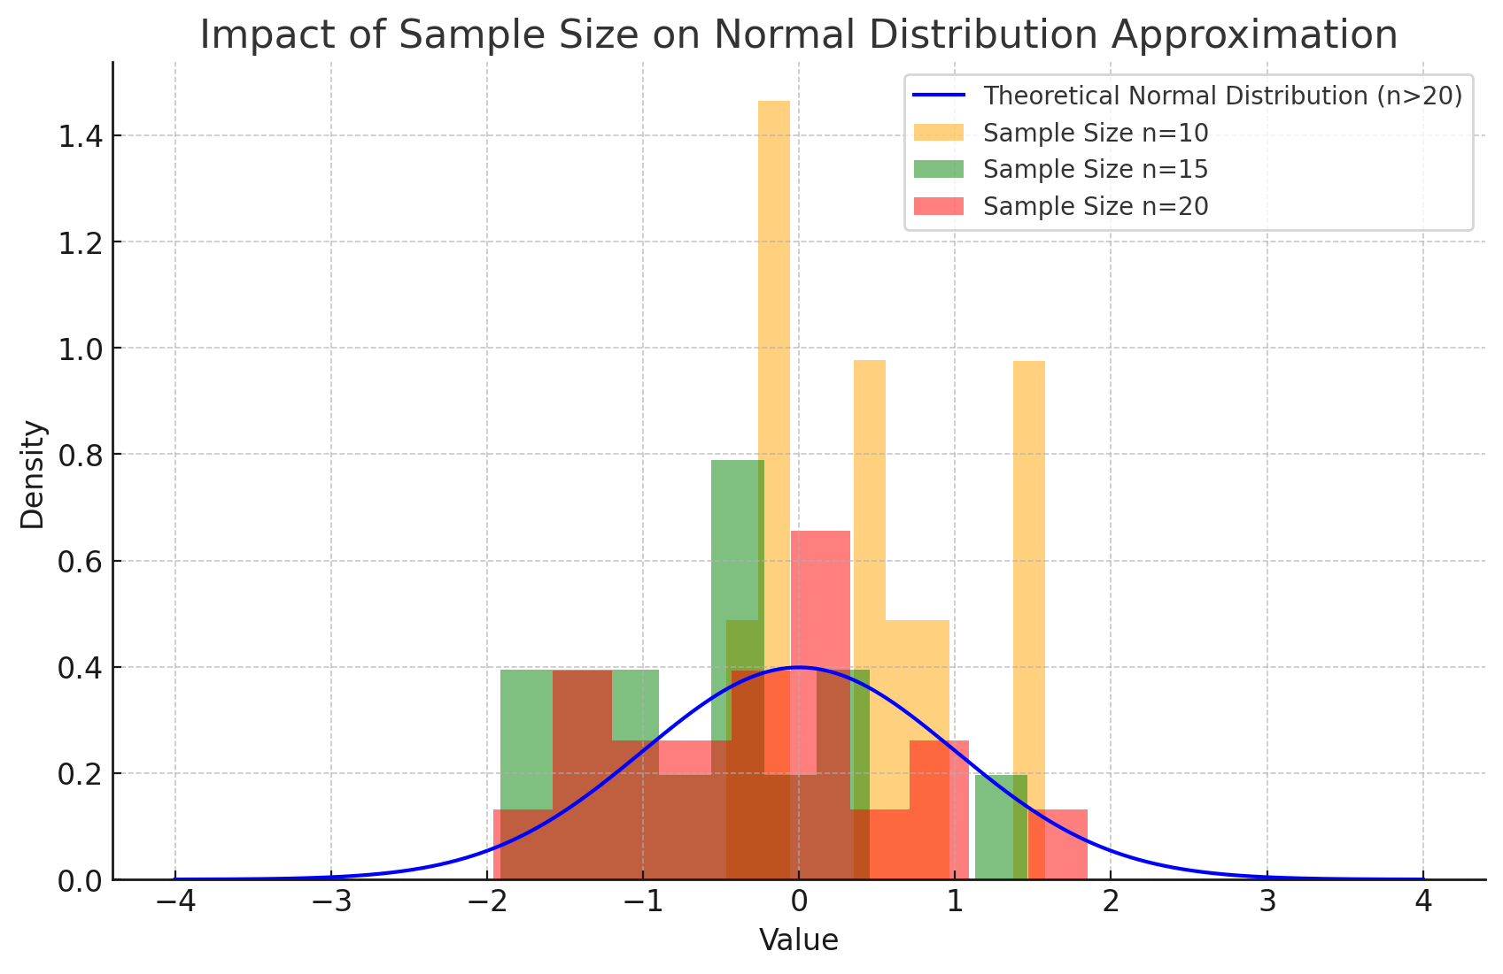
For sector, segment and persona comparisons
Central limit theorem a fundamental concept in statistics that determines when a sample size is large enough
to be considered reliable. There are different formulas and some debate amongst statisticians about the appropriate sample size. For industry comparisons or other subset analyses, a sample size of ( n > 20 ) is generally considered acceptable for drawing meaningful insights. This threshold aligns with common statistical practices, where a
sample size of 20 to 30 is generally the minimum needed to assume a normal distribution of the data.
Sample sizes below 20, but equal to or greater than 15
When the sample size is between 15 and 20, while not fully representative, it can still offer valuable insights
into trends. These statistics should be viewed as indicative, highlighting general directions in industry efforts
or barriers to investment but treated with some caution due to the smaller number of observations.
Sample sizes less than 15, but greater or equal to 10
For samples between 10 and 15, the data provides a snapshot guideline only. While such small samples can
show early trends, it's important to recognise that this does not guarantee future respondents will reflect the same trends. For instance, while 100% of respondents in a sample of 10 might invest in AI, it would be unrealistic to assume this pattern will hold as the sample size grows. However, if the sample size increases to 20, it is unlikely
that the trend will change drastically, and the next 10 respondents will have no investment.
ADAPT Data Analytics:
Notes on sample sizes
Why does sample size matter?
Each set of statistics is unique with measures,
distribution, variance and sample size. It is generally accepted in statistics that as sample size increases, analysts make fewer assumptions about the data, resulting in statistics that more accurately represent the truth.
ADAPT endeavours to provide transparency of sample size, whereby we provide a source on data slides with
the number of respondents and the survey where those respondents come from. In data and insights slide decks, ADAPT usually provides some insight on the breakdown
of the demographics at the end of the slide deck.
To protect privacy, ADAPT does not release lists
of individual respondents to surveys.

Slide 24

About ADAPT
ADAPT is a specialist Research & Advisory firm providing local market insights and benchmarking data
to Australia and New Zealand’s senior technology and business community.
Since 2011, we’ve been empowering the leaders of the region’s top enterprise and government organisations
to stay at the forefront of modern trends and build for the future. Our industry leading conferences, private roundtable events and custom research projects equip business leaders with the knowledge, relationships, inspiration and tools they need to make better strategic decisions.
adapt.com.au | hello@adapt.com.au
Data Validation
Results contained in this report (Report) are based on survey responses as provided by our clients and publicly available information. ADAPT does not subject the data contained in the Report to audit or review procedures or any other testing to validate the accuracy or reasonableness of the data provided by the participating clients. While we do not manipulate the survey responses, we do make an effort to identify outlier data or conflicting results that could lead to misinterpretations before the preparation of the Report.
Intended Use of the Report
The Report is designed to help technology executives in Australia and New Zealand make independent decisions regarding financial, resourcing and operational performance matters. The information and data contained in the Report are provided as is and are for information purposes only. They are not intended or implied to be recommendations and in no event will ADAPT be liable for any decisions or actions taken in reliance of the results obtained through the use of the information and/or data contained in the Report.
Research MSA and Privacy Policy
The Report and any other information provided by ADAPT is subject to the Research and Advisory Master Services Agreement and the ADAPT Privacy Policy.

Slide 25




Additional resources you can access
Members of ADAPT’s Research & Advisory platform have access to an entire suite of market leading content, insights and resources to help you execute in your role. For any assistance contact your Account Manager in the help section.
Community case studies and interviews
Case studies detailing the successes
and challenges of projects and initiatives.
Market Trend Reports Access a library of fact-based actionable insights, deep dives on ANZ business & IT trends.
Live access to ADAPT analysts
Through live ADAPT analyst market briefings and Q&A sessions
Downloadable data and insights
Elevate your business cases with downloadable market and industry data.
Industry expert presentations
Watch keynotes or read distilled 1-page executive summaries from our Edge Events.
Bespoke analysis of ADAPT data
Receive custom cuts and analysis of ADAPT proprietary data.
Premier executive community
Unlock access to our exclusive network of Australia’s leading technology and business executives.
Dedicated account manager and impact assessments
Your Account Manager will ensure you and your team are getting the most out of your subscription.
Dedicated analyst briefing
Leverage a dedicated briefing with an ADAPT analyst to help validate your strategies.
*Inclusions may vary depending on subscription level.

