Slide 1

ADAPT Persona Map
Categorised Investment Priorities
for Infrastructure Leaders

Slide 2
Investment priorities​
Investment priorities are indicated by respondents' intentions to spend
in a given area over the next year.
There are 83 line items of investment priorities. The investment priority
statistics represent the top 10 investments by proportion of spending
in the next year.
Measuring investment priorities​
If there are fewer than 10 investment priorities in a category, the exact number
of investment priorities in that category is displayed.
Please note: Some groups only have 5 or 6 investment line items.
Investment priorities are ranked according to their position in the
grouping, not overall rank in the master list of priorities.
Where there are more than 10 investment line items, the top 10 are shown.
CIE demographic budget breakdown
Document description
This document outlines different investment priorities for infrastructure leaders.
The document outlines investment priorities,
ranked according to the number of respondents investing in the next year.

Slide 3
All categories

Slide 4
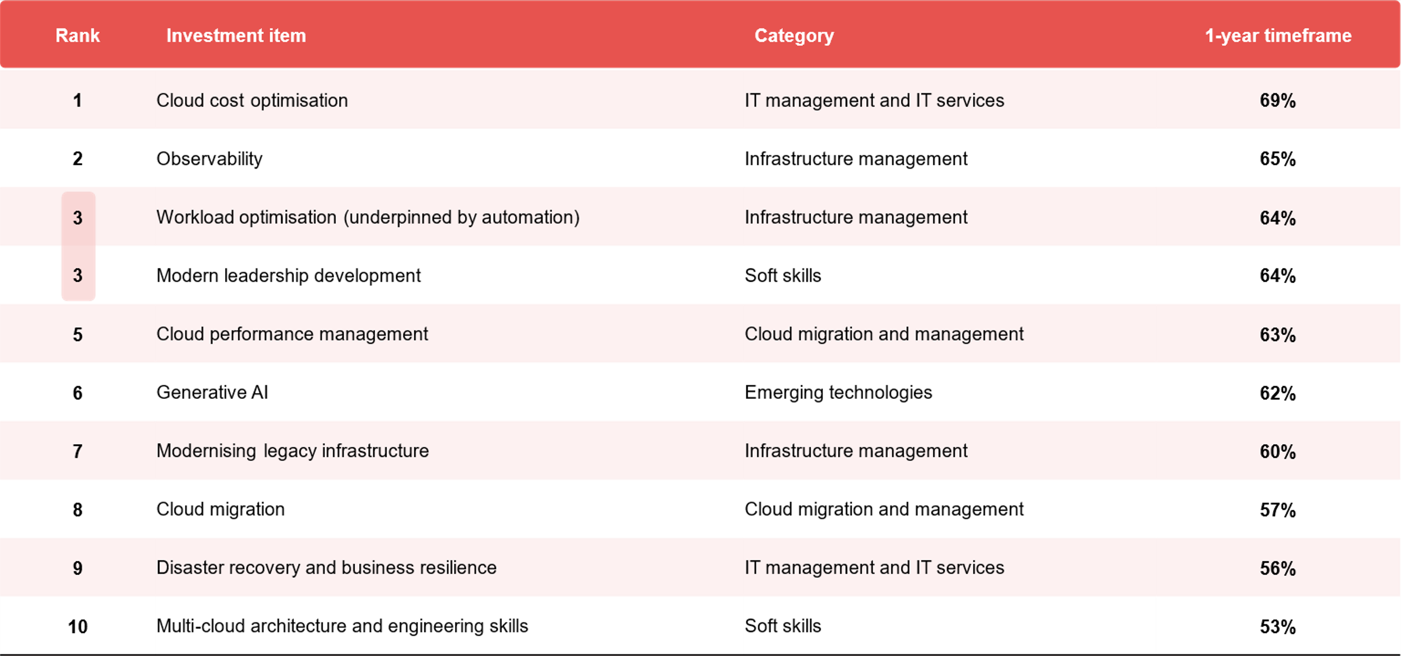
Percentage investing in the next 12 months
ADAPT Cloud and Infrastructure Edge Survey in Jul 2025. Sample size: 121 Australian Infrastructure leaders

Slide 5
CIE investment priorities:
Cloud and infrastructure management

Slide 6
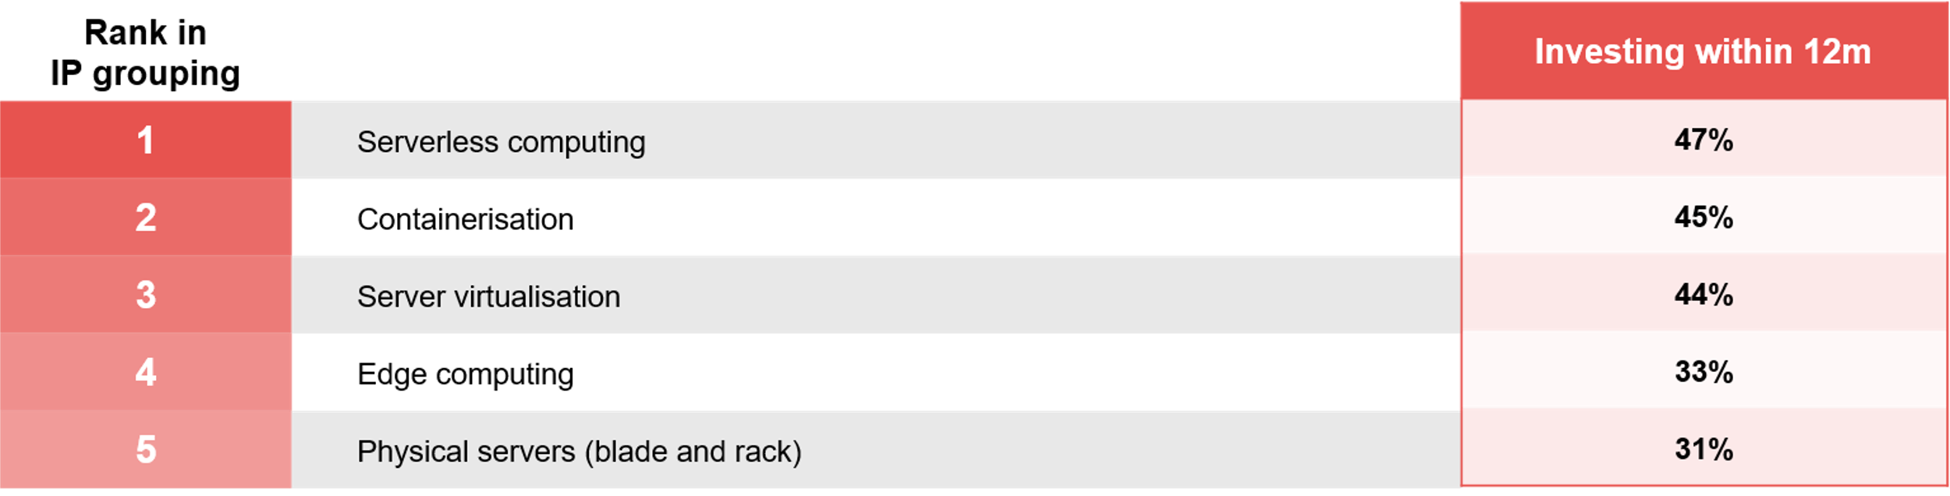
Compute investment priorities (5 items)
ADAPT Cloud and Infrastructure Edge Survey in Jul 2025. Sample size: 121 Australian Infrastructure leaders

Slide 7
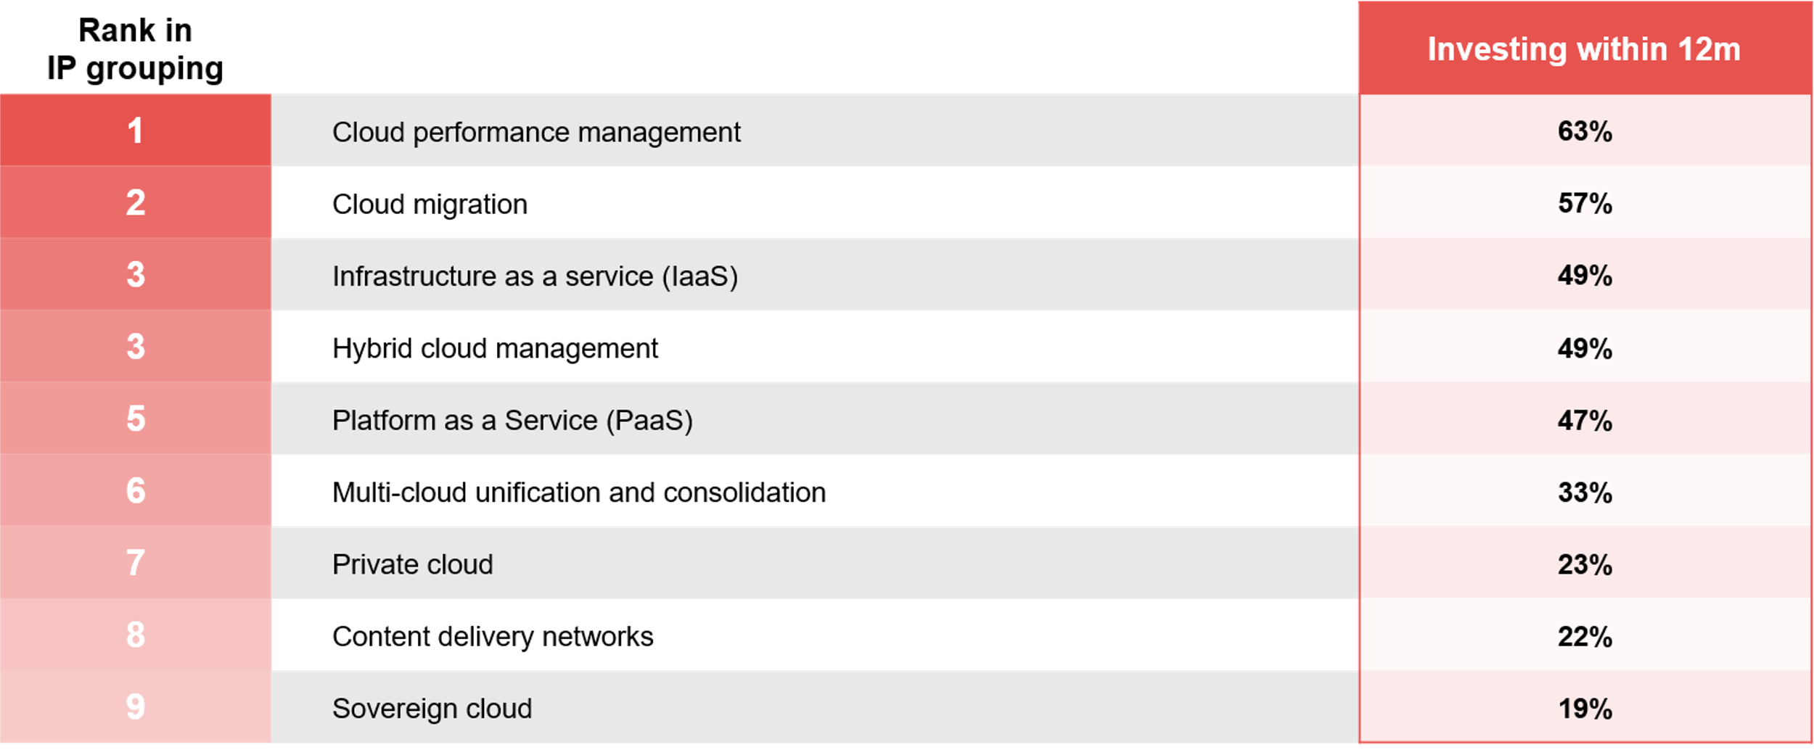
Cloud migration and management investment priorities (9 items)
ADAPT Cloud and Infrastructure Edge Survey in Jul 2025. Sample size: 121 Australian Infrastructure leaders

Slide 8
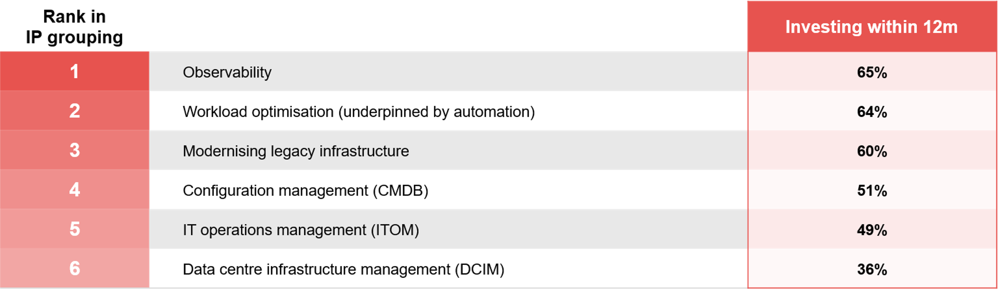
Infrastructure management investment priorities (6 items)
ADAPT Cloud and Infrastructure Edge Survey in Jul 2025. Sample size: 121 Australian Infrastructure leaders

Slide 9
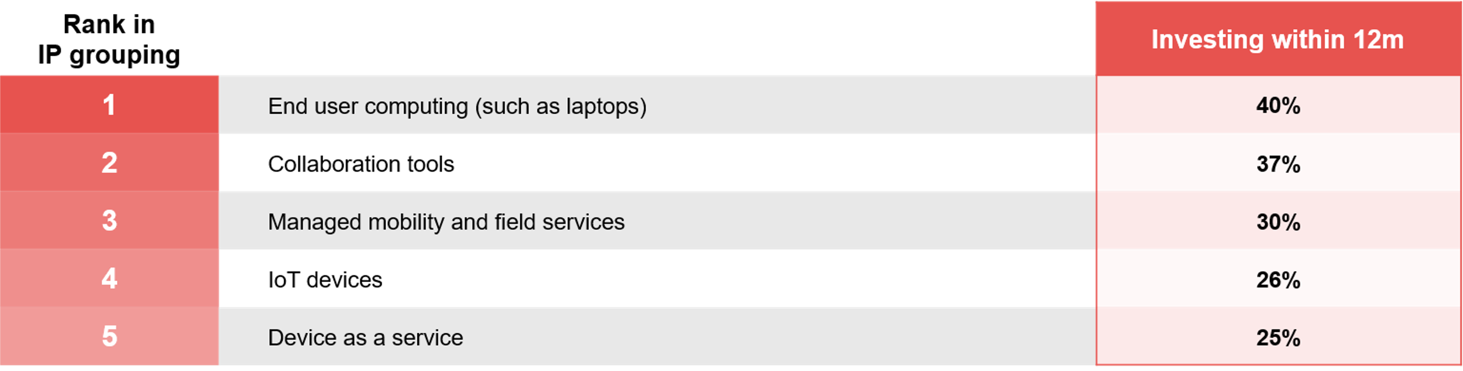
Device management investment priorities (5 items)
ADAPT Cloud and Infrastructure Edge Survey in Jul 2025. Sample size: 121 Australian Infrastructure leaders

Slide 10
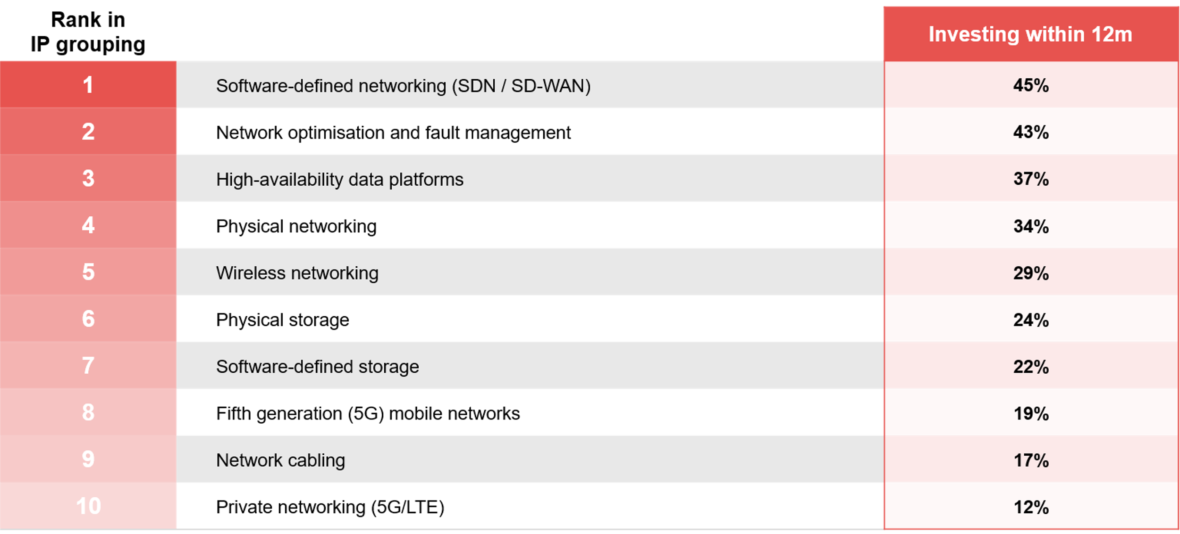
Networking and storage investment priorities (10 items)
ADAPT Cloud and Infrastructure Edge Survey in Jul 2025. Sample size: 121 Australian Infrastructure leaders

Slide 11
CIE investment priorities:
IT & application,
AI and DC management

Slide 12
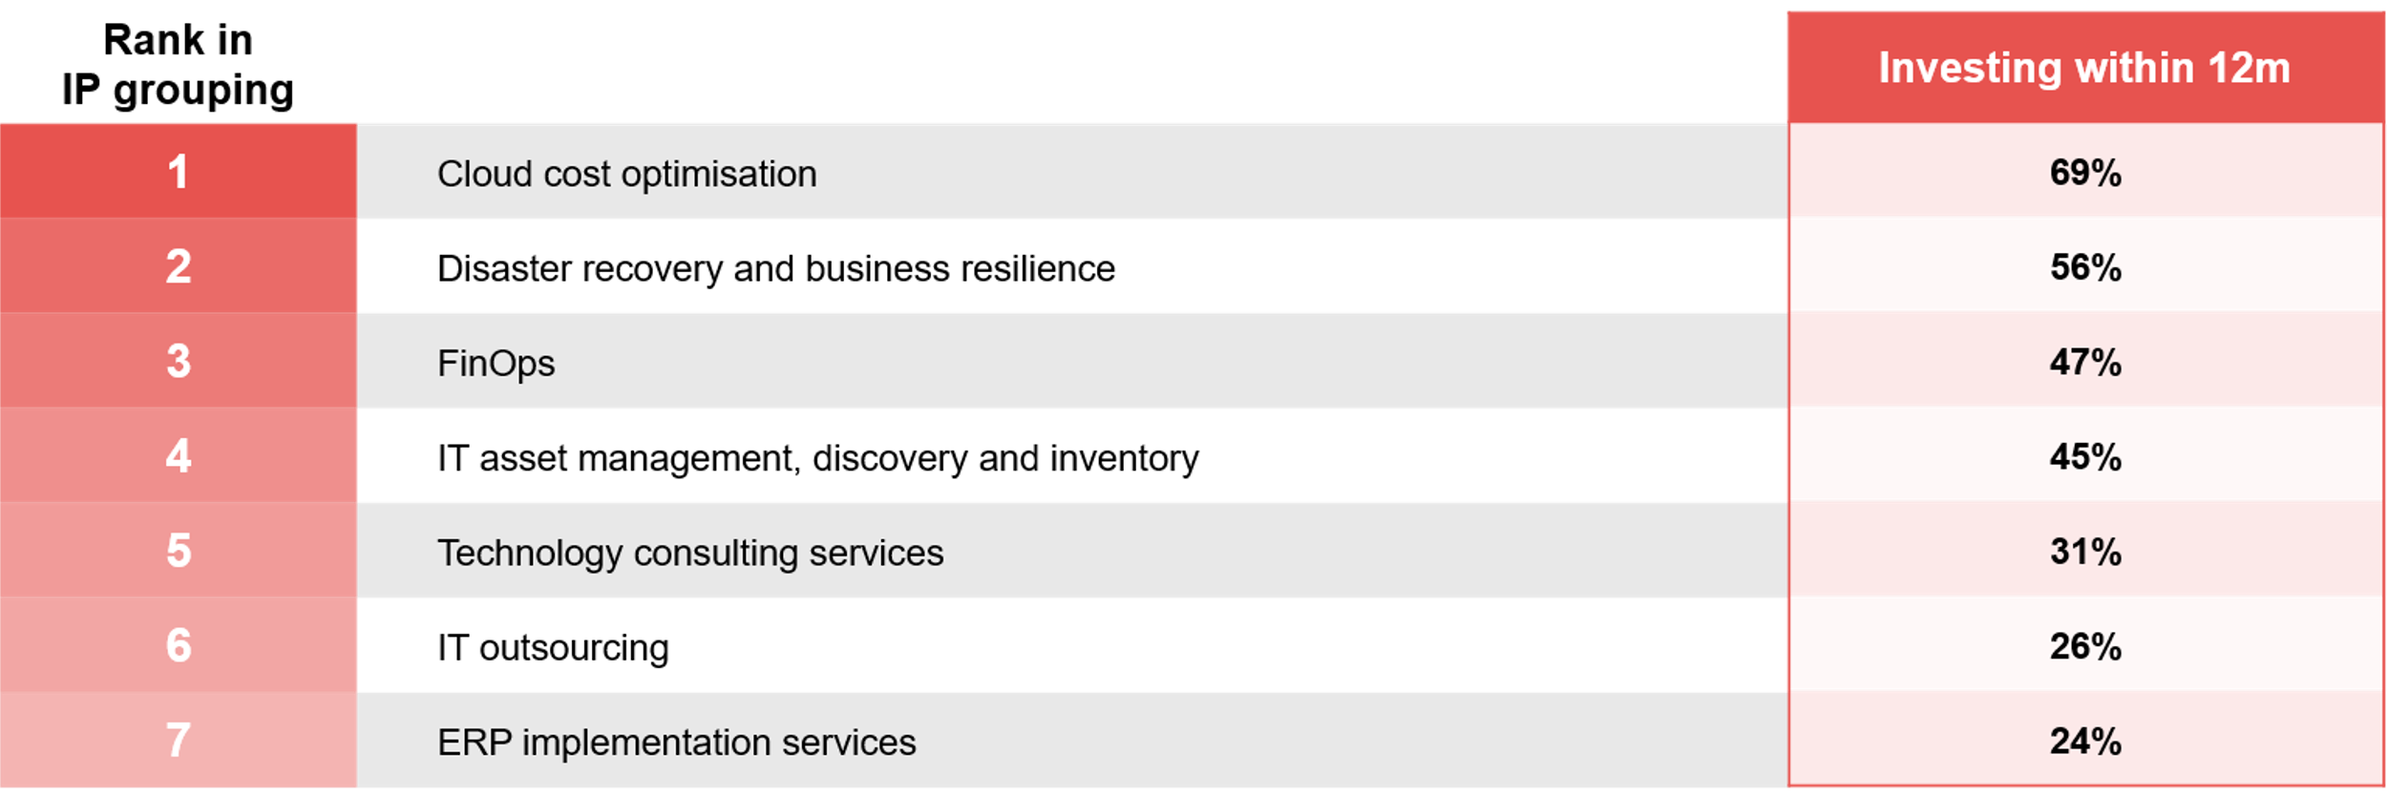
IT management and IT services investment priorities (7 items)
ADAPT Cloud and Infrastructure Edge Survey in Jul 2025. Sample size: 121 Australian Infrastructure leaders

Slide 13
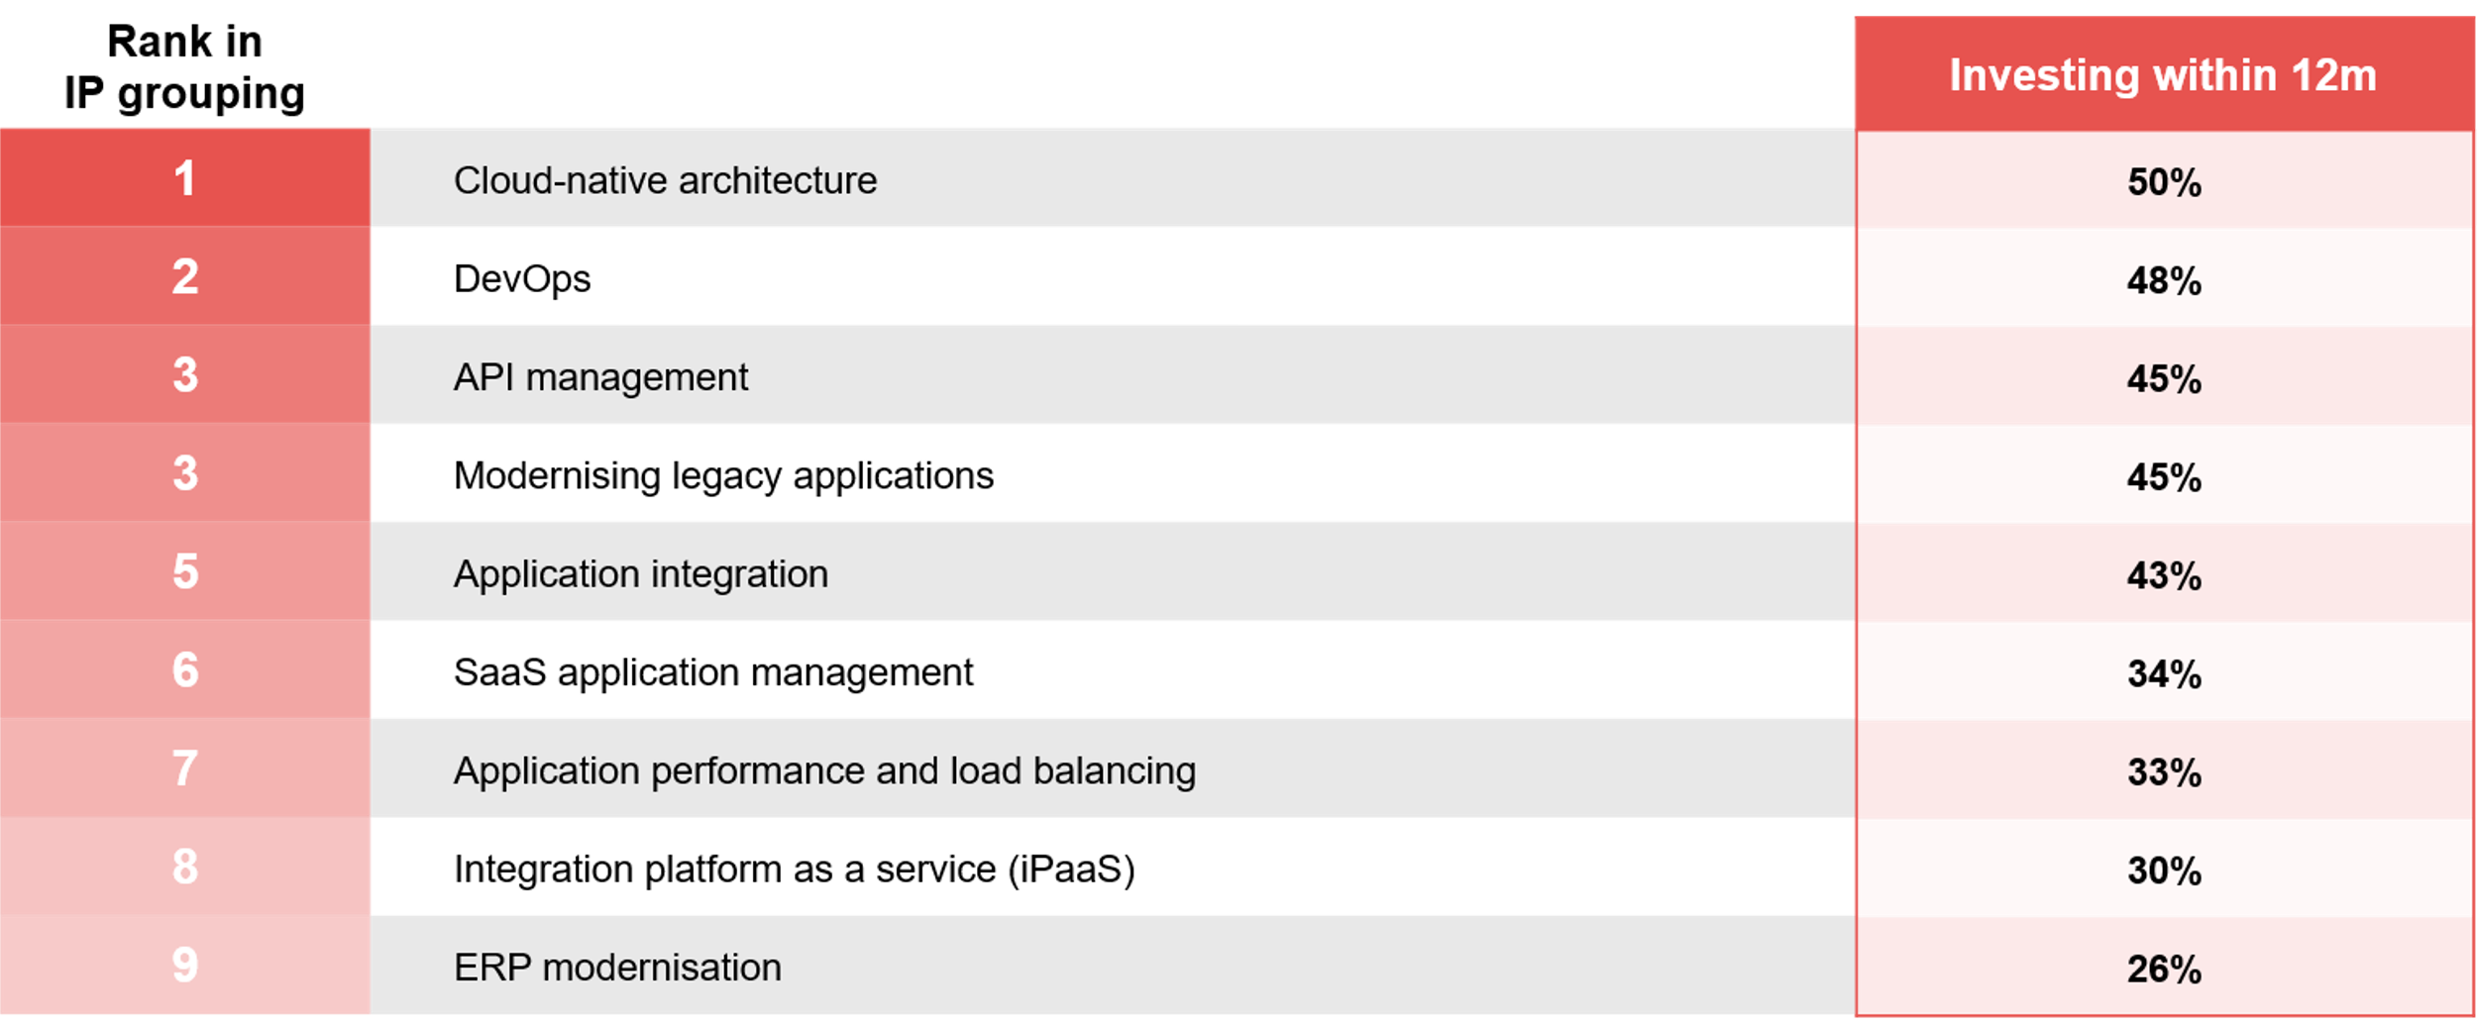
Application management and integration investment priorities (9 items)
ADAPT Cloud and Infrastructure Edge Survey in Jul 2025. Sample size: 121 Australian Infrastructure leaders

Slide 14
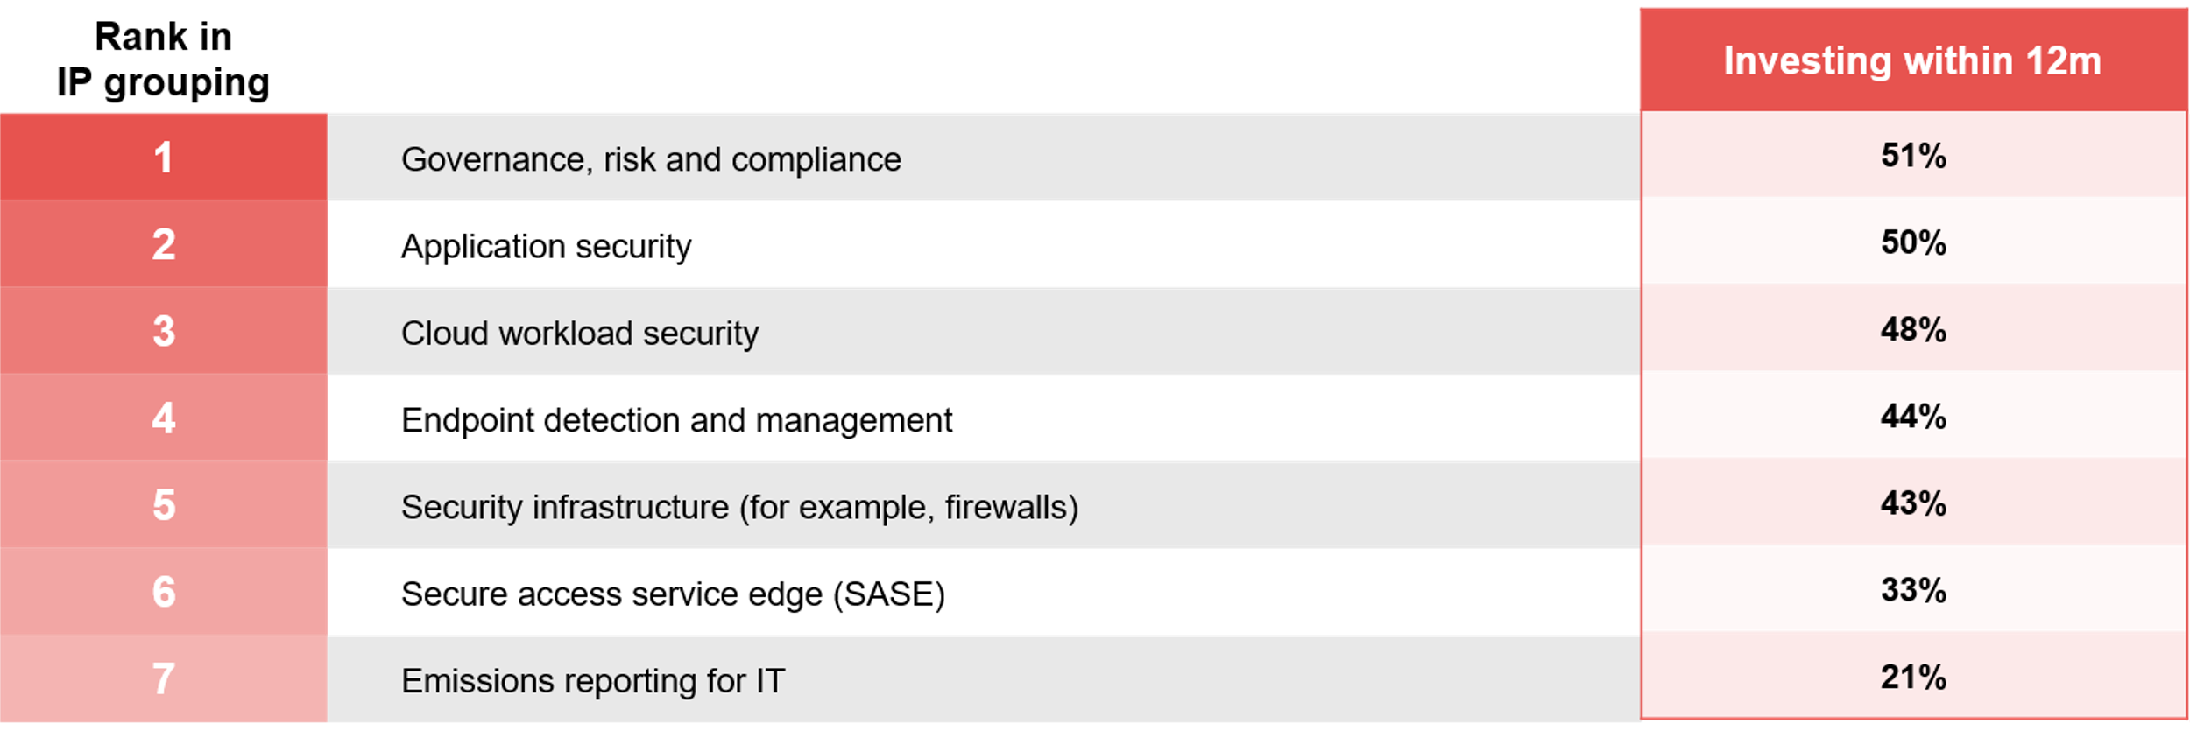
Security and risk management investment priorities (7 items)
ADAPT Cloud and Infrastructure Edge Survey in Jul 2025. Sample size: 121 Australian Infrastructure leaders

Slide 15
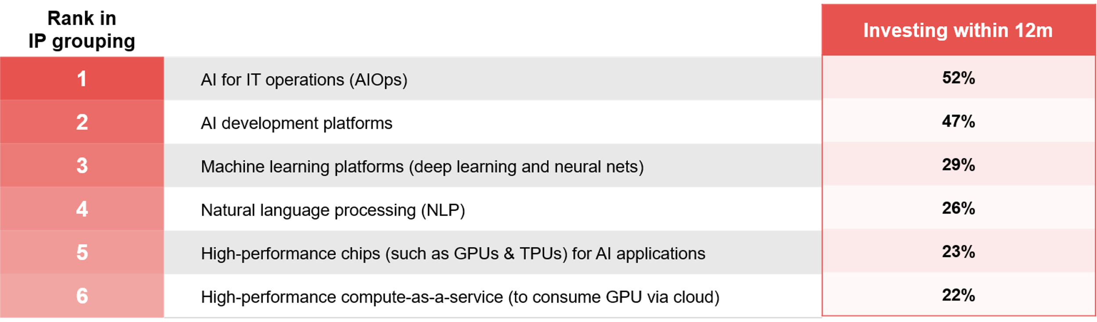
Artificial intelligence investment priorities (6 items)
ADAPT Cloud and Infrastructure Edge Survey in Jul 2025. Sample size: 121 Australian Infrastructure leaders

Slide 16
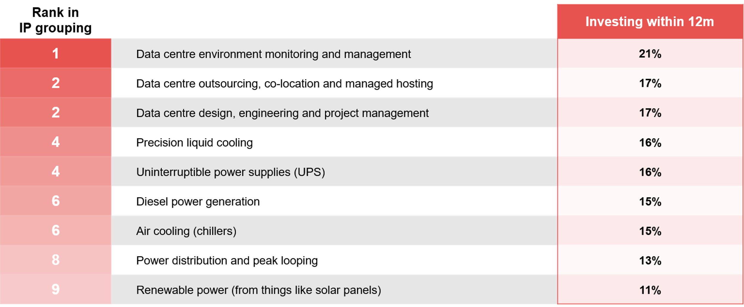
Data centre build, outsourcing and facilities investment priorities (6 items)
ADAPT Cloud and Infrastructure Edge Survey in Jul 2025. Sample size: 121 Australian Infrastructure leaders

Slide 17
CIE investment priorities:
Emerging technologies
and soft skills

Slide 18
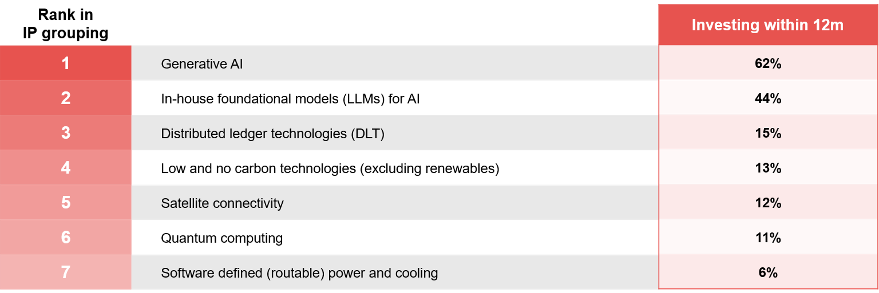
Emerging technologies investment priorities (7 items)
ADAPT Cloud and Infrastructure Edge Survey in Jul 2025. Sample size: 121 Australian Infrastructure leaders

Slide 19
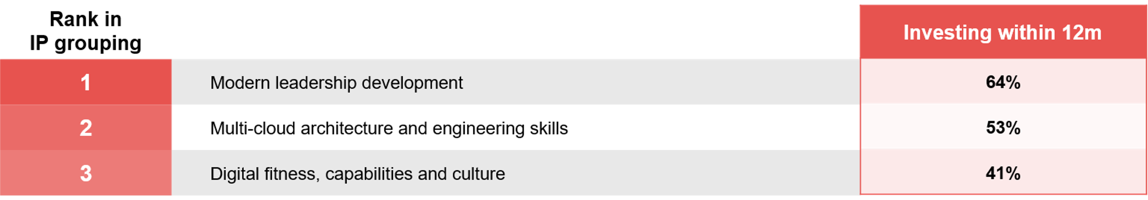
Soft skills investment priorities (3 items)
ADAPT Cloud and Infrastructure Edge Survey in Jul 2025. Sample size: 121 Australian Infrastructure leaders

Slide 20
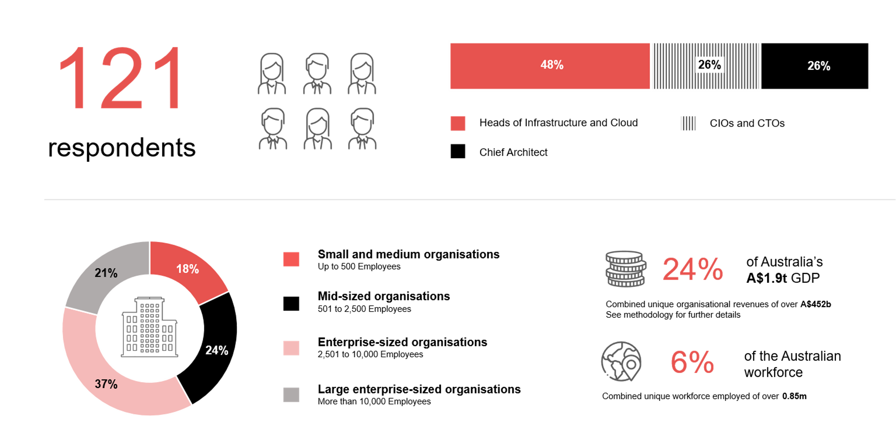
Survey demographics: Australian Infrastructure Leaders in 2024

Slide 21

For sector, segment and persona comparisons
Central limit theorem a fundamental concept in statistics that determines when a sample size is large enough
to be considered reliable. There are different formulas and some debate amongst statisticians about the appropriate sample size. For industry comparisons or other subset analyses, a sample size of ( n > 20 ) is generally considered acceptable for drawing meaningful insights. This threshold aligns with common statistical practices, where a
sample size of 20 to 30 is generally the minimum needed to assume a normal distribution of the data.
Sample sizes below 20, but equal to or greater than 15
When the sample size is between 15 and 20, while not fully representative, it can still offer valuable insights
into trends. These statistics should be viewed as indicative, highlighting general directions in industry efforts
or barriers to investment but treated with some caution due to the smaller number of observations.
Sample sizes less than 15, but greater or equal to 10
For samples between 10 and 15, the data provides a snapshot guideline only. While such small samples can
show early trends, it's important to recognise that this doesn't guarantee future respondents will reflect the same trends. For instance, while 100% of respondents in a sample of 10 might invest in AI, it'd be unrealistic to assume
this pattern will hold as the sample size grows. However, if the sample size increases to 20, it's unlikely
that the trend will change drastically, and the next 10 respondents will have no investment.
ADAPT Data Analytics:
Notes on sample sizes
Why does sample size matter?
Each set of statistics is unique with measures,
distribution, variance and sample size. It is generally accepted in statistics that as sample size increases, analysts make fewer assumptions about the data, resulting in statistics that more accurately represent the truth.
ADAPT endeavours to provide transparency of sample size, whereby we provide a source on data slides with
the number of respondents and the survey where those respondents come from. In data and insights slide decks, ADAPT usually provides some insight on the breakdown
of the demographics at the end of the slide deck.
To protect privacy, ADAPT does not release lists
of individual respondents to surveys.

Slide 22

Written by
Nathan Bustamante
Junior Data Analyst at ADAPT
Nathan is a versatile Data Analyst at ADAPT, skilled in data gathering, processing, and visualization across multiple platforms.
He excels in transforming raw data into insights, with proficiency in SQL, dashboard creation, and automated data collection.
Nathan’s diverse experience spans e-commerce and engineering, allowing him to bring a unique perspective to data analysis.
His ability to distill data into clear, impactful reports plays a crucial role in ADAPT’s commitment to delivering innovative,
data-driven solutions for businesses.

Slide 23

About ADAPT
ADAPT is a specialist Research & Advisory firm providing local market insights and benchmarking data
to Australia and New Zealand’s senior technology and business community.
Since 2011, we’ve been empowering the leaders of the region’s top enterprise and government organisations
to stay at the forefront of modern trends and build for the future. Our industry leading conferences, private roundtable events and custom research projects equip business leaders with the knowledge, relationships, inspiration and tools they need to make better strategic decisions.
adapt.com.au | hello@adapt.com.au
Data Validation
Results contained in this report (Report) are based on survey responses as provided by our clients and publicly available information. ADAPT does not subject the data contained in the Report to audit or review procedures or any other testing to validate the accuracy or reasonableness of the data provided by the participating clients. While we do not manipulate the survey responses, we do make an effort to identify outlier data or conflicting results that could lead to misinterpretations before the preparation of the Report.
Intended Use of the Report
The Report is designed to help technology executives in Australia and New Zealand make independent decisions regarding financial, resourcing and operational performance matters. The information and data contained in the Report are provided as is and are for information purposes only. They are not intended or implied to be recommendations and in no event will ADAPT be liable for any decisions or actions taken in reliance of the results obtained through the use of the information and/or data contained in the Report.
Research MSA and Privacy Policy
The Report and any other information provided by ADAPT is subject to the Research and Advisory Master Services Agreement and the ADAPT Privacy Policy.

Slide 24




Additional resources you can access
Members of ADAPT’s Research & Advisory platform have access to an entire suite of market leading content, insights and resources to help you execute in your role. For any assistance contact your Account Manager in the help section.
Community Case Studies & Interviews
Case studies detailing the successes
and challenges of projects and initiatives.
Market Trend Reports Access a library of fact-based actionable insights, deep dives on ANZ business & IT trends.
Live Access to ADAPT Analysts
Through live ADAPT analyst market briefings and Q&A sessions
Downloadable Data & Insights
Elevate your business cases with downloadable market and industry data.
Industry Expert Presentations
Watch keynotes or read distilled 1-page executive summaries from our Edge Events.
Bespoke Analysis of ADAPT Data
Receive custom cuts and analysis of ADAPT proprietary data.
Premier Executive Community
Unlock access to our exclusive network of Australia’s leading technology and business executives.
Dedicated Account Manager & Impact Assessments
Your Account Manager will ensure you and your team are getting the most out of your subscription.
Dedicated Analyst Briefing
Leverage a dedicated briefing with an ADAPT analyst to help validate your strategies.
*Inclusions may vary depending on subscription level.

Slide 25

adapt.com.au | hello@adapt.com.au | +61 (2) 9435 3535

