Slide 1

ADAPT Persona Map
What Role Can CDOs Play
in Enabling Growth

Slide 2
In this report, you’ll find insights into how Australian CDOs drive digitisation and automation initiatives
to acquire more customers and increase revenues.
The key areas of focus are:
Growing the business as the #1 priority
CDOs view this goal as a primary way to demonstrate value from their digital transformation investments and initiatives.
To deliver this outcome effectively, customer acquisition and retention is crucial.
Improving experiences by modernising and increasing data maturity
To improve experiences at an optimised cost, CDOs ensure they prioritise improving operational effectiveness through digital transformation, tech modernisation and AI adoption.
The top 10 initiatives also focus on helping achieve these goals successfully.
Delivering improved value and revenue outcomes
Value is largely generated through improved internal efficiencies and experiences.
However, most revenue continues to come from traditional (non-digital) channels, as the pace of digitisation slows.
Despite progress in modernisation, organisations risk missing out on new revenue opportunities if digital momentum declines.
Barriers to execution and challenges to delivering CX strategies
Funding/resource issues can be less about budget size and more about flexibility in meeting digital demands. When it comes to improving CX, CDOs struggle with broken omnichannel experience, personalisation, and non-tech operations (such as being too slow to adapt and clunky processes).
Persona Mapping: CDO
Key takeaways
The primary goal of Australian CDOs is to enable business and customer growth.
Their #1 initiative focuses on improving the omnichannel experiences, while the top investment priorities are data governance and chatbots & conversational AI.
Overall process digitisation has dropped by 4%, from 50% in 2024 to 46% in 2025, while progress in modernisation areas has increased.
API connectivity has gone up from 49% in 2024 to 52% in 2025. Customer orders captured and delivered digitally have risen by 11% and 13%.
Some organisations report they do not need a budget increase to execute digitisation and automation initiatives, despite insufficient funding being their #1 barrier to succeeding with these programs.

Slide 3

Goals, initiatives and investment priorities

Slide 4
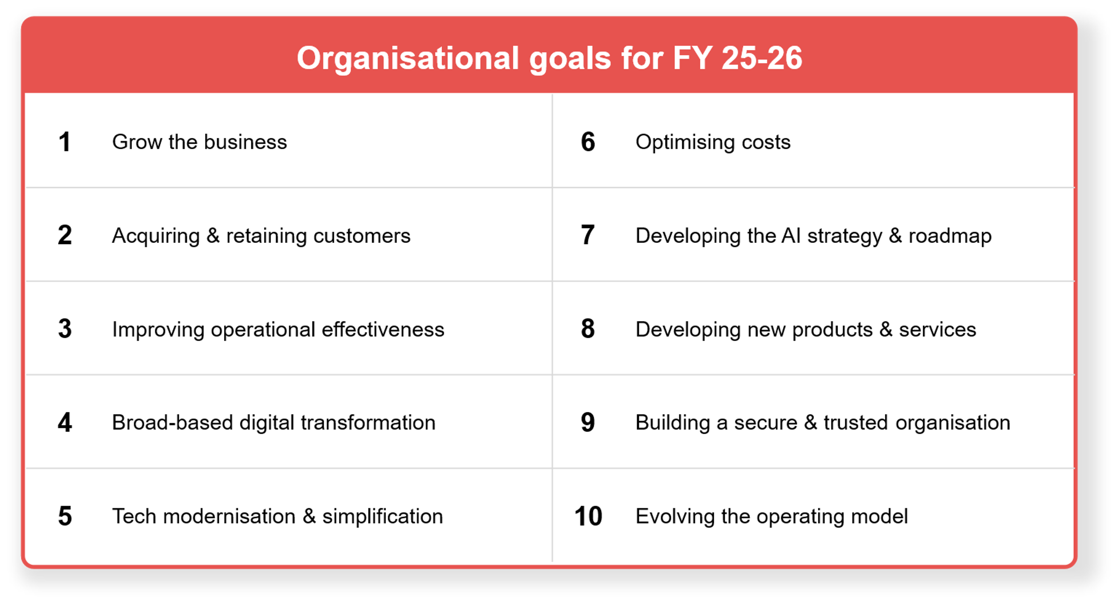
Digital and CX leaders’ organisational goals (June 2025)
Source : ADAPT Digital Edge Survey in June 2025. Sample size : 126 Australian CDOs

Slide 5
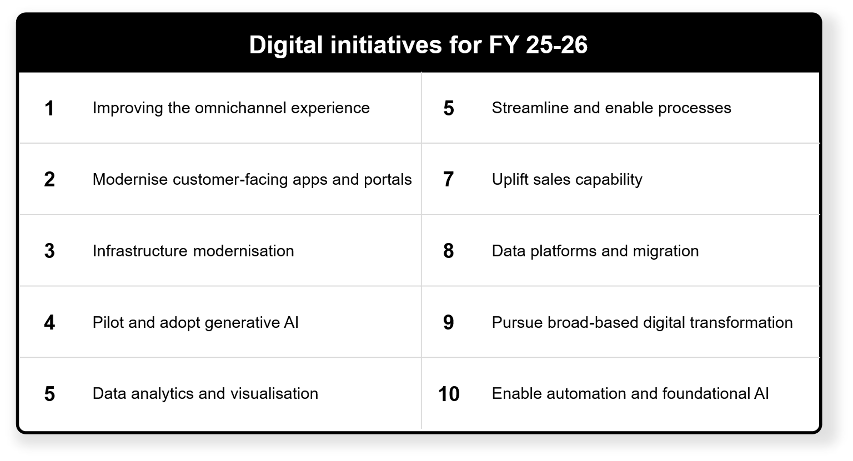
Digital initiatives according to Digital/CX leaders (June 2025)
Source : ADAPT Digital Edge Survey in June 2025. Sample size : 124 Australian CDOs

Slide 6
Creating more revenues
Australian CDOs are expected to maintain core operations while also driving revenue-growth initiatives.
Acquiring and retaining customers is crucial for increasing revenue potential. Customer attraction helps expand market reach, while retention maximises customer value. To deliver these outcomes effectively, CDOs aim to improve omnichannel experiences, modernise customer-facing apps, and uplift sales capability.
Driving digital and operational excellence
As CDOs are more focused on internal efficiencies, CX and EX from their digitisation and automation initiatives (see slide 11), they strive to improve operational effectiveness by transforming digitally, modernising tech and adopting AI at optimised costs.
They also increase priority in innovation that aligns with customer needs, behaviours and feedback.
Modernising infrastructure and data foundations
CDOs intend to implement these digital initiatives to accelerate AI, automation and digital transformation.
These initiatives can help ensure better outcomes for digital and operational excellence, as many organisations struggle to address broken omnichannel experiences, personalisation, clunky processes and a slow rate of adaptation to customer experience initiatives (see slide 17).
Evolving operational model with AI readiness and trust
To ensure success in maximising business and customer growth, CDOs also aim to be more
effective in building the foundation for AI adoption, security and operating model changes.
An evolving operational model is essential for AI to scale. To realise this, it is important to
integrate AI strategies with robust trust and security measures.
Persona Mapping: CDO
Enabling business and customer growth
The #1 goal of Australian CDOs is to enable business growth. Their #2 goal is customer acquisition and retention.
The top two initiatives are highly focused on customer-centric initiatives.
Achieving digital and operational excellence stems from the need to enable experiences.
Modernising infrastructure and maturing data foundations are crucial to accelerating AI, automation and transformation initiatives.
Enabling business and customer growth also requires a strong foundation for AI, security and operating model changes.

Slide 7
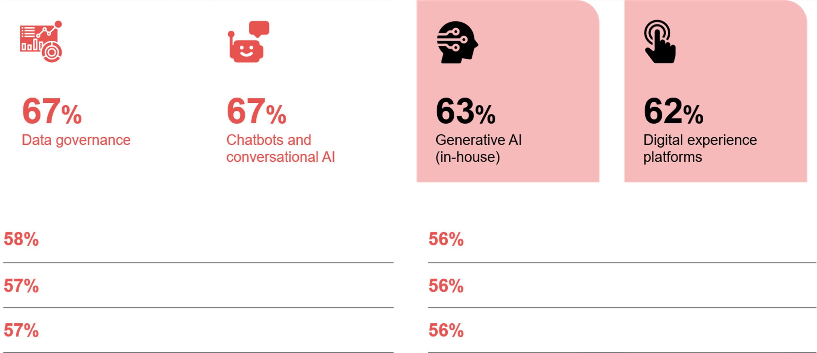
Digital and CX leaders' investment priorities in the next 12 months
Source : ADAPT Digital Edge Survey in June 2025. Sample size : 127 Australian CDOs

Slide 8
Prioritising governance to enable customer growth
This aligns with the need to leverage accurate insights from customer needs, behaviours and feedback.
ADAPT's Digital Edge Survey (Jun 2025) found that organisations with an AI ethics committee or monitoring systems in their governance are 3.3x more likely to use customer feedback in their digital product strategies and roadmaps than those who have no governance over AI or have human intervention.
Investing in customer-centric areas
With a greater need to elevate customer experience (#2 goal and #1 initiative), CDOs want to invest in AI
and digital experiences. These include chatbots, gen AI, agentic AI, digital experience platforms, customer engagement platforms and personalisation. CDOs also view these IPs as enablers of business growth by scaling customer service and support, which accelerates operations and delivers more value.
Improving operational efficiency and productivity
This includes process digitisation, journey mapping and collaboration and productivity tools.
ADAPT's Digital Edge Survey (Jun 2025) found that organisations that are effectively using data to improve CX and manage cross-functional collaboration have digitised their processes 1.6x faster than those that don't.
Further ADAPT resources that can frame valuable change
ADAPT Community Interview (Sep 2024): To succeed in transformation, it is crucial to align leadership with governance and prioritise foundational transformation before improving customer-facing experiences.
ADAPT Community Interview (Apr 2025): Streamlining security while leveraging AI tools is essential for internal productivity gains, automating operations and detecting customer feedback in real-time.
Persona Mapping: CDO
Investment priorities
The #1 investment priority (IP)
of Australian CDOs is data governance.
Six of the top 10 IPs are heavily focused
on improving customer experiences.
The remaining IPs are essential for improved efficiency and productivity.

Slide 9
Value, outcomes
and revenues

Slide 10
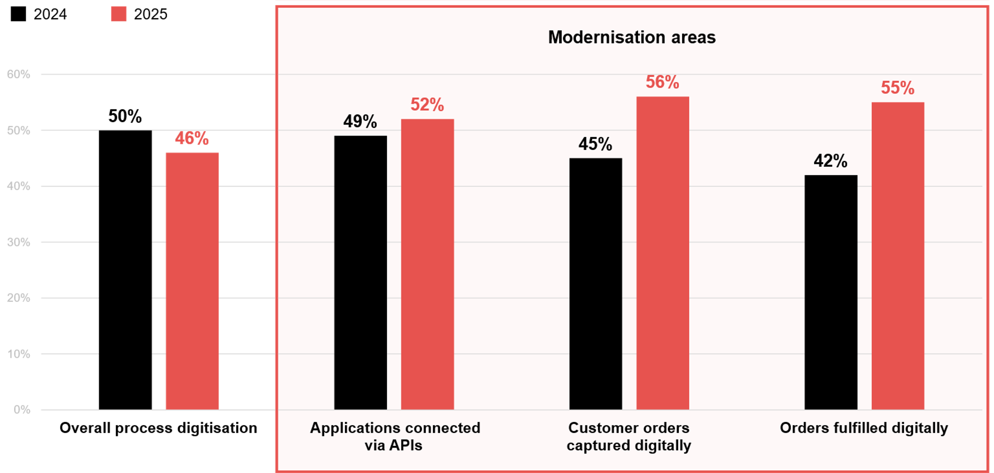
Overall process digitisation and progress in modernisation: 2024 vs 2025
Source : ADAPT Digital Edge Surveys in October 2024 and June 2025. Sample size : 167 Australian CDOs

Slide 11
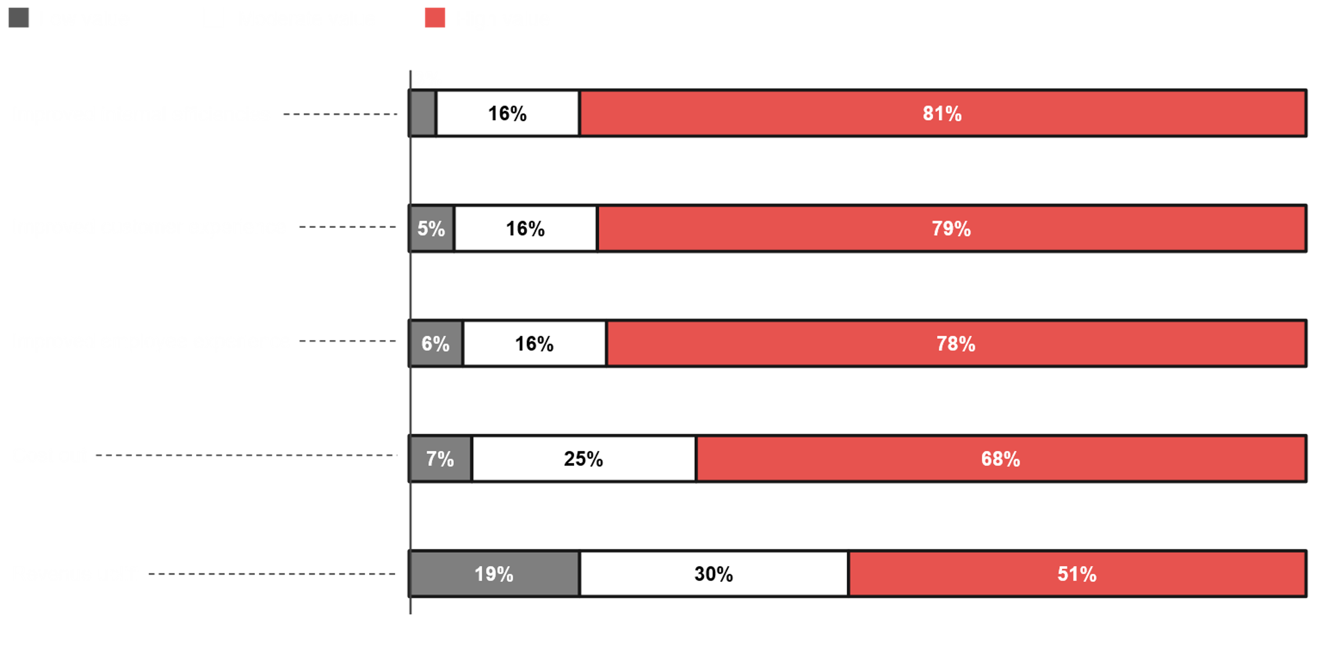
What value do you expect to achieve from digitisation and automation initiatives?
Source : ADAPT Digital Edge Survey in June 2025. Sample size : 121 Australian CDOs

Slide 12
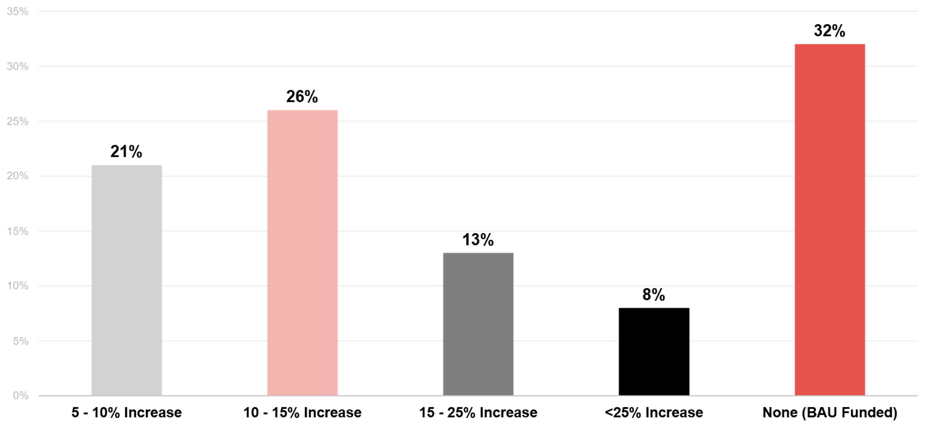
Annual budget increase required to execute digitisation and automation initiatives
Source : ADAPT Digital Edge Survey in June 2025. Sample size : 104 Australian CDOs

Slide 13
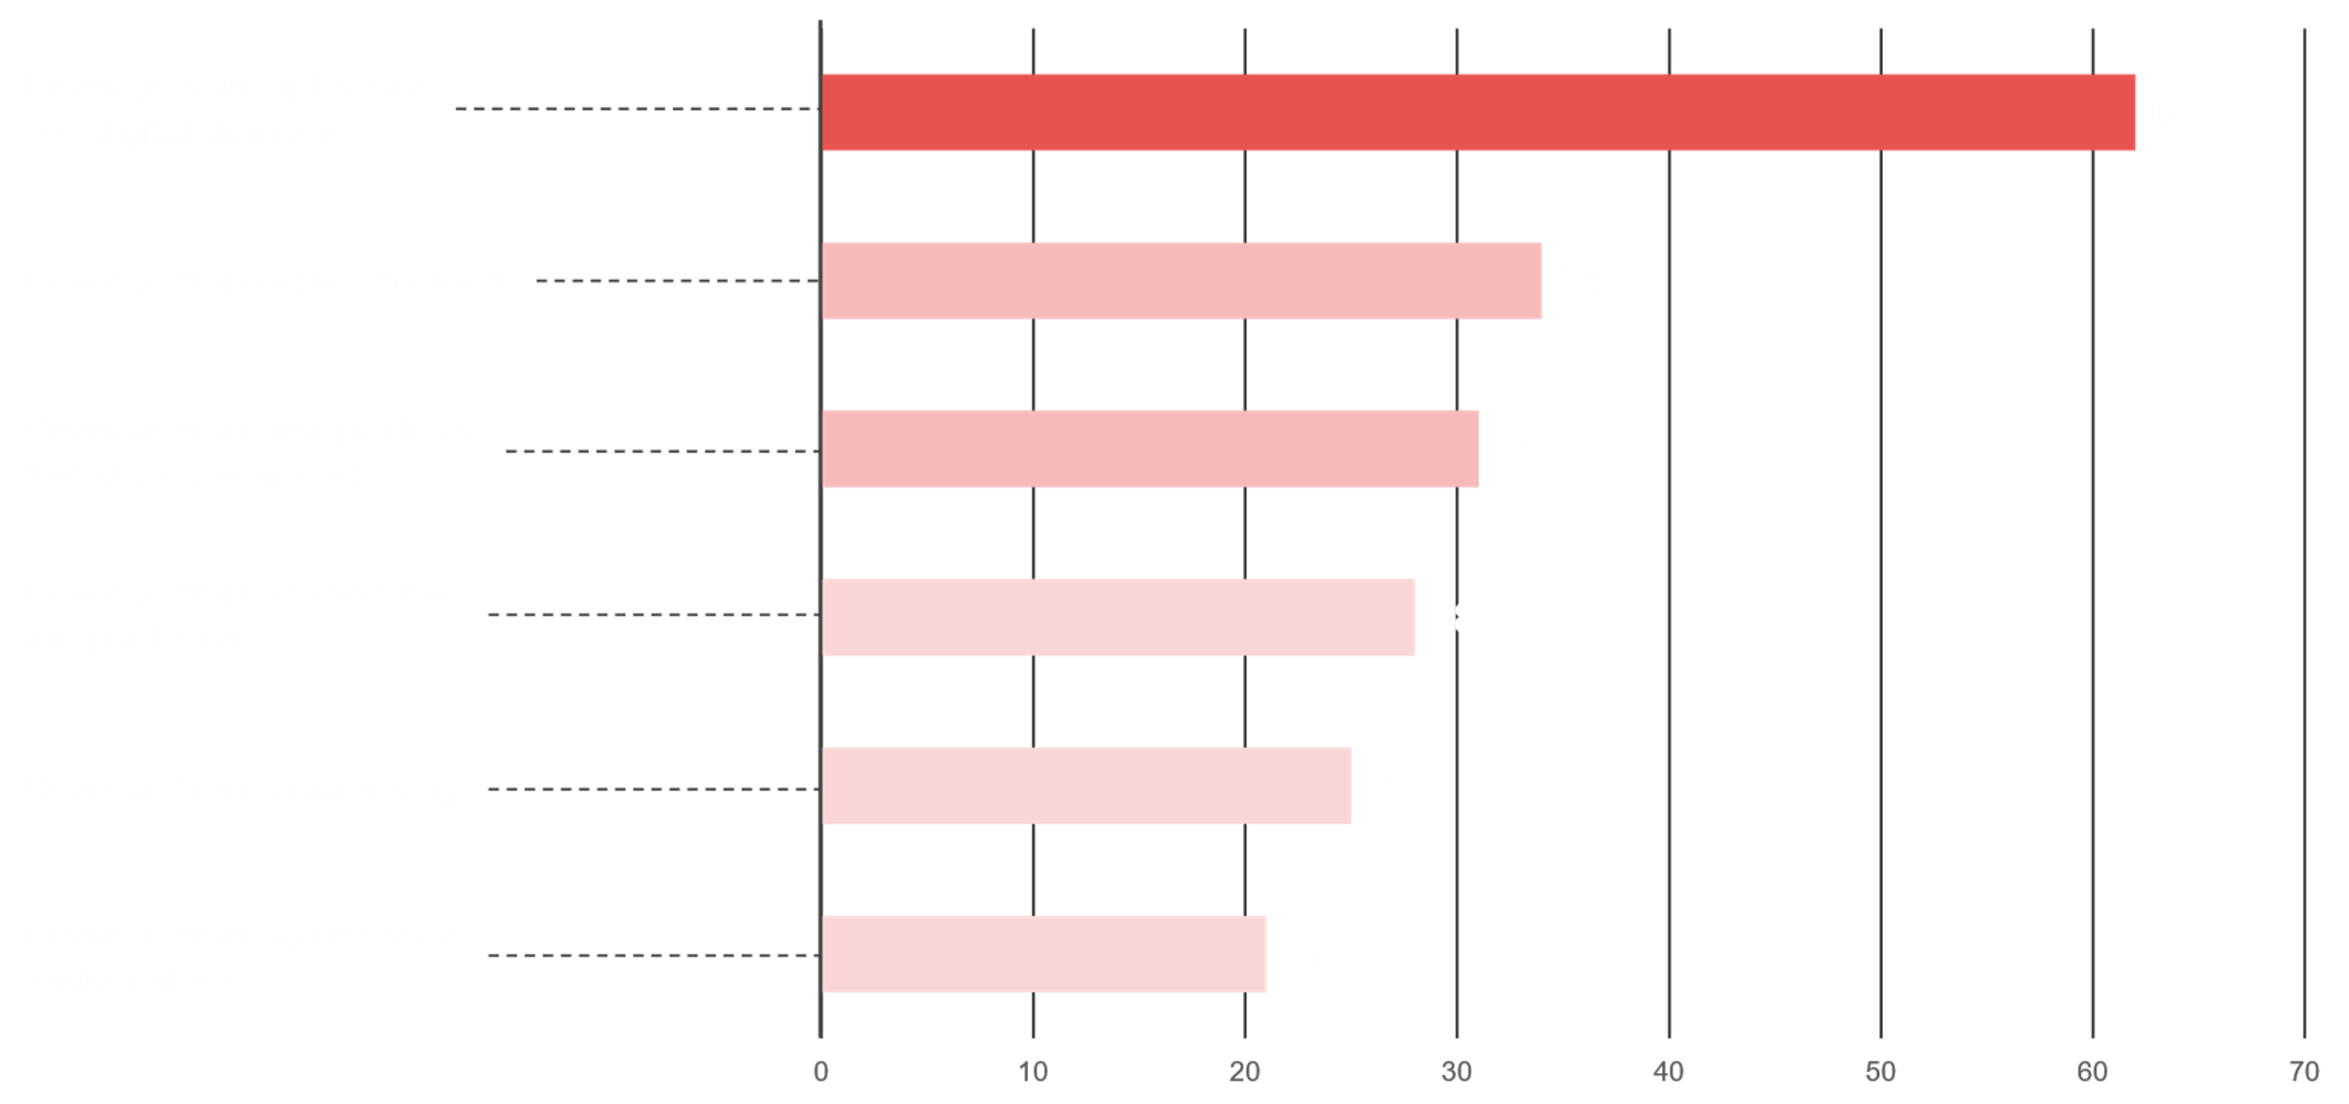
Average percentage of organisations’ revenues captured in the last 12 months
Source : ADAPT Digital Edge Survey in June 2025. Sample size : 66 Australian CDOs

Slide 14
Modernisation surges as digitisation drops
Even though digital transformation is ranked as a greater priority than tech modernisation, organisations have demonstrated a decrease in digitisation, while modernisation progress has increased.
The impact of this divergence can create friction in achieving business and customer growth. Competing priorities (#2 barrier) is also a hindrance in ensuring greater alignment between
digitising and modernising.
Deriving the most value from efficiencies and experiences
While cost out and revenue uplift are important, CDOs prioritise generating more value from internal efficiencies, CX and EX. Achieving these three values is crucial for driving customer growth (#2 goal) and improving operational effectiveness (#3 goal). More value from improved customer experience (CX) stems from organisations that have successfully integrated customer feedback into their digital product strategies and roadmaps.
Transforming digitally is blocked by perceived funding shortfalls
Despite the lack of funding or resources (#1 barrier), 32% of organisations say they do not need an additional budget for executing digitisation and automation initiatives. This apparent contradiction emphasises deeper challenges in how digital initiatives are prioritised and scaled across organisations.
Traditional channel revenue dominates, while digital channels and innovation lags behind
This reflects the decrease in digitisation. Traditional channels become the primary source of revenues.
Despite modernising, digital channels may fail to realise full revenue benefits when customer support and services digitisation is low. Additionally, as digitisation decreases, organisations may find it challenging to generate revenue from other sources such as innovation, ecosystems,
cross-selling and outside traditional sector.
Persona Mapping: CDO
Value, outcomes and revenues
Process digitisation across organisations has fallen from 50% in 2024 to 46% in 2025. API connectivity has increased by 3%, and other areas of modernisation have increased by at least 10% since 2024.
About 81% of Australian organisations expect to achieve high value from improved internal efficiencies after implementing digitisation and automation initiatives.
68% of organisations aim to increase their annual budget for digital initiatives.
On average, most revenues are captured from traditional channels.

Slide 15
Execution barriers
and CX challenges

Slide 16
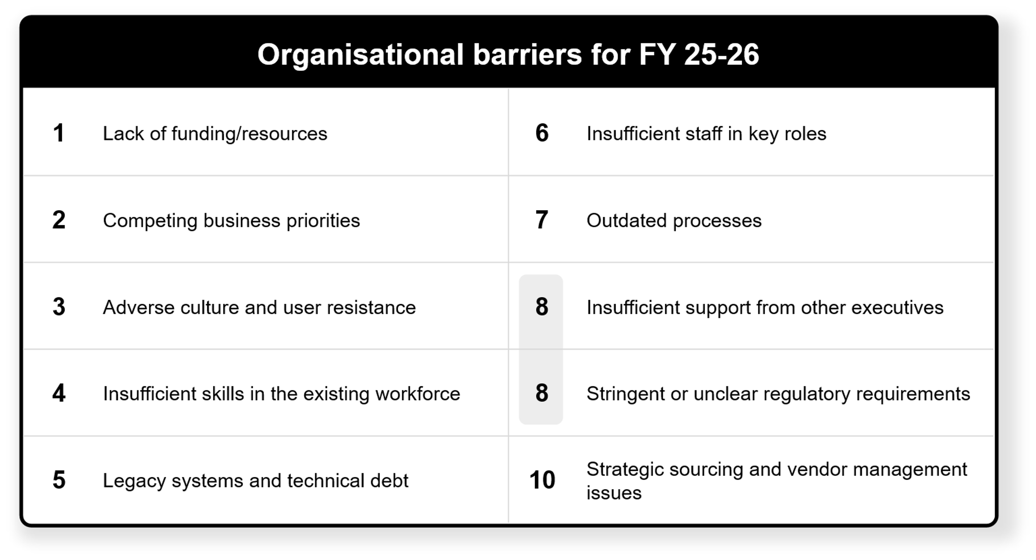
Organisational barriers according to Digital/CX leaders (June 2025)
Source : ADAPT Digital Edge Survey in June 2025. Sample size : 123 Australian CDOs

Slide 17
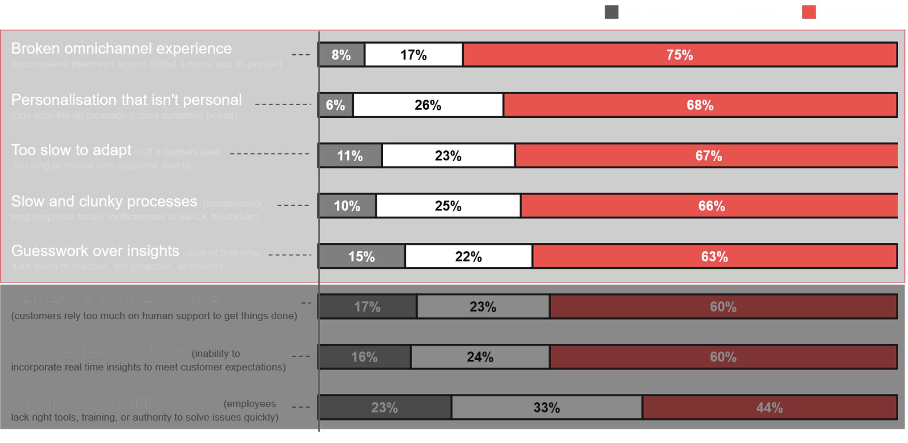
Major challenges in customer experience strategy
Source : ADAPT Digital Edge Survey in June 2025. Sample size : 114 Australian CDOs

Slide 18
Funding constraints, competing priorities and insufficient support
Insufficient funding or resources remain a critical barrier for CDOs in implementing digital initiatives despite some organisations saying they do not need a budget increase. The lack of unified executive support also leads to competing priorities, which causes divergence in digitisation and modernisation. Hence, aligning leadership and governance is crucial ensure transformation efforts are aligned with digital initiatives.
People, skills and cultural challenges
With talent attraction and retention no longer a top priority for CDOs, many are struggling to secure the skills and staff needed to deliver digital initiatives. Another challenge is adverse culture and resistance.
An ADAPT Community Interview (Nov 2024) emphasises the need to adopt a product mindset to foster
an entrepreneurial mindset, which empowers teams to continuously improve and adapt to change.
Technology, process and compliance limitations
The presence of legacy systems and outdated processes leads CDOs to increase priorities for digital transformation and modernisation. To enable these changes, integrating clear governance models is vital.
Also, many organisations struggle with complex vendor ecosystems. An ADAPT Community Interview
(Apr 2025) discusses how MetLife ensures cautious AI adoption with stronger vendor oversight.
Challenges in delivering CX strategies
Addressing fragmented omnichannel experiences has become the number one initiative for CDOs.
Other top challenge areas also demand significant digital focus, particularly around enhancing customer experiences.
Further information on how to elevate CX by navigating the five stages of AI maturity is explained in an ADAPT Expert Presentation (Nov 2024).
Persona Mapping: CDO
Execution barriers and CX challenges
Similar to other personas, the #1 execution barrier of Australian CDOs is the lack of funding or resources.
The pursuit of business growth is also significantly impeded by shortcomings in talent, skills, and organisational culture.
Strong and clear governance is essential to address limitations in tech and processes.
To truly excel in delivering exceptional CX strategies, organisations need to prioritise and strengthen customer-centric initiatives.

Slide 19
Survey demographics

Slide 20
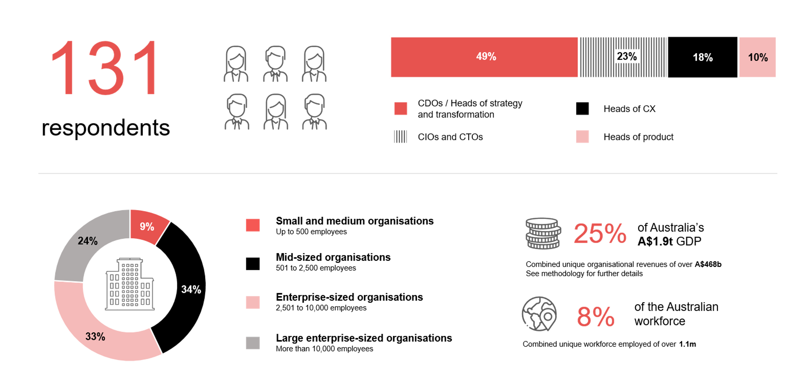
Survey demographics: Australian CDOs in 2025

Slide 21

For sector, segment and persona comparisons
Central limit theorem a fundamental concept in statistics that determines when a sample size is large enough
to be considered reliable. There are different formulas and some debate amongst statisticians about the appropriate sample size. For industry comparisons or other subset analyses, a sample size of ( n > 20 ) is generally considered acceptable for drawing meaningful insights. This threshold aligns with common statistical practices, where a
sample size of 20 to 30 is generally the minimum needed to assume a normal distribution of the data.
Sample sizes below 20, but equal to or greater than 15
When the sample size is between 15 and 20, while not fully representative, it can still offer valuable insights
into trends. These statistics should be viewed as indicative, highlighting general directions in industry efforts
or barriers to investment but treated with some caution due to the smaller number of observations.
Sample sizes less than 15, but greater or equal to 10
For samples between 10 and 15, the data provides a snapshot guideline only. While such small samples can
show early trends, it's important to recognise that this doesn't guarantee future respondents will reflect the same trends. For instance, while 100% of respondents in a sample of 10 might invest in AI, it'd be unrealistic to assume this pattern will hold as the sample size grows. However, if the sample size increases to 20, it's unlikely
that the trend will change drastically, and the next 10 respondents will have no investment.
ADAPT Data Analytics:
Notes on sample sizes
Why does sample size matter?
Each set of statistics is unique with measures,
distribution, variance and sample size. It is generally accepted in statistics that as sample size increases, analysts make fewer assumptions about the data, resulting in statistics that more accurately represent the truth.
ADAPT endeavours to provide transparency of sample size, whereby we provide a source on data slides with
the number of respondents and the survey where those respondents come from. In data and insights slide decks, ADAPT usually provides some insight on the breakdown
of the demographics at the end of the slide deck.
To protect privacy, ADAPT does not release lists
of individual respondents to surveys.

Slide 22

Written by
Honey Mari Gay
Junior Data Analyst at ADAPT
As a Junior Data Analyst at ADAPT, Mari enables the discovery and definition of market trends through visually meaningful statistics.
She ensures data presentations are accurate and aligned with modern statistical standards.
Mari is passionate about data and transforming it into actionable insights. With over three years of experience in project management and academic research, she has led end-to-end survey and research projects, processed and analysed data using a range of statistical tools
and techniques, and provided clients with statistical consultation and insights.

Slide 23

About ADAPT
ADAPT is a specialist Research & Advisory firm providing local market insights and benchmarking data
to Australia and New Zealand’s senior technology and business community.
Since 2011, we’ve been empowering the leaders of the region’s top enterprise and government organisations
to stay at the forefront of modern trends and build for the future. Our industry leading conferences, private roundtable events and custom research projects equip business leaders with the knowledge, relationships, inspiration and tools they need to make better strategic decisions.
adapt.com.au | hello@adapt.com.au
Data Validation
Results contained in this report (Report) are based on survey responses as provided by our clients and publicly available information. ADAPT does not subject the data contained in the Report to audit or review procedures or any other testing to validate the accuracy or reasonableness of the data provided by the participating clients. While we do not manipulate the survey responses, we do make an effort to identify outlier data or conflicting results that could lead to misinterpretations before the preparation of the Report.
Intended Use of the Report
The Report is designed to help technology executives in Australia and New Zealand make independent decisions regarding financial, resourcing and operational performance matters. The information and data contained in the Report are provided as is and are for information purposes only. They are not intended or implied to be recommendations and in no event will ADAPT be liable for any decisions or actions taken in reliance of the results obtained through the use of the information and/or data contained in the Report.
Research MSA and Privacy Policy
The Report and any other information provided by ADAPT is subject to the Research and Advisory Master Services Agreement and the ADAPT Privacy Policy.

Slide 24




Additional resources you can access
Members of ADAPT’s Research & Advisory platform have access to an entire suite of market leading content, insights and resources to help you execute in your role. For any assistance contact your Account Manager in the help section.
Community case studies and interviews
Case studies detailing the successes
and challenges of projects and initiatives.
Market Trend Reports Access a library of fact-based actionable insights, deep dives on ANZ business & IT trends.
Live access to ADAPT analysts
Through live ADAPT analyst market briefings and Q&A sessions
Downloadable data and insights
Elevate your business cases with downloadable market and industry data.
Industry expert presentations
Watch keynotes or read distilled 1-page executive summaries from our Edge Events.
Bespoke analysis of ADAPT data
Receive custom cuts and analysis of ADAPT proprietary data.
Premier executive community
Unlock access to our exclusive network of Australia’s leading technology and business executives.
Dedicated account manager and impact assessments
Your Account Manager will ensure you and your team are getting the most out of your subscription.
Dedicated analyst briefing
Leverage a dedicated briefing with an ADAPT analyst to help validate your strategies.
*Inclusions may vary depending on subscription level.

Slide 25

adapt.com.au | hello@adapt.com.au | +61 (2) 9435 3535

