Slide 1

ADAPT Technology Trends
Challenges in Enabling Better Customer and Employee Experiences

Slide 2
While Australian organisations face significant challenges in delivering better customer and employee experiences, this doesn’t necessarily mean they’re falling behind their competitors.
Friction in CX and EX doesn’t indicate regression; rather, it highlights the limitations of their current technology infrastructure.
Customer experience
Australian organisations are making progress in establishing trust. However,
they're struggling with technology-related issues like being too slow
to adapt and clunky processes.
Using data to improve customer experiences is often a challenge for many organisations. They're also less likely to integrate feedback from customers who are
using their products and services.
Employee experience
Only 5% of organisations say they've effectively managed cross-functional collaboration.
Many organisations report a significant gap in automating key processes and redefining workflows through digital technologies, often due to technology limitations. Making informed decisions is also challenging, as relevant information is difficult to locate and approvals are hard to obtain.
.
Technology trends: CX and EX
Key takeaways
ADAPT's 2025 Digital Edge Survey highlights significant challenges that hinder organisations from delivering better customer and employee experiences.
In this report, we explore how organisations
can enhance both CX and EX.

Slide 3
Customer experience

Slide 4
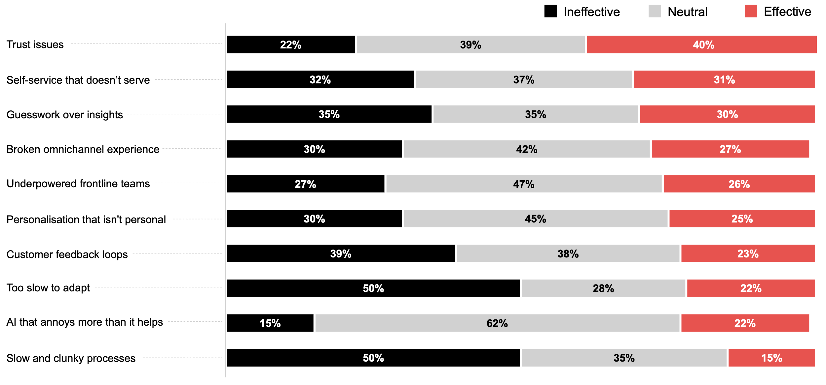
How effective is your organisation in addressing these CX challenges?
Please note that the percentages shown are rounded to the nearest whole number.
As a result, the total may appear slightly above or below 100% due to rounding.
Source : ADAPT Digital Edge Survey in June 2025. Sample size : 107 Australian CDOs

Slide 5
Resolving trust issues is the most promising area for Australian CDOs
With a greater need to acquire and retain more customers (#2 goal), it's crucial for CDOs to build
long-term loyalty by providing consistent support and a streamlined experience (#1 initiative).
As CDOs work toward being secure and trusted (#9 goal), they tend to prioritise customer data
privacy and consent while striving to deliver a better experience.
Streamlining, transforming and modernising operations
Slow adaptation and clunky processes highlight the urgent need to improve operational effectiveness, drive digital transformation, and modernise technology. These are the #3, #4 and #5 goals.
It's critical for CDOs to modernise legacy systems, reduce tech debt, and digitise outdated processes
with stronger governance. For more insights, view an ADAPT CDO Persona Map report (Jul 2025).
Building insight foundations to empower experience delivery
In addition to trust issues, reliance on guesswork instead of insights and weak customer feedback
loops hinder organisations from gaining a better understanding of customer data.
Building trust can become difficult when organisations are constrained by data quality and privacy
concerns. Closing feedback loops also becomes a challenge when organisations fail to act on it
effectively, despite collecting feedback.
Other areas suggest uncertainty and transitions in digital customer experience strategies
Other areas with high neutral response rates reflect a market in transition, where organisations
are actively reassessing their digital strategies to improve customer experiences.
These areas include AI that frustrates more than it helps, underpowered frontline teams, personalisation that feels generic, broken omnichannel experiences, and self-service options that fail to meet user needs.
Technology trends
Addressing CX challenges
Australian organisations are making progress in establishing trust. However, they're struggling with adaptability and process inefficiency.
Some organisations struggle to replace guesswork with data-driven insights and
effective customer feedback loops.
Most customer experience areas have
high percentages in the neutral category.

Slide 6
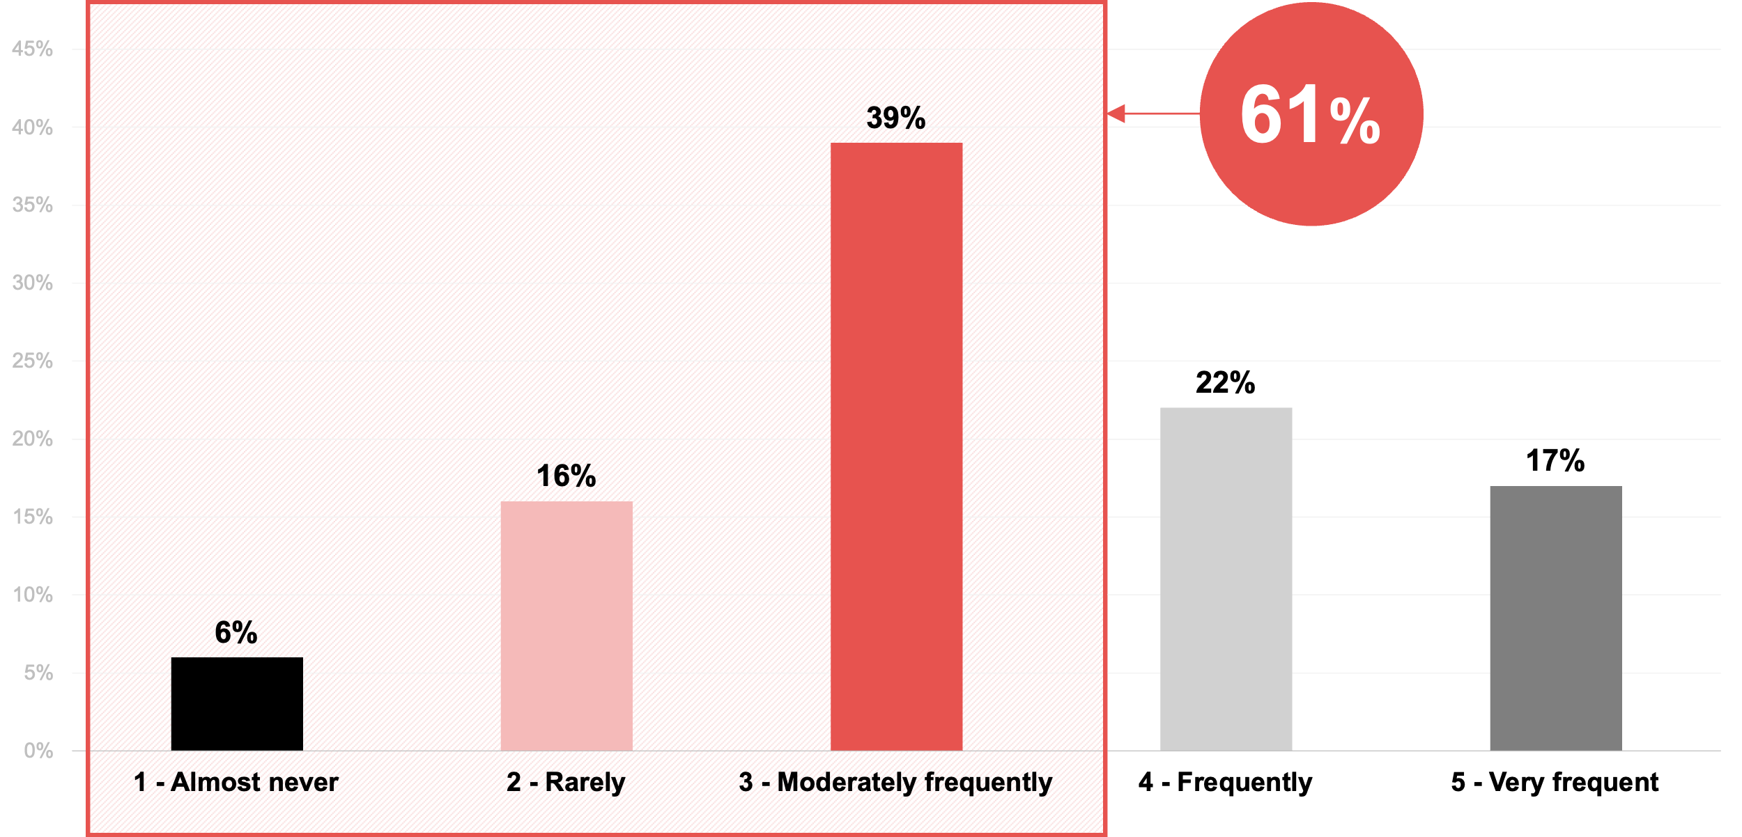
How often are customer needs, behaviours and feedback fed into digital product strategies and roadmaps?
Source : ADAPT Digital Edge Survey in June 2025. Sample size : 121 Australian CDOs

Slide 7
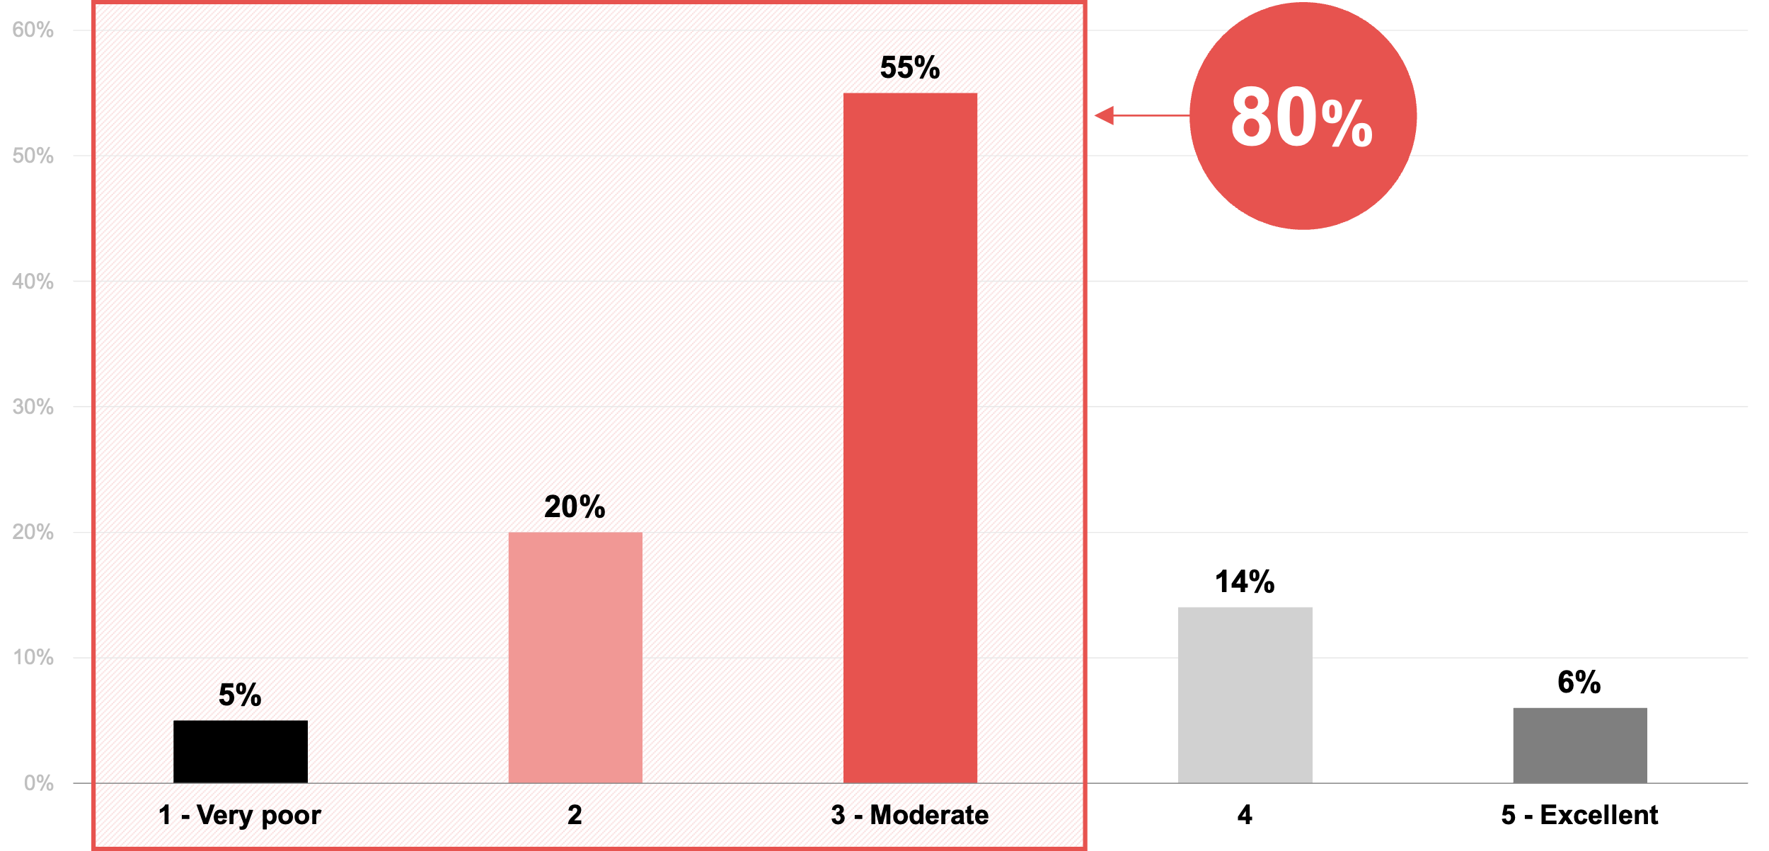
Ability to use its data to improve experiences for your customers
Source : ADAPT Digital Edge Survey in June 2025. Sample size : 121 Australian CDOs

Slide 8
Low customer feedback integration to digital product strategies and roadmaps
This gap indicates a significant opportunity for organisations to enhance their strategies
by prioritising customer insights, as customer acquisition and retention is the #2 goal. For CDOs.
Those organisations with moderate integration demonstrate a keen understanding of
customer feedback, without full commitment to comprehensive integration.
Low prevalence of customer feedback integration
The low prevalence of frequent customer feedback integration highlights critical barriers
to digital transformation, with many organisations struggling due to slow adaptation
and cumbersome processes. (see slide 4).
This underscores the need to prioritise customer-centric digital initiatives that effectively align feedback with digital strategy.
Ineffective in using data to improve customer experience
Challenges such as reliance on guesswork over insights and weak customer feedback loops can lead to fragmented or inaccessible customer data. This lack of clarity hinders informed decision-making and limits the ability to deliver meaningful customer value.
Additionally, the presence of legacy systems and technical debt (#5 barrier) further obstructs the effective use of data in driving CX innovation. Refer to an ADAPT CDO Persona Map
report (Jul 2025).
Technology trends
Frequency of customer integration and ability to use data for improved CX
About 61% of Australian CDOs acknowledge that they do not consistently incorporate customer needs, behaviours, and feedback into their digital product strategies and roadmaps.
Only 17% of organisations report engaging in this activity on a regular basis.
While the majority of CDOs have low customer integration in their digital strategies, 80% say that they were not actually that good at using data to improve experiences for their customers.

Slide 9
Employee experience

Slide 10
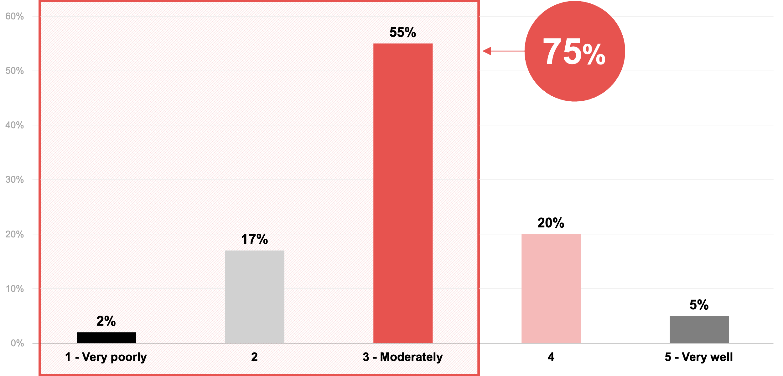
How well are you managing cross-functional collaboration?
Source : ADAPT Digital Edge Survey in June 2025. Sample size : 121 Australian CDOs

Slide 11
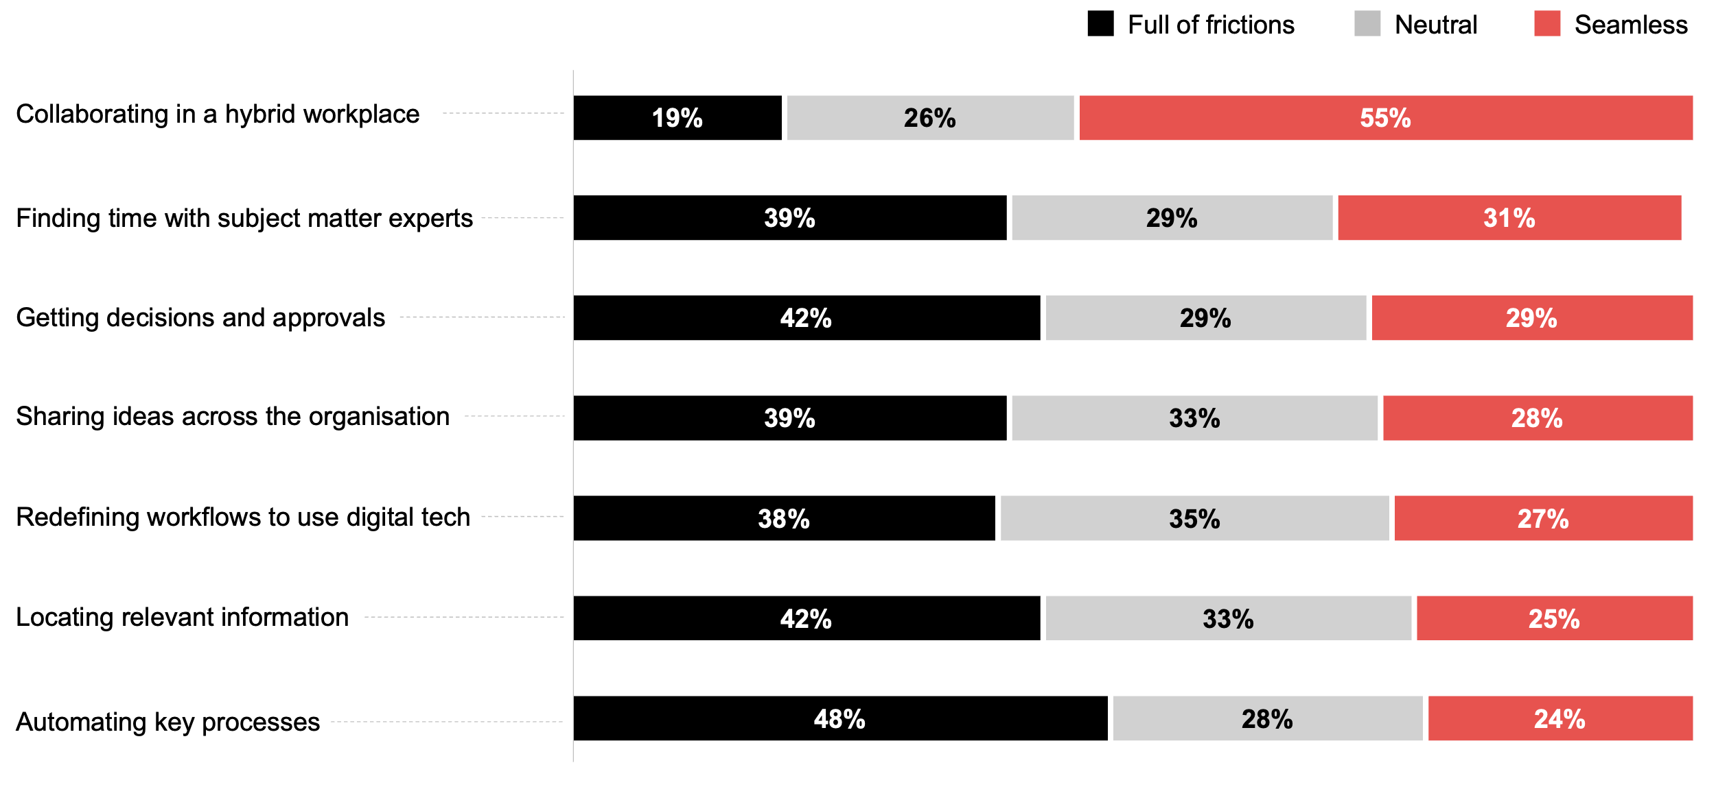
How seamless are your employees' experiences in the following areas?
Please note that the percentages shown are rounded to the nearest whole number.
As a result, the total may appear slightly above or below 100% due to rounding.
Source : ADAPT Digital Edge Survey in June 2025. Sample size : 118 Australian CDOs

Slide 12
Difficulty in integrating cross-functional capabilities
Although many organisations collaborate effectively in hybrid workplaces, only 5% excel at cross‑functional collaboration. An ADAPT Expert Presentation (Aug 2022) highlights the significance of replacing organisational charts with aligned values
allowing organisations to remove frictions from tasks through cross-functional
and team collaboration.
Success in hybrid workplace collaboration
As organisations have rapidly adapted to post-pandemic work models, a high success
rate in hybrid workplace collaboration suggests that they have effectively leveraged
digital collaboration tools.
However, while collaboration has become remarkably seamless, organisations find it difficult to share ideas across the organisation and with subject matter experts.
Automating key processes remains the most challenging area
This highlights a critical gap in digital transformation efforts, like digitising
processes. In fact, average digitisation has dropped this year by 4%
(ADAPT CDO Persona Map, Jul 2025).
While organisations are progressive in collaborative technologies, they face significant hurdles in creating truly integrated digital workflows.
Technology trends
Employee experience
75% of Australian organisations say they are not effective at managing cross-functional collaboration.
About 25% are managing it well.
55% of organisations say they achieve success
in collaborating in a hybrid workplace.
Some organisations struggle with automating
key processes.

Slide 13
Survey demographics

Slide 14
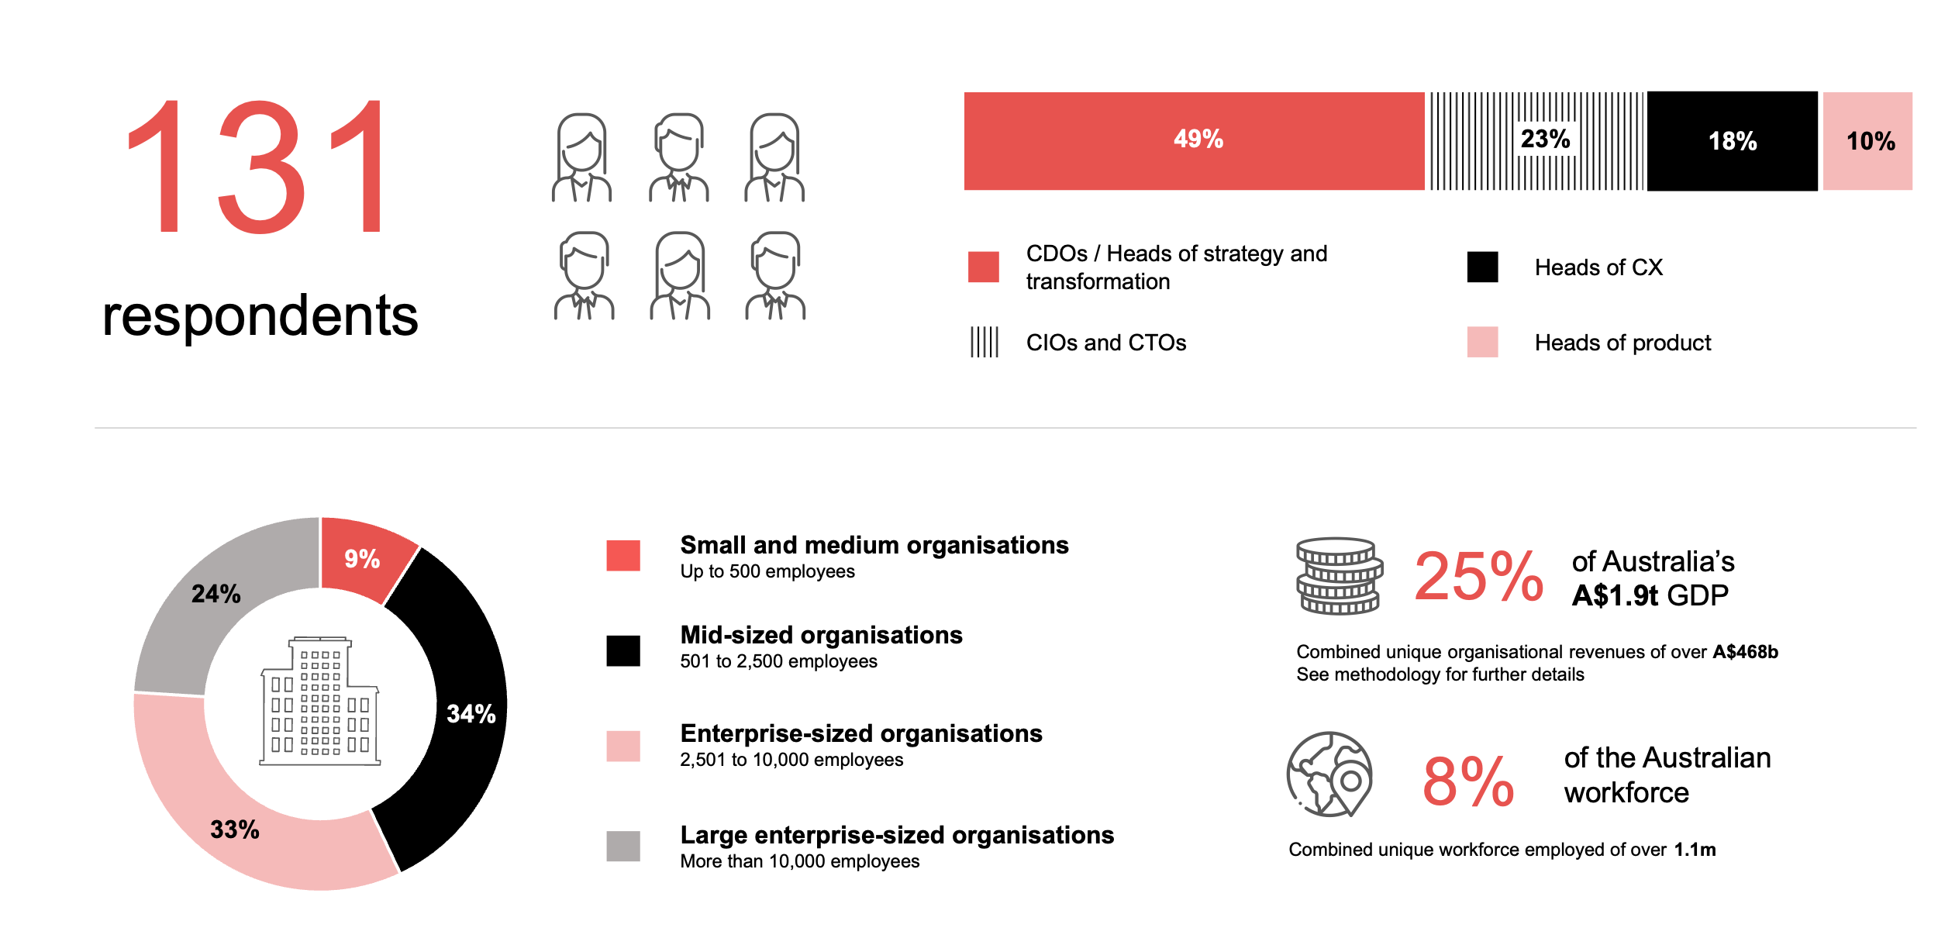
Survey demographics: Australian CDOs in 2025

Slide 15

For sector, segment and persona comparisons
Central limit theorem a fundamental concept in statistics that determines when a sample size is large enough
to be considered reliable. There are different formulas and some debate amongst statisticians about the appropriate sample size. For industry comparisons or other subset analyses, a sample size of ( n > 20 ) is generally considered acceptable for drawing meaningful insights. This threshold aligns with common statistical practices, where a
sample size of 20 to 30 is generally the minimum needed to assume a normal distribution of the data.
Sample sizes below 20, but equal to or greater than 15
When the sample size is between 15 and 20, while not fully representative, it can still offer valuable insights
into trends. These statistics should be viewed as indicative, highlighting general directions in industry efforts
or barriers to investment but treated with some caution due to the smaller number of observations.
Sample sizes less than 15, but greater or equal to 10
For samples between 10 and 15, the data provides a snapshot guideline only. While such small samples can
show early trends, it's important to recognise that this doesn't guarantee future respondents will reflect the same trends. For instance, while 100% of respondents in a sample of 10 might invest in AI, it'd be unrealistic to assume this pattern will hold as the sample size grows. However, if the sample size increases to 20, it's unlikely
that the trend will change drastically, and the next 10 respondents will have no investment.
ADAPT Data Analytics:
Notes on sample sizes
Why does sample size matter?
Each set of statistics is unique with measures,
distribution, variance and sample size. It is generally accepted in statistics that as sample size increases, analysts make fewer assumptions about the data, resulting in statistics that more accurately represent the truth.
ADAPT endeavours to provide transparency of sample size, whereby we provide a source on data slides with
the number of respondents and the survey where those respondents come from. In data and insights slide decks, ADAPT usually provides some insight on the breakdown
of the demographics at the end of the slide deck.
To protect privacy, ADAPT does not release lists
of individual respondents to surveys.

Slide 16

Written by
Honey Mari Gay
Junior Data Analyst at ADAPT
As a Junior Data Analyst at ADAPT, Mari enables the discovery and definition of market trends through visually meaningful statistics.
She ensures data presentations are accurate and aligned with modern statistical standards.
Mari is passionate about data and transforming it into actionable insights. With over three years of experience in project management
and academic research, she has led end-to-end survey and research projects, processed and analysed data using a range of statistical
tools and techniques, and provided clients with statistical consultation and insights.

Slide 17

About ADAPT
ADAPT is a specialist Research & Advisory firm providing local market insights and benchmarking data
to Australia and New Zealand’s senior technology and business community.
Since 2011, we’ve been empowering the leaders of the region’s top enterprise and government organisations
to stay at the forefront of modern trends and build for the future. Our industry leading conferences, private roundtable events and custom research projects equip business leaders with the knowledge, relationships, inspiration and tools they need to make better strategic decisions.
adapt.com.au | hello@adapt.com.au
Data Validation
Results contained in this report (Report) are based on survey responses as provided by our clients and publicly available information. ADAPT does not subject the data contained in the Report to audit or review procedures or any other testing to validate the accuracy or reasonableness of the data provided by the participating clients. While we do not manipulate the survey responses, we do make an effort to identify outlier data or conflicting results that could lead to misinterpretations before the preparation of the Report.
Intended Use of the Report
The Report is designed to help technology executives in Australia and New Zealand make independent decisions regarding financial, resourcing and operational performance matters. The information and data contained in the Report are provided as is and are for information purposes only. They are not intended or implied to be recommendations and in no event will ADAPT be liable for any decisions or actions taken in reliance of the results obtained through the use of the information and/or data contained in the Report.
Research MSA and Privacy Policy
The Report and any other information provided by ADAPT is subject to the Research and Advisory Master Services Agreement and the ADAPT Privacy Policy.

Slide 18




Additional resources you can access
Members of ADAPT’s Research & Advisory platform have access to an entire suite of market leading content, insights and resources to help you execute in your role. For any assistance contact your Account Manager in the help section.
Community case studies and interviews
Case studies detailing the successes
and challenges of projects and initiatives.
Market Trend Reports Access a library of fact-based actionable insights, deep dives on ANZ business & IT trends.
Live access to ADAPT analysts
Through live ADAPT analyst market briefings and Q&A sessions
Downloadable data and insights
Elevate your business cases with downloadable market and industry data.
Industry expert presentations
Watch keynotes or read distilled 1-page executive summaries from our Edge Events.
Bespoke analysis of ADAPT data
Receive custom cuts and analysis of ADAPT proprietary data.
Premier executive community
Unlock access to our exclusive network of Australia’s leading technology and business executives.
Dedicated account manager and impact assessments
Your Account Manager will ensure you and your team are getting the most out of your subscription.
Dedicated analyst briefing
Leverage a dedicated briefing with an ADAPT analyst to help validate your strategies.
*Inclusions may vary depending on subscription level.

