Slide 1

ADAPT Persona Map
CISO Investment Priorities and
Budget Breakdown by Organisational Size

Slide 2
CISO demographic budget breakdown
Document description
Security budget allocation​
Respondents were asked how their budget is allocated across different areas. These broad categories provide insight into general trends in Security
budget spending.
The budget allocations add up to 100%.
Budgets should be viewed as the average spend, not what an organisation
should spend. They are a benchmarking guideline only.
Investment priorities​
Investment priorities are indicated by respondents' intentions to spend
in a given area over the next year.
There are approximately 73 line items of investment priorities. The investment priority statistics represent the top 10 investments by proportion of spending
in the next year.
This document outlines percentage allocations
of security budgets for Chief Information Security Officers (CISOs).
The demographic breakdown of organisations is:
SMB (<= 500 employees)
Mid-sized organisations (501 to 2,500 employees)
Enterprise organisations (2,501 to 10,000 employees)
Large enterprise organisations (> 10,000)
The statistics shown in this report cover:
Security budget allocation.
Investment priorities.

Slide 3
Security budgets

Slide 4
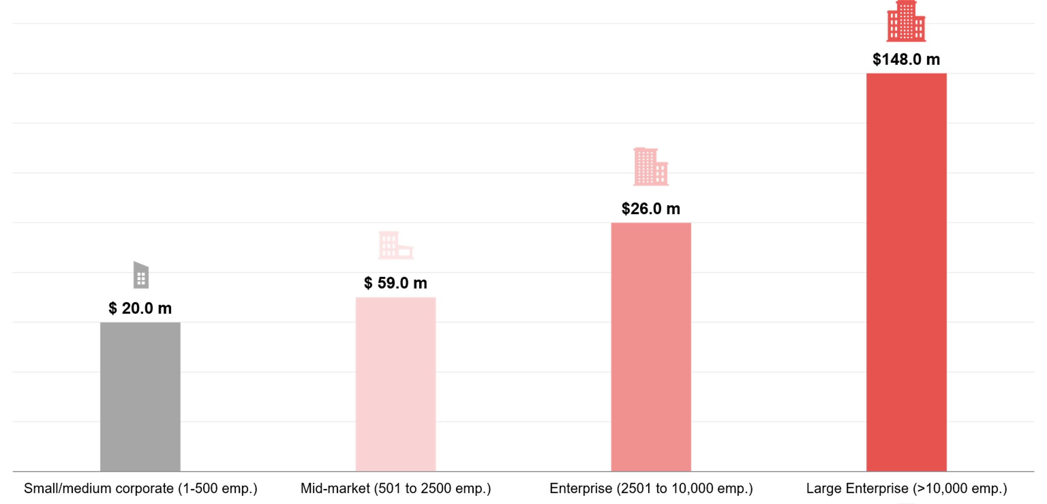
CISO budget allocation by organisation size in 2025
Source: ADAPT CISO Edge Surveys in April 2025 Sample size: 35 Australian CIOs

Slide 5
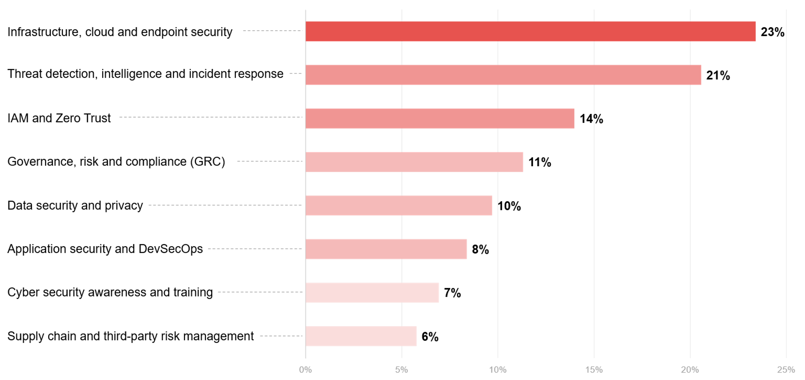
CISO budget allocation
Source: ADAPT CISO Edge Surveys in April and Oct 2025 . Sample size: 123 Australian CISOs

Slide 6
Large enterprise
(above 10,000 employees)

Slide 7
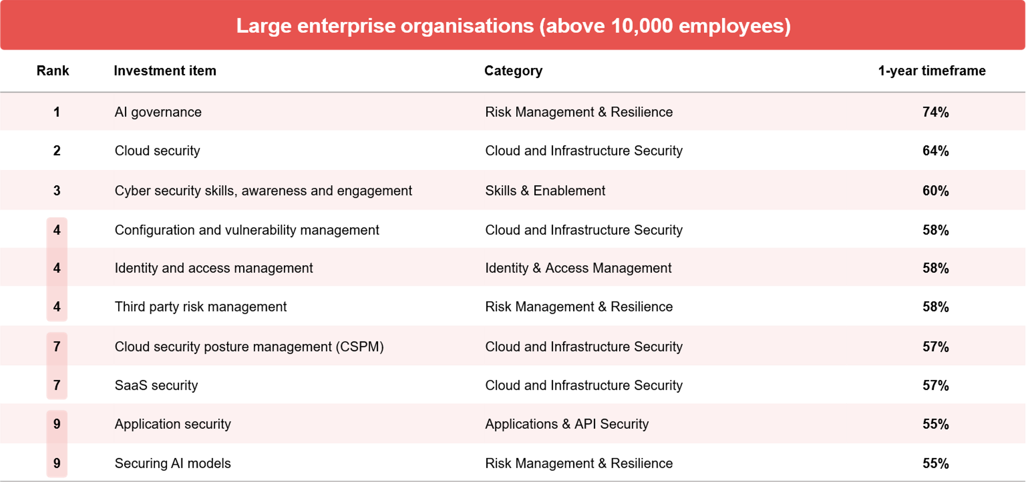
Percentage investing in the next 12 months
Source: ADAPT CISO Edge Survey in April2025 Sample size: 241 Australian CISOs, 53 Large enterprise

Slide 8
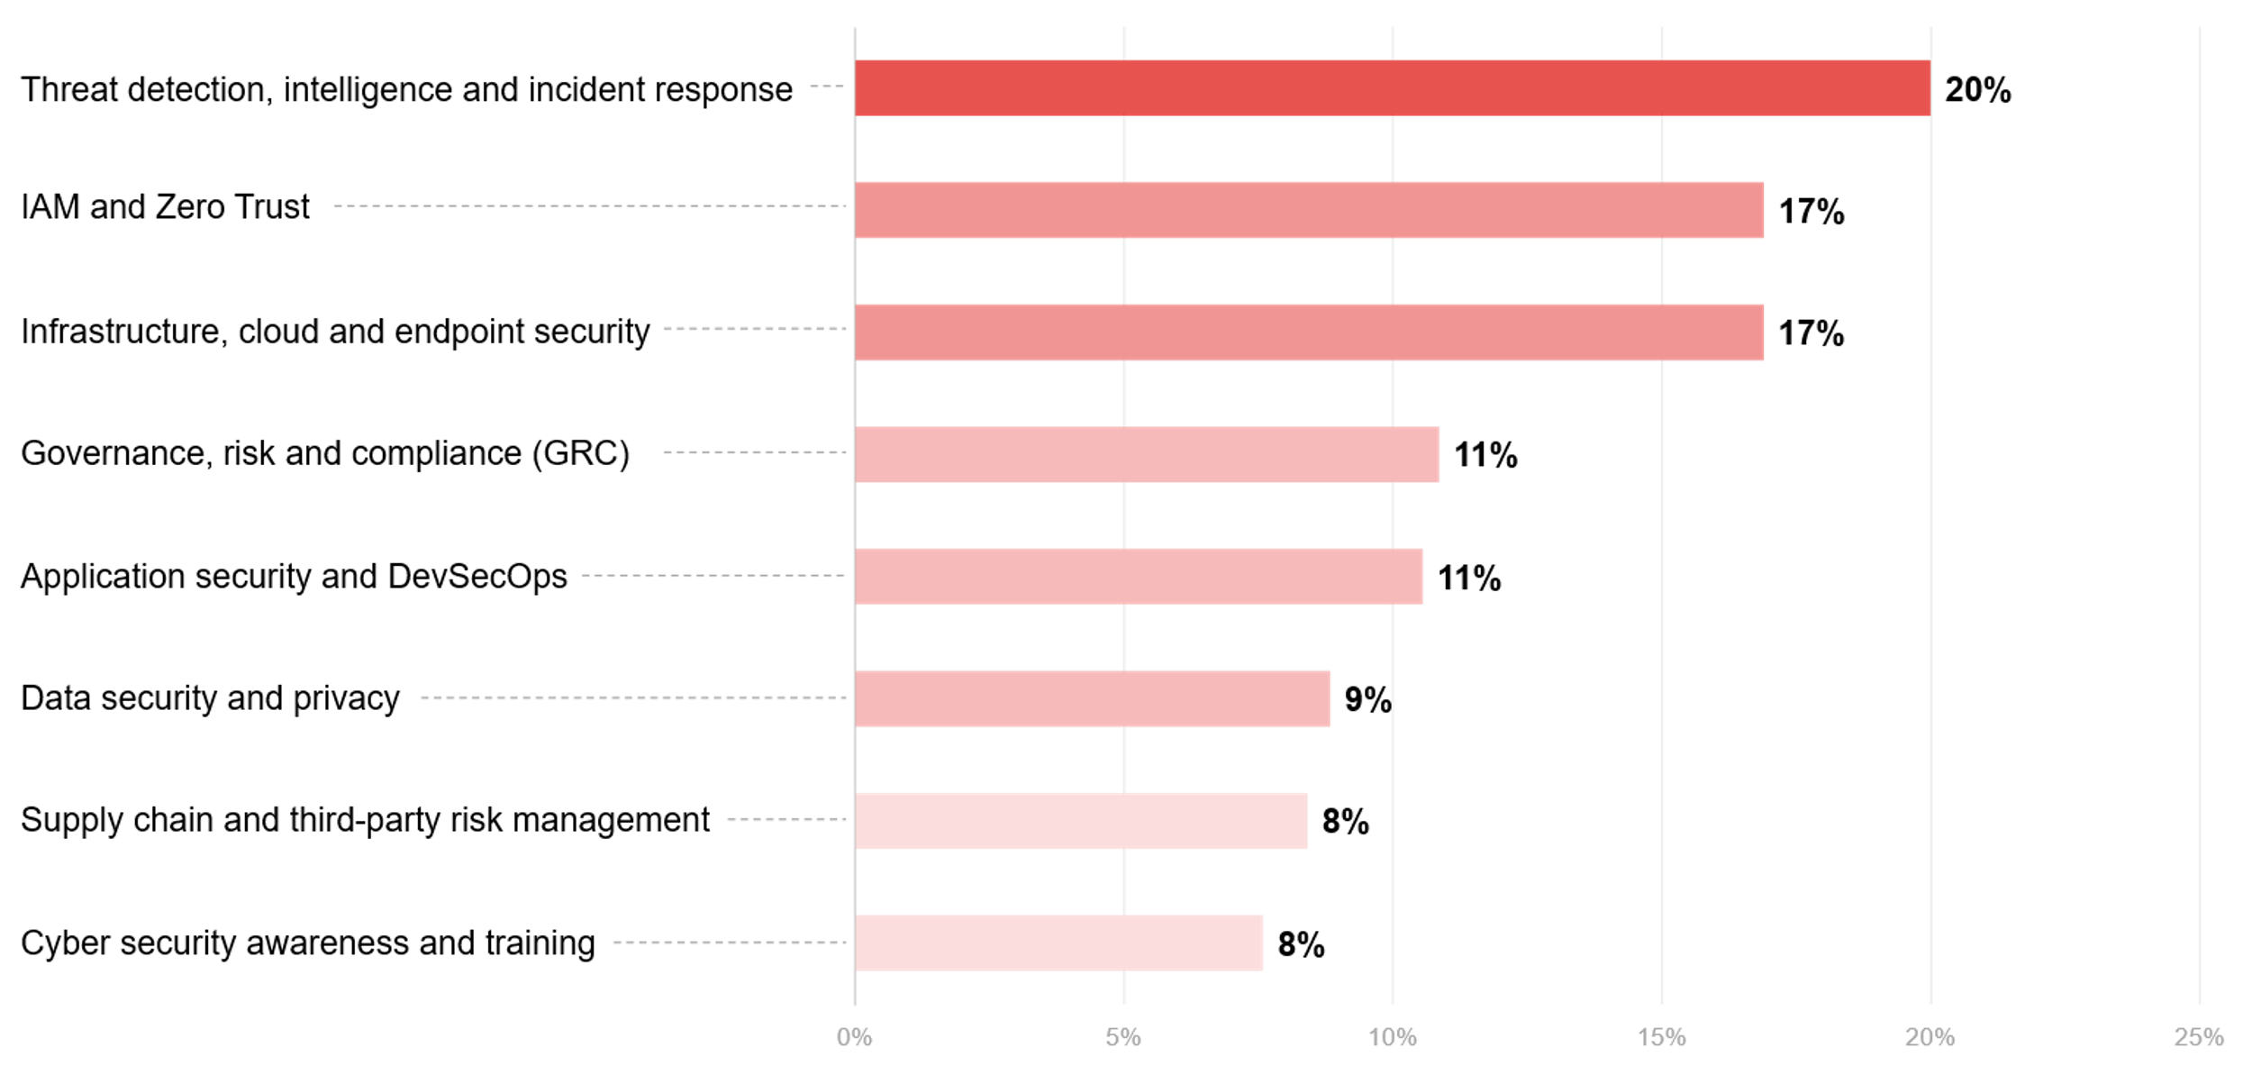
Budget splits large enterprise (>10,000 employees)
Source: ADAPT CISO Edge Survey in April 2025. Sample size: 123 Australian CISOs, 21 Large enterprise

Slide 9
Enterprise
(2,501 to 10,000 employees)

Slide 10
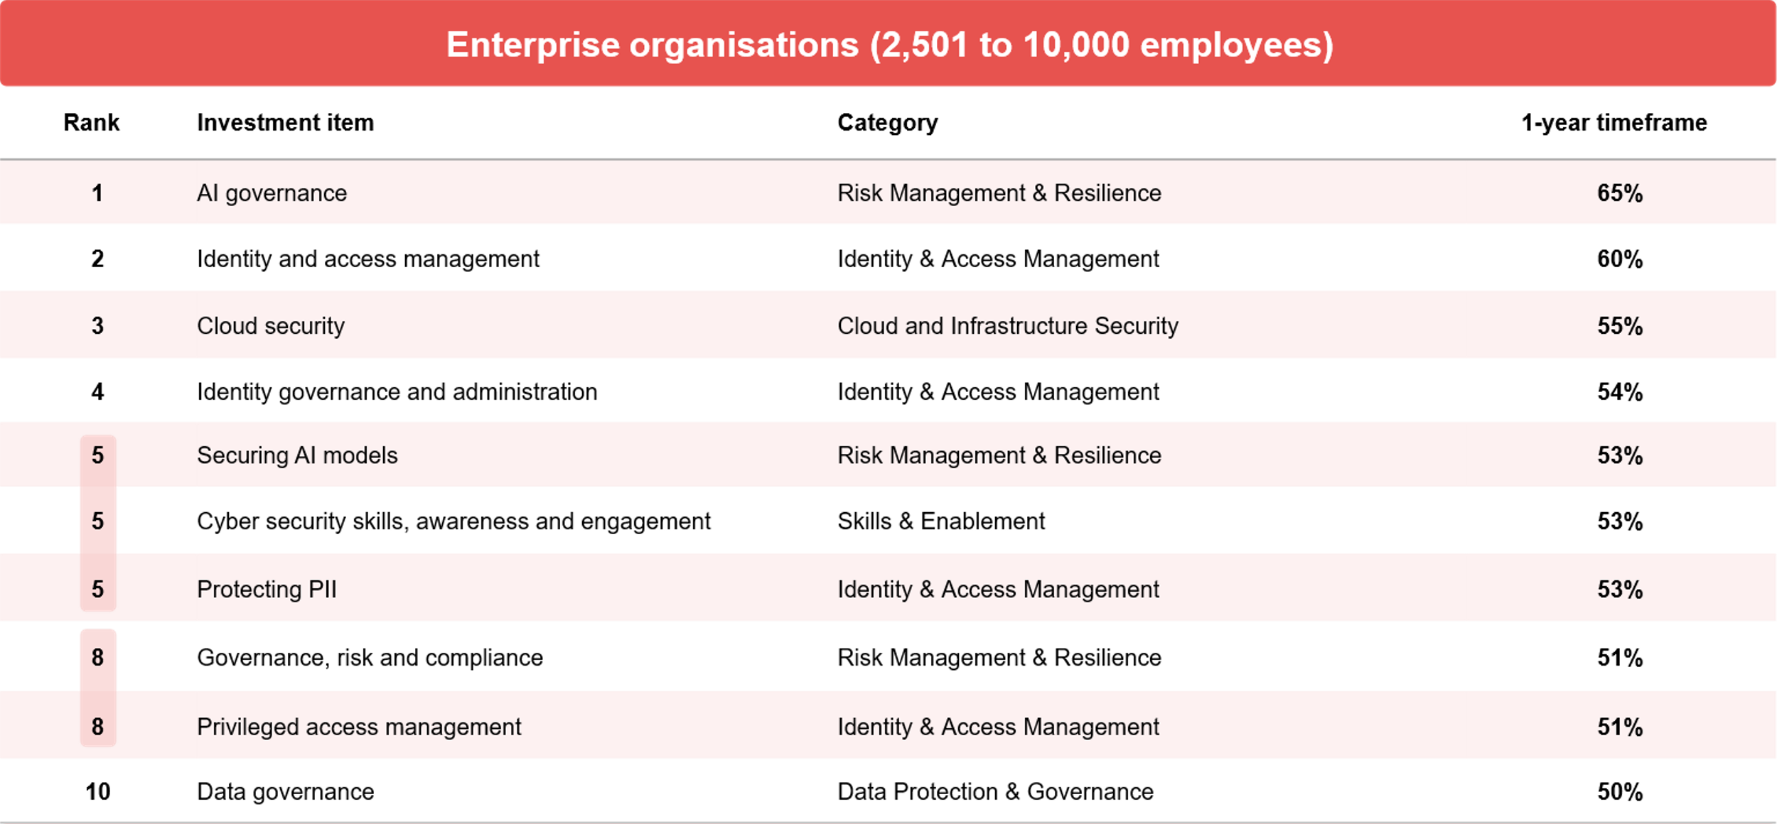
Percentage investing in the next 12 months
Source: ADAPT CISO Edge Survey in April2025 Sample size: 241 Australian CISOs, 78 Enterprise

Slide 11
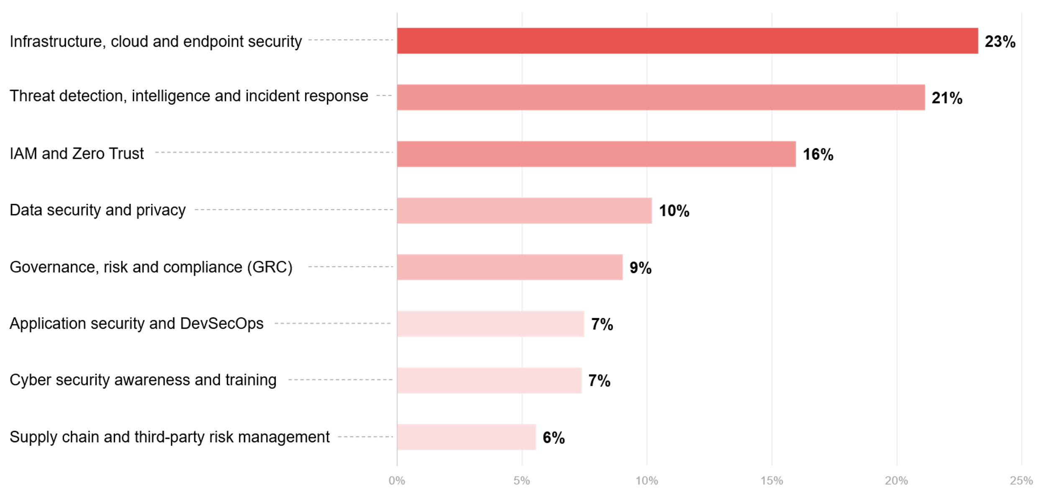
Enterprise (2501 to 10,000 employees)
Source: ADAPT CISO Edge Survey in April 2025 . Sample size: 123 Australian CISOs, 41 Enterprise

Slide 12
Mid-sized organisations
(501 to 2,500 employees)

Slide 13
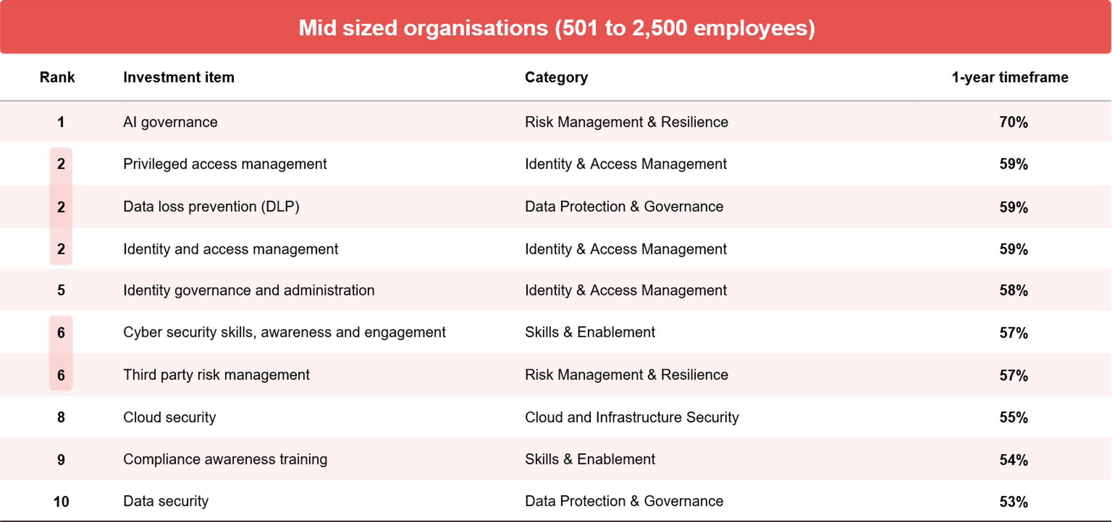
Percentage investing in the next 12 months
Source: ADAPT CISO Edge Survey in April and Oct 2025 Sample size: 241 Australian CIOs, 74 Mid-Market

Slide 14
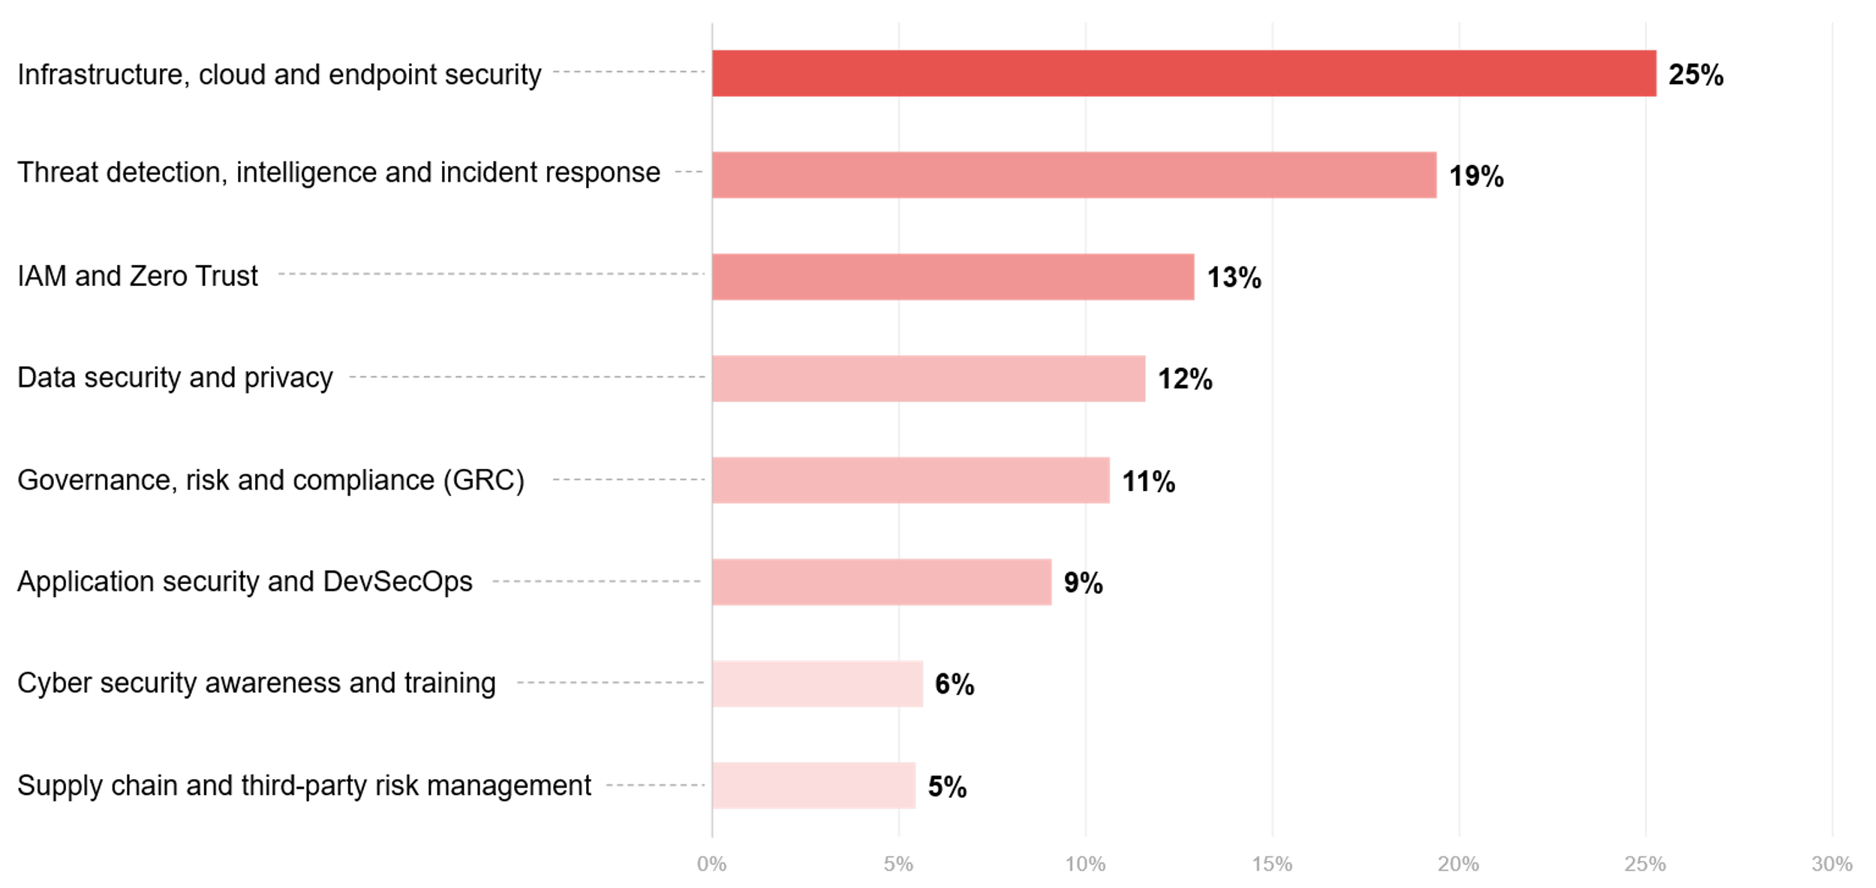
Mid-sized (501 to 2,500)
Source: ADAPT CISO Edge Survey in April 2025 . Sample size: 123 Australian CISOs, 35 Mid-sized Organisations

Slide 15
Small organisations
(500 employees and under)

Slide 16
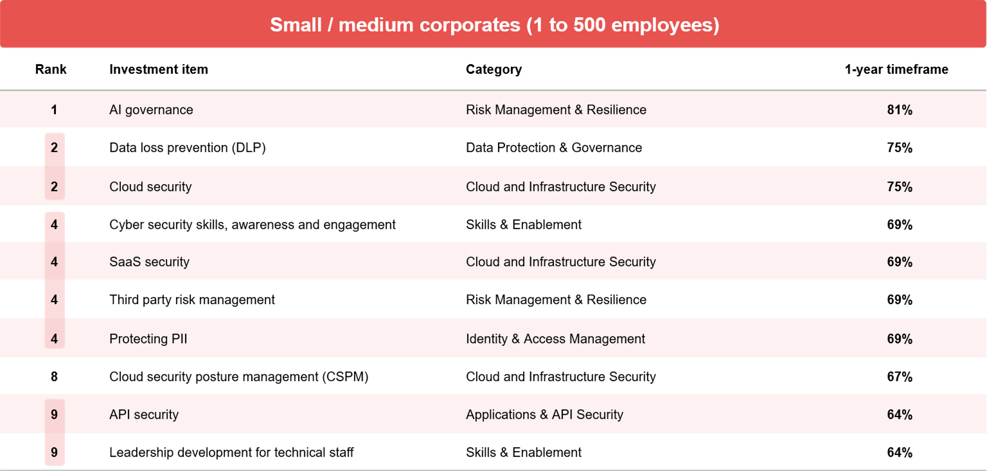
Percentage investing in the next 12 months
Source: ADAPT CISO Edge Survey in April2025 Sample size: 241 Australian CIOs, 36 Small/medium corporate

Slide 17
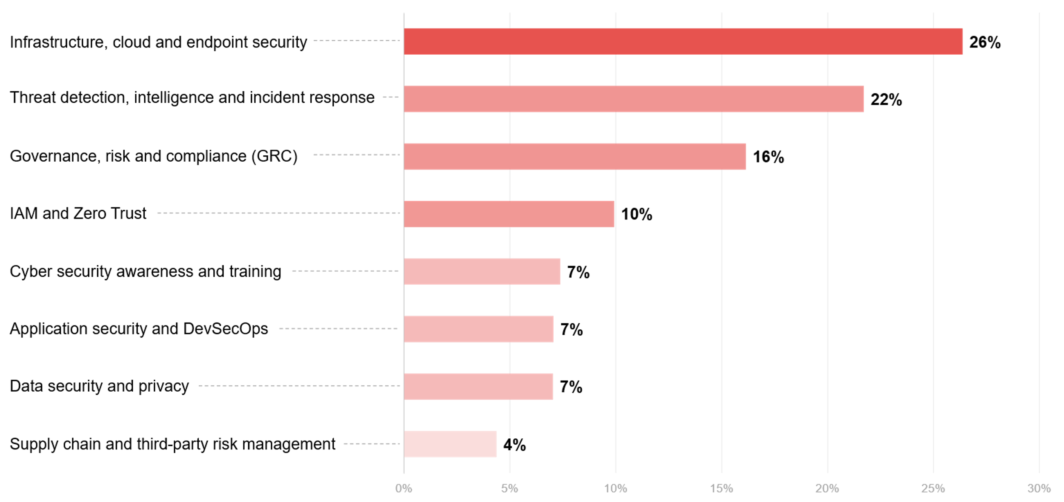
Small (500 employees and under)
Source: ADAPT CISO Edge Survey in April 2025 . Sample size: 123 Australian CIOs, 26 Small/mid size

Slide 18
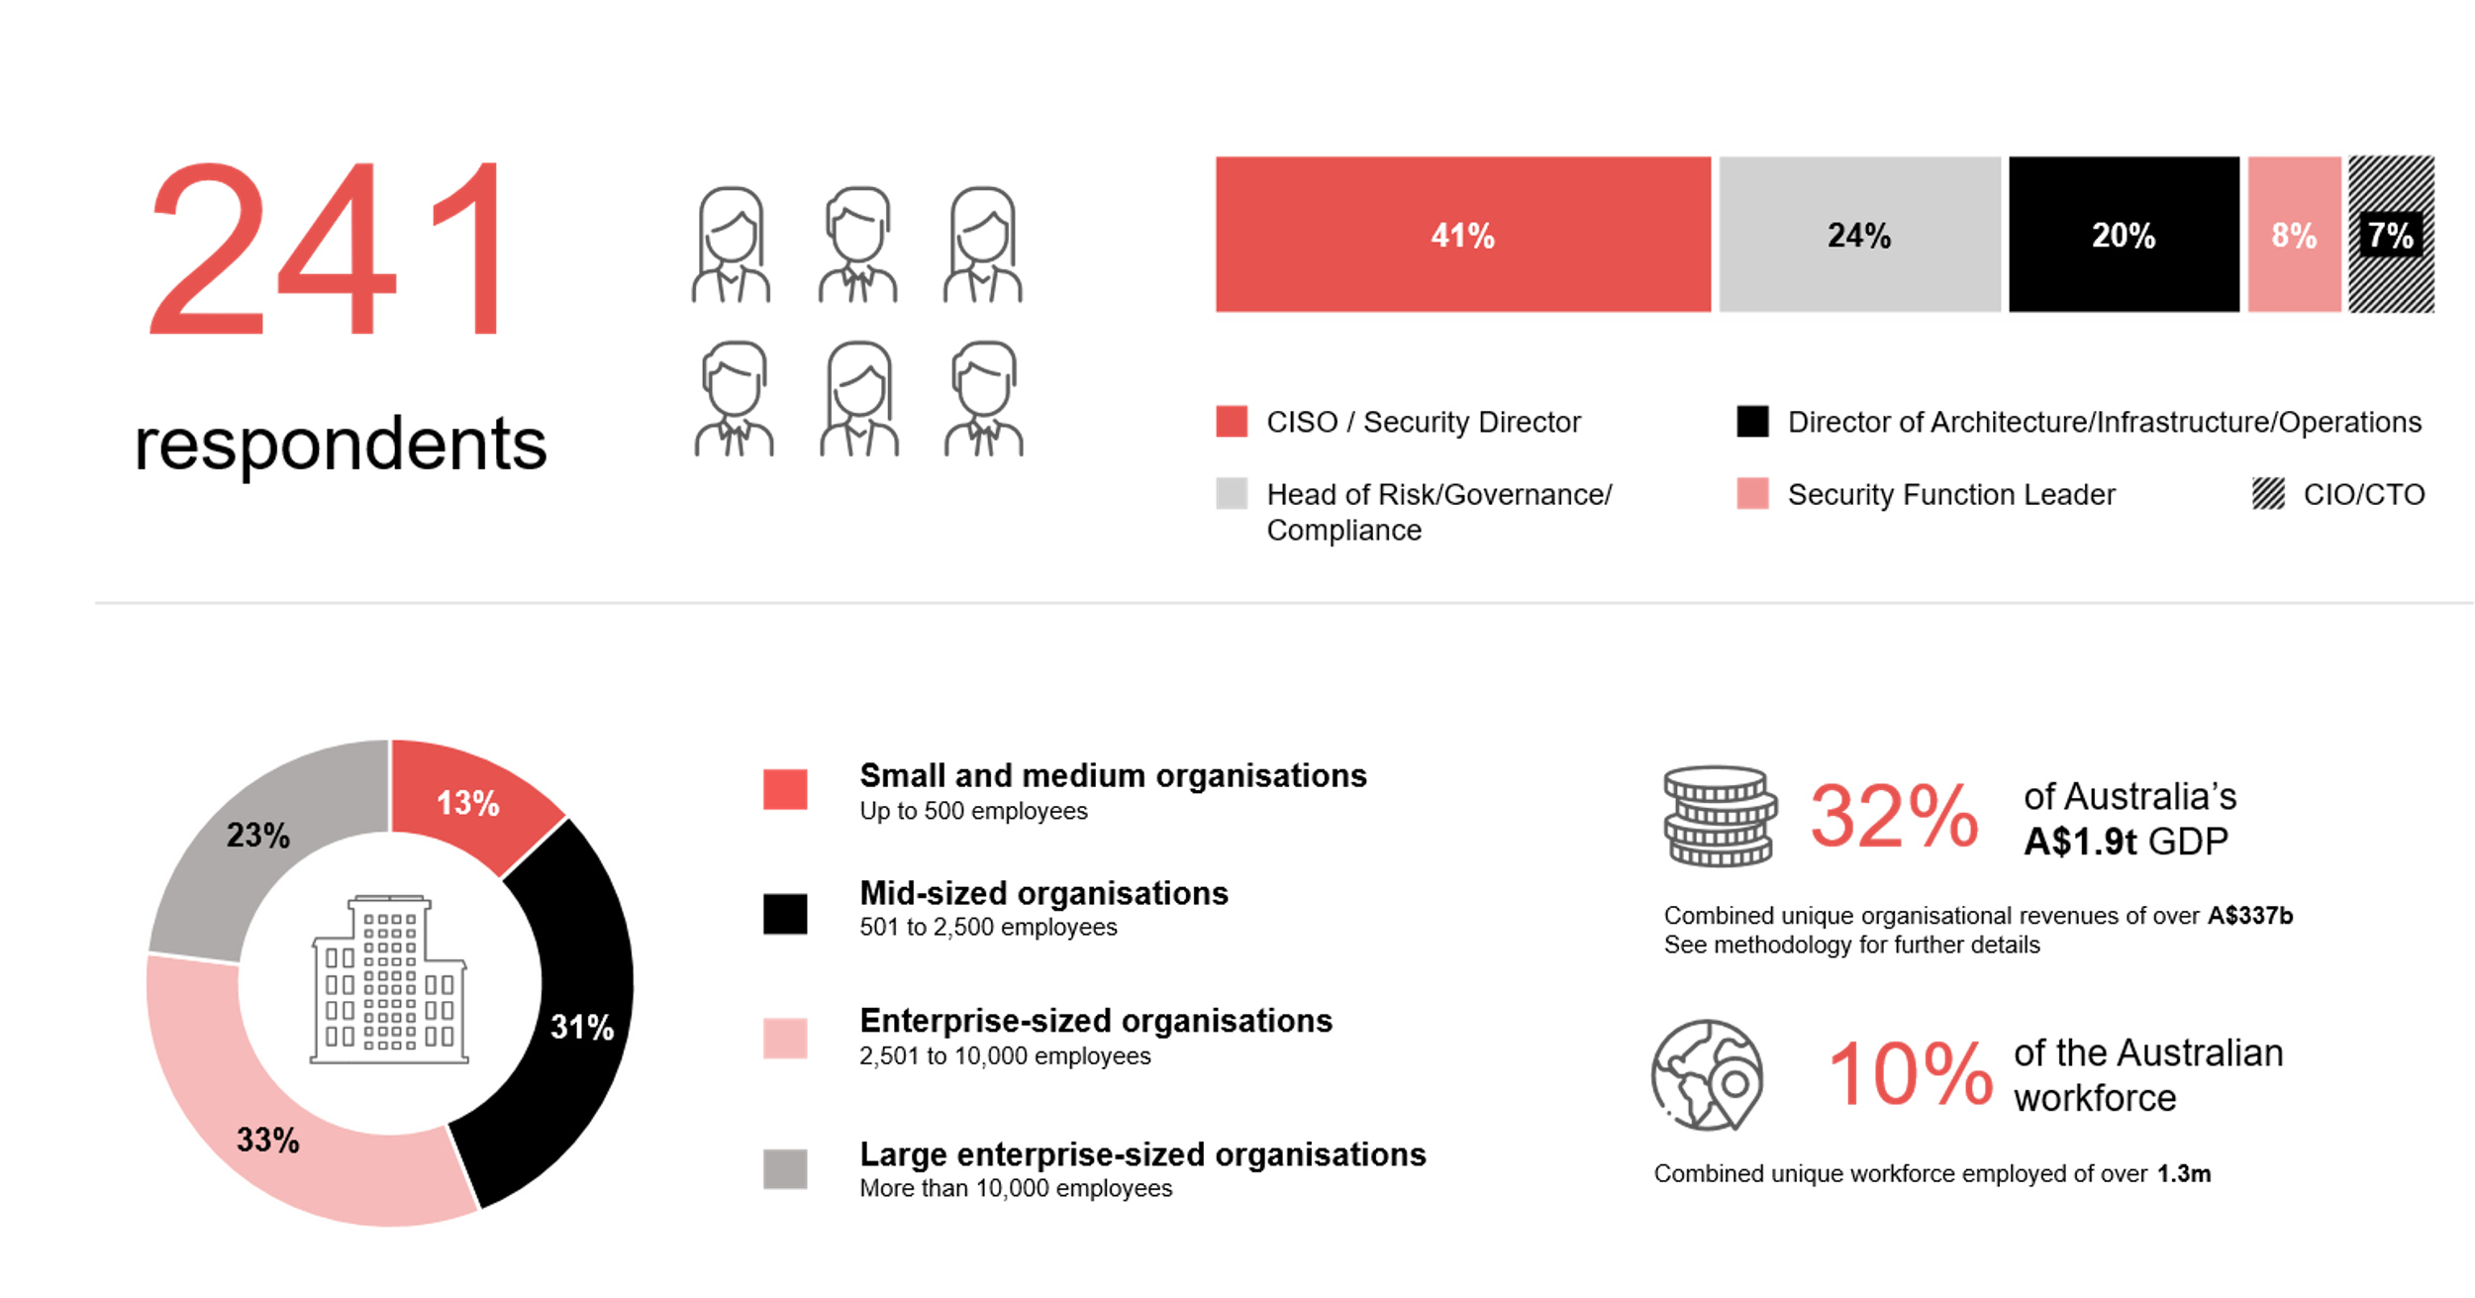
Survey demographics: Australian CISOs in October 2025

Slide 19

For sector, segment and persona comparisons
Central limit theorem a fundamental concept in statistics that determines when a sample size is large enough
to be considered reliable. There are different formulas and some debate amongst statisticians about the appropriate sample size. For industry comparisons or other subset analyses, a sample size of ( n > 20 ) is generally considered acceptable for drawing meaningful insights. This threshold aligns with common statistical practices, where a
sample size of 20 to 30 is generally the minimum needed to assume a normal distribution of the data.
Sample sizes below 20, but equal to or greater than 15
When the sample size is between 15 and 20, while not fully representative, it can still offer valuable insights
into trends. These statistics should be viewed as indicative, highlighting general directions in industry efforts
or barriers to investment but treated with some caution due to the smaller number of observations.
Sample sizes less than 15, but greater or equal to 10
For samples between 10 and 15, the data provides a snapshot guideline only. While such small samples can
show early trends, it's important to recognise that this doesn't guarantee future respondents will reflect the same trends. For instance, while 100% of respondents in a sample of 10 might invest in AI, it'd be unrealistic to assume this pattern will hold as the sample size grows. However, if the sample size increases to 20, it's unlikely
that the trend will change drastically, and the next 10 respondents will have no investment.
ADAPT Data Analytics:
Notes on sample sizes
Why does sample size matter?
Each set of statistics is unique with measures,
distribution, variance and sample size. It is generally accepted in statistics that as sample size increases, analysts make fewer assumptions about the data, resulting in statistics that more accurately represent the truth.
ADAPT endeavours to provide transparency of sample size, whereby we provide a source on data slides with
the number of respondents and the survey where those respondents come from. In data and insights slide decks, ADAPT usually provides some insight on the breakdown
of the demographics at the end of the slide deck.
To protect privacy, ADAPT does not release lists
of individual respondents to surveys.

Slide 20

Written by
Nathan Bustamante
Junior Data Analyst at ADAPT
Nathan is a versatile Data Analyst at ADAPT, skilled in data gathering, processing, and visualization across multiple platforms.
He excels in transforming raw data into insights, with proficiency in SQL, dashboard creation, and automated data collection.
Nathan’s diverse experience spans e-commerce and engineering, allowing him to bring a unique perspective to data analysis.
His ability to distill data into clear, impactful reports plays a crucial role in ADAPT’s commitment to delivering innovative,
data-driven solutions for businesses.

Slide 21

About ADAPT
ADAPT is a specialist Research & Advisory firm providing local market insights and benchmarking data
to Australia and New Zealand’s senior technology and business community.
Since 2011, we’ve been empowering the leaders of the region’s top enterprise and government organisations
to stay at the forefront of modern trends and build for the future. Our industry leading conferences, private roundtable events and custom research projects equip business leaders with the knowledge, relationships, inspiration and tools they need to make better strategic decisions.
adapt.com.au | hello@adapt.com.au
Data Validation
Results contained in this report (Report) are based on survey responses as provided by our clients and publicly available information. ADAPT does not subject the data contained in the Report to audit or review procedures or any other testing to validate the accuracy or reasonableness of the data provided by the participating clients. While we do not manipulate the survey responses, we do make an effort to identify outlier data or conflicting results that could lead to misinterpretations before the preparation of the Report.
Intended Use of the Report
The Report is designed to help technology executives in Australia and New Zealand make independent decisions regarding financial, resourcing and operational performance matters. The information and data contained in the Report are provided as is and are for information purposes only. They are not intended or implied to be recommendations and in no event will ADAPT be liable for any decisions or actions taken in reliance of the results obtained through the use of the information and/or data contained in the Report.
Research MSA and Privacy Policy
The Report and any other information provided by ADAPT is subject to the Research and Advisory Master Services Agreement and the ADAPT Privacy Policy.

Slide 22




Additional resources you can access
Members of ADAPT’s Research & Advisory platform have access to an entire suite of market leading content, insights and resources to help you execute in your role. For any assistance contact your Account Manager in the help section.
Community case studies and interviews
Case studies detailing the successes
and challenges of projects and initiatives.
Market Trend Reports Access a library of fact-based actionable insights, deep dives on ANZ business & IT trends.
Live access to ADAPT analysts
Through live ADAPT analyst market briefings and Q&A sessions
Downloadable data and insights
Elevate your business cases with downloadable market and industry data.
Industry expert presentations
Watch keynotes or read distilled 1-page executive summaries from our Edge Events.
Bespoke analysis of ADAPT data
Receive custom cuts and analysis of ADAPT proprietary data.
Premier executive community
Unlock access to our exclusive network of Australia’s leading technology and business executives.
Dedicated account manager and impact assessments
Your Account Manager will ensure you and your team are getting the most out of your subscription.
Dedicated analyst briefing
Leverage a dedicated briefing with an ADAPT analyst to help validate your strategies.
*Inclusions may vary depending on subscription level.

Slide 23

adapt.com.au | hello@adapt.com.au | +61 (2) 9435 3535

