Slide 1

ADAPT Persona Map
Government Leaders Delivering Public Value Through AI

Slide 2
In this report, you’ll find insights about Australian government leaders’ delivering public value through AI. Government agencies show strong consistency in what they aim to achieve, how they execute, and where they invest. Building an AI strategy roadmap is reinforced by increased funding towards AI initiatives, despite budget and resource constraints.
The key areas of focus are:
Strong alignment across AI goals, initiatives, and investments
Government leaders are prioritising the development of robust AI strategies and roadmaps, supported by increased investment in AI initiatives.
Agencies are tightening security and governance and improving data capabilities to support responsible AI adoption. Modernisation efforts and key capabilities are leveraged to improve citizen experience and societal outcomes, while streamlining operations to optimise costs.
Public cloud expansion, despite lagging behind other sectors
Although lagging behind other sectors in public cloud migration, government agencies are expecting to double their public cloud workloads in the next 12 months. This shift from on-premise workloads to the public cloud is closely linked with the need for effective AI strategies and roadmaps. However, a one-size-fits-all cloud approach is not viable. Some government workloads must remain outside the public cloud.
Insufficient funding/resources are holding back government efforts on AI
Like other sectors, government leaders face challenges securing budgets for more urgent operational needs, often due to competing operational demands or skills to support this change.
With AI strategy as a top priority, there is a greater need to uplift AI literacy.
Persona Mapping: Government leader
Key takeaways
ADAPT’s Government Edge Survey (Oct 2025), reveals that the top goal of Australian government leaders is to develop an AI strategy and roadmap.
The #1 initiative priority is to pilot and adopt generative AI, while the #1 investment priority
is the deployment of AI agents.
Currently, the federal government retains nearly
half of its workloads in-house, but agencies plan
to double their public cloud footprint within the
next year.
The primary barrier to executing AI and modernisation initiatives is a lack of funding
and resources.

Slide 3

Goals, initiatives and investment priorities

Slide 4
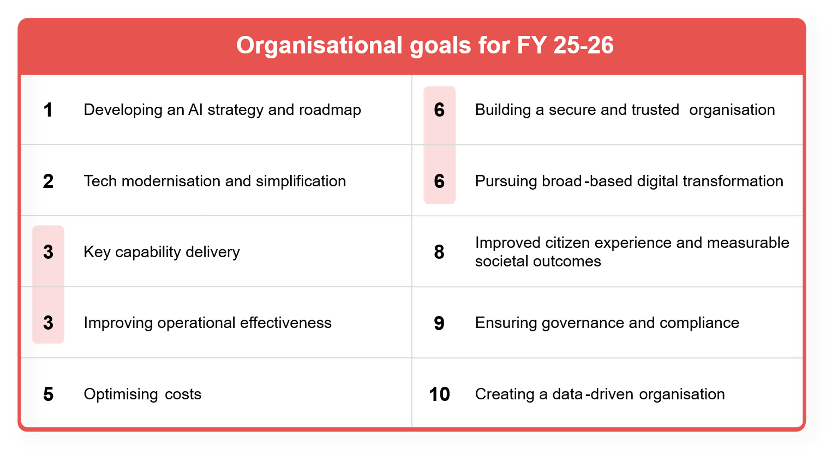
Government leaders’ organisational goals (Oct 2025)
Source : ADAPT Government Edge Survey in Oct 2025. Sample size : 138 Australian Government Leaders

Slide 5
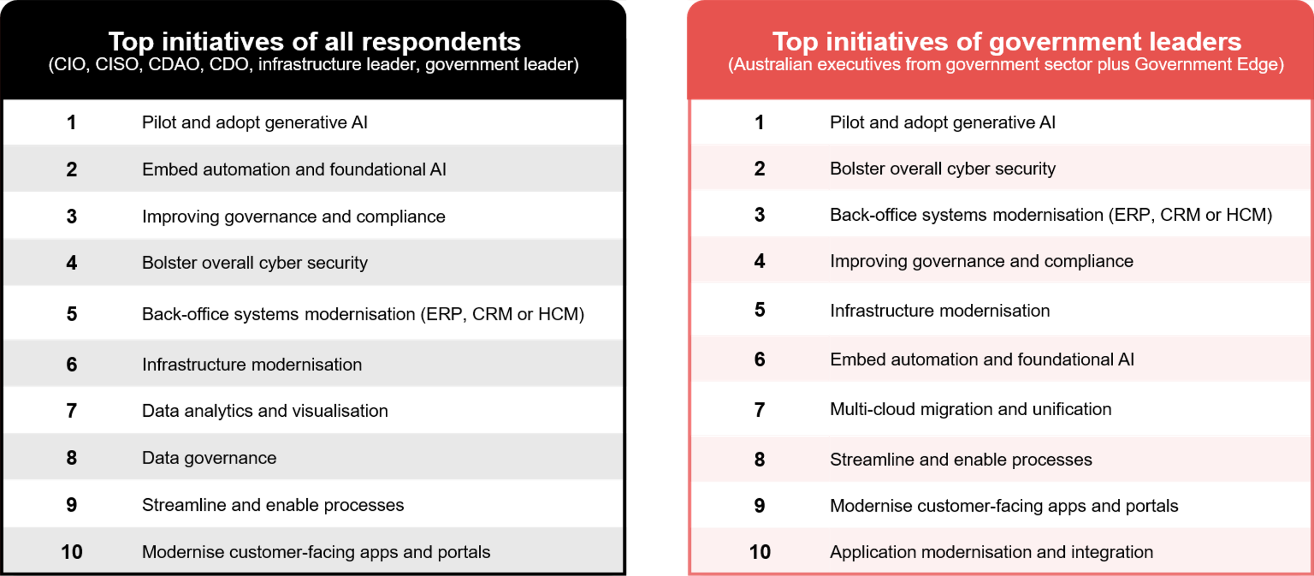
Top initiatives in 2025: Private sector vs federal government
Source : ADAPT Edge Surveys from Feb to Oct 2025. Sample size : 1,142 Australian CIOs, CISOs, CDAOs, CDOs,
Infrastructure Leaders and Government Leaders, including 224 from Government

Slide 6
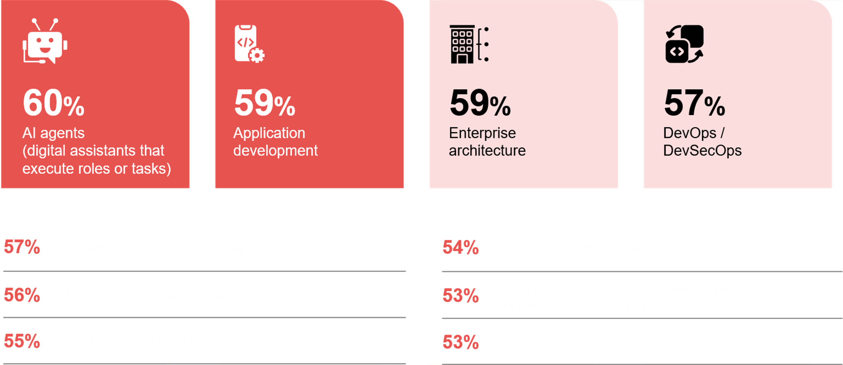
Investment priorities of government leaders in the next 12 months
Source : ADAPT Government Edge Survey in Oct 2025. Sample size : 139 Australian Government Leaders

Slide 7
Government leaders aim to achieve AI strategy and roadmap by piloting and heavily investing in AI
This effort is designed to shape the future of public service and digital government. AI strategy connects with improved citizen experience through better services and fairer societal outcomes.
The top goal aligns with the Digital Transformation Agency (DTA) Corporate Plan 2025-26, which commits to advancing AI and building strong foundations for safe and responsible adoption.
Importance of building security and ensuring governance
Government agencies are expected not only to deliver measurable public value, but also to govern the responsible use of AI (#6 initiative). Security and governance must be fully integrated into AI strategies to ensure compliance and enable safe, scalable adoption. For further insights, view an ADAPT Community Interview (Jun 2025).
Investing in data foundations (#10 goal) before AI pilots, and sufficient cyber security skills
are also essential.
Aligning AI with tech modernisation and key capabilities
The strong emphasis on modernisation implies a pressing need to improve systems, infrastructure, integration, cloud adoption and citizen-facing digital services.
To ensure faster AI deployment, agencies are securing access to modern AI platforms and tools.
This ensures AI and modernisation work at scale, while delivering key capabilities.
Streamlining operations to optimise costs
Operational excellence remains a top priority for government leaders; doing things faster, more efficiently and consistently, while delivering greater value. Cost optimisation is crucial to address fiscal constraints and competing demands for public funding (#1 government barrier).
Investing in AI and modernisation
Scaling AI can be risky with legacy systems (#5 barrier), so modernisation acts as an enabler. Application development accelerates AI adoption while enterprise architecture operationalises AI strategy.
Change management investment ensures AI pilots become organisation-wide practices (#9 IP).
Persona Mapping: Government leader
Delivering public value through AI
The #1 goal of Australian government leaders is to develop AI strategies and roadmaps. The #1 initiative is to pilot and adopt generative AI, and the #1 investment priority is AI agents.
A strong AI strategy requires robust security (#6 goal) and governance (#9 goal) frameworks, which are in the top initiatives and investment priorities.
The #2 and #3 goals are tech modernisation and delivering key capability, respectively. Five of the top 10 initiatives relate to modernisation.
Improving operational effectiveness (#4 goal) and optimising costs (#5 goal) are crucial to deliver greater public value.
The top four investment priorities focus on building and scaling AI and modern applications.

Slide 8
Cloud migration

Slide 9
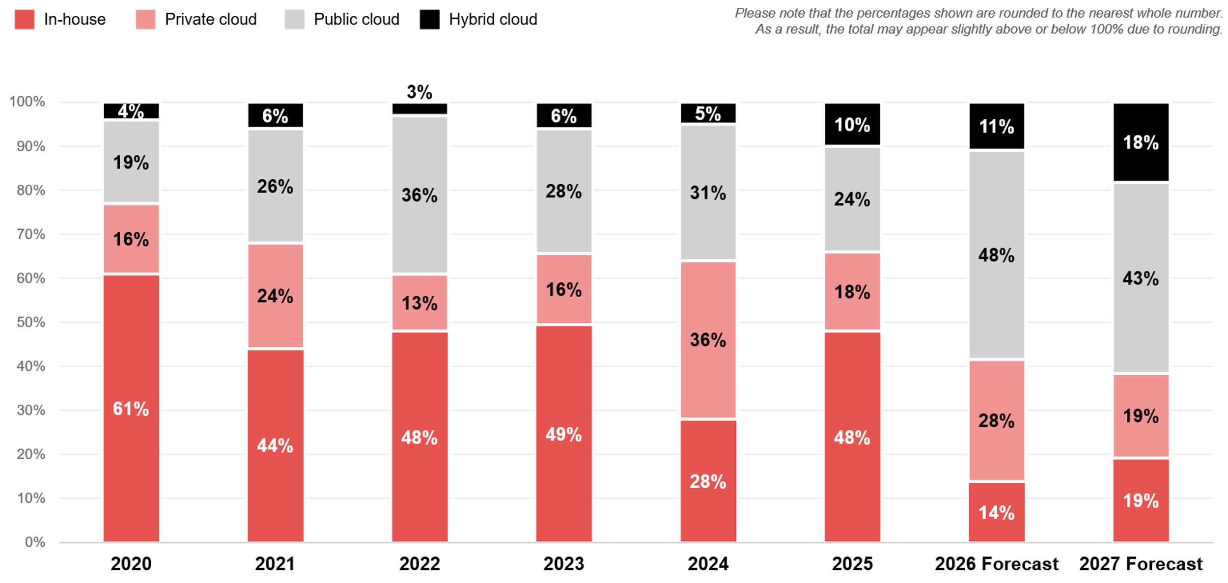
Government: Cloud migration trends 2020 – 2027
ADAPT CIO, Cloud and Infrastructure, and Government Edge Surveys from 2020 to 2025. Sample size: 214 Australian CIOs, Infrastructure leaders and Government leaders from Government

Slide 10
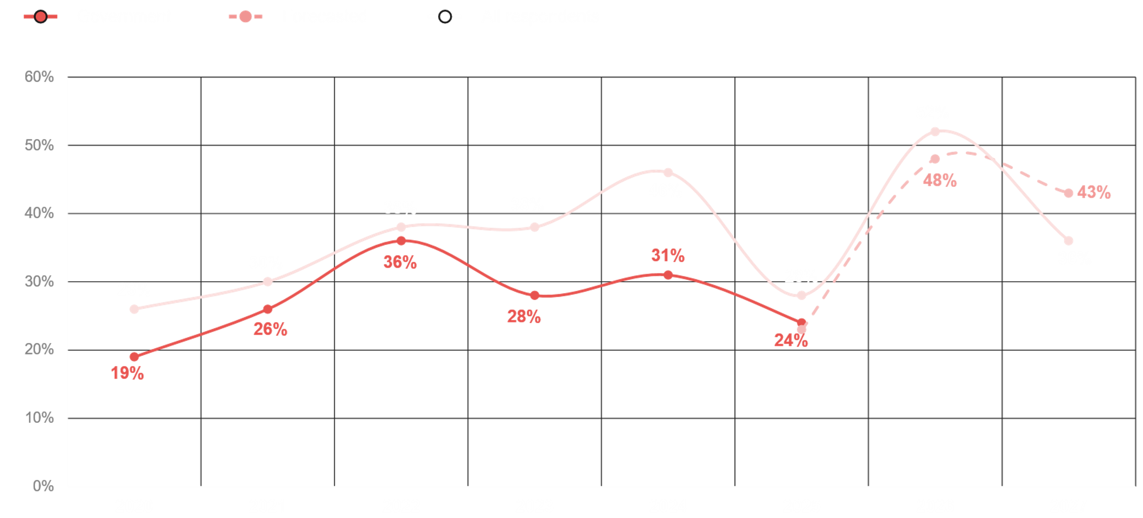
Migration to public cloud: Government vs all respondents
ADAPT CIO, Cloud and Infrastructure, and Government Edge Surveys in from 2020 to 2025. Sample size: 2, 282 Australian CIOs, Infrastructure leaders and Government Leaders, 214 from Government

Slide 11
Shifting from in-house to public cloud
Over the next 12 months, government agencies plan to reduce in-house workloads and migrate
most of them to the public cloud. In-house infrastructure is declining, indicating a high priority for cloud-based solutions.
Public cloud migration is driven by the need for cloud readiness, enabling robust AI strategies and access to modern AI platforms and tools for faster deployment and system integration.
No one-size-fits all approach
Not all workloads can move to the public cloud. Agencies must adopt a best-fit cloud model based on data type, workload, and service requirements. This trend aligns with broader industry patterns (ADAPT Tech Trend report, Sep 2025).
Private cloud emerges as the leading choice for government after public cloud
For workloads unsuitable for public cloud services, private cloud is expected to become the next preferred option. (See NSW State Government Cloud Policy).
Ultimately, data location determines the execution environment, whether in-house, public, private,
or hybrid cloud.
Government organisations lag behind other sectors in public cloud migration
This often results in agencies having a low level of maturity when it comes to data interoperability.
ADAPT’s Government Edge Survey (Oct 2025) reveals that government mostly excels in data-sharing policy maturity, but data quality and lineage lag because they depend on modern cloud platforms and integrated workloads, many of which have not yet been migrated.
Persona Mapping: Government leader
Cloud migration
Australian government leaders plan to
double their public cloud workloads within
the next year.
Hybrid cloud is emerging, while private cloud is projected to grow by 1% over the next 2 years.
Government organisations lag behind other sectors in public cloud migration, with 24% of workloads in the public cloud for government, compared to 28% for other sectors.

Slide 12
Execution barriers

Slide 13
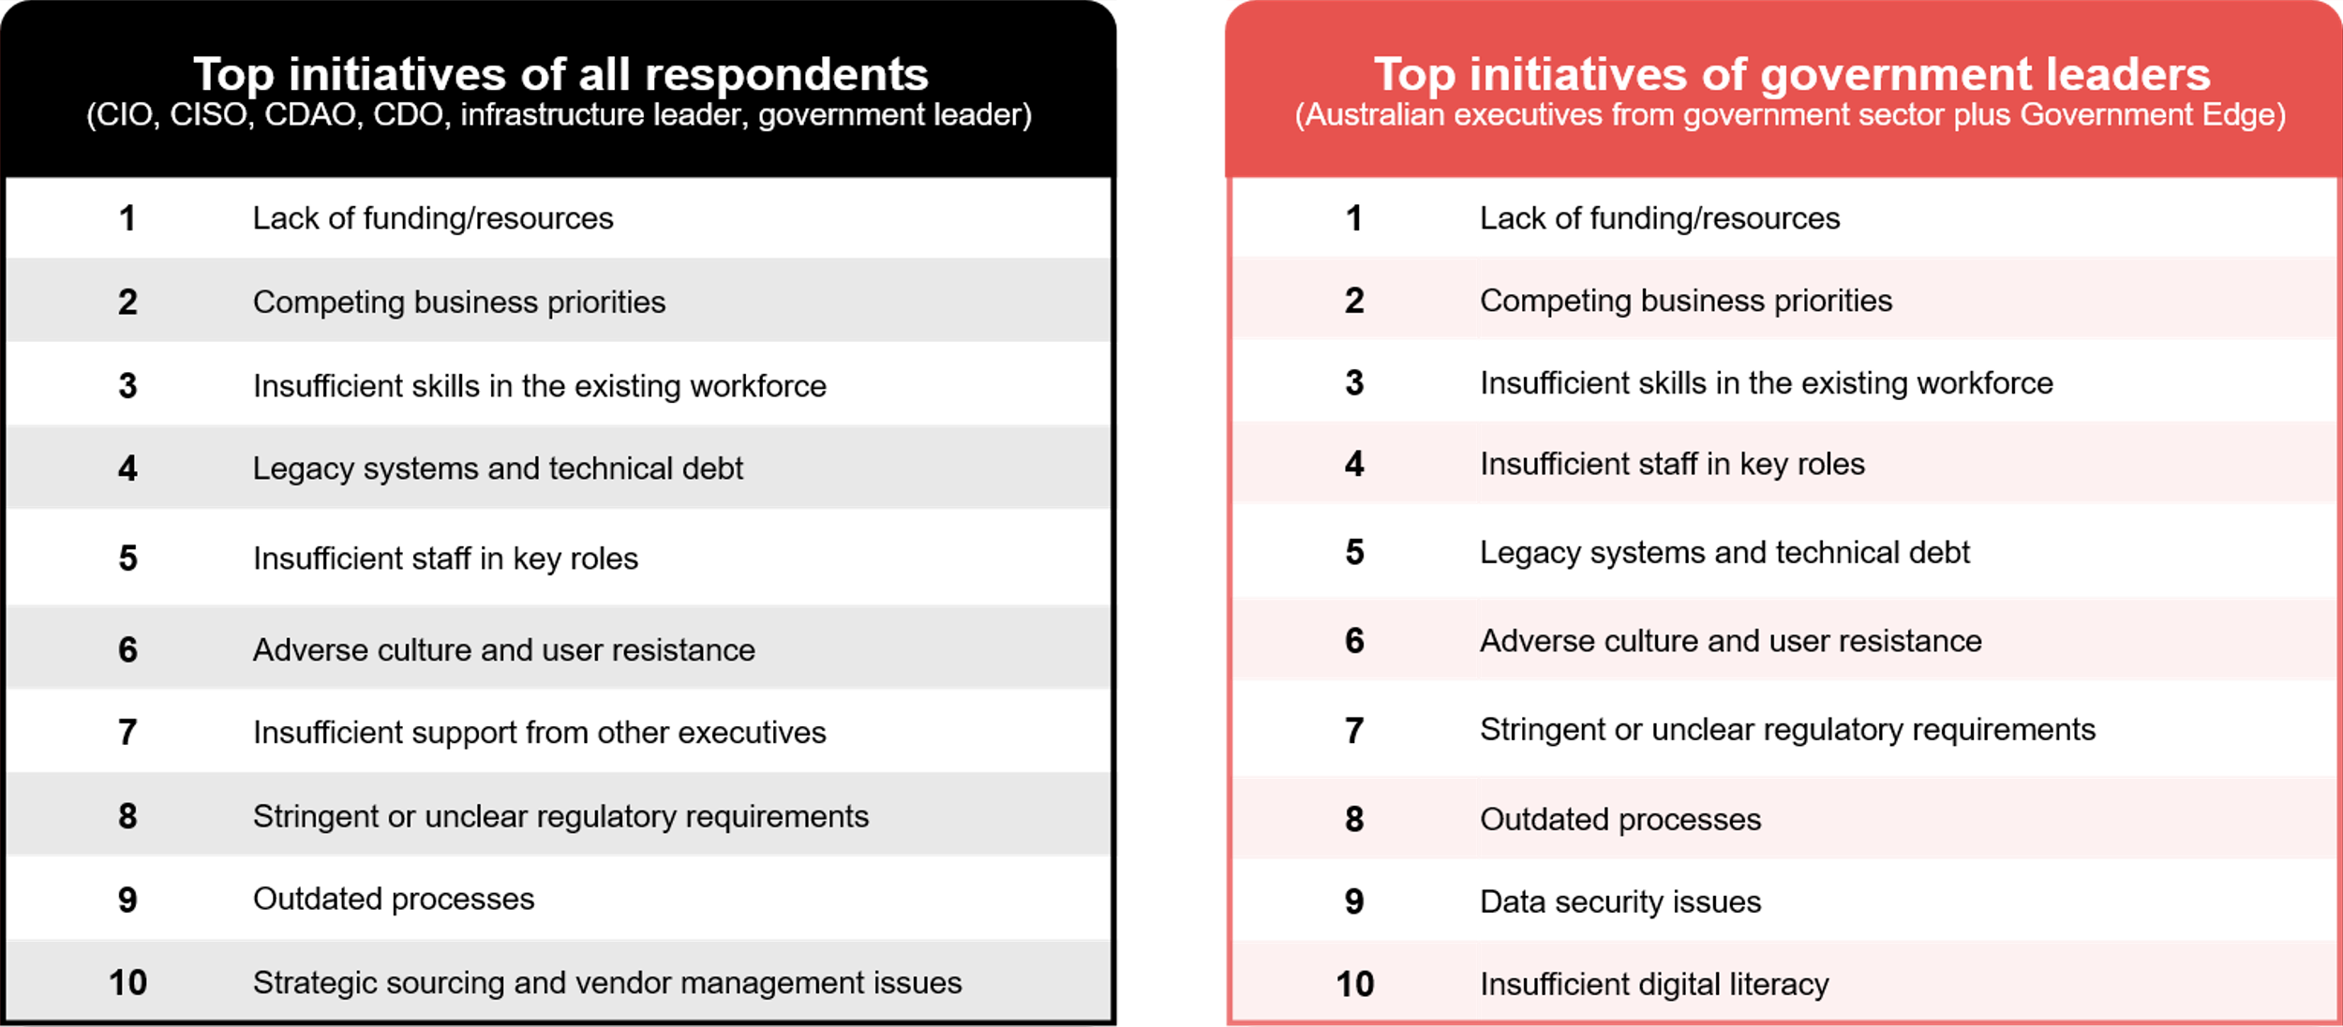
Private sector and government organisations face the same barriers
Top barriers: Private sector vs federal government
Source : ADAPT Edge Surveys from Feb to Oct 2025. Sample size : 1,121 Australian CIOs, CISOs, CDAOs, CDOs,
Infrastructure Leaders and Government Leaders, including 223 from Government

Slide 14
Persona Mapping: Government leader
AI requires upfront investment before value is realised
Like private organisations, government agencies are investing in data platforms, cloud infrastructure, security and governance, and change management (see slide 6) to secure AI strategy and
modernisation outcomes.
However, with insufficient funding, structure, or skills, agencies struggle to justify budgets against more urgent operational needs.
Skills shortage keeps AI strategy conceptual
AI roadmaps and modernisation initiatives require specialist skills (AI, data and cyber security expertise).
These roles are scarce and highly competitive in the Australian labour market (see the Data and Digital Government Strategy report).
Legacy systems further hinder agencies’ ability to leverage AI and secure infrastructure that supports modern workloads. Without cultural adoption, changes cannot be sustained.
Regulatory requirements, outdated processes, and data security issues
Government agencies operate under strict legal, privacy, data residency, and audit requirements.
Leaders often face contradictory expectations, slowing AI roadmap development.
Government processes prioritise accountability and consistency, not speed,
creating friction for innovation.
Uplifting AI literacy
Security concerns slow AI and modernisation initiatives, making AI literacy a critical
leadership competency.
The Australian government has developed GovAI, which is designed to uplift AI capability, enabling efficient ways of working and enhancing productivity across all APS agencies
Execution barriers
The three most significant barriers for government agencies and organisations are:
1. Lack of funding
2. Competing priorities
3. Insufficient skills
Skills and capacity gaps, legacy systems and cultural resistance remain operational blockers to innovation.
The bottom four execution barriers relate to delays in developing and executing an AI strategy and roadmap.

Slide 15
Survey demographics

Slide 16
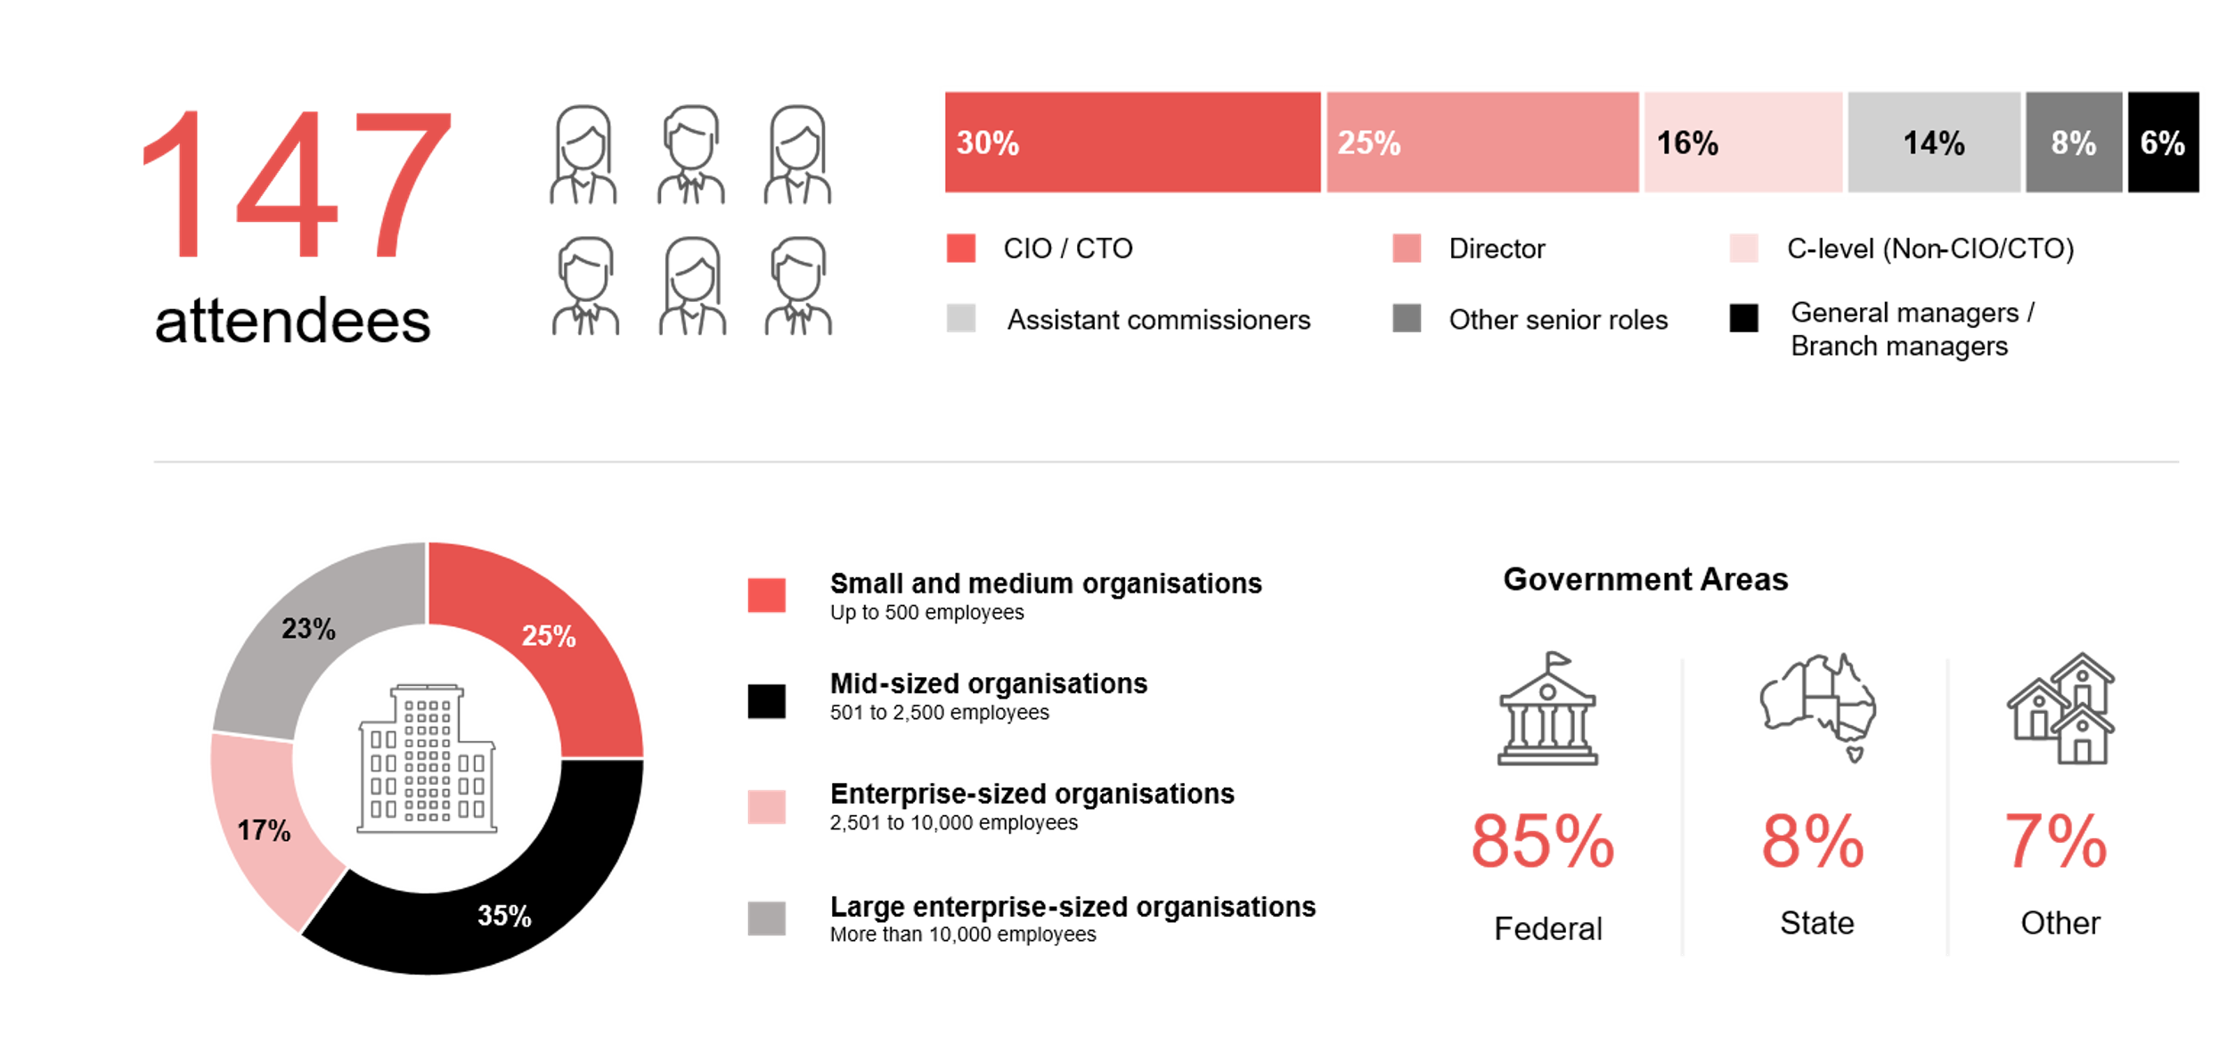
Survey demographics: Australian government leaders in 2025

Slide 17

For sector, segment and persona comparisons
Central limit theorem a fundamental concept in statistics that determines when a sample size is large enough
to be considered reliable. There are different formulas and some debate amongst statisticians about the appropriate sample size. For industry comparisons or other subset analyses, a sample size of ( n > 20 ) is generally considered acceptable for drawing meaningful insights. This threshold aligns with common statistical practices, where a
sample size of 20 to 30 is generally the minimum needed to assume a normal distribution of the data.
Sample sizes below 20, but equal to or greater than 15
When the sample size is between 15 and 20, while not fully representative, it can still offer valuable insights
into trends. These statistics should be viewed as indicative, highlighting general directions in industry efforts
or barriers to investment but treated with some caution due to the smaller number of observations.
Sample sizes less than 15, but greater or equal to 10
For samples between 10 and 15, the data provides a snapshot guideline only. While such small samples can
show early trends, it's important to recognise that this doesn't guarantee future respondents will reflect the same trends. For instance, while 100% of respondents in a sample of 10 might invest in AI, it'd be unrealistic to assume
this pattern will hold as the sample size grows. However, if the sample size increases to 20, it's unlikely
that the trend will change drastically, and the next 10 respondents will have no investment.
ADAPT Data Analytics:
Notes on sample sizes
Why does sample size matter?
Each set of statistics is unique with measures,
distribution, variance and sample size. It is generally accepted in statistics that as sample size increases, analysts make fewer assumptions about the data, resulting in statistics that more accurately represent the truth.
ADAPT endeavours to provide transparency of sample size, whereby we provide a source on data slides with
the number of respondents and the survey where those respondents come from. In data and insights slide decks, ADAPT usually provides some insight on the breakdown
of the demographics at the end of the slide deck.
To protect privacy, ADAPT does not release lists
of individual respondents to surveys.

Slide 18

Written by
Honey Mari Gay
Junior Data Analyst at ADAPT
As a Junior Data Analyst at ADAPT, Mari enables the discovery and definition of market trends through visually meaningful statistics.
She ensures data presentations are accurate and aligned with modern statistical standards.
Mari is passionate about data and transforming it into actionable insights. With over three years of experience in project management and academic research, she has led end-to-end survey and research projects, processed and analysed data using a range of statistical tools
and techniques, and provided clients with statistical consultation and insights.

Slide 19

About ADAPT
ADAPT is a specialist Research & Advisory firm providing local market insights and benchmarking data
to Australia and New Zealand’s senior technology and business community.
Since 2011, we’ve been empowering the leaders of the region’s top enterprise and government organisations
to stay at the forefront of modern trends and build for the future. Our industry leading conferences, private roundtable events and custom research projects equip business leaders with the knowledge, relationships, inspiration and tools they need to make better strategic decisions.
adapt.com.au | hello@adapt.com.au
Data Validation
Results contained in this report (Report) are based on survey responses as provided by our clients and publicly available information. ADAPT does not subject the data contained in the Report to audit or review procedures or any other testing to validate the accuracy or reasonableness of the data provided by the participating clients. While we do not manipulate the survey responses, we do make an effort to identify outlier data or conflicting results that could lead to misinterpretations before the preparation of the Report.
Intended Use of the Report
The Report is designed to help technology executives in Australia and New Zealand make independent decisions regarding financial, resourcing and operational performance matters. The information and data contained in the Report are provided as is and are for information purposes only. They are not intended or implied to be recommendations and in no event will ADAPT be liable for any decisions or actions taken in reliance of the results obtained through the use of the information and/or data contained in the Report.
Research MSA and Privacy Policy
The Report and any other information provided by ADAPT is subject to the Research and Advisory Master Services Agreement and the ADAPT Privacy Policy.

Slide 20




Additional resources you can access
Members of ADAPT’s Research & Advisory platform have access to an entire suite of market leading content, insights and resources to help you execute in your role. For any assistance contact your Account Manager in the help section.
Community case studies and interviews
Case studies detailing the successes
and challenges of projects and initiatives.
Market Trend Reports Access a library of fact-based actionable insights, deep dives on ANZ business & IT trends.
Live access to ADAPT analysts
Through live ADAPT analyst market briefings and Q&A sessions
Downloadable data and insights
Elevate your business cases with downloadable market and industry data.
Industry expert presentations
Watch keynotes or read distilled 1-page executive summaries from our Edge Events.
Bespoke analysis of ADAPT data
Receive custom cuts and analysis of ADAPT proprietary data.
Premier executive community
Unlock access to our exclusive network of Australia’s leading technology and business executives.
Dedicated account manager and impact assessments
Your Account Manager will ensure you and your team are getting the most out of your subscription.
Dedicated analyst briefing
Leverage a dedicated briefing with an ADAPT analyst to help validate your strategies.
*Inclusions may vary depending on subscription level.

Slide 21

adapt.com.au | hello@adapt.com.au | +61 (2) 9435 3535

