Slide 1

ADAPT Persona Map
How CIOs Are Achieving Business Growth
by Investing in AI Agents and Generative AI

Slide 2
In this report, you'll find insights into how CIOs are achieving business growth
by investing in AI agents and generative AI.
The key areas of focus are:
Growing the business as the #1 priority
CIOs now view modernising tech and boosting operational effectiveness as key drivers for
business growth, with AI playing a critical role. Optimising costs is also important.
Acquiring more customers drives business growth, while other key outcomes include digitising processes, advancing digital transformation, building trust, and becoming more data-driven.
Adopting AI to deliver measurable value quickly
Piloting GenAI ahead of traditional IT modernisation indicates a strong intent to showcase AI’s
potential through quick wins.
Although CIOs are placing AI at the centre of their investment priorities, budgets remain misaligned.
Transforming the workforce with AI
Even as leadership development, digital fitness, capabilities and culture slip from the top of CIO investment priorities, significant spending on people and skills continues.
The goal is to equip employees with the capabilities required for an AI-driven, modernised organisation.
Implementing AI initiatives and priorities while facing budget and resource constraints
Budget / resource pressures are forcing CIOs to take a selective approach to AI and IT initiatives.
Instead of pursuing broad transformation, they’re narrowing their focus to initiatives and priorities
that can deliver measurable value instantly.
Persona Mapping: CIO
Key takeaways
Business growth has emerged as the #1 goal for Australian CIOs, surpassing modernisation, which ranked first in the previous six months and is now the #2 goal.
The #1 initiative is to pilot and adopt generative AI (GenAI), followed by modernising back-office systems.
AI investments are highly prioritised.
However, only 4% of budgets are
currently allocated to innovation.
Although the largest share of funding goes toward people and skills, a shortage of qualified staff and expertise remains a major obstacle.
The #1 and #2 execution barriers are
still the lack of funding/resources
and competing priorities.

Slide 3

Goals and initiatives

Slide 4
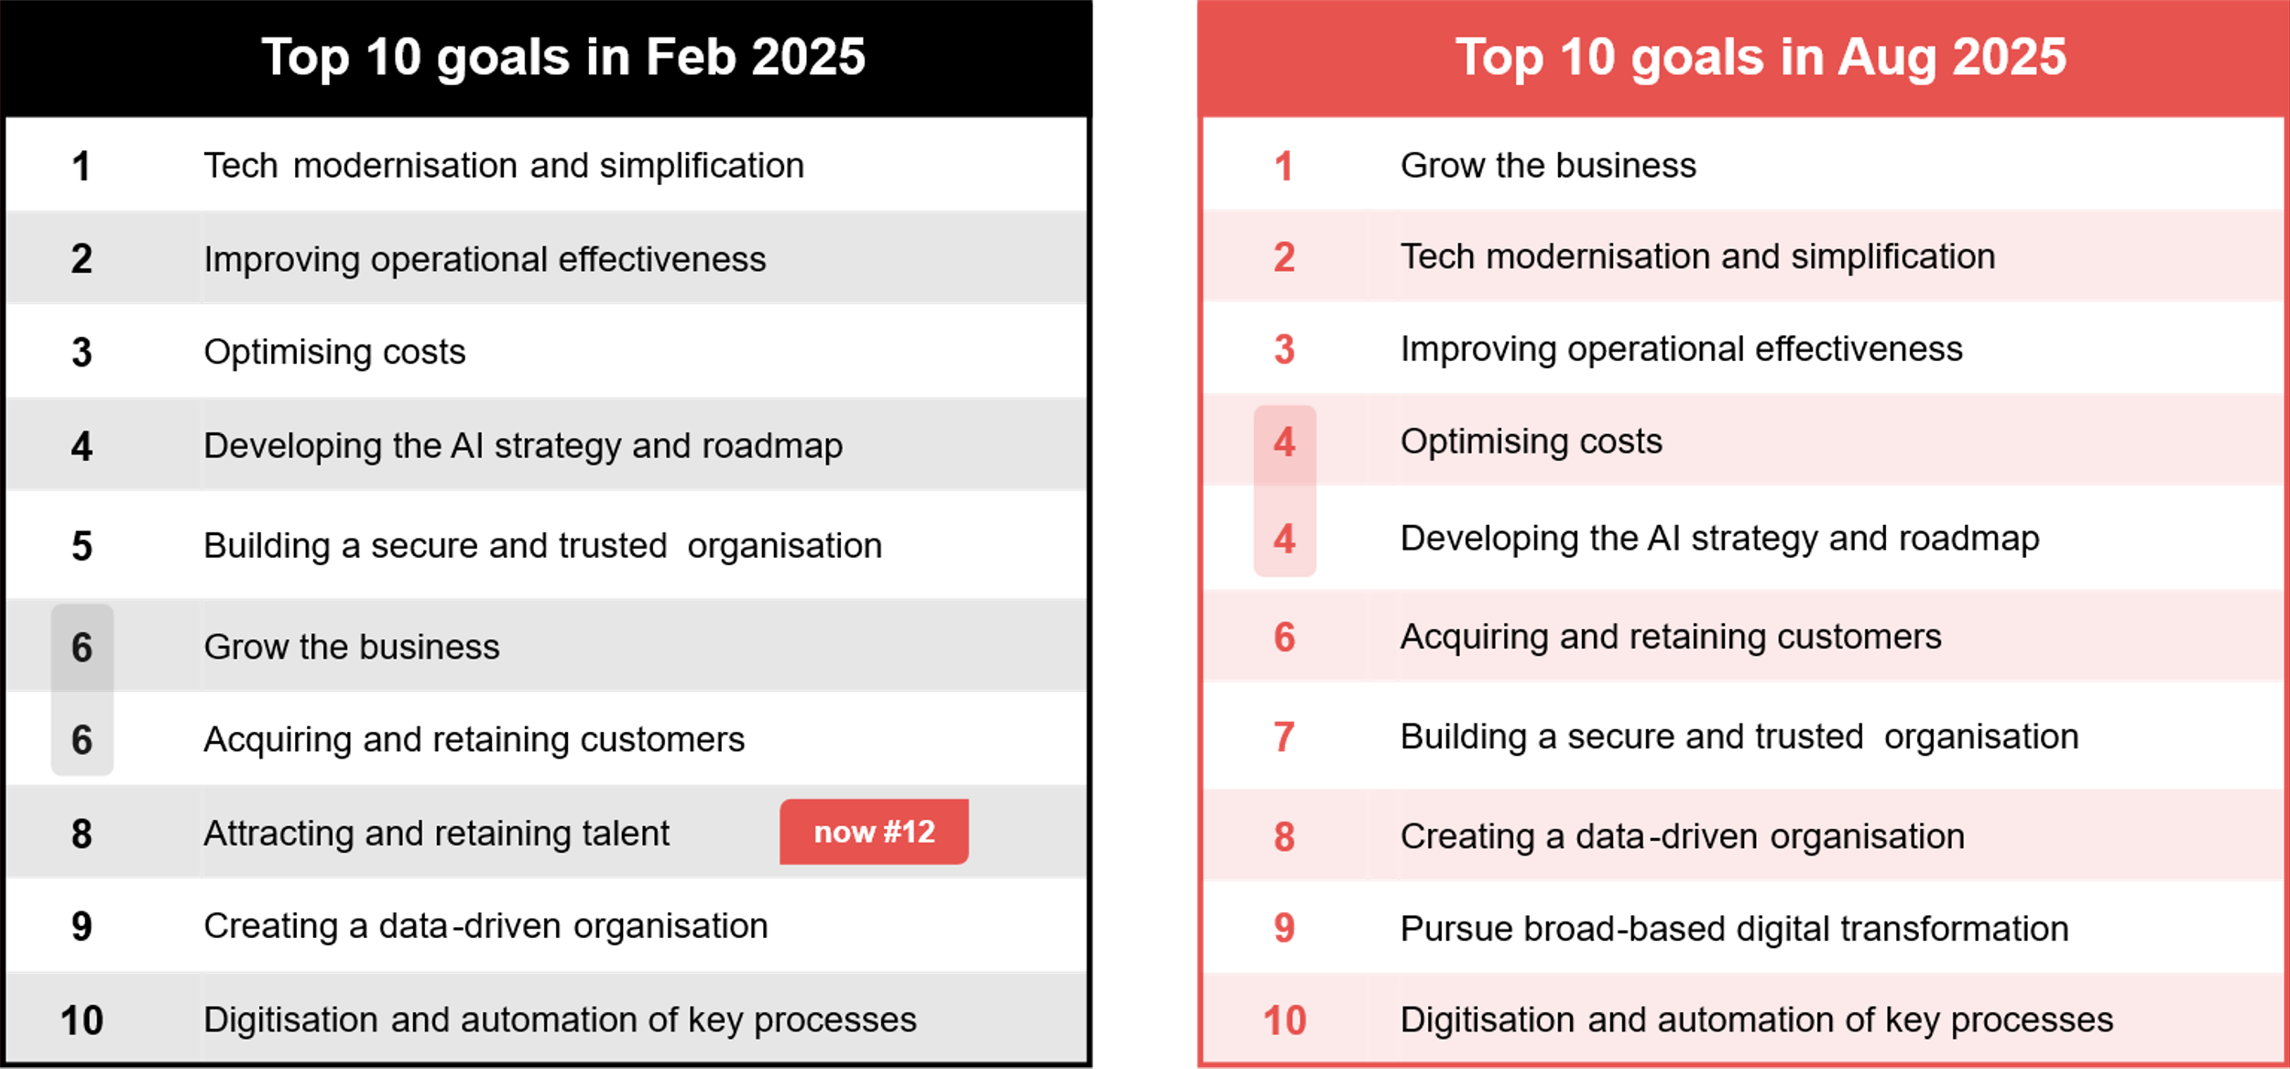
CIOs’ organisational goals: Feb 2025 vs Aug 2025
Source : ADAPT CIO Edge Surveys in Feb and Aug 2025. Sample size : 371 Australian CIOs

Slide 5
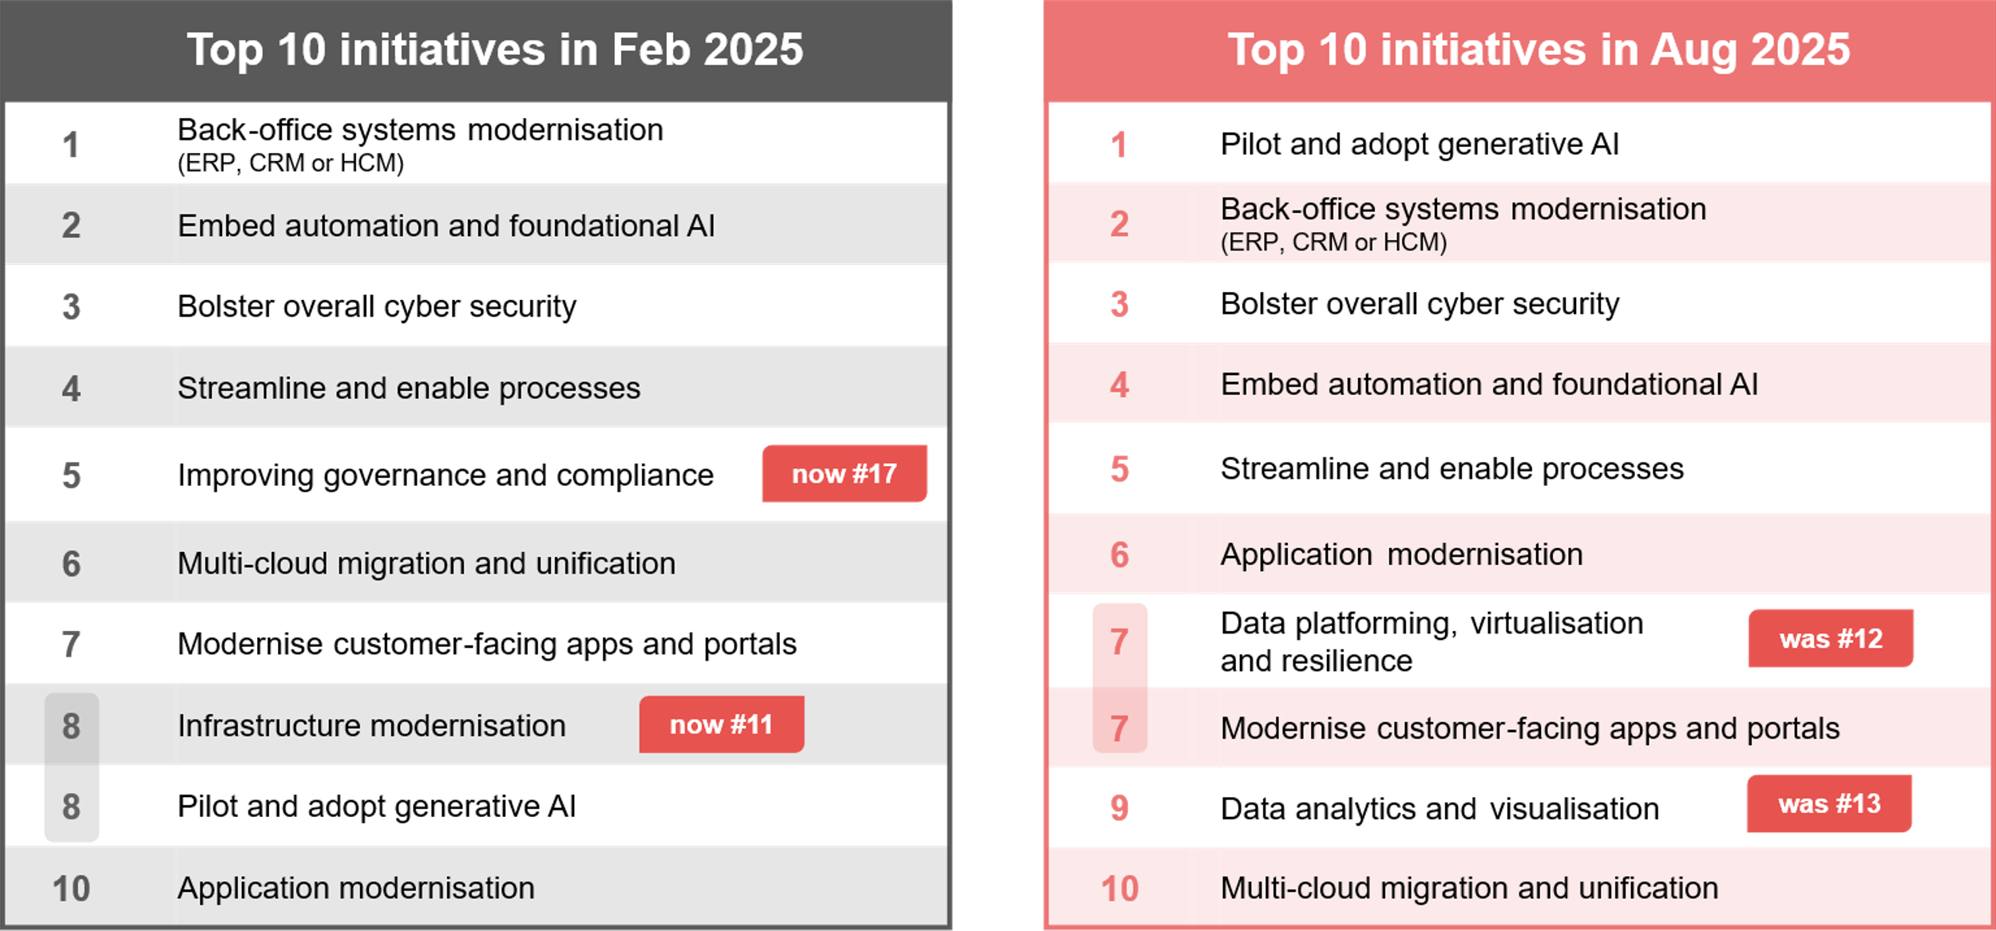
CIOs’ initiatives: Feb 2025 vs Aug 2025
Source : ADAPT CIO Edge Surveys in Feb and Aug 2025. Sample size : 364 Australian CIOs

Slide 6
Growing the business is the goal of Australian CIOs for the coming 12 months
CIOs strive for business growth by leveraging technology to improve operational effectiveness.
Adopting AI is also a key component for organisations modernising their tech infrastructures.
The change in modernisation’s ranking suggests it's no longer just an IT objective but is now viewed
as a catalyst for growth, driven by operational excellence to ensure scalability and profitability.
Goals #6 to #10 strongly support business growth
Digitisation and automation directly fuel growth, while digital transformation redefines how value is created and delivered. This alignment enables CIOs to integrate customer experiences, supply chains, analytics, and innovation pipelines under a unified strategy. As customer growth anchors business expansion, securing trust and becoming more data-driven help ensure agility and resilience.
Balancing the adoption of AI capabilities by strengthening core systems and data platforms
As generative AI relies on strong digital foundations, high quality, secure and well-governed
data is crucial.
Multi-cloud plays a critical role in GenAI pilots and adoption by providing access to best-of-breed AI services and optimising compute resources for AI training. In addition, modernised core systems and customer applications ensure AI solutions can run effectively in production environments.
Shifting from governance to data-driven initiatives
The decline in priority for governance and infrastructure modernisation suggests these foundational investments are progressing well. Meanwhile, the strong uptake of data initiatives shows that CIOs
are focused on leveraging their growing data assets to drive innovation.
The high ranking of cyber security points to the ongoing challenges in securing systems and data.
Persona Mapping: CIO
Growing the business as the #1 outcome
Growing the business has jumped from #6 to the #1 goal of Australian CIOs for the past six months. Modernisation is now the #2 goal.
Digital transformation has grown in importance. However, talent attraction and retention have become lower priorities, suggesting that organisations may have made progress in this area or resolved major challenges.
GenAI adoption has quickly become the top priority for CIOs, while data-related initiatives, such as platforming and analytics, have also risen significantly in importance.
Governance and infrastructure modernisation have become lower priorities as CIOs shift their focus toward data-driven initiatives.

Slide 7
Funding and investment

Slide 8
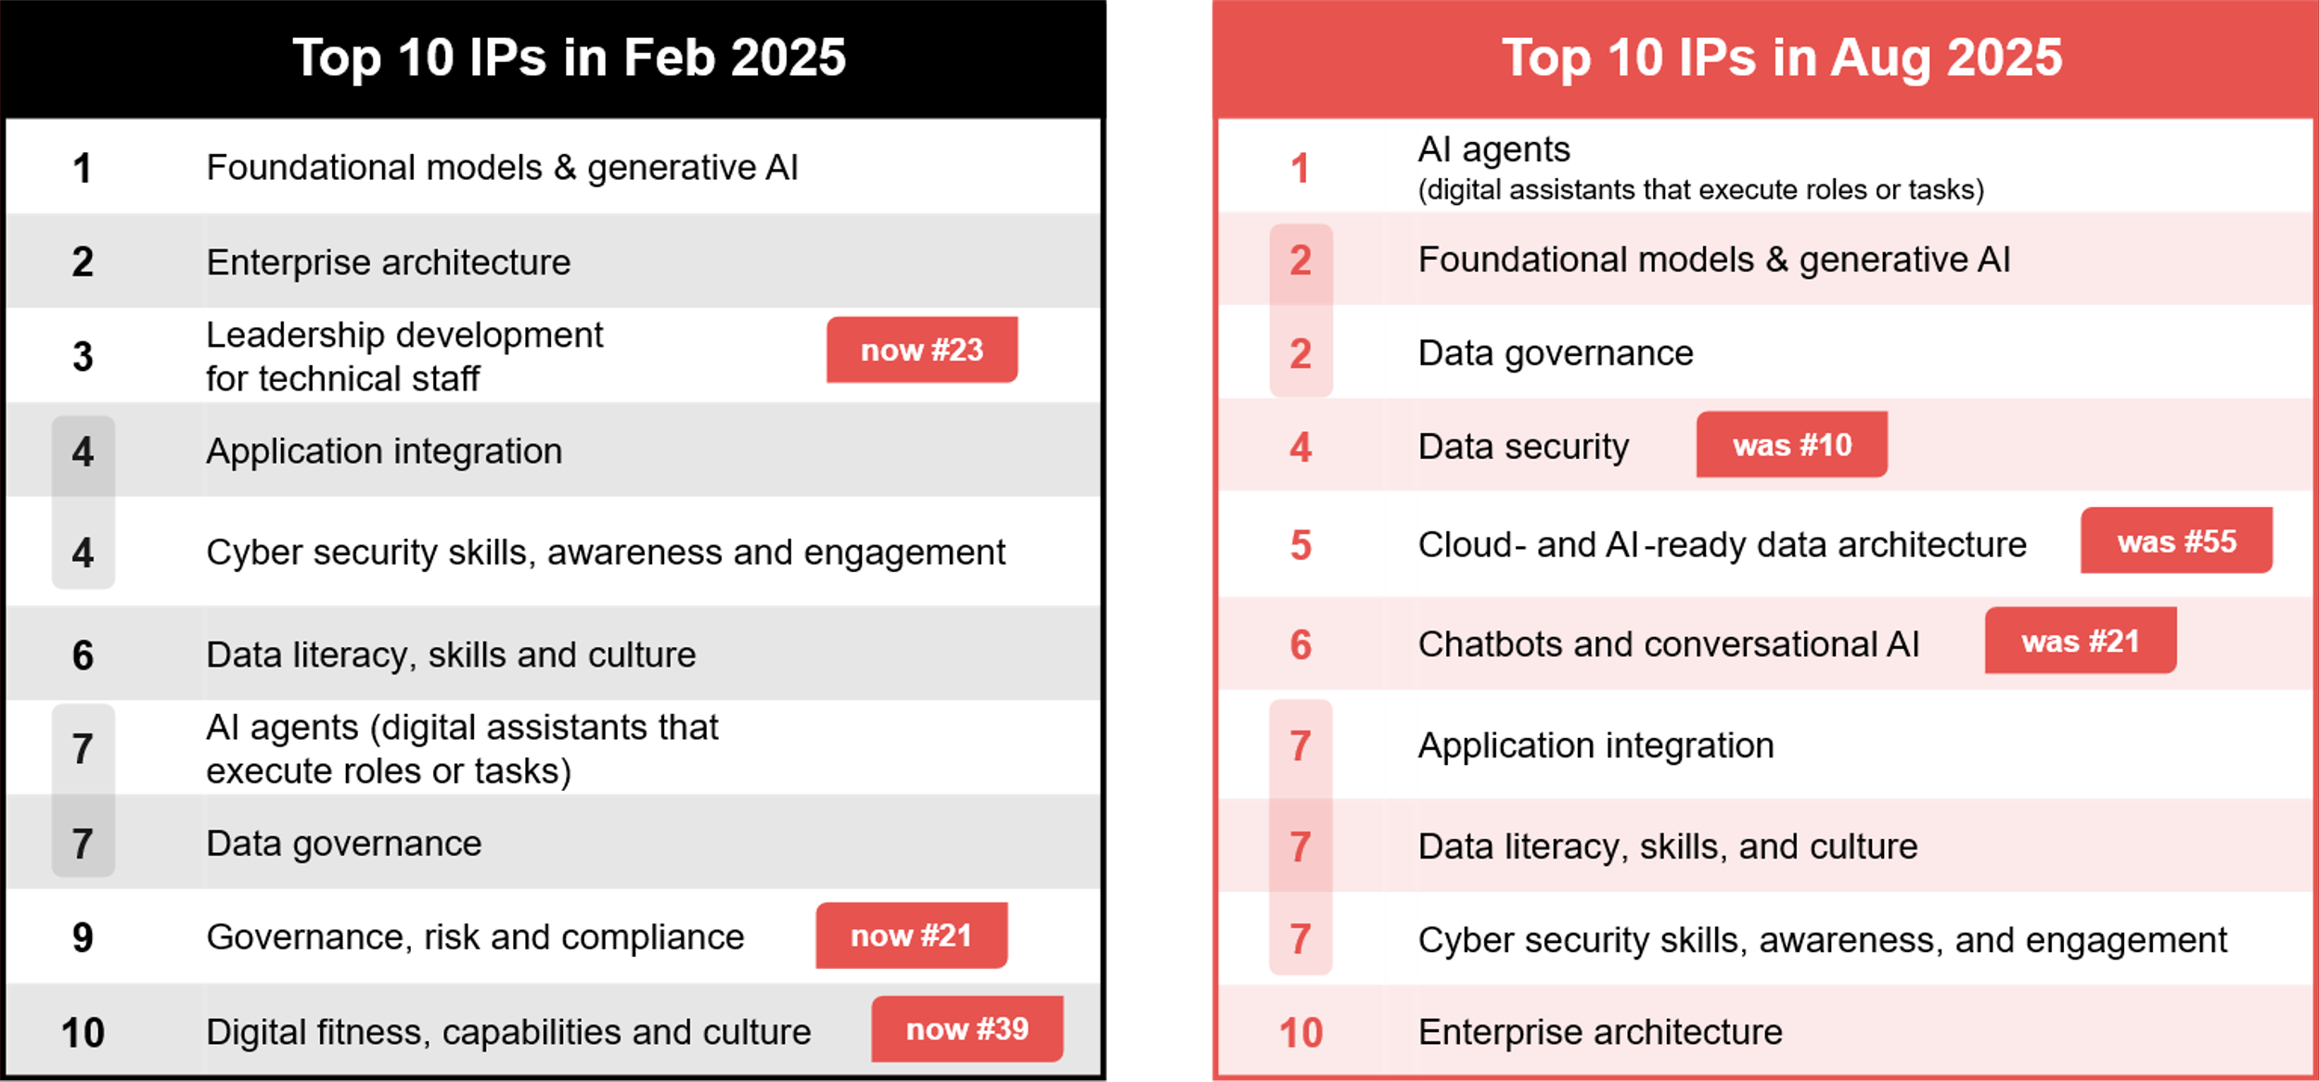
Investment priorities according to CIOs: Feb 2025 vs Aug 2025
Source : ADAPT CIO Edge Surveys in Feb and Aug 2025. Sample size : 370 Australian CIOs

Slide 9
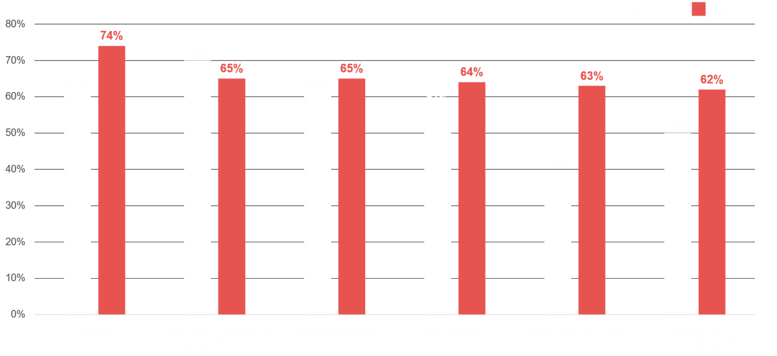
AI- and data-related investment priorities: Feb 2025 vs Aug 2025
Source : ADAPT CIO Edge Surveys in Feb and Aug 2025. Sample size : 370 Australian CIOs

Slide 10
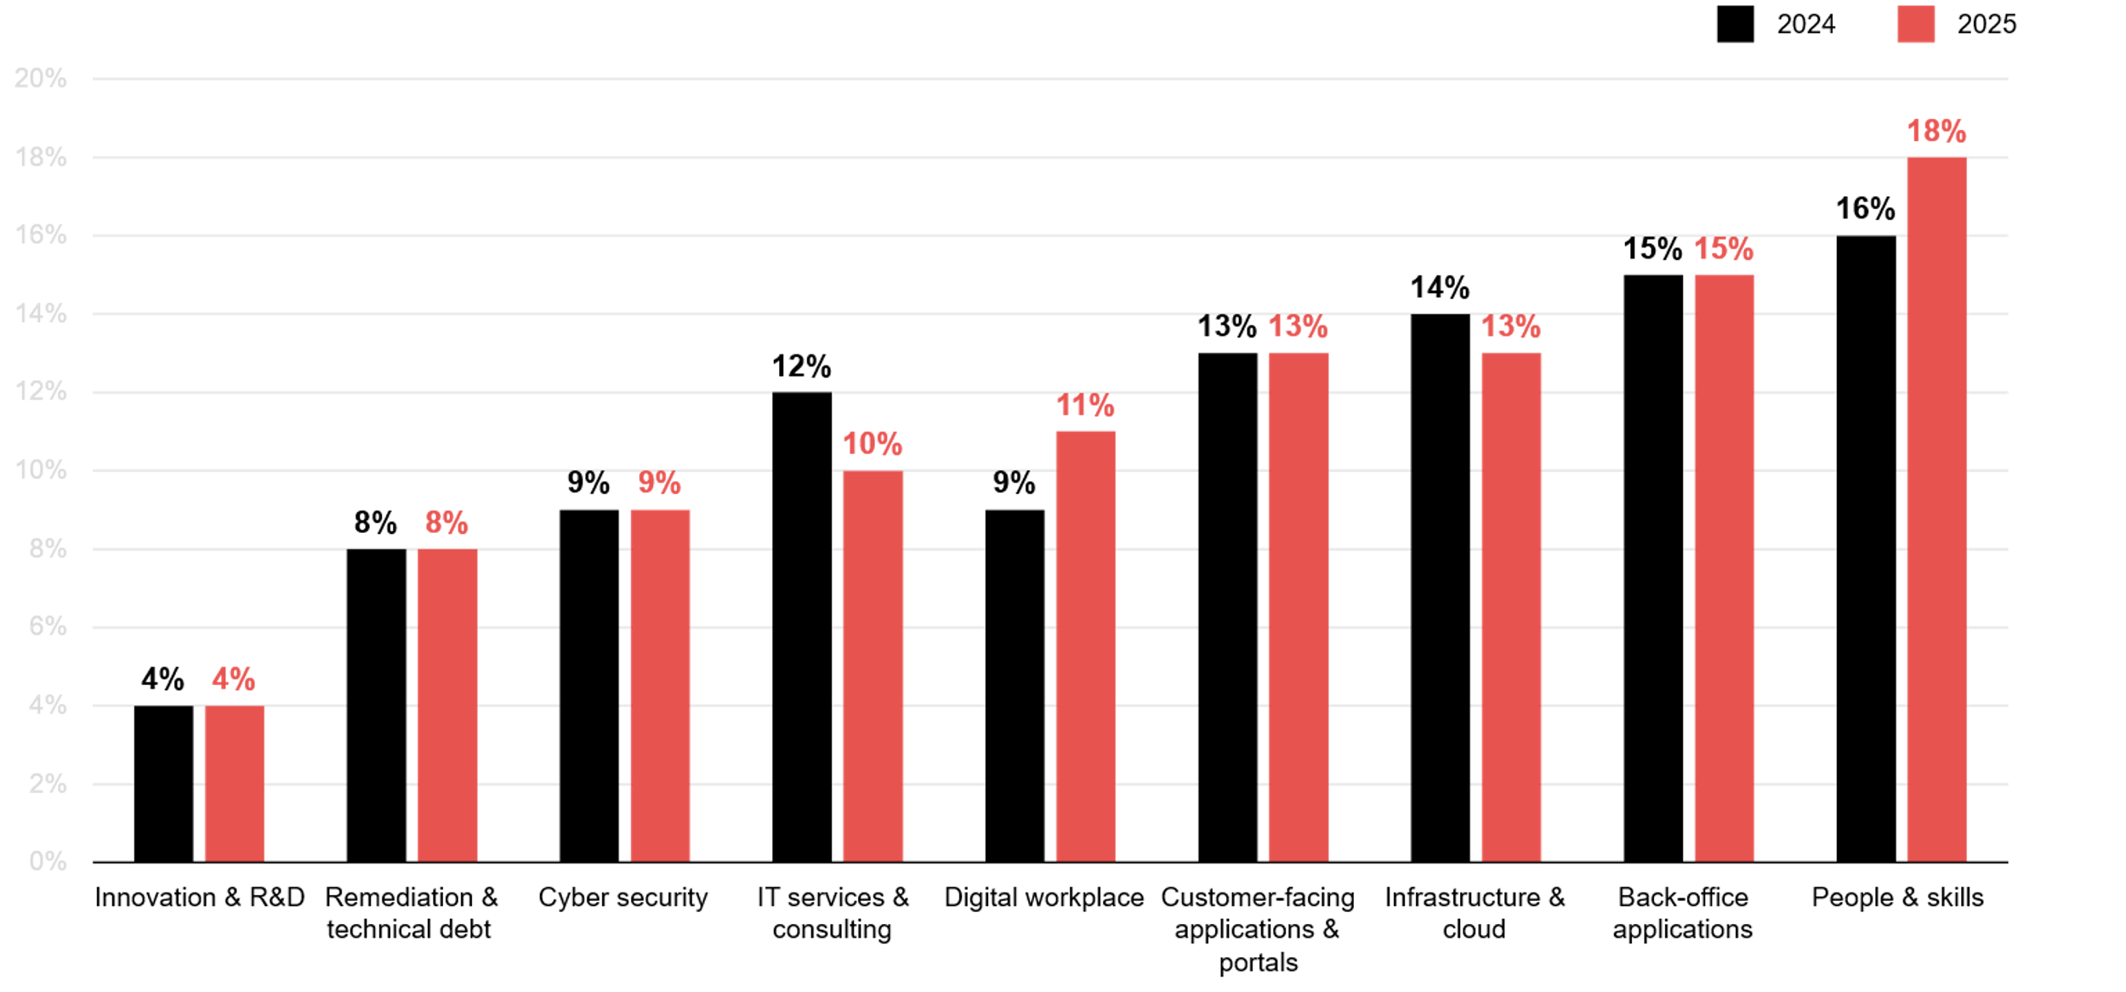
IT budget allocation: 2024 vs 2025
Source : ADAPT CIO Edge Surveys in Feb and Aug 2024 and Aug 2025. Sample size : 277 Australian CIOs

Slide 11
AI and data-related technologies dominate the top investment priorities
High investment in AI agents aligns with the need to drive cost efficiency and intelligent automation.
While some organisations may have reduced their investments in generative AI, it remains a high asset.
These two IPs free up significant resources, enabling the scaling of business growth initiatives. Additionally, governance and data security are critical to ensuring AI outputs remain reliable, ethical, and secure.
Increasing investment priority on data governance
The focus on data governance, security and architecture demonstrates the significant role of data in driving business value. Additionally, CIOs are under pressure to show direct impact on revenue, cost reduction and efficiency, where governance delivers more indirectly.
Higher investment priority in cloud- and AI-ready data architecture
Modernising data infrastructure is essential to support both transformation and AI initiatives while reducing long-term infrastructure costs. Although some organisations have trimmed IT budgets for infrastructure
and cloud compared to last year, this area remains among the top 3 most funded priorities.
Investing in customer-centric IT
As CIOs continue to prioritise customer acquisition and retention, they are focusing on chatbots, conversational AI, and application integration. These investments demonstrate a commitment to agile operations by enhancing customer experience and streamlining IT infrastructures.
Reshaping the workforce, not just growing it
The declining emphasis on leadership development, skills, and culture suggests these areas are being overshadowed by urgent technology priorities.
However, despite no longer being a top priority, CIOs continue to allocate significant budgets to people initiatives—indicating a shift toward reshaping the workforce rather than simply expanding it.
Persona Mapping: CIO
Higher investment priorities in AI and data, and more spending on people
More Australian organisations are planning
to invest in AI agents by next year, rising
from 61% in February 2025 to 74% in August.
While governance (ranked #17) may have moved down the list of CIO priorities, it continues to evolve steadily and remains budgeted for.
Cloud and AI-ready data architecture has the most significant increase in investment priority, from 39% to 63% within 6 months.
CIOs have also increased the priority of chatbots and conversational AI, rising from
50% to 62% in just six months.
The largest IT spending continues to focus on skills and workforce development.

Slide 12
Execution barriers

Slide 13
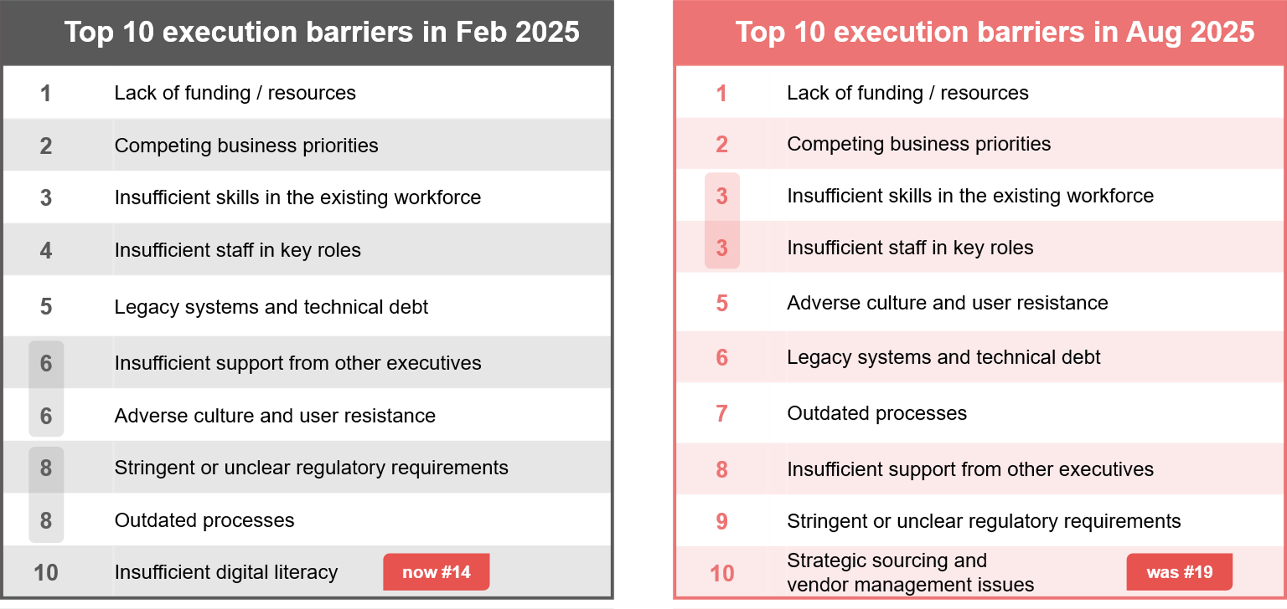
CIOs’ execution barriers: Feb 2025 vs Aug 2025
Source : ADAPT CIO Edge Surveys in Feb and Aug 2025. Sample size : 354 Australian CIOs

Slide 14
Despite tight budgets, CIOs are still expected to deliver on major transformation goals.
In the past 6 months, 60% of CIOs have struggled to justify IT investments, and 50% report having no visibility into tech spending (ADAPT Article, Mar 2025). Although AI investments, such as AI agents and GenAI, are accelerating, they remain under-resourced, with AI budgets accounting for only 4% of total tech spend. As a result, CIOs are expected to modernise back-office systems and deliver AI strategies despite shrinking budgets.
Competing priorities stem from the need to modernise ERP and adopt AI, while reducing spend
Back-office systems and AI roadmaps clash with shrinking resources. AI agents and generative AI are seen as essential but underfunded. CIOs are often pressured to improve operational effectiveness while enhancing customer experience.
People and skills: The biggest spend, yet CIOs struggle with its limitations
People and skills remain the largest spending area, yet CIOs continue to face its limitations. They're under pressure to modernise core systems while operating with constrained service budgets, just 10% of total IT spend. This limited allocation restricts outsourcing and forces CIOs to prioritise process simplification and automation.
Tech and compliance challenges
Legacy systems remain a critical issue. According to ADAPT's CIO Edge Survey (Aug 2025), 40% of mission-critical applications still run on legacy technology, meaning CIOs must modernise with fewer resources and tighter budgets. Outdated processes further hinder progress.
Additionally, managing regulatory risks is crucial, as these directly impact AI roadmaps
and security postures.
Persona Mapping: CIO
Execution barriers
The top 4 execution barriers for Australian CIOs over the next 6 months remain a lack of funding and resources, competing priorities, and insufficient skills and staff.
Competing priorities stem from the need to modernise ERP and adopt AI, while reducing spend.
CIOs also face challenges such as limited talent, cultural resistance, and insufficient executive support, all amid tight budgets and service cuts. They are also expected to deliver complex transformations.
Other barriers such as legacy systems, tech debt, outdated processes and stringent regulatory requirements continue to hinder CIOs' execution capabilities.

Slide 15
Survey demographics

Slide 16
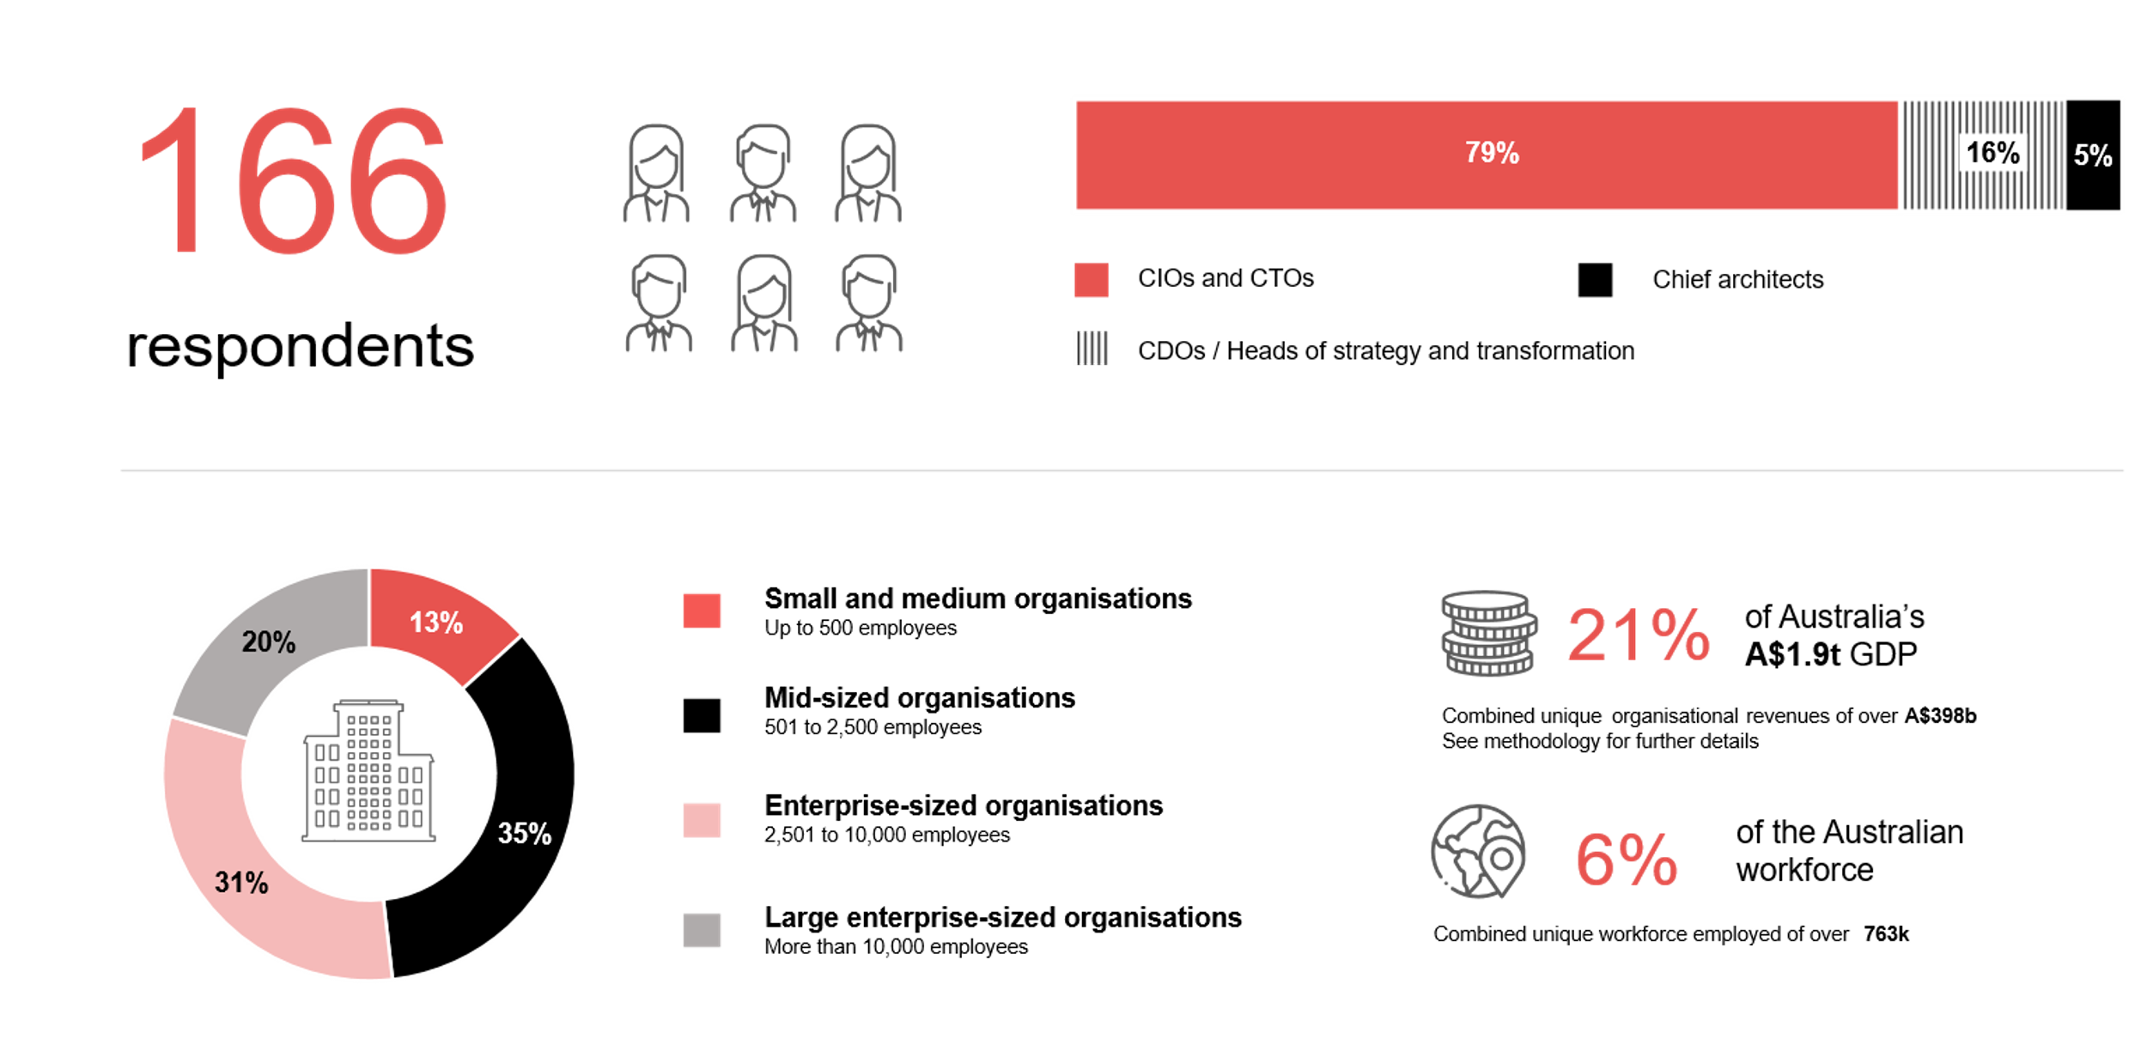
Survey demographics: Australian CIOs in 2025

Slide 17

For sector, segment and persona comparisons
Central limit theorem a fundamental concept in statistics that determines when a sample size is large enough
to be considered reliable. There are different formulas and some debate amongst statisticians about the appropriate sample size. For industry comparisons or other subset analyses, a sample size of ( n > 20 ) is generally considered acceptable for drawing meaningful insights. This threshold aligns with common statistical practices, where a
sample size of 20 to 30 is generally the minimum needed to assume a normal distribution of the data.
Sample sizes below 20, but equal to or greater than 15
When the sample size is between 15 and 20, while not fully representative, it can still offer valuable insights
into trends. These statistics should be viewed as indicative, highlighting general directions in industry efforts
or barriers to investment but treated with some caution due to the smaller number of observations.
Sample sizes less than 15, but greater or equal to 10
For samples between 10 and 15, the data provides a snapshot guideline only. While such small samples can
show early trends, it's important to recognise that this doesn't guarantee future respondents will reflect the same trends. For instance, while 100% of respondents in a sample of 10 might invest in AI, it'd be unrealistic to assume this pattern will hold as the sample size grows. However, if the sample size increases to 20, it's unlikely
that the trend will change drastically, and the next 10 respondents will have no investment.
ADAPT Data Analytics:
Notes on sample sizes
Why does sample size matter?
Each set of statistics is unique with measures,
distribution, variance and sample size. It is generally accepted in statistics that as sample size increases, analysts make fewer assumptions about the data, resulting in statistics that more accurately represent the truth.
ADAPT endeavours to provide transparency of sample size, whereby we provide a source on data slides with
the number of respondents and the survey where those respondents come from. In data and insights slide decks, ADAPT usually provides some insight on the breakdown
of the demographics at the end of the slide deck.
To protect privacy, ADAPT does not release lists
of individual respondents to surveys.

Slide 18

Written by
Honey Mari Gay
Junior Data Analyst at ADAPT
As a Junior Data Analyst at ADAPT, Mari enables the discovery and definition of market trends through visually meaningful statistics.
She ensures data presentations are accurate and aligned with modern statistical standards.
Mari is passionate about data and transforming it into actionable insights. With over three years of experience in project management and academic research, she has led end-to-end survey and research projects, processed and analysed data using a range of statistical tools
and techniques, and provided clients with statistical consultation and insights.

Slide 19

About ADAPT
ADAPT is a specialist Research & Advisory firm providing local market insights and benchmarking data
to Australia and New Zealand’s senior technology and business community.
Since 2011, we’ve been empowering the leaders of the region’s top enterprise and government organisations
to stay at the forefront of modern trends and build for the future. Our industry leading conferences, private roundtable events and custom research projects equip business leaders with the knowledge, relationships, inspiration and tools they need to make better strategic decisions.
adapt.com.au | hello@adapt.com.au
Data Validation
Results contained in this report (Report) are based on survey responses as provided by our clients and publicly available information. ADAPT does not subject the data contained in the Report to audit or review procedures or any other testing to validate the accuracy or reasonableness of the data provided by the participating clients. While we do not manipulate the survey responses, we do make an effort to identify outlier data or conflicting results that could lead to misinterpretations before the preparation of the Report.
Intended Use of the Report
The Report is designed to help technology executives in Australia and New Zealand make independent decisions regarding financial, resourcing and operational performance matters. The information and data contained in the Report are provided as is and are for information purposes only. They are not intended or implied to be recommendations and in no event will ADAPT be liable for any decisions or actions taken in reliance of the results obtained through the use of the information and/or data contained in the Report.
Research MSA and Privacy Policy
The Report and any other information provided by ADAPT is subject to the Research and Advisory Master Services Agreement and the ADAPT Privacy Policy.

Slide 20




Additional resources you can access
Members of ADAPT’s Research & Advisory platform have access to an entire suite of market leading content, insights and resources to help you execute in your role. For any assistance contact your Account Manager in the help section.
Community case studies and interviews
Case studies detailing the successes
and challenges of projects and initiatives.
Market Trend Reports Access a library of fact-based actionable insights, deep dives on ANZ business & IT trends.
Live access to ADAPT analysts
Through live ADAPT analyst market briefings and Q&A sessions
Downloadable data and insights
Elevate your business cases with downloadable market and industry data.
Industry expert presentations
Watch keynotes or read distilled 1-page executive summaries from our Edge Events.
Bespoke analysis of ADAPT data
Receive custom cuts and analysis of ADAPT proprietary data.
Premier executive community
Unlock access to our exclusive network of Australia’s leading technology and business executives.
Dedicated account manager and impact assessments
Your Account Manager will ensure you and your team are getting the most out of your subscription.
Dedicated analyst briefing
Leverage a dedicated briefing with an ADAPT analyst to help validate your strategies.
*Inclusions may vary depending on subscription level.

Slide 21

adapt.com.au | hello@adapt.com.au | +61 (2) 9435 3535

