Slide 1

ADAPT Technology Trends
AI Capabilities: Governance Maturity, Benefits and Risks

Slide 2
Technology Trends: AI
AI governance is rising but governance framework maturity remains low
Australian CISOs are prioritising AI governance, but current frameworks are still evolving.
Most organisations remain at a basic maturity level, with limited automated decisions or structured oversight of AI. Progress toward responsible AI will depend on a collaborative governance model shared across the executive team, not owned by security alone.
AI (generative AI and agentic AI) is viewed as the next frontier of cyber defence
AI capabilities are perceived as essential for faster, safer threat detection and reliable automation.
However, AI also has risks related to governance. These risks involve data leakage through careless prompts and uncontrolled system access to sensitive data.
Governance determines whether AI creates value or risks
  While governance frameworks are still maturing, robust governance remains essential
  to reduce AI risks and give organisations the confidence to scale AI.
Key takeaways
ADAPT’s 2025 CISO Edge Survey (Oct 25), describes CISOs’ views on:
AI governance
AI benefits and risks.

Slide 3
AI governance

Slide 4
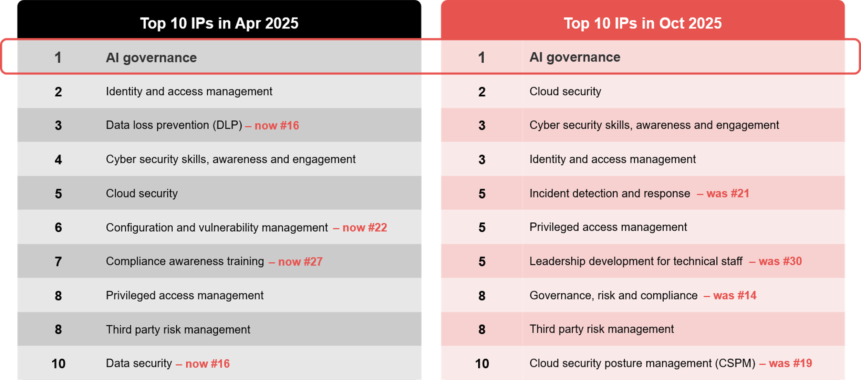
Investment priorities according to CISOs: Apr 2025 vs Oct 2025
Source : ADAPT Security Edge Surveys in Apr and Oct 2025. Sample size : 243 Australian CISOs

Slide 5

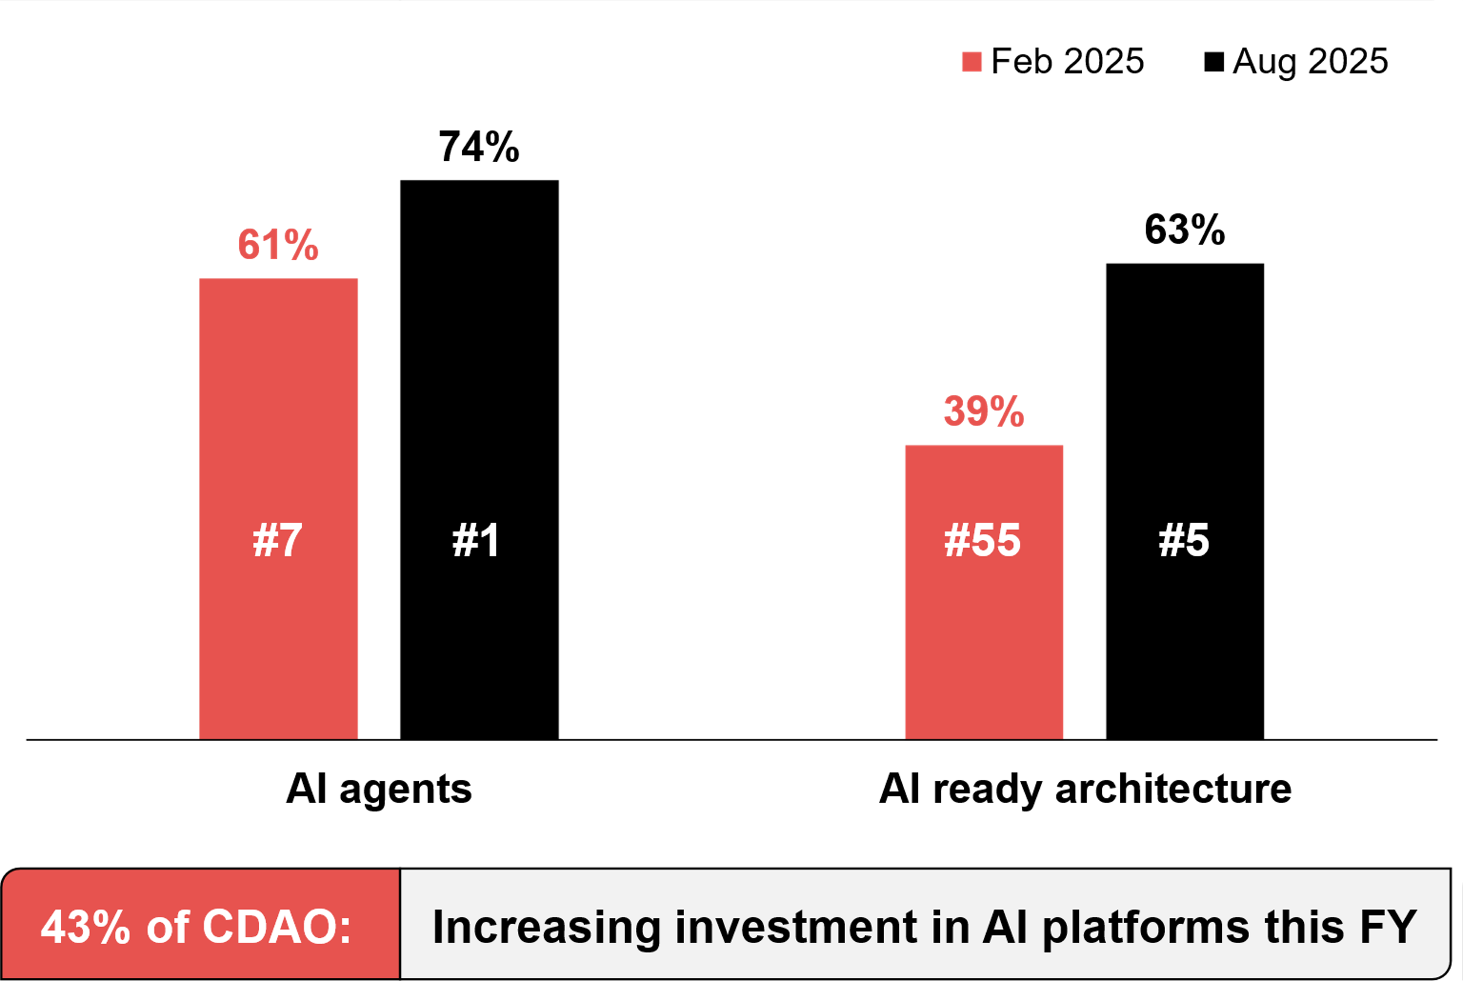
Increased investment in AI
Source : ADAPT CIO, and Data and AI Edge Surveys in 2024 and 2025. Sample size : 731 Australian CIOs and CDAOs

Slide 6

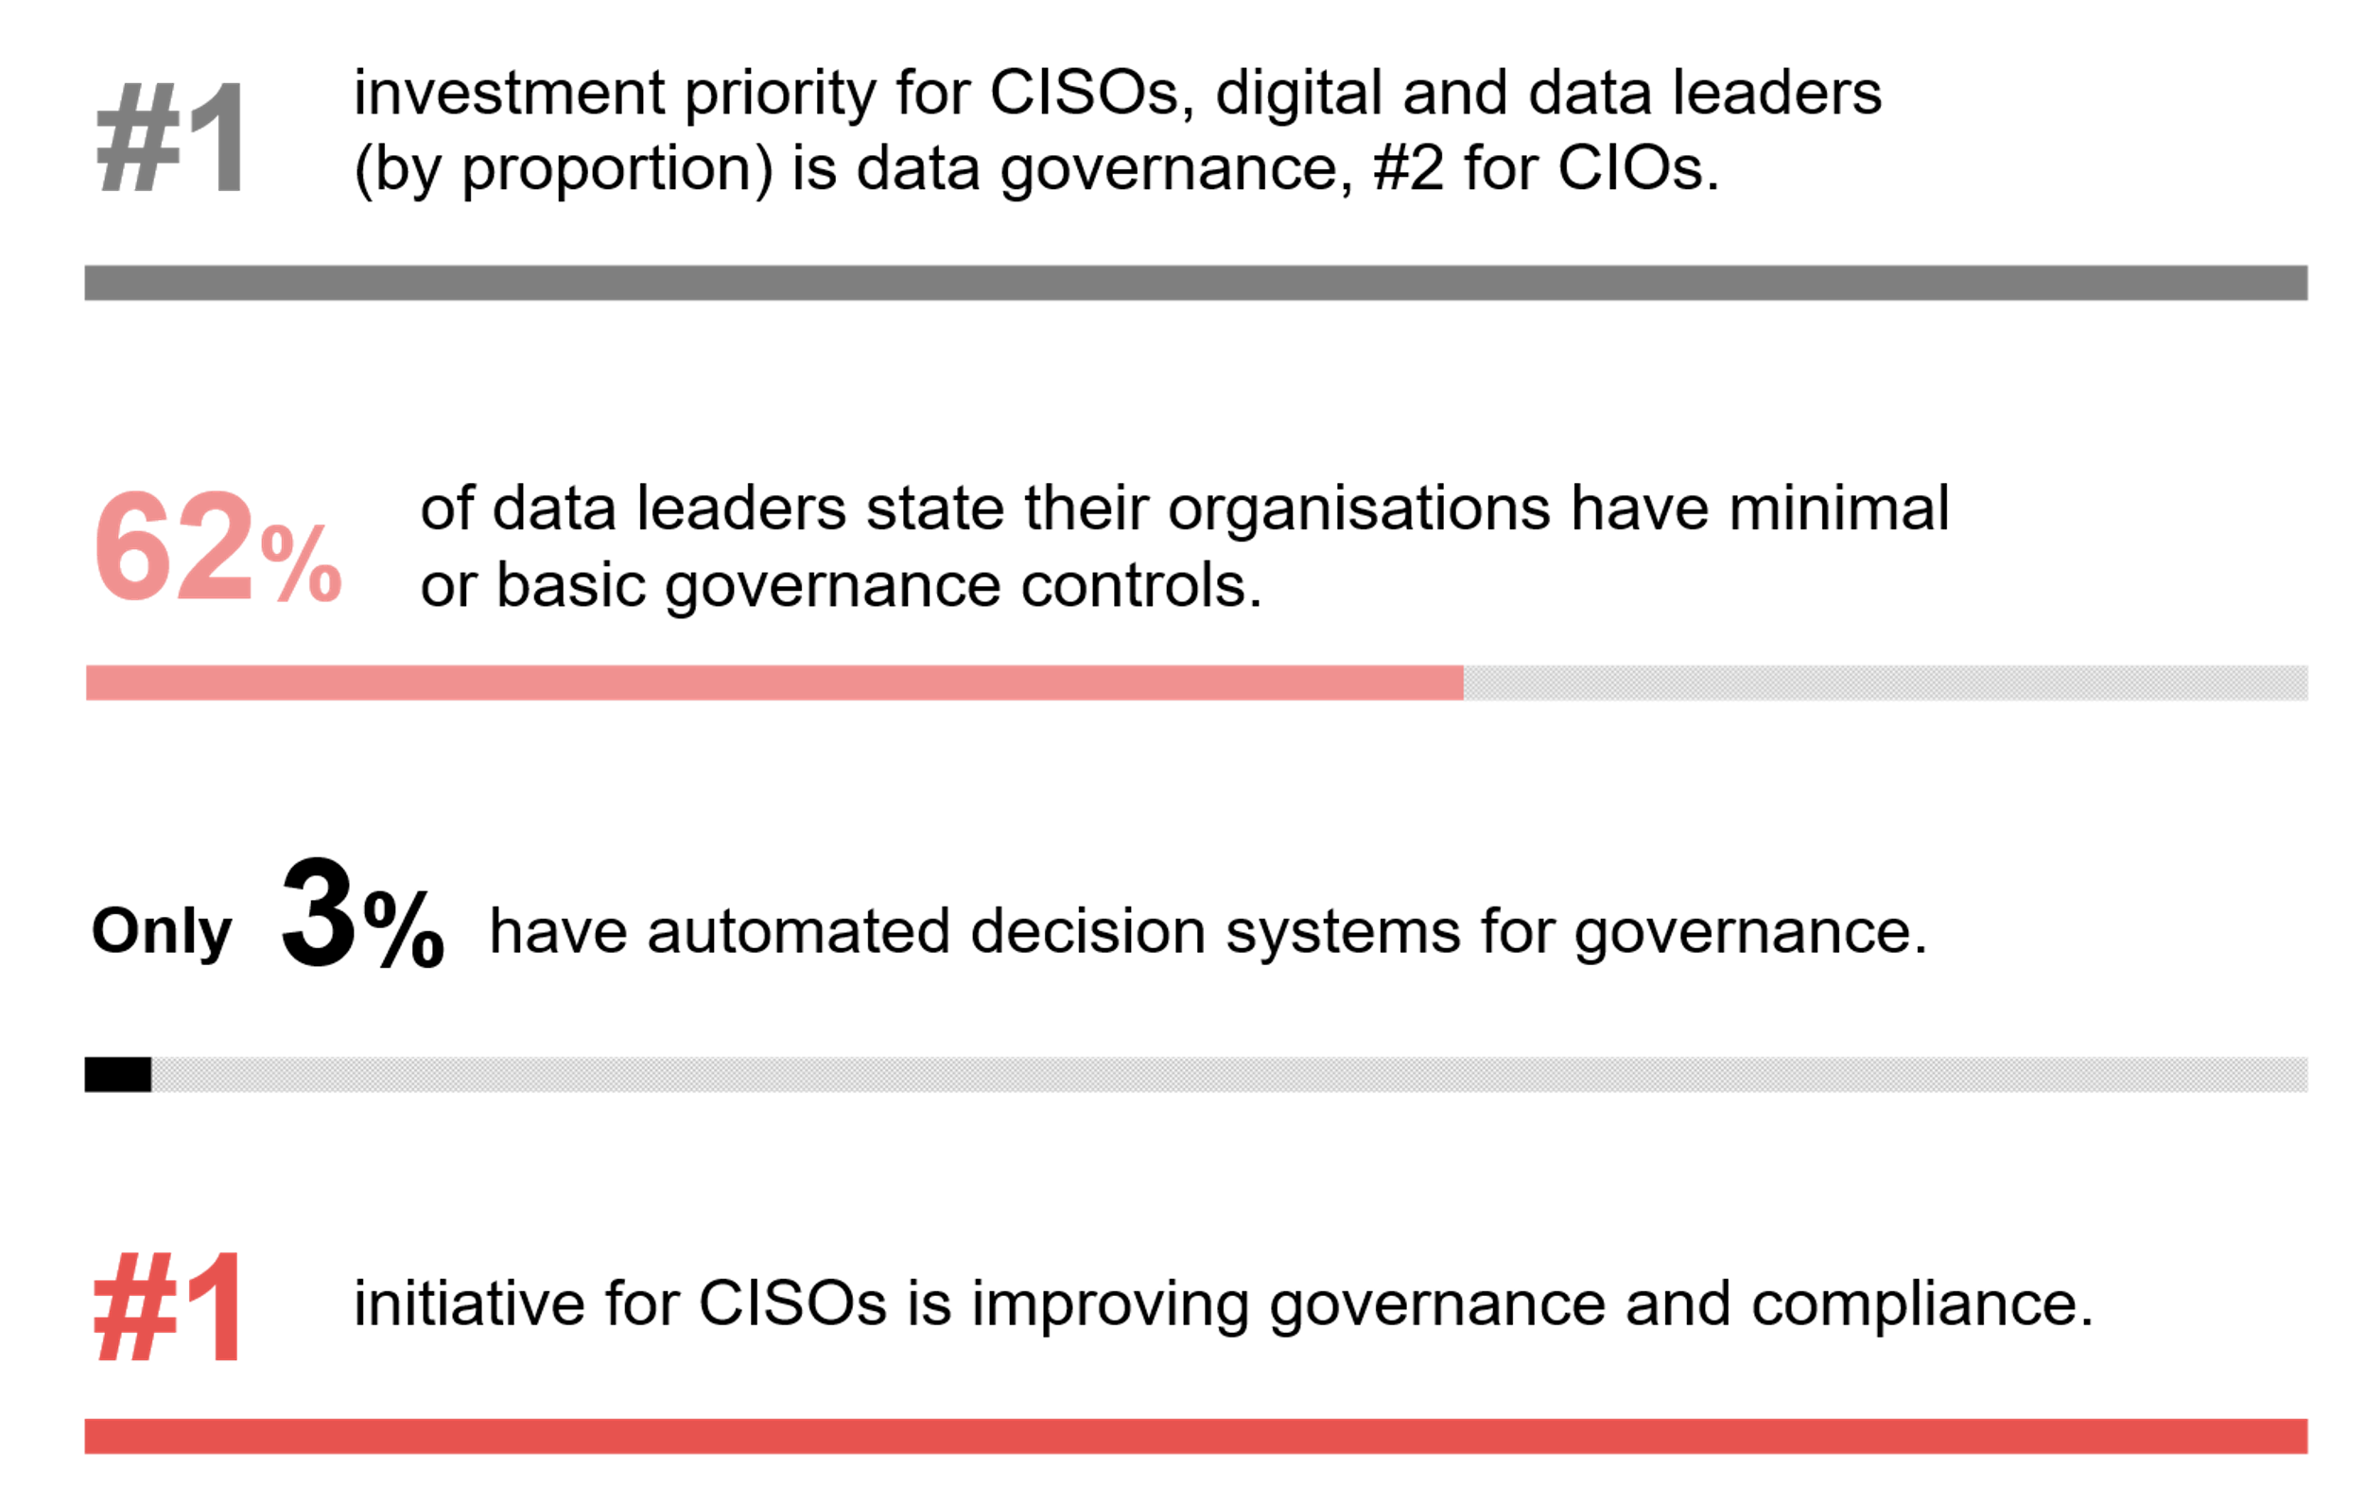
Maturity with data governance
Source : ADAPT CIO, Data and AI, Digital and Security Edge Surveys from Feb to Oct 2025. Sample size : 796 Australian CIOs, CDAOs, CDOs and CISOs

Slide 7
From security enablement to AI governance maturity
As organisations ramp up AI investment, CISOs are becoming the key leaders shaping responsible and secure AI adoption. Their role has shifted from enabling security to ensuring stronger AI governance frameworks.
The high investment priority in AI governance aligns with the #2 benchmarking interest, AI enablement and governance readiness, following cyber resilience maturity (ADAPT Security Edge, Oct 2025).
Governance and security frameworks remain a work in progress for many CISOs
Despite AI governance topping investment intent, AI strategy development ranks only #8 as an organisational goal (ADAPT Security Edge Survey, Oct 2025), indicating that CISOs are prioritising risk control over expanding AI capabilities.
CIOs report that 31% of organisations have well-defined governance and security frameworks. However, only 6% have a comprehensive framework (ADAPT CIO Tech Trend report, Apr 2025).
Data governance as the first step in AI governance
Governance, being the top CISO initiative, reinforces its critical role in enabling AI. Data governance remains a key foundation, still maturing but evolving within AI and risk management functions.
An ADAPT Market Pulse (Sep 2025) lists practical steps to accelerate safe innovation through AI governance. One recommended action is adopting simple governance models tailored to risk.
Greater alignment of governance functions with CDAOs, CDOs and CIOs
Building mature AI governance frameworks remains challenging for CISOs due to limited automated decision systems for governance (ADAPT Tech Trend report, Oct 2025) and minimal or basic governance controls (ADAPT Tech Trend, Apr 2025).
Increased collaboration between CISOs and other executive leaders (such as CDAOs, CDOs and CIOs) is crucial to govern data quality and AI capability.
Technology Trends
AI governance maturity
AI governance remains the top investment priority for Australian CISOs.
A higher investment priority in AI governance follows AI and risk functions.
Data governance is also maturing, providing a critical foundation for strengthening AI governance frameworks.
Growing convergence with CDAO, CDO and CIO roles is crucial for CISOs to enable automating governance decision-making.

Slide 8
AI benefits and risks

Slide 9
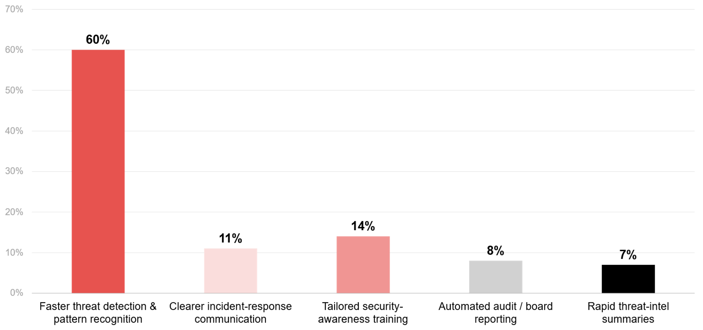
Top benefits of generative AI chatbots
Source : ADAPT Security Edge Survey in Oct 2025. Sample size : 84 Australian CISOs

Slide 10
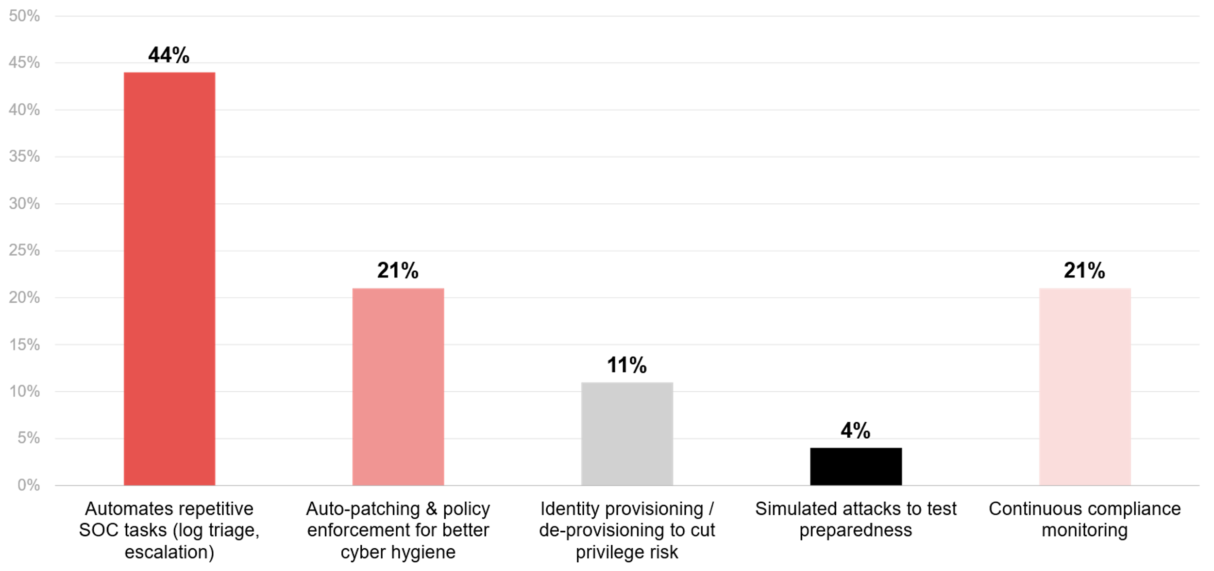
Top benefits of agentic AI intelligent automations
Source : ADAPT Security Edge Survey in Oct 2025. Sample size : 82 Australian CISOs

Slide 11
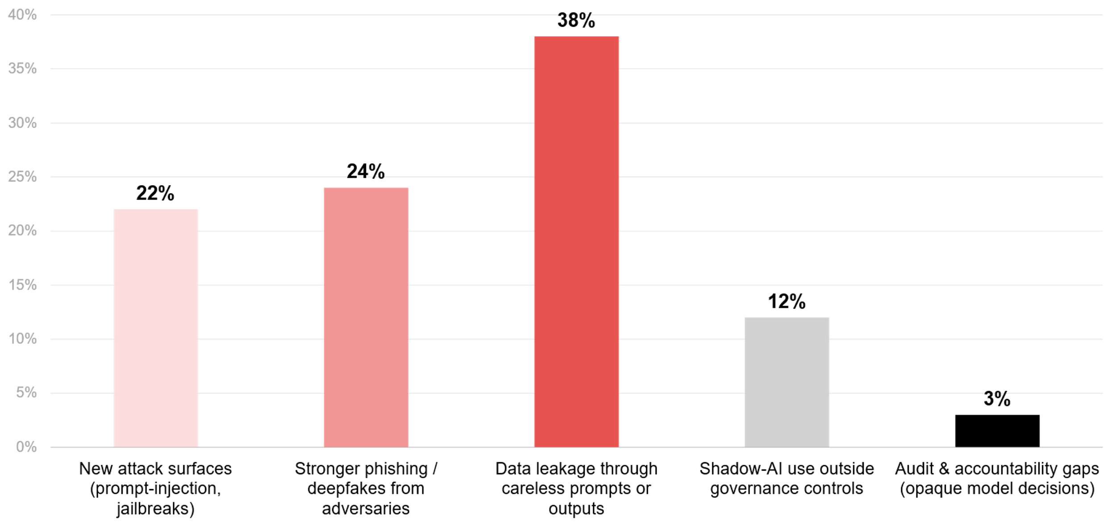
Top risks of generative AI chatbots
Source : ADAPT Security Edge Survey in Oct 2025. Sample size : 86 Australian CISOs

Slide 12
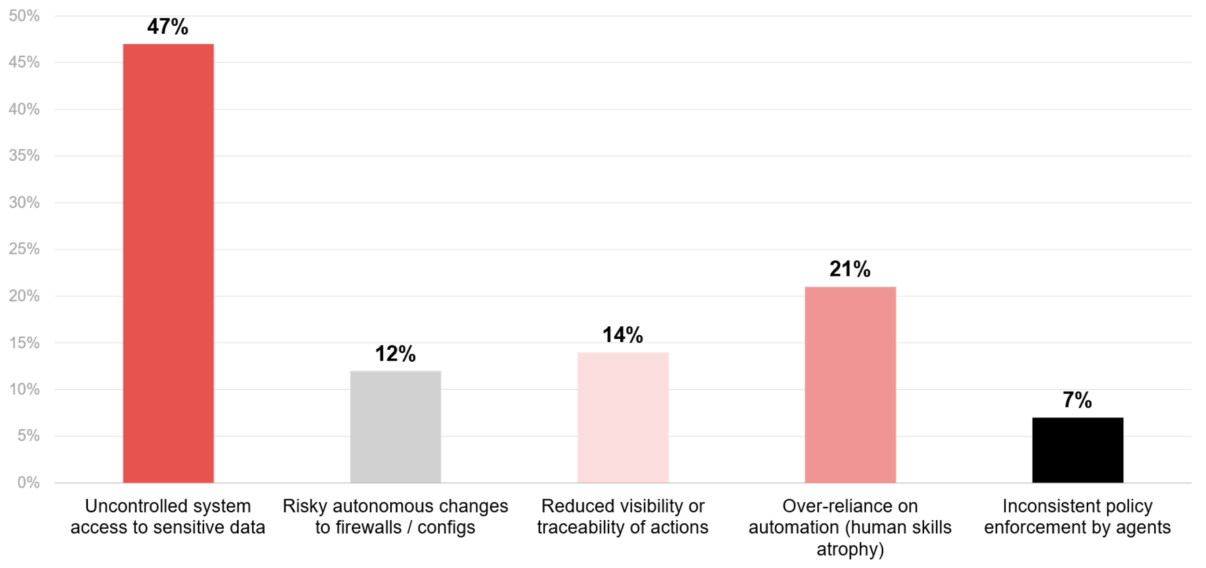
Top risks of agentic AI intelligent automations
Source : ADAPT Security Edge Survey in Oct 2025. Sample size : 86 Australian CISOs

Slide 13
AI as the next frontier of cyber defence
CISOs highlight that AI capabilities enable faster, safer detection and reliable automation.
For further insights on how AI amplifies cyber threats, view an ADAPT Expert Presentation (Apr 2025).
Generative AI chatbots for faster threat detection
  Most Australian CISOs view generative AI as a catalyst for rapid threat detection and pattern recognition within their security programs. Some CISOs also see its potential for tailored security-awareness training and clearer incident-response communication. However, fewer than 10% expect value in areas like automated audit/board reporting (8%) and rapid threat-intel summaries (7%).
Agentic AI for automating repetitive SOC tasks
  Most CISOs believe agentic AI will automate repetitive SOC tasks, including auto-patching, policy enforcement, and continuous compliance monitoring.
  Only 4% recognise its potential for simulated attack generation to test preparedness.
  AI risks are tied to AI governance maturity
  While CISOs see AI chatbots and agentic AI as crucial for scaling cyber defence, risks increase without strong governance.
  It’s essential for CISOs to enforce data access controls to prevent leakage, embed human oversight into AI workflows and extend AI governance frameworks to manage the risks systematically.
  Importance of AI governance and effective collaboration with tech leaders
  CISOs acknowledge that without mature AI governance, these tools could compromise data integrity, compliance and trust. This aligns closely with CISOs prioritising investment in AI governance.
  Effective collaboration between tech and security leaders is crucial to balance AI with security, as discussed in an ADAPT Expert Presentation (Apr 2025).
Technology Trends
Top AI benefits and risks
Most Australian CISOs agree that generative AI chatbots and agentic AI represent the next frontier in cyber defence.
60% believe that AI chatbots enable faster threat detection and 65% say agentic AI automates repetitive SOC tasks and enforces auto-patching and policy for better cyber hygiene.
The most cited generative AI chatbot risk, according to CISOs, is data leakage through careless prompts or outputs. For agentic AI intelligent automations, the biggest risk is uncontrolled system access to sensitive data.
AI governance remains critical to ensure that innovation in threat detection operates within a safe and transparent framework.

Slide 14
Survey demographics

Slide 15
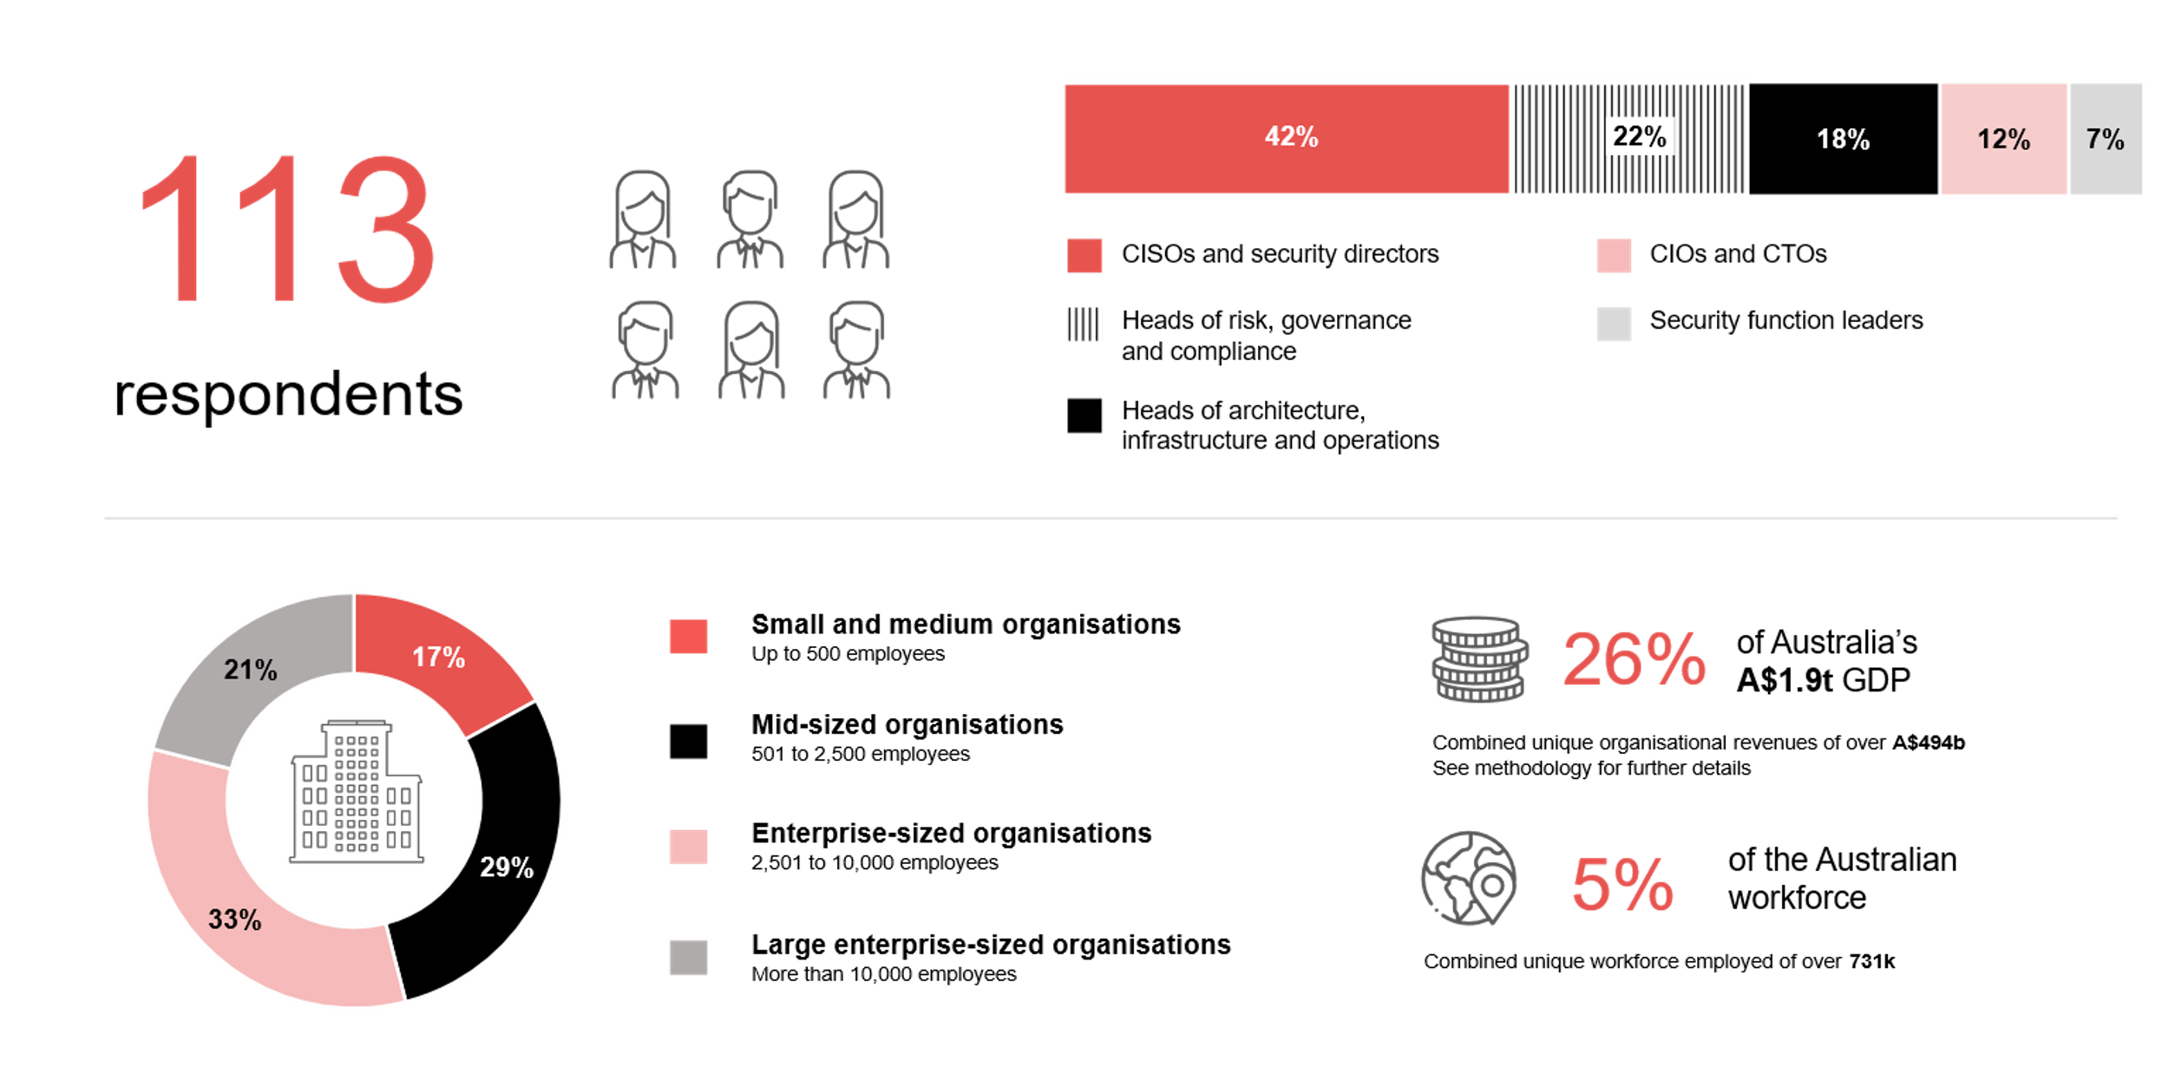
Survey demographics: Australian CISOs in 2025

Slide 16

For sector, segment and persona comparisons
Central limit theorem a fundamental concept in statistics that determines when a sample size is large enough
to be considered reliable. There are different formulas and some debate amongst statisticians about the appropriate sample size. For industry comparisons or other subset analyses, a sample size of ( n > 20 ) is generally considered acceptable for drawing meaningful insights. This threshold aligns with common statistical practices, where a
sample size of 20 to 30 is generally the minimum needed to assume a normal distribution of the data.
Sample sizes below 20, but equal to or greater than 15
When the sample size is between 15 and 20, while not fully representative, it can still offer valuable insights
into trends. These statistics should be viewed as indicative, highlighting general directions in industry efforts
or barriers to investment but treated with some caution due to the smaller number of observations.
Sample sizes less than 15, but greater or equal to 10
For samples between 10 and 15, the data provides a snapshot guideline only. While such small samples can
show early trends, it's important to recognise that this doesn't guarantee future respondents will reflect the same trends. For instance, while 100% of respondents in a sample of 10 might invest in AI, it'd be unrealistic to assume this pattern will hold as the sample size grows. However, if the sample size increases to 20, it's unlikely
that the trend will change drastically, and the next 10 respondents will have no investment.
ADAPT Data Analytics:
Notes on sample sizes
Why does sample size matter?
Each set of statistics is unique with measures,
distribution, variance and sample size. It is generally accepted in statistics that as sample size increases, analysts make fewer assumptions about the data, resulting in statistics that more accurately represent the truth.
ADAPT endeavours to provide transparency of sample size, whereby we provide a source on data slides with
the number of respondents and the survey where those respondents come from. In data and insights slide decks, ADAPT usually provides some insight on the breakdown
of the demographics at the end of the slide deck.
To protect privacy, ADAPT does not release lists
of individual respondents to surveys.

Slide 17


Written by
Gabby Fredkin
Head of Data and Analytics at ADAPT
Honey Mari Gay
Junior Data Analyst at ADAPT
Gabby’s primary role is managing ADAPT’s overall strategy for Data Analytics. He has extensive experience in using data to identify trends in technology that help shape Australian organisations. Using modern data science techniques, he ensures the accuracy and validity of the information that supports ADAPT’s research, advisory services, and events, giving both ADAPT and its customers greater confidence in the insights provided.
With a passion for creating stories with data, Gabby is consistently rated as one of the top speakers at ADAPT Events. In round table discussions, he specialises in using statistics to initiate thought-provoking discussions. Gabby is effective in translating information into insights, enabling ADAPT’s customers to become more data-driven.
As a Junior Data Analyst at ADAPT, Mari enables the discovery and definition of market trends through visually meaningful statistics. She ensures data presentations are accurate and aligned with modern statistical standards.
Mari is passionate about data and transforming it into actionable insights. With over three years of experience in project management and academic research, she has led end-to-end survey and research projects, processed and analysed data using a range of statistical tools and techniques, and provided clients with statistical
consultation and insights.

Slide 18

About ADAPT
ADAPT is a specialist Research & Advisory firm providing local market insights and benchmarking data
to Australia and New Zealand’s senior technology and business community.
Since 2011, we’ve been empowering the leaders of the region’s top enterprise and government organisations
to stay at the forefront of modern trends and build for the future. Our industry leading conferences, private roundtable events and custom research projects equip business leaders with the knowledge, relationships, inspiration and tools they need to make better strategic decisions.
adapt.com.au | hello@adapt.com.au
Data Validation
Results contained in this report (Report) are based on survey responses as provided by our clients and publicly available information. ADAPT does not subject the data contained in the Report to audit or review procedures or any other testing to validate the accuracy or reasonableness of the data provided by the participating clients. While we do not manipulate the survey responses, we do make an effort to identify outlier data or conflicting results that could lead to misinterpretations before the preparation of the Report.
Intended Use of the Report
The Report is designed to help technology executives in Australia and New Zealand make independent decisions regarding financial, resourcing and operational performance matters. The information and data contained in the Report are provided as is and are for information purposes only. They are not intended or implied to be recommendations and in no event will ADAPT be liable for any decisions or actions taken in reliance of the results obtained through the use of the information and/or data contained in the Report.
Research MSA and Privacy Policy
The Report and any other information provided by ADAPT is subject to the Research and Advisory Master Services Agreement and the ADAPT Privacy Policy.

Slide 19




Additional resources you can access
Members of ADAPT’s Research & Advisory platform have access to an entire suite of market leading content, insights and resources to help you execute in your role. For any assistance contact your Account Manager in the help section.
Community case studies and interviews
Case studies detailing the successes
and challenges of projects and initiatives.
Market Trend Reports Access a library of fact-based actionable insights, deep dives on ANZ business & IT trends.
Live access to ADAPT analysts
Through live ADAPT analyst market briefings and Q&A sessions
Downloadable data and insights
Elevate your business cases with downloadable market and industry data.
Industry expert presentations
Watch keynotes or read distilled 1-page executive summaries from our Edge Events.
Bespoke analysis of ADAPT data
Receive custom cuts and analysis of ADAPT proprietary data.
Premier executive community
Unlock access to our exclusive network of Australia’s leading technology and business executives.
Dedicated account manager and impact assessments
Your Account Manager will ensure you and your team are getting the most out of your subscription.
Dedicated analyst briefing
Leverage a dedicated briefing with an ADAPT analyst to help validate your strategies.
*Inclusions may vary depending on subscription level.

