Slide 1

ADAPT Persona Map
CISOs Pivot from Defence to Growth:
Balancing Business Enablement, Operational Excellence, and Modernisation

Slide 2
In this report, you’ll find insights about why Australian CISOs are pivoting from defence to growth. They're now prioritising business growth, operational effectiveness and tech modernisation, while integrating AI strategy and talent development into a broader resilience agenda.
The key areas of focus are:
Aligning security and compliant outcomes with business growth
Growing the business marks a clear pivot to aligning cyber security strategy with value creation. CISOs are maintaining their focus on cyber resilience and involvement in IT transformation.
As business and efficiency dominate the first 3 goals, traditional security and compliance priorities have dropped in ranking but remain foundational.
Dominance of governance and access management initiatives
This highlights the need to demonstrate resilience. As organisations increasingly prioritise AI initiatives, it's essential to focus on automation and the maturity of control frameworks over the emerging technology itself.
The spending patterns of CISOs focus on core defence, detection and governance
As AI governance remains the #1 investment priority, GRC spend is increasing.
However, foundational controls still dominate budgets, this reflects the need to consolidate
and modernise existing defences.
The lack of resources, tools and people to execute on security strategies continues to persist
While CISOs are becoming more strategic, they remain constrained by tight budgets, legacy systems, workforce limitations, and compliance demands. Much of their focus is directed toward governance, automation, and integration; key areas that are transforming cyber security from a defensive function into a driver of innovation and growth.
Persona Mapping: CISO
Key takeaways
ADAPT's CISO Edge Survey (Oct 2025), reveals the #1 goal of Australian CISOs is to grow the business.
Building a secure and trusted organisation has dropped from the #1 goal to #6 in the past 6 months.
Improving governance, compliance and access management are still the #1 and #2 initiative priorities. AI is emerging as an initiative for CISOs.
AI governance is still the #1 investment priority.
There are only slight changes in the top 10 execution barriers for CISOs.

Slide 3

Goals, initiatives and investment priorities

Slide 4
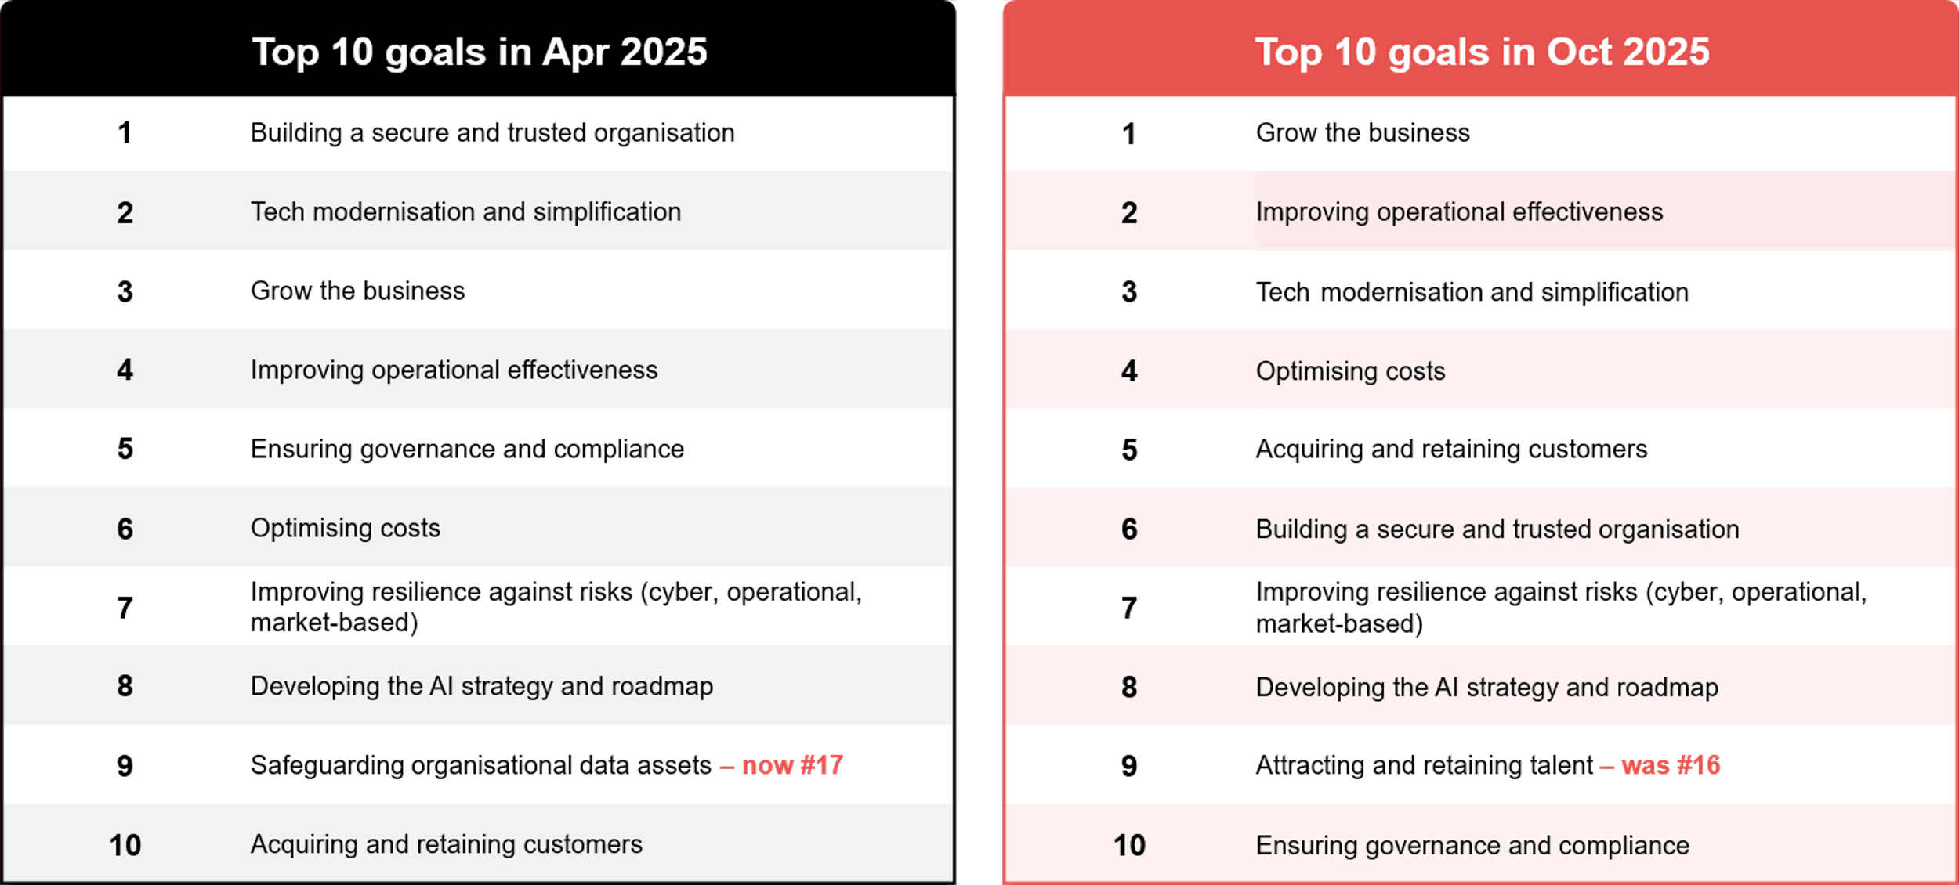
CISOs' organisational goals: Apr 2025 vs Oct 2025
Source : ADAPT Security Edge Surveys in Apr and Oct 2025. Sample size : 232 Australian CISOs

Slide 5
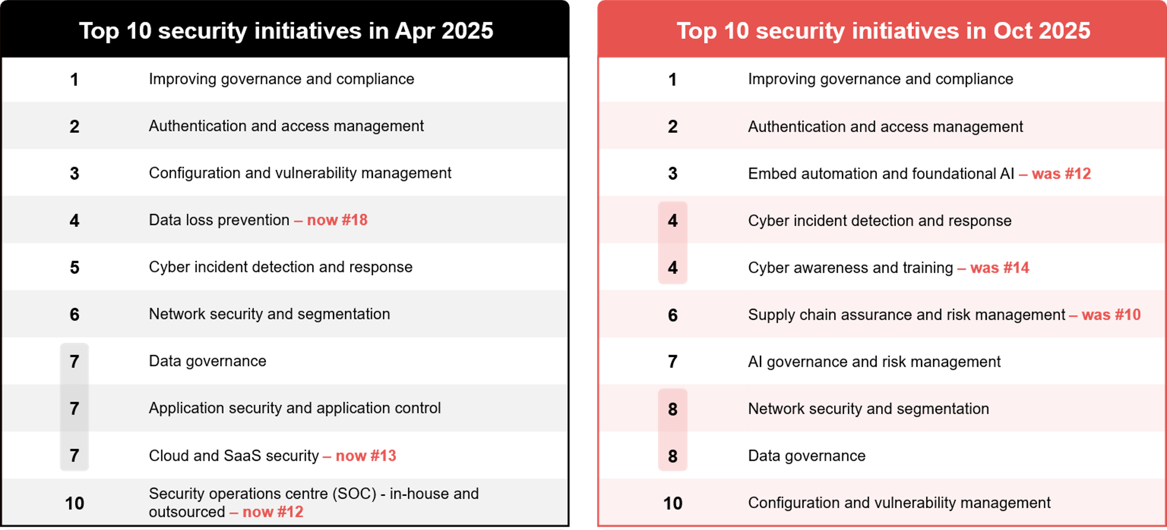
CISOs' security initiatives: Apr 2025 vs Oct 2025
Source : ADAPT Security Edge Surveys in Apr and Oct 2025. Sample size : 230 Australian CISOs

Slide 6
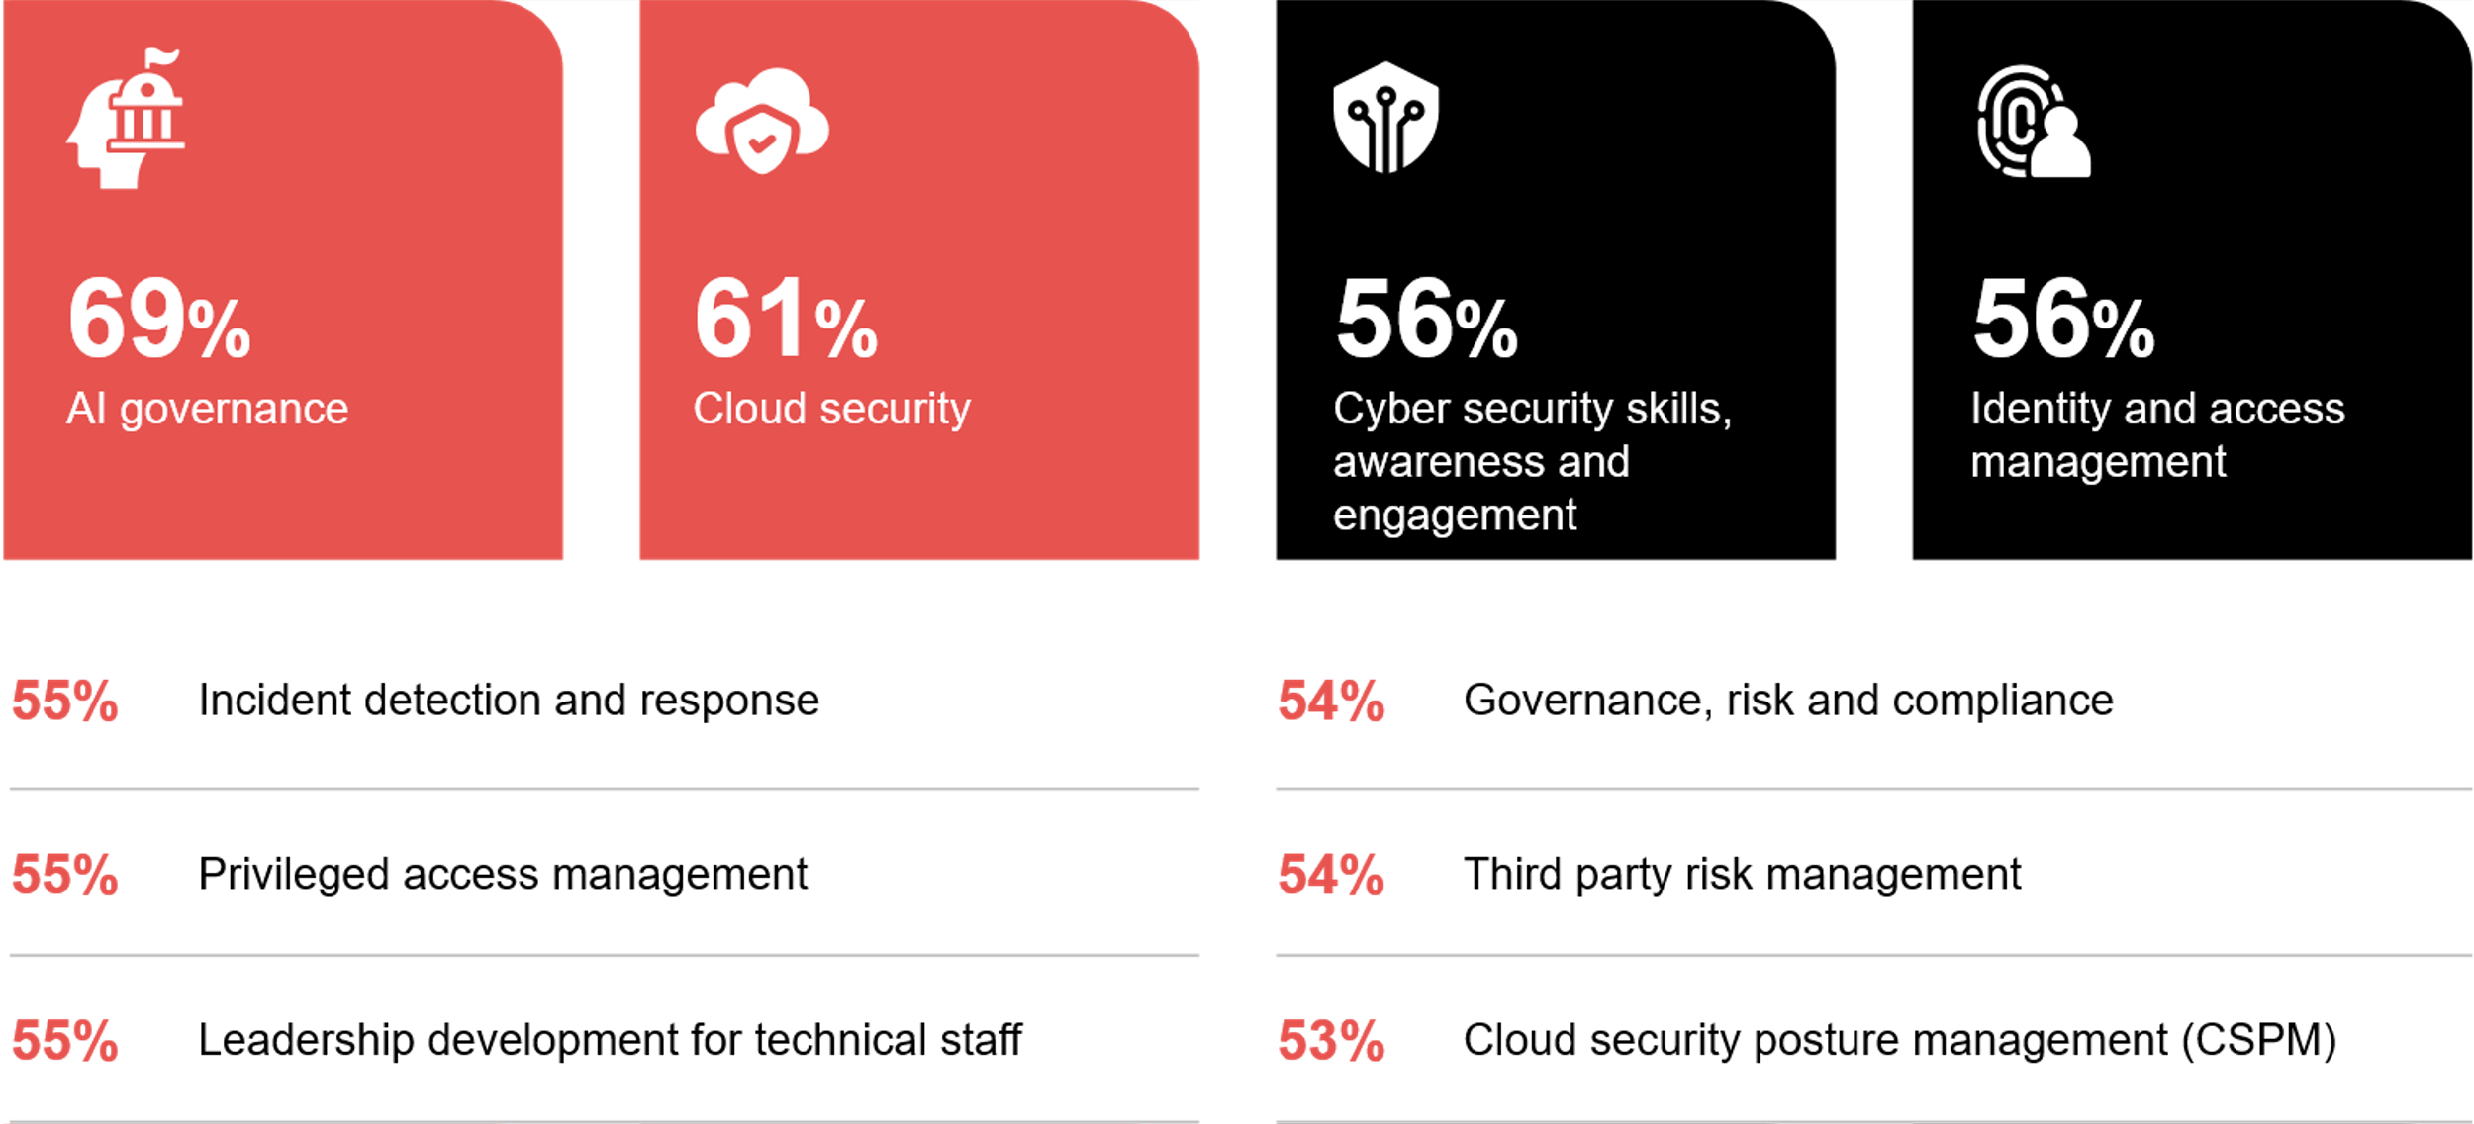
Investment priorities of CISOs in the next 12 months
Source : ADAPT Security Edge Survey in Oct 2025. Sample size : 109 Australian CISOs

Slide 7
Driving business growth and customer value
Australian CISOs are expected to go beyond protecting assets. They must enable revenue by
fostering trust, ensuring customer confidence and driving safe innovation.
While business growth is the #1 goal, building security and trust is seen as foundational.
What sets CISOs apart now is their ability to leverage them for AI adoption, customer retention,
and revenue growth.
Building a secure, trusted and sustainable organisation
While security and trust are no longer the #1 goal, they have become embedded assumptions—foundational expectations for doing business. As a result, CISOs are now focusing their initiatives on the executional enablers of resilience: governance, identity, detection, and AI preparedness. This shift makes investment in cyber security skills, leadership development, and governance, risk, and compliance (GRC) more critical than ever.
How can CISOs tie security outcomes directly to business growth?
There is strong alignment between the #1 goal and security and AI initiatives, which include automation, foundational AI, and governance for both AI and data. These efforts drive innovation, streamline adoption, ensure responsible AI use, and protect data to enable trusted digital customer engagement.
To support these outcomes, CISOs are prioritising investments in AI governance, cloud security,
and identity and access management (IAM).
Strengthening operational excellence and resilience
CISOs also aim to enable faster and more resilient operations in the face of cyber and market risks.
By automating security processes, modernising tech and managing operational risks, CISOs can reduce costs and improve resilience. With AI governance, CISOs can prioritise
where automation and AI deliver the greatest value while effectively managing risk. As a result, initiatives are also focused on incident detection and response, supply chain assurance, network security, and vulnerability management.
Persona Mapping: CISO
Growing the business with effective security outcomes
Growing the business is now the #1 priority for Australian CISOs. In contrast, building a secure and trusted organisation has dropped from the #1 goal to #6 over the past six months.
Security and trust are increasingly viewed as enablers of growth, rather than standalone objectives.
Improving governance and compliance remains the #1 initiative, underscoring the importance of sustaining long-term security.
AI governance has emerged as the #1 investment priority, reflecting the urgent need for safe and responsible AI adoption.

Slide 8
Budgets

Slide 9
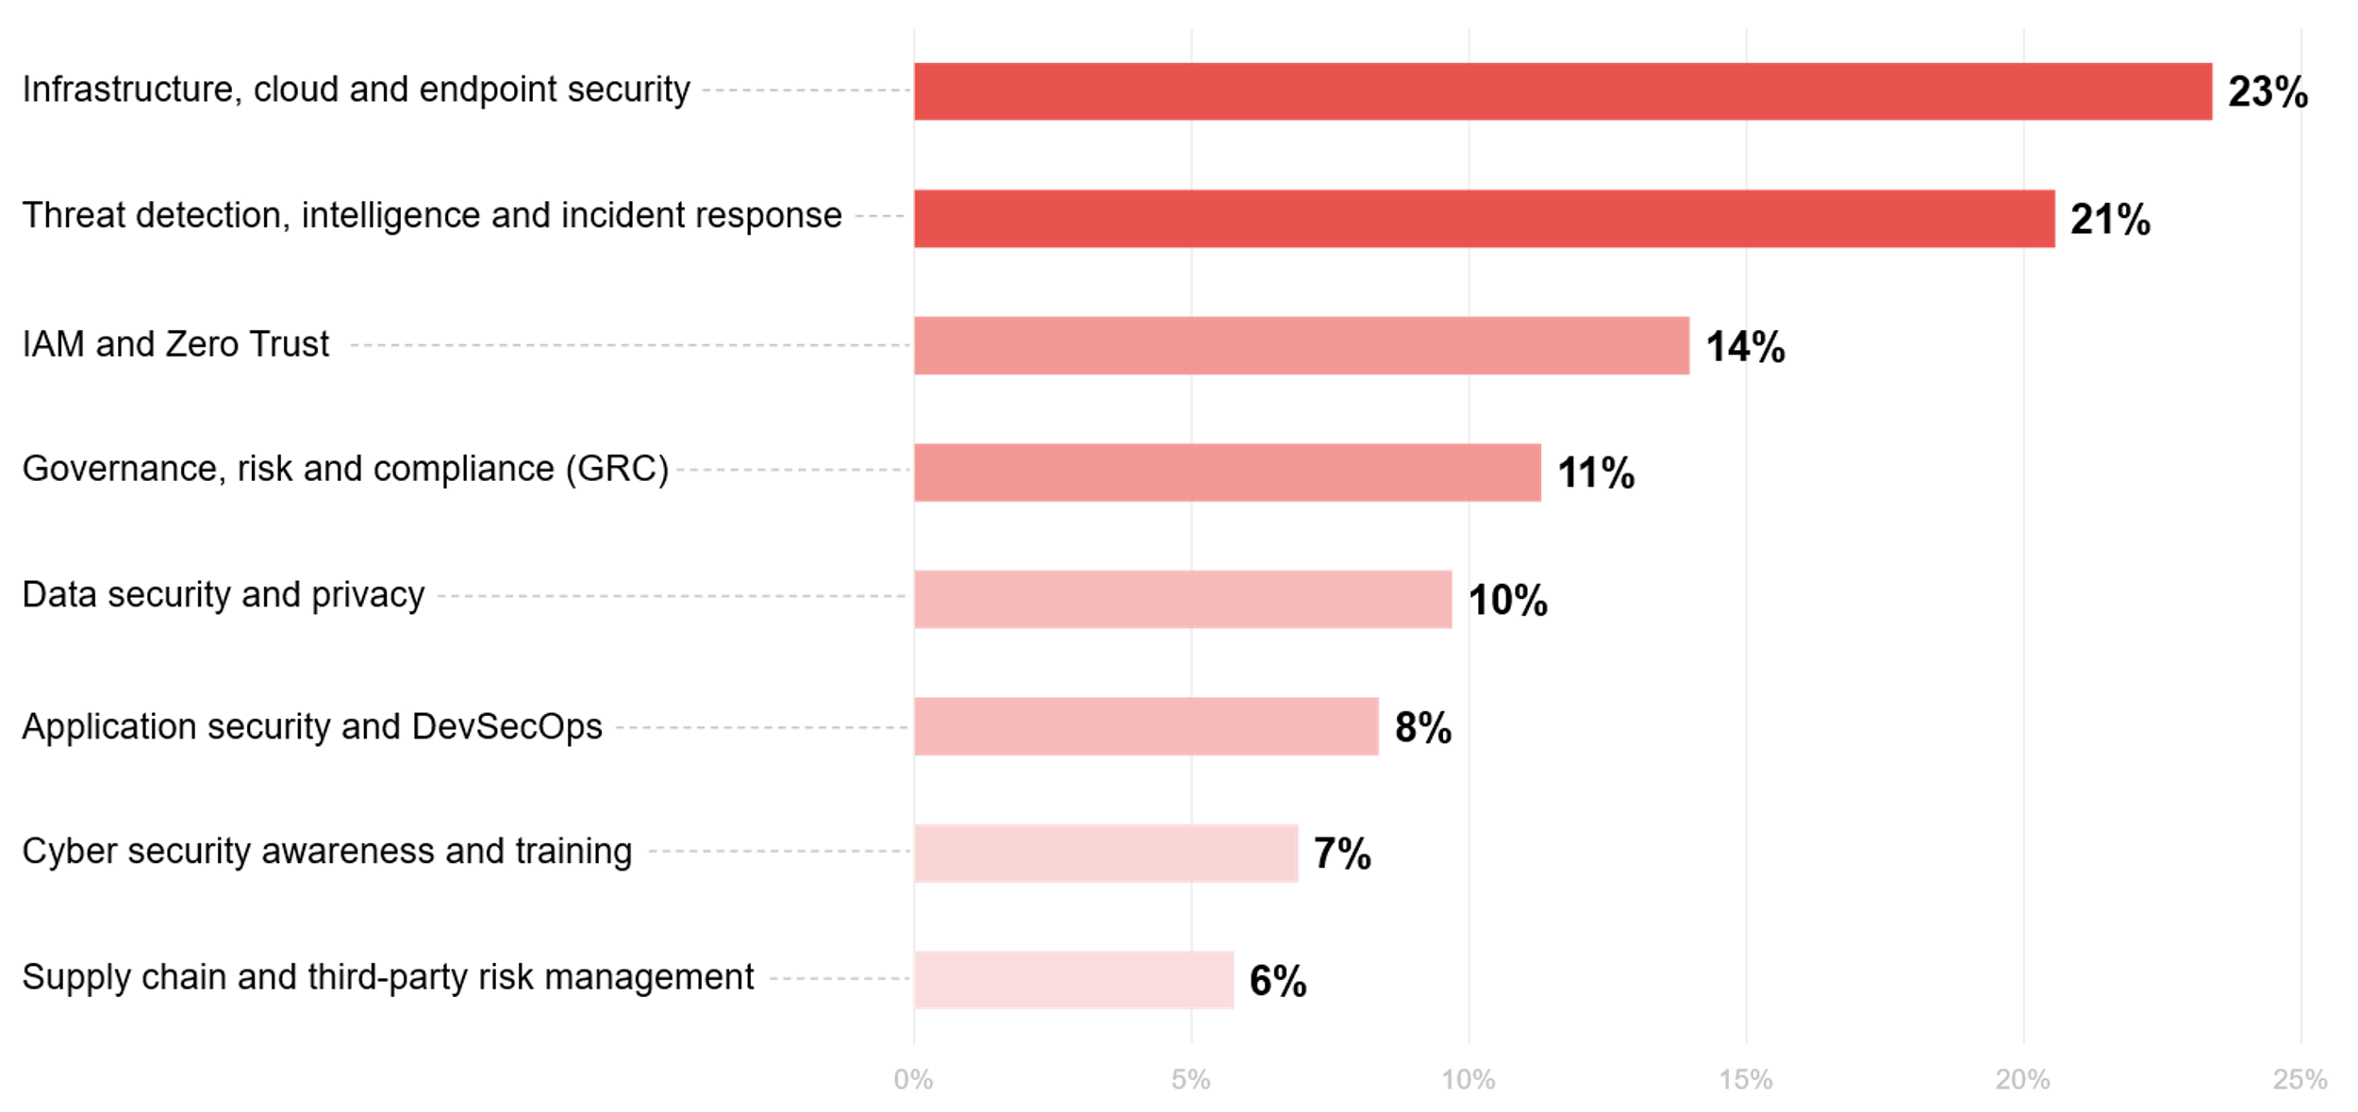
CISO budget allocation
Source: ADAPT CISO Edge Surveys in April and Oct 2025 . Sample size: 123 Australian CISOs

Slide 10
Infrastructure, cloud, and endpoint security account for the largest share of the security budget
These areas rank highest as CISOs continue to modernise core defences against ransomware and vulnerabilities introduced by hybrid work environments. This focus is also tied to legacy systems and technical debt ( #3 barrier), alongside persistent challenges with multi-cloud visibility and configuration, which rank as the #8 and #9 barriers, respectively. Additionally, only 4% of organisations have a fully unified multi-cloud approach (ADAPT Tech Trend report, Sep 2025).
CISOs concentrate their spend on detection and identity controls
Threat detection, intelligence, and incident response form the operational core of modern cyber security. Identity control also remains a key pillar of risk mitigation. These capabilities are essential for CISOs to deliver on operational excellence (#2 goal) and modernisation (#3 goal).
Detection and response ranked 4th among initiative priorities, reflecting strong ongoing investment in SOC capabilities and automation—95% of organisations now operate either in-house or outsourced SOCs.
Boards and regulators are exerting greater oversight on GRC
CISOs are embedding AI oversight into GRC frameworks to ensure that algorithmic decision-making meets the same ethical, regulatory, and operational standards as traditional IT systems. The use of AI in algorithmic decision-making is expected to become a high-risk area after two years of experimentation, underscoring the need for proactive governance (ADAPT Tech Trend report, Jul 2025). CISOs also report rising compliance burdens and accountability (#9 barrier).
The other four security areas reflect the need to rebalance spending
Core infrastructure, detection, identity, and governance programs consume the largest share of cyber security budgets. As a result, these areas are increasingly supported through process integration, automation, and cross-functional ownership, where non-security teams share both responsibility and cost rather than through large, standalone investments.
Persona Mapping: CISO
Budgets
The largest security budget is allocated to infrastructure, cloud
and endpoint security.
While being secure and trusted is no longer the #1 goal, CISOs continue to focus their spend on foundational cyber resilience—reinforcing infrastructure, detection and identity controls.
The GRC budget is aligned with both the #1 security initiative and the #1 investment priority.
The remaining four security focus areas highlight the need for integration across enterprise-wide operations, along with a growing expectation that non-security teams share both responsibility and cost.

Slide 11
Security barriers

Slide 12
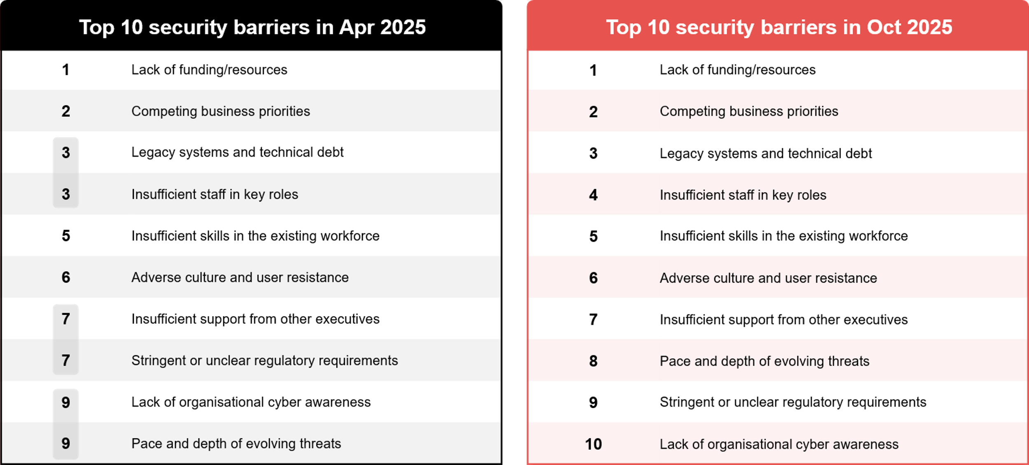
CISOs' security barriers: Apr 2025 vs Oct 2025
Source : ADAPT Security Edge Surveys in Apr and Oct 2025. Sample size : 222 Australian CISOs

Slide 13
Cyber budgets still lag exposure growth
Despite heightened board awareness post- Latitude, Medibank and Optus (ADAPT Market Trend report, Jul 2024), many CISOs report spending more on maintaining legacy systems than on proactive defence innovation. Because cybersecurity is still perceived as a constant operational centre rather than a strategic value enabler, CISOs often struggle to align their roadmaps with business growth objectives, resulting in competing priorities.
Cyber resilience remains structurally limited due to legacy systems and tech debt
Many organisations are still maintaining old infrastructure that cannot support zero trust or modern encryption. However, other legacy infrastructure can still be crucial and deliver significant value to organisations. View an ADAPT Community Interview with MongoDB (Oct 2025).
Increasing visibility at the board level can allow tech debt to be tracked and managed.
People problems are holding back operational excellence and modernisation
CISOs are now prioritising talent attraction and retention (from #16 in Apr 2025 to #9 in Oct 2025). With talent and skills shortages, CISOs struggle to keep pace with business initiatives that require rapid security integration (such as AI pilots).
Adverse organisational culture creates resistance to change, while executive misalignment leads to competing priorities and stalled funding. This fragments risk ownership across operations and hinders modernisation efforts.
Three additional challenges continue to impact business growth:
Evolving threats are prompting the reallocation of funds toward defence, slowing innovation and digital rollout.
Regulatory uncertainty contributes to compliance fatigue and reduces organisational agility.
Low cyber awareness continues to expose businesses to ongoing operational risks.
Persona Mapping: CISO
Security barriers
The top three execution barriers for Australian CISOs remain consistent: lack of funding and resources (#1), competing priorities (#2), and legacy systems (#3).
Technical debt is no longer viewed solely as a technical constraint, it's now recognised as a financial, operational, and reputational risk that limits business growth.
Understaffed teams, limited skills, resistant organisational cultures, and inconsistent executive support continue to hinder progress toward operational excellence and modernisation.
The remaining 3 barriers continue to impact either short or long-term business growth.

Slide 14
Survey demographics

Slide 15
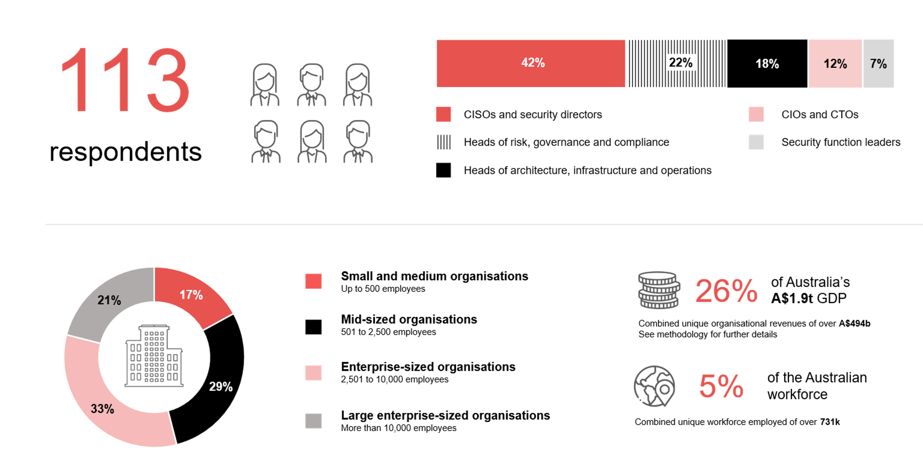
Survey demographics: Australian CISOs in 2025

Slide 16

For sector, segment and persona comparisons
Central limit theorem a fundamental concept in statistics that determines when a sample size is large enough
to be considered reliable. There are different formulas and some debate amongst statisticians about the appropriate sample size. For industry comparisons or other subset analyses, a sample size of ( n > 20 ) is generally considered acceptable for drawing meaningful insights. This threshold aligns with common statistical practices, where a
sample size of 20 to 30 is generally the minimum needed to assume a normal distribution of the data.
Sample sizes below 20, but equal to or greater than 15
When the sample size is between 15 and 20, while not fully representative, it can still offer valuable insights
into trends. These statistics should be viewed as indicative, highlighting general directions in industry efforts
or barriers to investment but treated with some caution due to the smaller number of observations.
Sample sizes less than 15, but greater or equal to 10
For samples between 10 and 15, the data provides a snapshot guideline only. While such small samples can
show early trends, it's important to recognise that this doesn't guarantee future respondents will reflect the same trends. For instance, while 100% of respondents in a sample of 10 might invest in AI, it'd be unrealistic to assume
this pattern will hold as the sample size grows. However, if the sample size increases to 20, it's unlikely
that the trend will change drastically, and the next 10 respondents will have no investment.
ADAPT Data Analytics:
Notes on sample sizes
Why does sample size matter?
Each set of statistics is unique with measures,
distribution, variance and sample size. It is generally accepted in statistics that as sample size increases, analysts make fewer assumptions about the data, resulting in statistics that more accurately represent the truth.
ADAPT endeavours to provide transparency of sample size, whereby we provide a source on data slides with
the number of respondents and the survey where those respondents come from. In data and insights slide decks, ADAPT usually provides some insight on the breakdown
of the demographics at the end of the slide deck.
To protect privacy, ADAPT does not release lists
of individual respondents to surveys.

Slide 17

Written by
Honey Mari Gay
Junior Data Analyst at ADAPT
As a Junior Data Analyst at ADAPT, Mari enables the discovery and definition of market trends through visually meaningful statistics.
She ensures data presentations are accurate and aligned with modern statistical standards.
Mari is passionate about data and transforming it into actionable insights. With over three years of experience in project management and academic research, she has led end-to-end survey and research projects, processed and analysed data using a range of statistical tools
and techniques, and provided clients with statistical consultation and insights.

Slide 18

About ADAPT
ADAPT is a specialist Research & Advisory firm providing local market insights and benchmarking data
to Australia and New Zealand’s senior technology and business community.
Since 2011, we’ve been empowering the leaders of the region’s top enterprise and government organisations
to stay at the forefront of modern trends and build for the future. Our industry leading conferences, private roundtable events and custom research projects equip business leaders with the knowledge, relationships, inspiration and tools they need to make better strategic decisions.
adapt.com.au | hello@adapt.com.au
Data Validation
Results contained in this report (Report) are based on survey responses as provided by our clients and publicly available information. ADAPT does not subject the data contained in the Report to audit or review procedures or any other testing to validate the accuracy or reasonableness of the data provided by the participating clients. While we do not manipulate the survey responses, we do make an effort to identify outlier data or conflicting results that could lead to misinterpretations before the preparation of the Report.
Intended Use of the Report
The Report is designed to help technology executives in Australia and New Zealand make independent decisions regarding financial, resourcing and operational performance matters. The information and data contained in the Report are provided as is and are for information purposes only. They are not intended or implied to be recommendations and in no event will ADAPT be liable for any decisions or actions taken in reliance of the results obtained through the use of the information and/or data contained in the Report.
Research MSA and Privacy Policy
The Report and any other information provided by ADAPT is subject to the Research and Advisory Master Services Agreement and the ADAPT Privacy Policy.

Slide 19




Additional resources you can access
Members of ADAPT’s Research & Advisory platform have access to an entire suite of market leading content, insights and resources to help you execute in your role. For any assistance contact your Account Manager in the help section.
Community case studies and interviews
Case studies detailing the successes
and challenges of projects and initiatives.
Market Trend Reports Access a library of fact-based actionable insights, deep dives on ANZ business & IT trends.
Live access to ADAPT analysts
Through live ADAPT analyst market briefings and Q&A sessions
Downloadable data and insights
Elevate your business cases with downloadable market and industry data.
Industry expert presentations
Watch keynotes or read distilled 1-page executive summaries from our Edge Events.
Bespoke analysis of ADAPT data
Receive custom cuts and analysis of ADAPT proprietary data.
Premier executive community
Unlock access to our exclusive network of Australia’s leading technology and business executives.
Dedicated account manager and impact assessments
Your Account Manager will ensure you and your team are getting the most out of your subscription.
Dedicated analyst briefing
Leverage a dedicated briefing with an ADAPT analyst to help validate your strategies.
*Inclusions may vary depending on subscription level.

Slide 20

adapt.com.au | hello@adapt.com.au | +61 (2) 9435 3535

