Slide 1

ADAPT Technology Trends
Cyber Resiliency
and Security Maturity

Slide 2
Technology Trends: Security
Cyber resilience is emerging, yet maturity gaps remain
On a scale of 1 to 100, the average cyber resilience of Australian organisations in 2025
is 60, showing that CISOs believe their organisations are functionally resilient but still far
from high maturity.
The Essential Eight (E8) remains the foundational baseline for resilience, but most organisations are still operating around maturity level 2. Application whitelisting and hardening user apps are showing significant challenges in achieving full security maturity.
The Security Operations Centre (SOC) is mostly fully outsourced
Organisations are shifting toward partially or fully outsourced SOC, indicating a greater need for more scalable and specialised expertise.
The majority of organisations can now detect and respond to incidents within 6 hours.
Fewer incidents escalate to high severity, which suggests better containment and stronger cyber security capabilities.
Prioritising assets that protect organisations from loss rather than those that enable growth
  The top metrics when classifying assets are core operational dependency, customer and brand impact, data sensitivity and financial impact.
  Except for utility/usability, all security dimensions are critical for analysing security assets.
Key takeaways
ADAPT’s 2025 Security Edge Survey (Oct 8), describes CISOs’ views on:
cyber defence maturity and detection performance
prioritising and enabling secure initiatives.

Slide 3
Cyber defence maturity
and detection performance

Slide 4
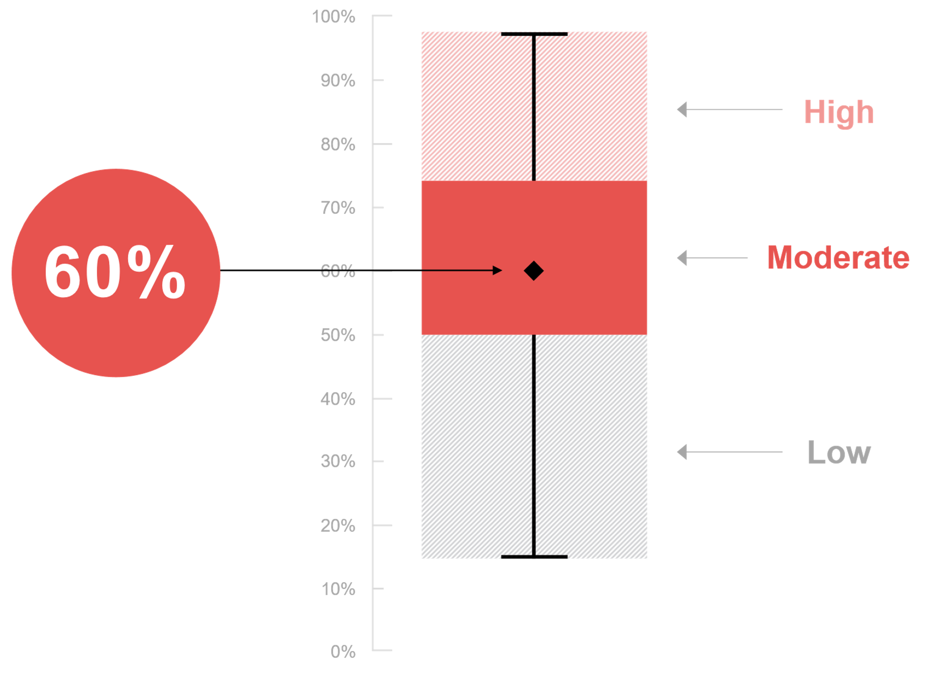
Based on your evaluation of the questions in this section, how would you rate your organisation's overall cyber resilience?
Source : ADAPT Security Edge Survey in Oct 2025. Sample size : 80 Australian CISOs

Slide 5
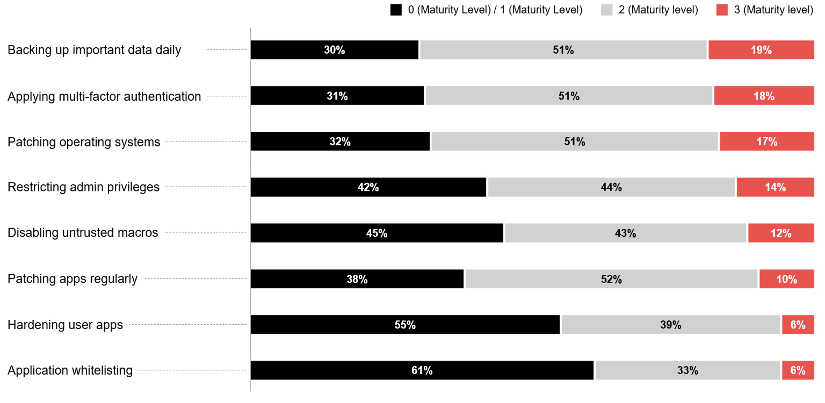
‘Essential Eight’ maturity (based on the ASD 0-3 maturity definitions)
Source : ADAPT Security Edge Surveys in Apr and Oct 2025. Sample size : 194 Australian CISOs

Slide 6
Cyber resilience is continually evolving, but gaps persist
Australian organisations’ cyber resilience is progressing, but maturity remains uneven (slide 5).
Resilience is shifting from tech strength to operational effectiveness, heavily challenged by funding limitations, competing priorities, and legacy systems (ADAPT CISO Persona Map report, Dec 2025).
The E8 remains a core resilience baseline for Australian CISOs
The E8 maturity trend suggests organisations are incrementally improving cyber security capabilities. However, CISOs report they struggle to achieve robust security governance and face challenges in translating security investments into mature practices (ADAPT CISO Persona Map report, Dec 2025).
It's still improving but not yet mature enough to fully underpin AI governance.
Backing up important data daily and applying multi-factor authentication
Backing up data and MFA are the strongest areas of maturity, with 51% at level 2 and 18-19%
at level 3, emphasising the critical role of backups and authentication in cyber security.
Additionally, CISOs also acknowledge that without strong E8 hygiene (such as MFA, patching,
and privilege control), AI-driven systems magnify vulnerabilities faster than they can be contained.
Systemic maturity challenges
Application whitelisting and user app hardening demonstrate the lowest percentages in level 3,
both at 6%. This reveals a significant gap in implementing security.
The current maturity levels also indicate organisations are not yet fully prepared for robust AI governance. The low maturity levels across E8 areas suggest potential vulnerabilities in AI system security and challenges in developing comprehensive AI risk management frameworks.
Technology Trends
Cyber resilience and Essential Eight maturity
On a scale of 1 to 100, the average cyber resilience of Australian organisations in 2025 is 60.
Organisations exhibit a significant variance in cyber resilience, ranging from 0 to 98, with a quartile range of 50 to 74, highlighting the disparity between leading and lagging organisations.
Across the Essential Eight (E8) framework, organisations are showing a pattern of clustering at maturity levels 1 and 2, with minimal progression to full maturity (level 3).
Backing up important data daily and applying multifactor authentication are the strongest areas of E8 maturity.
Other areas show less than 15% in achieving full maturity (level 3).

Slide 7
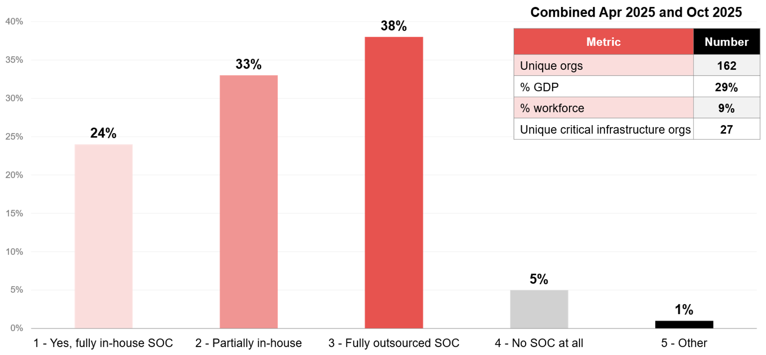
Does your organisation have an in-house security operations centre?
Source : ADAPT Security Edge Surveys in Apr and Oct 2025. Sample size : 221 Australian CISOs

Slide 8
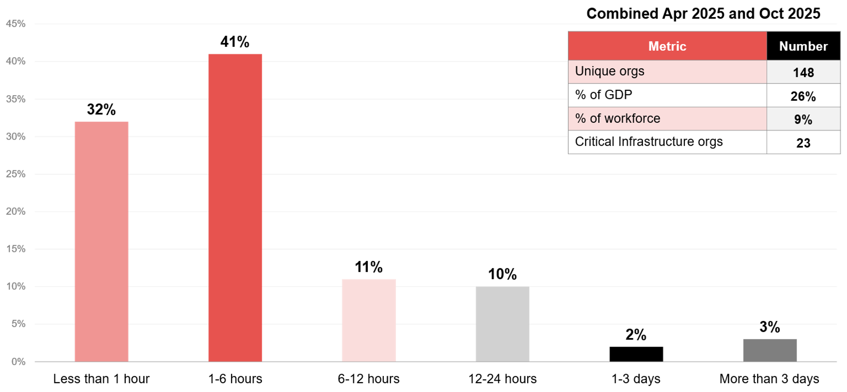
What is the average mean time to detect (MTTD) a security incident in your organisation?
Source : ADAPT Security Edge Surveys in Apr and Oct 2025. Sample size : 203 Australian CISOs

Slide 9
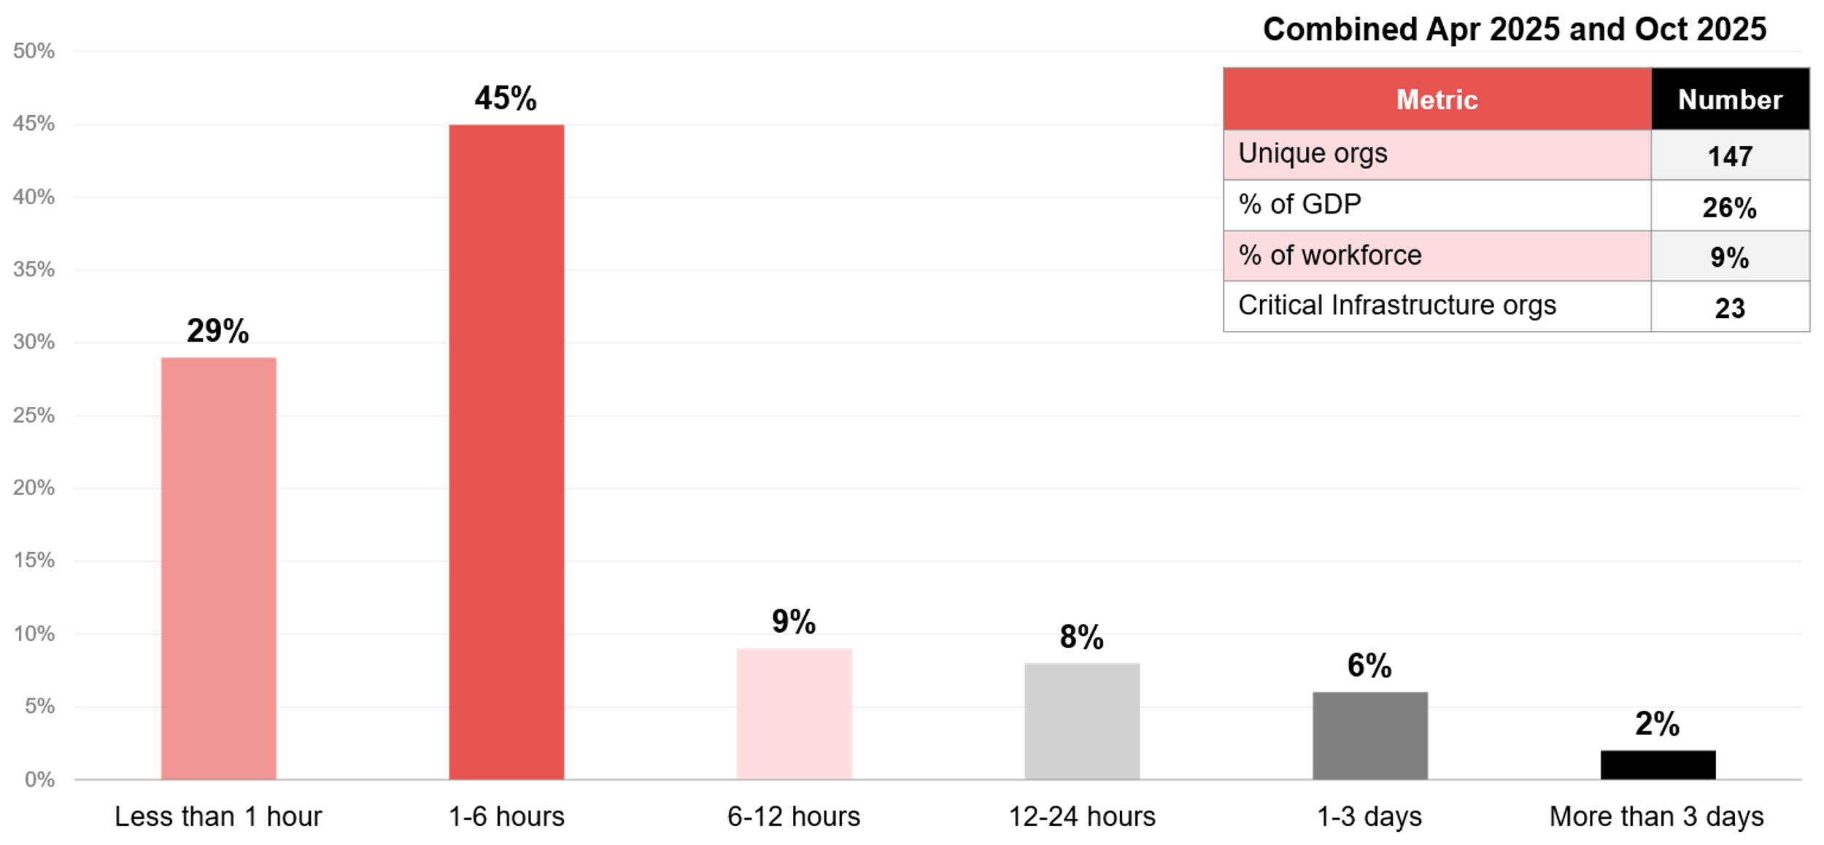
What is the average mean time to respond (MTTR) to a security incident once detected?
Source : ADAPT Security Edge Surveys in Apr and Oct 2025. Sample size : 201 Australian CISOs

Slide 10
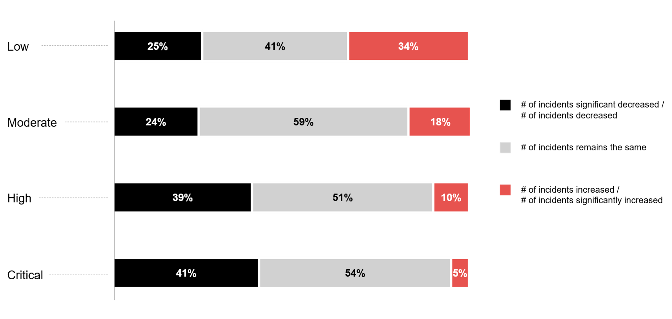
In the last 12 months, how would you rate your organisation's experience of security incidents across the following severity levels?
Source : ADAPT Security Edge Survey in Oct 2025. Sample size : 83 Australian CISOs

Slide 11
Technology Trends
The SOC approach indicates a diverse security strategy implementation
The trend towards outsourcing and hybrid models indicates organisations are seeking flexible,
cost-effective security solutions that can keep pace with fast-changing threats.
Fully outsourced SOC is emerging as the most dominant model. This suggests a greater need for faster access to threat intelligence and automation capabilities, while maintaining governance and cyber security outcomes.
Most organisations can detect and respond to any incidents within 6 hours
The alignment between the ability of organisations to detect and respond to incidents suggests
a mature approach to cyber security incident handling. There's still room for improvement in the remaining 25%+ of organisations.
Severity level progression
As the severity level of security incidents escalates, the percentage of incidents that increase declines dramatically. The increase in low severity levels is significant and concerning, at 34%.
The percentage increase at other levels is as follows: moderate incidents – 18%, high incidents – 10%, and critical incidents – 5%. The reduction in high-severity incidents suggests that organisations are maturing and strengthening their cyber security capabilities.
Consistent pattern of stability across severity levels
The stability in the grey area demonstrates that organisations are looking to enable AI use cases while maintaining stringent compliance and risk management protocols.
This further supports CISOs' #2 benchmarking interest in AI enablement and governance
readiness (ADAPT Security Edge Survey, Oct 2025).
SOC approach, MTTD, MTTR, and security incident levels
71% of organisations operate a partially in-house and fully outsourced SOC, while 24% maintain a fully in-house SOC.
The ability of organisations to detect and respond to incidents is showing remarkable consistency, with 73% of organisations detecting incidents within 6 hours and 74% able to respond effectively once detected.
Organisations are showing an inverse relationship between security incident severity and the percentage of security incidents that increase.
As the security incident level progression becomes more concerning, CISOs prioritise core operational dependency, financial impact and data sensitivity as their top metrics when classifying assets.

Slide 12
Prioritising and enabling secure initiatives

Slide 13
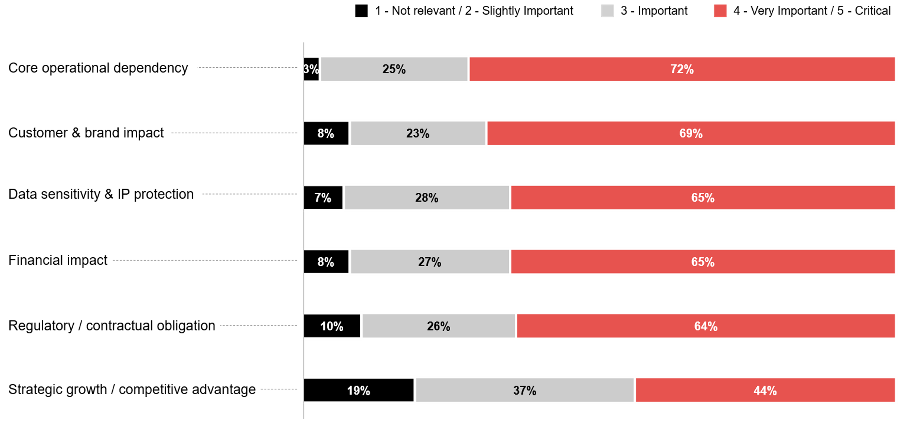
How important is each metric for business leaders in your organisation when prioritising or classifying assets?
Source : ADAPT Security Edge Survey in Oct 2025. Sample size : 92 Australian CISOs

Slide 14
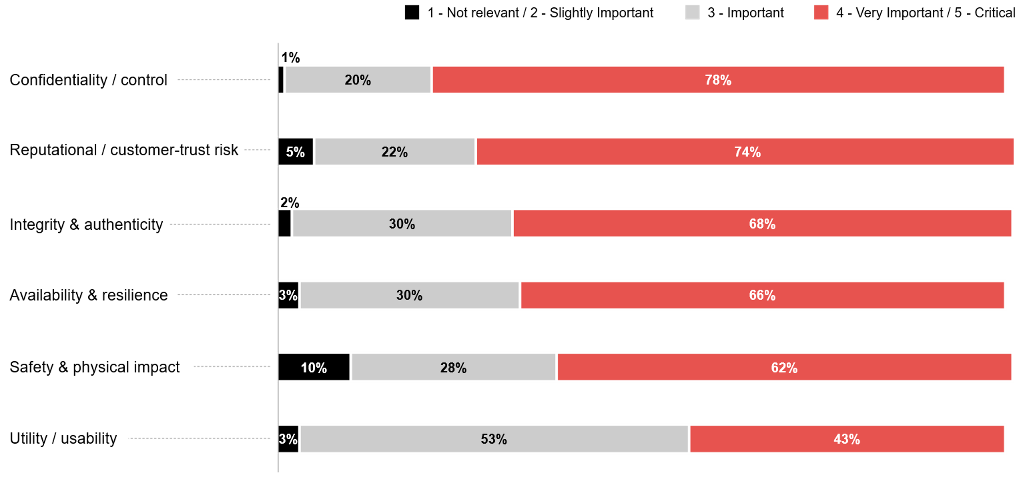
How important is each security control dimension for the security / risk team when analysing asset criticality?
Source : ADAPT Security Edge Survey in Oct 2025. Sample size : 89 Australian CISOs

Slide 15
The following key insights describe the top metrics in prioritising or classifying assets:
Core operational dependency as the top metric
  When Australian CISOs prioritise or classify business assets, they consider metrics that show
  how organisations balance cyber risk management with value creation.
  To ensure business continuity in the face of cyber risks, core operational dependency becomes a critical metric. This indicates that CISOs are prioritising assets essential to keeping organisations running.
Customer and brand impact is driven by operational dependency
This metric is nearly as important as operational risk, highlighting the need to protect customer experience and brand credibility. Strategic growth is recognised as less important because its frameworks and governance are designed for resilience, not growth, which is the #1 CISO goal.
Data sensitivity and financial impact
  Data sensitivity reflects growing concerns about intellectual property in technology. While data
  protection remains a foundational element, cyber security is no longer viewed merely as a cost
  but as something directly linked to financial exposure. Compliance continues to be a major enabler,
  though it is not regarded as a primary driver.
CISOs prioritise assets that protect their organisations from loss (such as operations, reputation,
and financial) rather than those that enable growth.
Except for utility/usability, all security control dimensions are critical for analysing a security asset
As the security focus is on protecting value rather than maximising usage, utility or usability
is not considered critical, as it does not directly reduce cyber risk.
The strong emphasis on system and reputational resilience suggests that CISOs aim
to maintain customer trust and ensure operational continuity.
Technology Trends
Prioritising and enabling secure initiatives
The most prominent emerging security metrics are core operational dependency, along with customer and brand impact.
CISOs regard confidentiality and control as the most important security measures for security and risk teams when analysing asset criticality.

Slide 16
Survey demographics

Slide 17
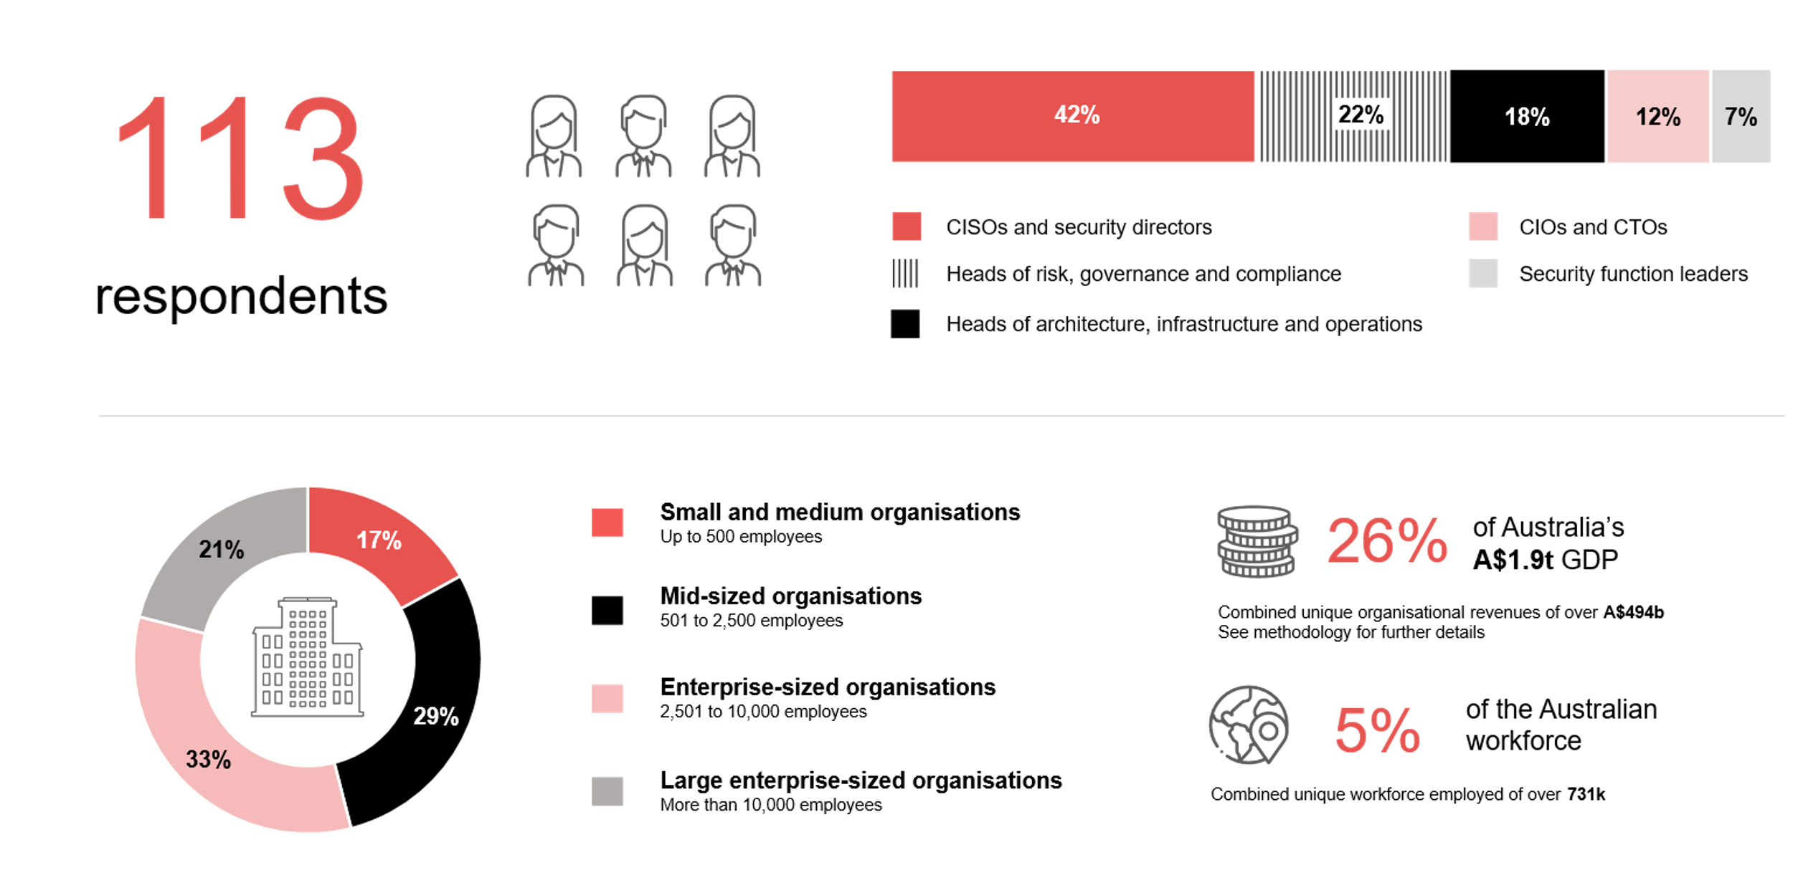
Survey demographics: Australian CISOs in 2025

Slide 18

For sector, segment and persona comparisons
Central limit theorem a fundamental concept in statistics that determines when a sample size is large enough
to be considered reliable. There are different formulas and some debate amongst statisticians about the appropriate sample size. For industry comparisons or other subset analyses, a sample size of ( n > 20 ) is generally considered acceptable for drawing meaningful insights. This threshold aligns with common statistical practices, where a
sample size of 20 to 30 is generally the minimum needed to assume a normal distribution of the data.
Sample sizes below 20, but equal to or greater than 15
When the sample size is between 15 and 20, while not fully representative, it can still offer valuable insights
into trends. These statistics should be viewed as indicative, highlighting general directions in industry efforts
or barriers to investment but treated with some caution due to the smaller number of observations.
Sample sizes less than 15, but greater or equal to 10
For samples between 10 and 15, the data provides a snapshot guideline only. While such small samples can
show early trends, it's important to recognise that this doesn't guarantee future respondents will reflect the same trends. For instance, while 100% of respondents in a sample of 10 might invest in AI, it'd be unrealistic to assume this pattern will hold as the sample size grows. However, if the sample size increases to 20, it's unlikely
that the trend will change drastically, and the next 10 respondents will have no investment.
ADAPT Data Analytics:
Notes on sample sizes
Why does sample size matter?
Each set of statistics is unique with measures,
distribution, variance and sample size. It is generally accepted in statistics that as sample size increases, analysts make fewer assumptions about the data, resulting in statistics that more accurately represent the truth.
ADAPT endeavours to provide transparency of sample size, whereby we provide a source on data slides with
the number of respondents and the survey where those respondents come from. In data and insights slide decks, ADAPT usually provides some insight on the breakdown
of the demographics at the end of the slide deck.
To protect privacy, ADAPT does not release lists
of individual respondents to surveys.

Slide 19


Written by
Gabby Fredkin
Head of Data and Analytics at ADAPT
Honey Mari Gay
Junior Data Analyst at ADAPT
Gabby’s primary role is managing ADAPT’s overall strategy for Data Analytics. He has extensive experience in using data to identify trends in technology that help shape Australian organisations. Using modern data science techniques, he ensures the accuracy and validity of the information that supports ADAPT’s research, advisory services, and events, giving both ADAPT and its customers greater confidence in the insights provided.
With a passion for creating stories with data, Gabby is consistently rated as one of the top speakers at ADAPT Events. In round table discussions, he specialises in using statistics to initiate thought-provoking discussions. Gabby is effective in translating information into insights, enabling ADAPT’s customers to become more data-driven.
As a Junior Data Analyst at ADAPT, Mari enables the discovery and definition of market trends through visually meaningful statistics. She ensures data presentations are accurate and aligned with modern statistical standards.
Mari is passionate about data and transforming it into actionable insights. With over three years of experience in project management and academic research, she has led end-to-end survey and research projects, processed and analysed data using a range of statistical tools and techniques, and provided clients with statistical
consultation and insights.

Slide 20

About ADAPT
ADAPT is a specialist Research & Advisory firm providing local market insights and benchmarking data
to Australia and New Zealand’s senior technology and business community.
Since 2011, we’ve been empowering the leaders of the region’s top enterprise and government organisations
to stay at the forefront of modern trends and build for the future. Our industry leading conferences, private roundtable events and custom research projects equip business leaders with the knowledge, relationships, inspiration and tools they need to make better strategic decisions.
adapt.com.au | hello@adapt.com.au
Data Validation
Results contained in this report (Report) are based on survey responses as provided by our clients and publicly available information. ADAPT does not subject the data contained in the Report to audit or review procedures or any other testing to validate the accuracy or reasonableness of the data provided by the participating clients. While we do not manipulate the survey responses, we do make an effort to identify outlier data or conflicting results that could lead to misinterpretations before the preparation of the Report.
Intended Use of the Report
The Report is designed to help technology executives in Australia and New Zealand make independent decisions regarding financial, resourcing and operational performance matters. The information and data contained in the Report are provided as is and are for information purposes only. They are not intended or implied to be recommendations and in no event will ADAPT be liable for any decisions or actions taken in reliance of the results obtained through the use of the information and/or data contained in the Report.
Research MSA and Privacy Policy
The Report and any other information provided by ADAPT is subject to the Research and Advisory Master Services Agreement and the ADAPT Privacy Policy.

Slide 21




Additional resources you can access
Members of ADAPT’s Research & Advisory platform have access to an entire suite of market leading content, insights and resources to help you execute in your role. For any assistance contact your Account Manager in the help section.
Community case studies and interviews
Case studies detailing the successes
and challenges of projects and initiatives.
Market Trend Reports Access a library of fact-based actionable insights, deep dives on ANZ business & IT trends.
Live access to ADAPT analysts
Through live ADAPT analyst market briefings and Q&A sessions
Downloadable data and insights
Elevate your business cases with downloadable market and industry data.
Industry expert presentations
Watch keynotes or read distilled 1-page executive summaries from our Edge Events.
Bespoke analysis of ADAPT data
Receive custom cuts and analysis of ADAPT proprietary data.
Premier executive community
Unlock access to our exclusive network of Australia’s leading technology and business executives.
Dedicated account manager and impact assessments
Your Account Manager will ensure you and your team are getting the most out of your subscription.
Dedicated analyst briefing
Leverage a dedicated briefing with an ADAPT analyst to help validate your strategies.
*Inclusions may vary depending on subscription level.

