Slide 1

ADAPT Technology Trends
How Are Australian Public
Service Agencies Developing
and Executing AI Initiatives
That Drive Value?

Slide 2
The Australian Public Service (APS) capability and outsourcing trends
The APS is outsourcing for outcomes while insourcing capabilities.
Given the APS’s focus on sovereign capability, most agencies have reduced staff augmentation
and increased specialist capability bursts by 10-20% over the past 12-18 months.
They continue to rely on managed services and outcome-based outsourcing, valuing operational
partnerships and end-to-end delivery by external vendors.
Current capability state
Most key functions remain below the ideal capability level.
The largest capability gaps are in data, analytics and AI, and automation.
Cyber security, cloud operations and applications show relatively stronger maturity.
However, they are still far from being optimal.
Value tracking and realisation
  The leading metrics when evaluating agencies' top initiatives are operational resilience, staff experience
  and public value. Sustainability metrics are considered essential, but not yet urgent for agencies.
  Under the new APS ERP approach, 86% of agencies have already made progress in modernisation.
  In terms of cyber security maturity across the E8 framework, agencies are mostly mature in disabling
  untrusted macros and application whitelisting.
Challenges in delivering public value
Agencies identify resources & incentives, coordination mindset, and legal and policy clarity
as the biggest limitations to delivering a seamless service experience for citizens.
Although progress is being made on data-sharing standards, interoperability remains low
in cross-jurisdiction data exchange, common vocabularies, data quality and AGA-aligned APIs.
Technology Trends:
IT / Business Initiatives
Key takeaways
ADAPT’s 2025 Government Edge Survey (Oct 30), describes
government leaders’ views on:
resourcing and workforce transformation
value tracking and realisation
challenges to deliver public value.

Slide 3
Resourcing and workforce transformation

Slide 4
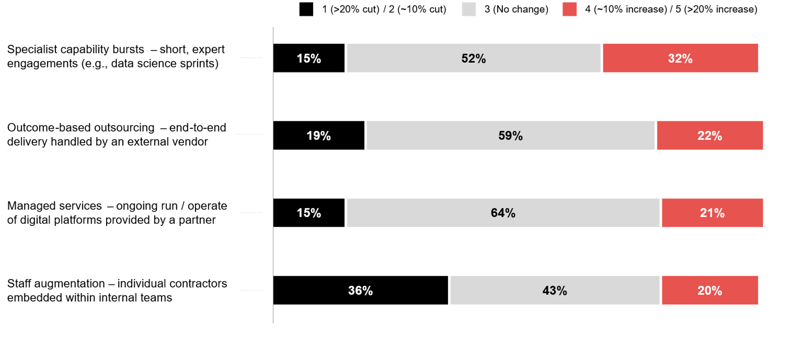
How has your agency’s reliance on each engagement model changed over the past 12–18 months?
Please note that the percentages shown are rounded to the nearest whole number.
As a result, the total may appear slightly above or below 100% due to rounding.
Source : ADAPT Government Edge Survey in Oct 2025. Sample size : 83 Australian Government leaders

Slide 5
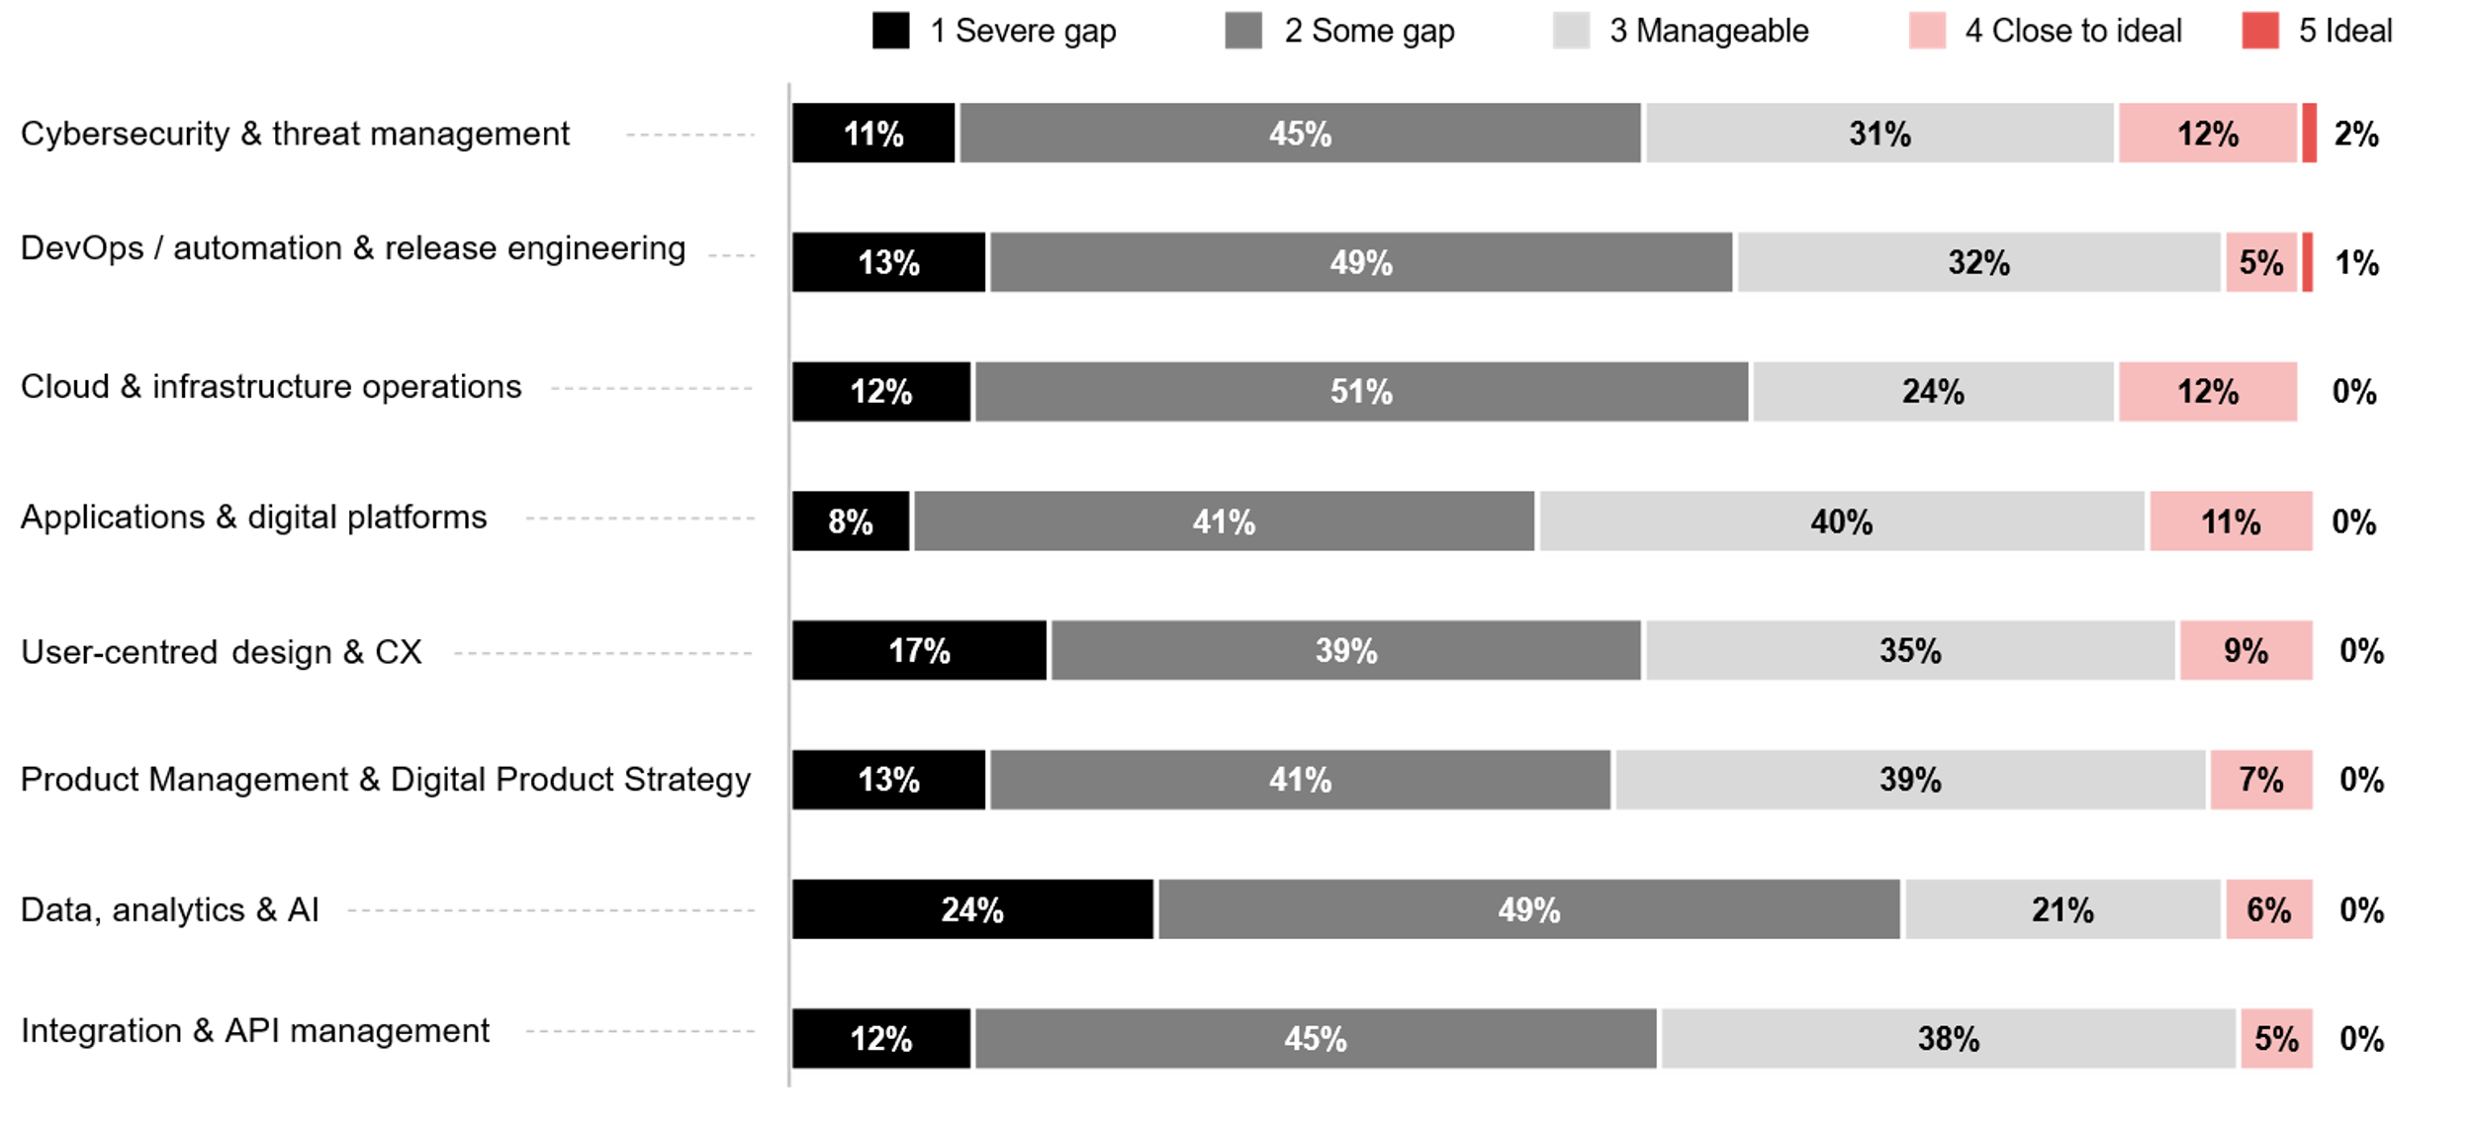
With current end goals in mind, how close is your current capacity /
capability to your ideal state for each function below?
Please note that the percentages shown are rounded to the nearest whole number.
As a result, the total may appear slightly above or below 100% due to rounding.
Source : ADAPT Government Edge Survey in Oct 2025. Sample size : 87 Australian government leaders

Slide 6
Technology Trends
Shifting from staff augmentation to specialist capability bursts
APS agencies are revising how they engage external partners considering their sovereign capability goals.
The reduction in staff augmentation and the increase in specialist roles reflect a preference for targeted skills transfer rather than reliance on embedded contractors. As AI pilots accelerate progress more effectively than adding contractors, agencies are using short bursts of expert capability to maximise
value for innovation and adoption.
High priority on operational partnerships and outcome-based contracts
Managed services is the most stable model, showing continued trust in operational partnerships.
The APS continues to value outcome-based outsourcing. Agencies recognise they cannot yet deliver
all capabilities internally. Outcome-based contracts enable progress without creating over-reliance
on individual contractors.
Most key functions are still below the ideal capability state
The government remains in a capability-deficit environment, with most agencies operating at manageable or moderate gap levels rather than approaching ideal maturity. The greatest uplift is needed in data, analytics and AI (73%), cloud and infrastructure (63%), automation (62%), and integration (57%).
Cyber security shows relatively stronger maturity, despite being far from optimal.
The maturity in this area stems from the ongoing ERP (see slide 9) and SaaS adoption (#8 investment priority). More insights on SaaS adoption are explained in an ADAPT Expert Presentation (Nov 2025).
Despite cloud and infrastructure operations being more mature compared to cyber security,
some gaps in this area still exist due to legacy dependencies (#6 barrier.)
Resourcing and workforce transformation
In the past 12 to 18 months, most APS agencies have reduced staff augmentation by 10-20% and increased specialist capability bursts by the same percentage.
Managed services is the most stable engagement model (64%), followed by outcome-based outsourcing (59%) and capability bursts (52%).
Most government agencies report significant capability gaps across all eight digital functions, with no function reaching more than 2% of full ideal maturity.
Cyber security and threat management are gradually evolving towards an ideal capability, with 14% of government agencies reporting progress in this area.

Slide 7
Value tracking and realisation

Slide 8
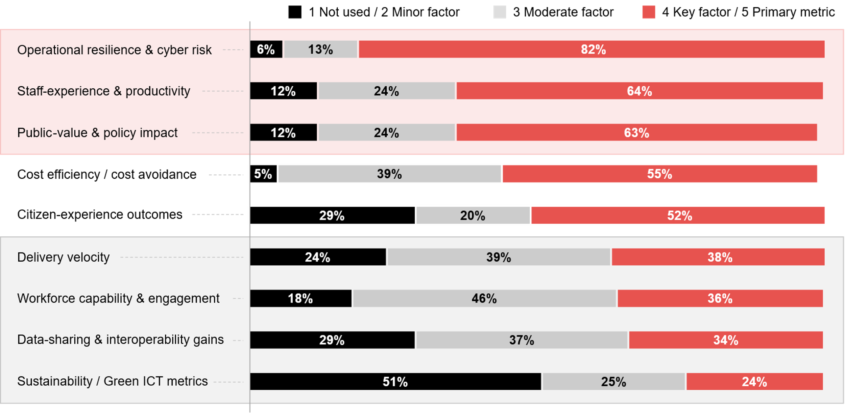
Which metrics matter most when you evaluate your agency’s top initiatives?
Source : ADAPT Government Edge Survey in Nov 2025. Sample size : 95 Australian government leaders

Slide 9
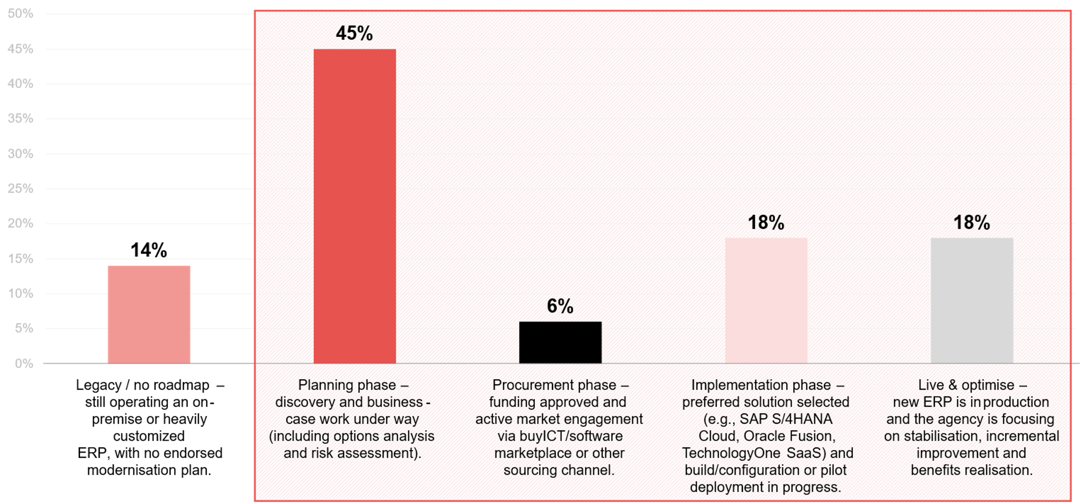
Where is your agency in its ERP modernisation journey given the new APS ERP approach?
Source : ADAPT Government Edge Survey in Oct 2025. Sample size : 85 Australian Government Leaders

Slide 10
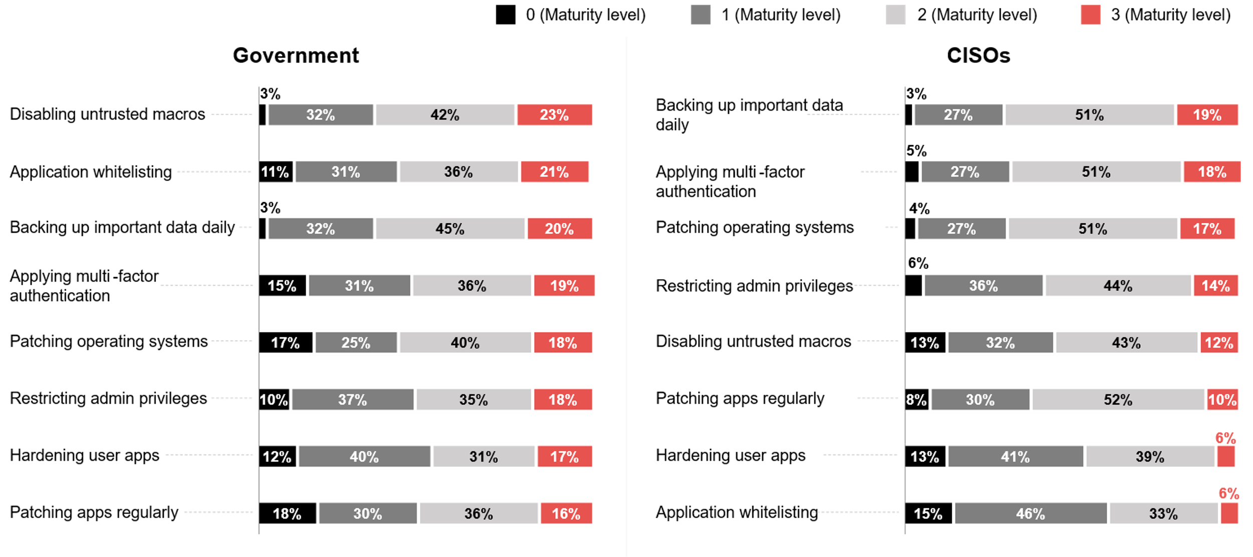
Please rate your department's cyber security maturity across the
‘Essential Eight’ – based on the ASD 0-3 maturity definitions
Source : ADAPT Security and Government Edge Survey in Apr and Oct 2025. Sample size : 255 Australian CISOs and Government Leaders

Slide 11
Prioritising metrics that ensure resilience, improve productivity, and deliver public value
As AI is the top goal, initiative and investment priority for government leaders (ADAPT Government Edge Survey, Oct 2025), agencies view operational resilience and cyber risk as foundational. When assessing the success of these initiatives, government leaders look beyond resilience, security and risk.
The impact on staff experience and the creation of public value are equally critical for most agencies, ensuring the benefits are felt both internally and by the public.
Cost efficiency and citizen experience outcomes are moderately critical metrics
While resilience remains the primary metric, cost efficiency also matters, but not at the expense of reliability, security or risk mitigation.
Delivering public service outcomes is crucial, yet these can be harder to quantify depending on the type
of impact. This measurement typically follows once public value has been effectively created.
Sustainability or green ICT metrics are essential, but not yet urgent
As agencies focus first on keeping their systems secure and operational, sustainability does not immediately deliver direct operational benefits. Between 34% and 38% of agencies identify delivery velocity, workforce capability and data sharing as key factors or primary metrics.
ERP modernisation journey
Most agencies are in the planning phase, 18% are both in the implementation and optimisation phases, and only 6% are in the procurement phase.
As AI initiatives advance, a modern ERP becomes critical. Having the right architecture, vendor strategy and governance is more important than rushing implementation.
Essential Eight framework maturity
Government leaders prioritise operational resilience and risk reduction, while CISOs focus on cyber defence and resilience against active threats. Government leaders place greater emphasis on keeping systems stable and compliant, whereas CISOs concentrate on threat defence and rapid recovery.
Technology Trends
Value tracking
and realisation
Agencies assess how initiatives ensure operational resilience, enhance staff experience, and create public value.
About 52-55% of agencies consider
cost efficiency and citizen experience outcomes as key factors or
primary metrics.
Most agencies don't view sustainability as a top metric when evaluating initiatives.
Given the new APS ERP approach, over 80% of agencies are already on their way to modernisation progress.
Government agencies are mostly mature in disabling untrusted macros (23%) and application whitelisting (21%). In contrast, CISOs are mostly mature in data back-ups (19%), multi-factor authentication (18%), and patching (18%).

Slide 12
Challenges in delivering public value

Slide 13
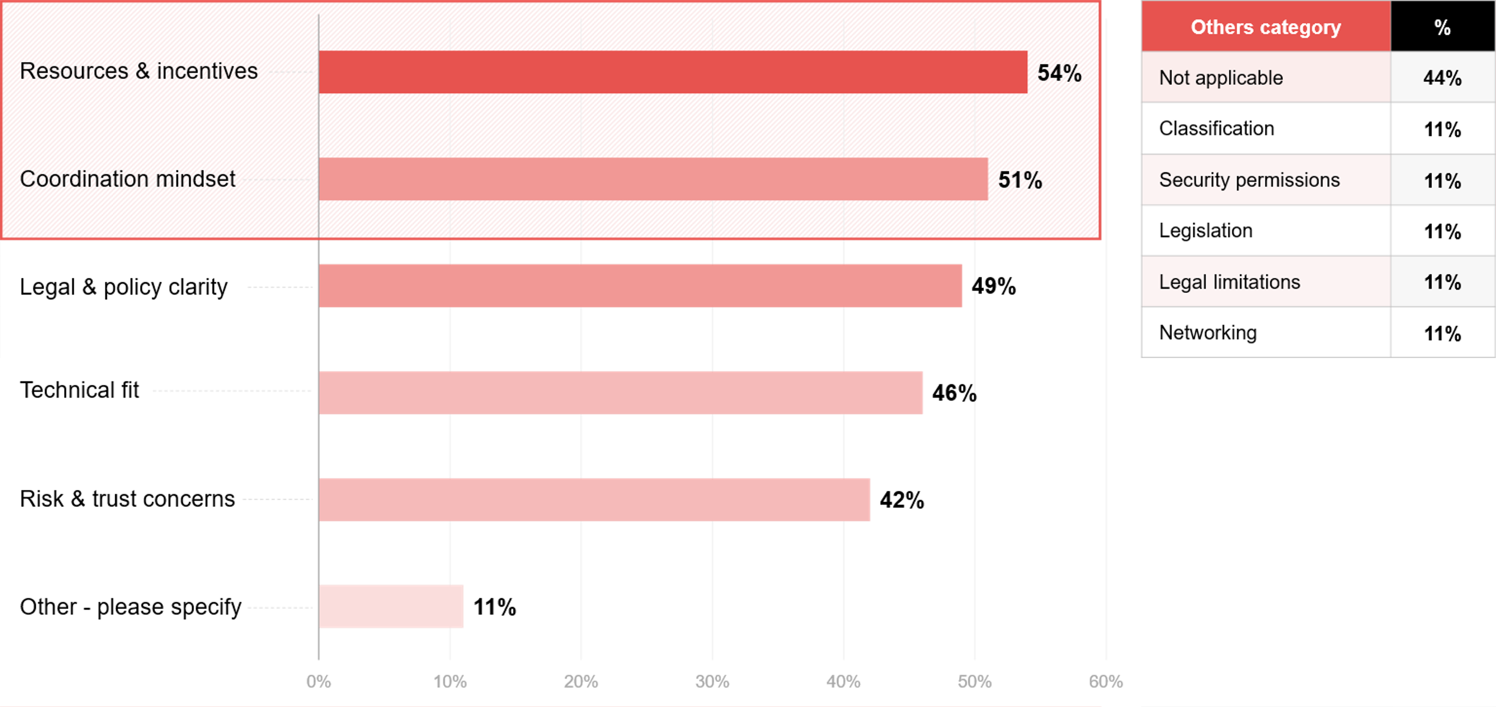
What limits your ability to work with other agencies to deliver a seamless service experience for citizens across different life events (e.g., birth, job loss, moving house)?
Source : ADAPT Government Edge Survey in Oct 2025. Sample size : 81 Australian Government Leaders

Slide 14
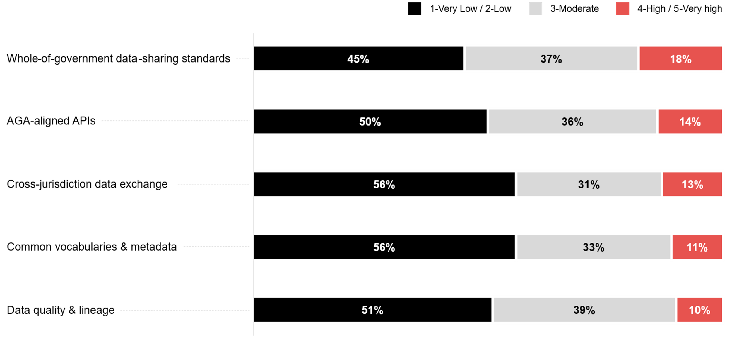
How would you rate your agency's maturity in each area of data interoperability?
Source : ADAPT Government Edge Survey in Oct 2025. Sample size : 75 Australian Government Leaders

Slide 15
Technology Trends
Insufficient resources, cross-agency misalignment, and policy issues
Resources and incentives constraint is the top barrier, which is highly aligned with the lack of funding models (ADAPT Government Edge Survey, Oct 2025).
Even when the intent is strong, cross-agency collaboration remains difficult, which reflects siloed structures and agency-first cultures. Also, legal and policy clarity are obstacles, despite policy
impact being one of the top initiative metrics (see slide 8).
Whole-of-government data-sharing standards are emerging
The steady progress of whole-of-government data-sharing standards shows stronger alignment
with the APS’s focus on sovereign capability.
AGA-aligned APIs show a more balanced approach. This indicates that agencies are showing
gradual progress in standardised API integration.
Other areas still have gaps
Agencies continue to struggle with metadata consistency (56%), cross-jurisdiction exchange (56%), and data quality (51%).
Metadata and data quality challenges largely arise from inconsistent data definitions, schema mapping, and validation processes across agencies. Security and privacy requirements (#9 barrier) further complicate cross-agency data validation.
Challenges in delivering public value
The top challenges in delivering a seamless service experience for citizens are resources and incentives (54%), coordination mindset (51%), and legal and policy clarity (49%).
There is a low data interoperability maturity across the five areas of maturity. Over half of agencies rate their maturity as low, with only 10-18% achieving a high capability.

Slide 16
Survey demographics

Slide 17
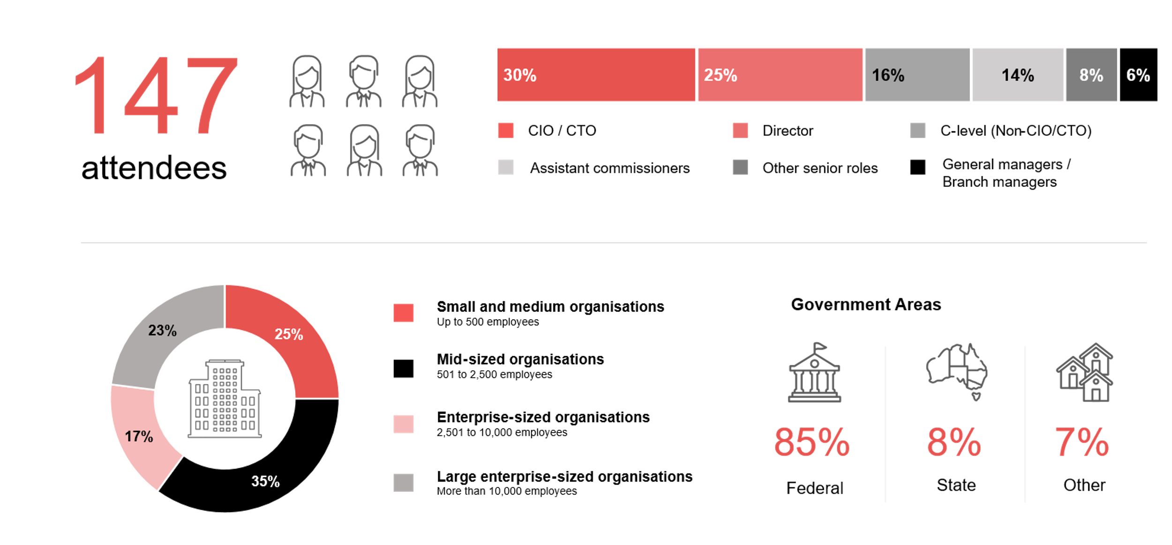
Survey demographics: Australian government leaders in 2025

Slide 18

For sector, segment and persona comparisons
Central limit theorem a fundamental concept in statistics that determines when a sample size is large enough
to be considered reliable. There are different formulas and some debate amongst statisticians about the appropriate sample size. For industry comparisons or other subset analyses, a sample size of ( n > 20 ) is generally considered acceptable for drawing meaningful insights. This threshold aligns with common statistical practices, where a
sample size of 20 to 30 is generally the minimum needed to assume a normal distribution of the data.
Sample sizes below 20, but equal to or greater than 15
When the sample size is between 15 and 20, while not fully representative, it can still offer valuable insights
into trends. These statistics should be viewed as indicative, highlighting general directions in industry efforts
or barriers to investment but treated with some caution due to the smaller number of observations.
Sample sizes less than 15, but greater or equal to 10
For samples between 10 and 15, the data provides a snapshot guideline only. While such small samples can
show early trends, it's important to recognise that this doesn't guarantee future respondents will reflect the same trends. For instance, while 100% of respondents in a sample of 10 might invest in AI, it'd be unrealistic to assume this pattern will hold as the sample size grows. However, if the sample size increases to 20, it's unlikely
that the trend will change drastically, and the next 10 respondents will have no investment.
ADAPT Data Analytics:
Notes on sample sizes
Why does sample size matter?
Each set of statistics is unique with measures,
distribution, variance and sample size. It is generally accepted in statistics that as sample size increases, analysts make fewer assumptions about the data, resulting in statistics that more accurately represent the truth.
ADAPT endeavours to provide transparency of sample size, whereby we provide a source on data slides with
the number of respondents and the survey where those respondents come from. In data and insights slide decks, ADAPT usually provides some insight on the breakdown
of the demographics at the end of the slide deck.
To protect privacy, ADAPT does not release lists
of individual respondents to surveys.

Slide 19


Written by
Gabby Fredkin
Head of Data and Analytics at ADAPT
Honey Mari Gay
Junior Data Analyst at ADAPT
Gabby’s primary role is managing ADAPT’s overall strategy for Data Analytics. He has extensive experience in using data to identify trends in technology that help shape Australian organisations. Using modern data science techniques, he ensures the accuracy and validity of the information that supports ADAPT’s research, advisory services, and events, giving both ADAPT and its customers greater confidence in the insights provided.
With a passion for creating stories with data, Gabby is consistently rated as one of the top speakers at ADAPT Events. In round table discussions, he specialises in using statistics to initiate thought-provoking discussions. Gabby is effective in translating information into insights, enabling ADAPT’s customers to become more data-driven.
As a Junior Data Analyst at ADAPT, Mari enables the discovery and definition of market trends through visually meaningful statistics. She ensures data presentations are accurate and aligned with modern statistical standards.
Mari is passionate about data and transforming it into actionable insights. With over three years of experience in project management and academic research, she has led end-to-end survey and research projects, processed and analysed data using a range of statistical tools and techniques, and provided clients with statistical
consultation and insights.

Slide 20

About ADAPT
ADAPT is a specialist Research & Advisory firm providing local market insights and benchmarking data
to Australia and New Zealand’s senior technology and business community.
Since 2011, we’ve been empowering the leaders of the region’s top enterprise and government organisations
to stay at the forefront of modern trends and build for the future. Our industry leading conferences, private roundtable events and custom research projects equip business leaders with the knowledge, relationships, inspiration and tools they need to make better strategic decisions.
adapt.com.au | hello@adapt.com.au
Data Validation
Results contained in this report (Report) are based on survey responses as provided by our clients and publicly available information. ADAPT does not subject the data contained in the Report to audit or review procedures or any other testing to validate the accuracy or reasonableness of the data provided by the participating clients. While we do not manipulate the survey responses, we do make an effort to identify outlier data or conflicting results that could lead to misinterpretations before the preparation of the Report.
Intended Use of the Report
The Report is designed to help technology executives in Australia and New Zealand make independent decisions regarding financial, resourcing and operational performance matters. The information and data contained in the Report are provided as is and are for information purposes only. They are not intended or implied to be recommendations and in no event will ADAPT be liable for any decisions or actions taken in reliance of the results obtained through the use of the information and/or data contained in the Report.
Research MSA and Privacy Policy
The Report and any other information provided by ADAPT is subject to the Research and Advisory Master Services Agreement and the ADAPT Privacy Policy.

Slide 21




Additional resources you can access
Members of ADAPT’s Research & Advisory platform have access to an entire suite of market leading content, insights and resources to help you execute in your role. For any assistance contact your Account Manager in the help section.
Community case studies and interviews
Case studies detailing the successes
and challenges of projects and initiatives.
Market Trend Reports Access a library of fact-based actionable insights, deep dives on ANZ business & IT trends.
Live access to ADAPT analysts
Through live ADAPT analyst market briefings and Q&A sessions
Downloadable data and insights
Elevate your business cases with downloadable market and industry data.
Industry expert presentations
Watch keynotes or read distilled 1-page executive summaries from our Edge Events.
Bespoke analysis of ADAPT data
Receive custom cuts and analysis of ADAPT proprietary data.
Premier executive community
Unlock access to our exclusive network of Australia’s leading technology and business executives.
Dedicated account manager and impact assessments
Your Account Manager will ensure you and your team are getting the most out of your subscription.
Dedicated analyst briefing
Leverage a dedicated briefing with an ADAPT analyst to help validate your strategies.
*Inclusions may vary depending on subscription level.

