Slide 1

ADAPT Technology Trends
Is the Australian Public Service Ready to Harness Generative and Agentic AI?

Slide 2
Technology Trends: AI
Generative AI adoption in the Australian Public Service (APS)
Generative AI deployment across the Australian Public Service (APS) is currently limited,
with most use cases confined to sandbox experiments.
Agencies are prioritising low-risk applications and are cautiously withholding generative AI
from public-facing applications.
The APS is expecting to assess the potential benefits of agentic AI
About 73% of agencies are expecting to monitor (29%) and explore (44%) use cases
of agentic AI over the next 18 months.
While generative AI adoption is still in the experimentation phase, agencies are also assessing how agentic AI can add value to ensure that it is in line with public trust expectations.
Key takeaways
ADAPT’s 2025 Government Edge Survey
(Oct 30), presents Australian government leaders’ views on:
deployment maturity of
generative AI use cases
capability to leverage agentic AI.
Note:
The APS’s maturity in generative and agentic AI adoption mirrors broader trends among Australian executive leaders.
Refer to the technology trend reports below:
Organisations are insufficiently prepared to adopt and operationalise AI initiatives (ADAPT CISO Tech Trend report,
Jul 2025 and an ADAPT CDO Tech Trend report, Oct 2025).
AI does not impact operations yet and falls short of ROI expectations (ADAPT CDAO Tech Trend report, Jul 2025).
When it comes to agentic AI maturity, organisations are still either monitoring industry trends or evaluating its potential use cases (ADAPT CIO Tech Trend report, Dec 2025).

Slide 3
Deployment maturity of generative AI use cases

Slide 4
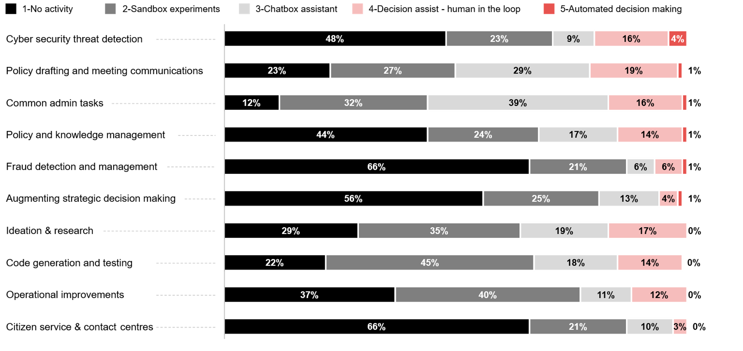
What are your primary generative AI use cases and how mature are their deployments?
Source : ADAPT Government Edge Survey in Nov 2025. Sample size : 78 Australian Government Leaders

Slide 5
Technology Trends
Deployment maturity of generative AI use cases
Generative AI adoption within the APS is mostly
inactive and low in maturity
Most inactive use cases
APS is holding back on deploying generative AI in high-risk or citizen-facing contexts due to governance, data sovereignty and accountability concerns. This reflects a practical and low-risk adoption mindset, before extending AI to decision or fraud-related functions.
Progressing generative AI use cases
Under the decision assist and automated decision-making categories, agencies are prioritising cyber security threat detection (20%), policy drafting (20%), common admin tasks (17%), research (17%), and knowledge management (15%) over public-facing applications (3%).
Technical and operational applications in sandbox trials
APS agencies mostly rely on sandbox experiments to explore generative AI for technical and operational applications, focusing on high learning potential with manageable risks. These use cases are code generation, operational improvements and research.
Chatbot assistants driving productivity
Chatbot assistants are viewed as essential tools for handling common tasks and policy drafting. This suggests that the APS prioritises increasing productivity and reducing manual administrative work.
With generative AI cutting policy drafting cycles from weeks to days, APS teams can act more responsively on policy decisions, delivering better societal outcomes.
Generative AI adoption within the APS is marked by widespread experimentation but remains limited in maturity. Most use cases are either inactive or confined to sandbox trials.
The most inactive generative AI use cases include:
  citizen services (66%)
  fraud detection (66%)
  augmenting decisions (56%).
Sandbox experimentation is currently focused on:
  code generation (45%)
  operational improvements (40%)
  ideation & research (35%).
Chatbot assistants are mostly used for:
  common admin tasks (39%)
  policy drafting (29%).

Slide 6
Capability to leverage
agentic AI

Slide 7
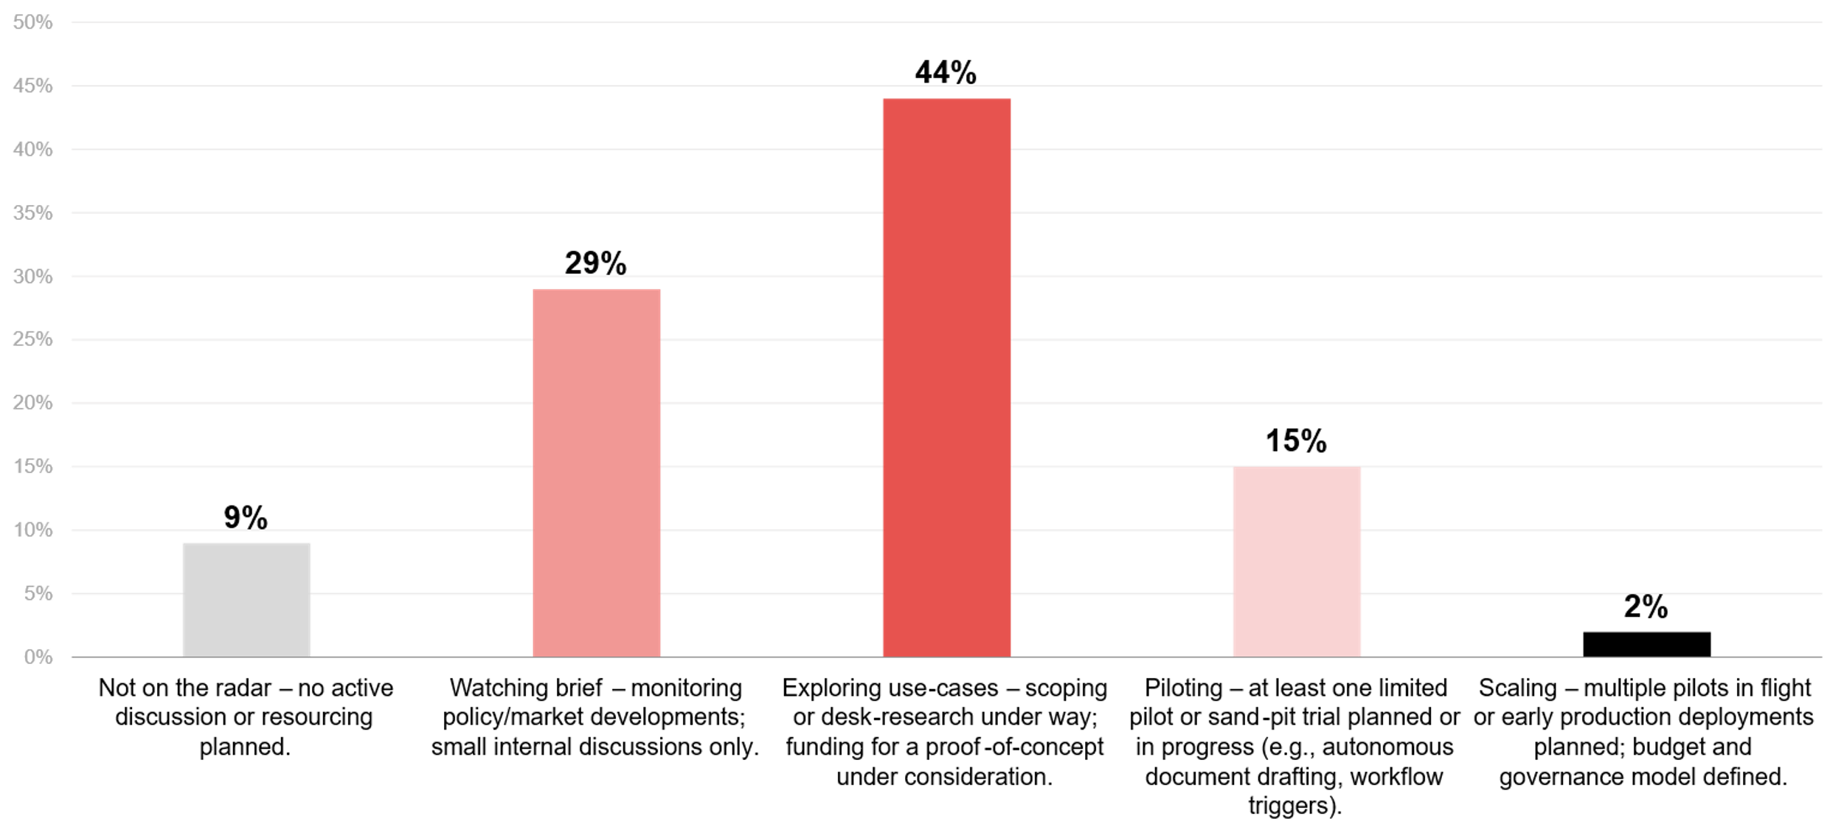
Which statement best describes your agency’s current appetite and capability to leverage agentic AI over the next 18 months?
Source : ADAPT Government Edge Survey in Oct 2025. Sample size : 95 Australian Government Leaders

Slide 8
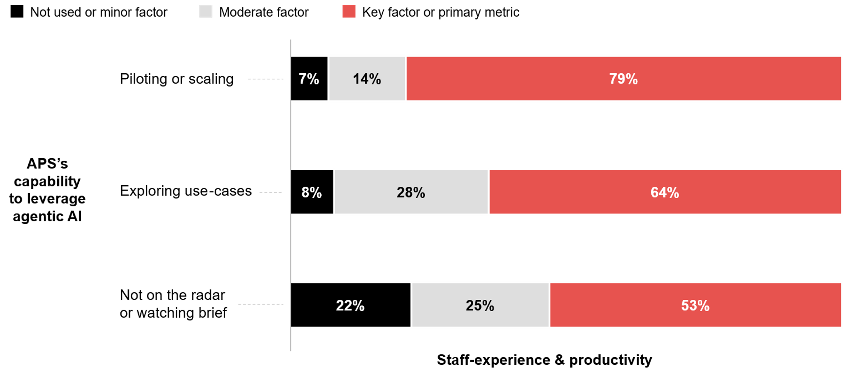
APS’ capability to leverage agentic AI over the next 18 months as it relates to staff-experience and productivity
Source: ADAPT Government Edge Survey in Oct 2025: Sample size: 95 Australian Government Leaders'

Slide 9
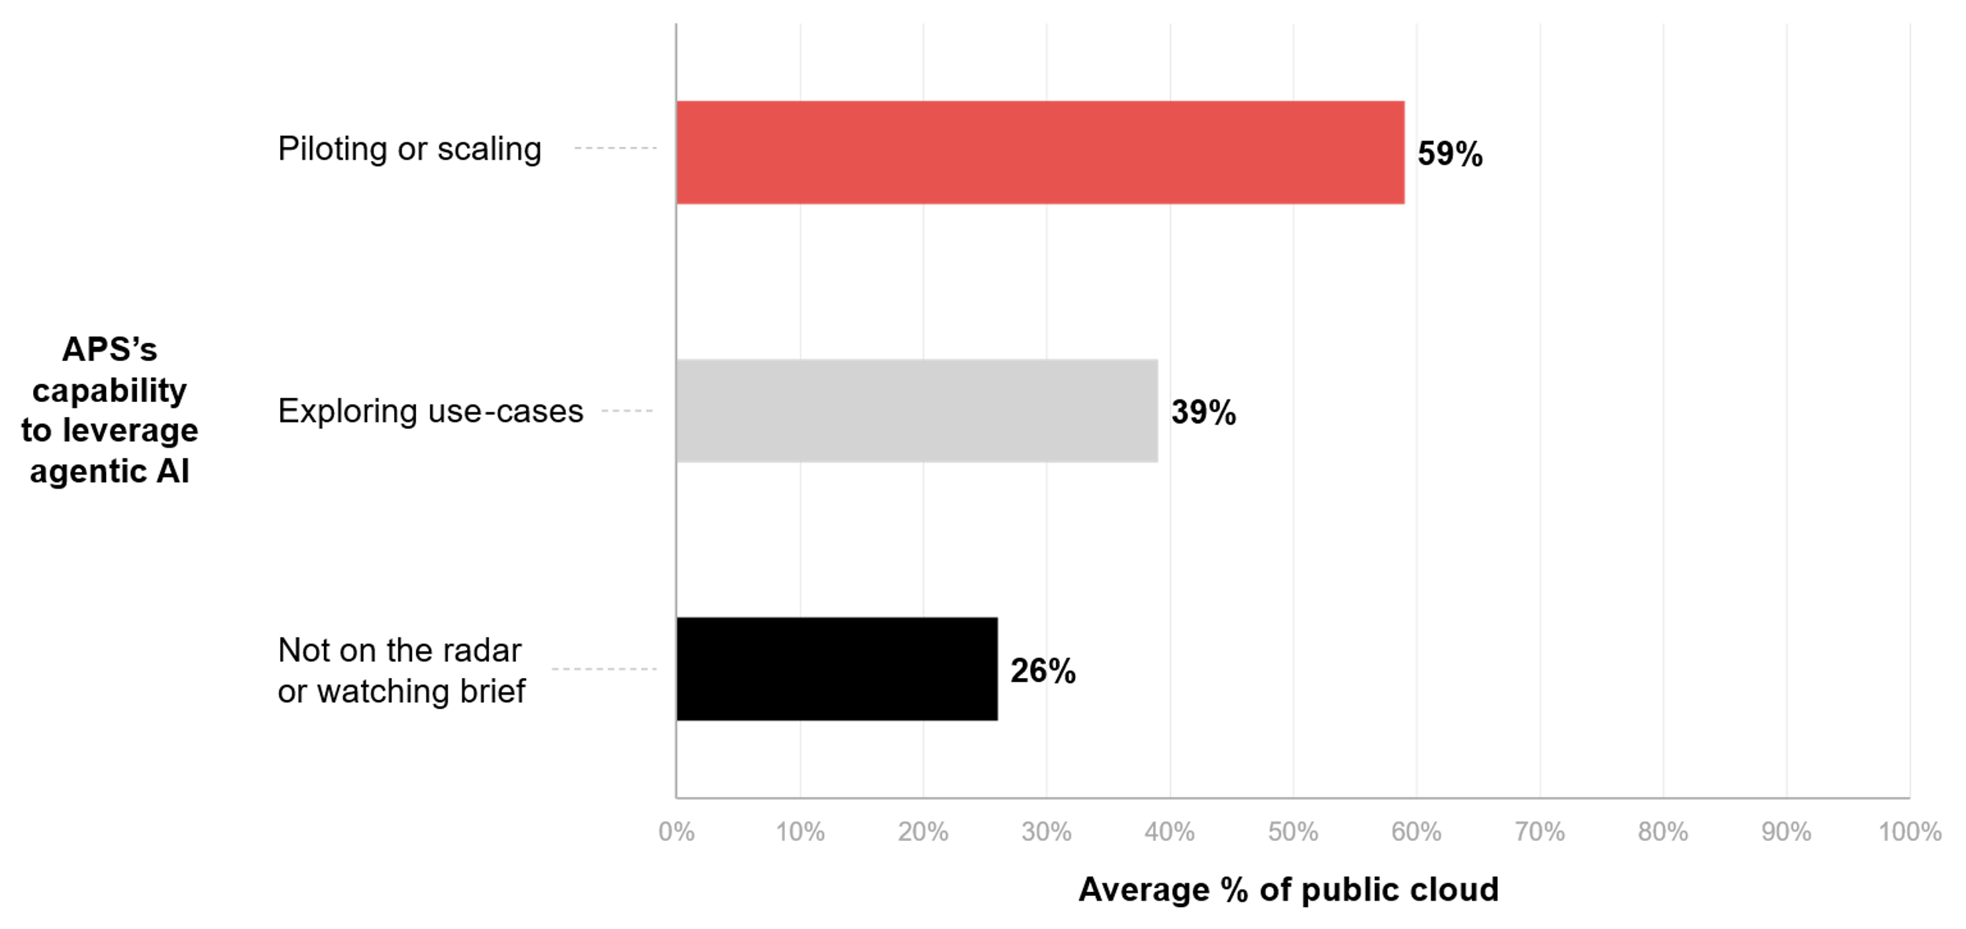
APS’s capability to leverage agentic AI over the next 18 months as it relates to average percentage of workloads in the public cloud
Source: ADAPT Government Edge Survey in Oct 2025: Sample size: 95 Australian Government Leaders'

Slide 10
Technology Trends
APS agencies are expecting to evaluate agentic AI value over the next 18 months
There is a high alignment between agentic AI readiness and generative AI deployment maturity.
Most APS agencies are still testing generative AI, while simultaneously assessing how agentic AI
could add value in the next 18 months. As generative AI pilots build foundational experience,
agentic AI exploration positions agencies for autonomous capabilities, supported by funding
and governance models.
ADAPT correlation analysis identifies some factors that enable APS to leverage agentic AI.
Staff experience and productivity as a metric of top initiatives evaluation
Unlike generative AI, agentic AI can take autonomous actions. However, its outputs and decisions
still depend on human oversight. Productivity gains signal an effective AI integration.
Measuring staff experience and productivity ensures that technology uplift translates to improved citizen outcomes and responsible AI governance.
More workloads in the public cloud
Agencies that have piloted or scaled agentic AI have 2.3x more workloads in the public cloud,
on average, than those that are not on the radar yet or monitoring phase.
Migrating more workloads to the public cloud indicates a strong foundation for APS agencies
to adopt agentic AI.
Capability to leverage
agentic AI
Over 70% of agencies are expecting to monitor and explore use cases of agentic AI over the next 18 months. About 15% aim for some pilots.
Only 2% have the governance, data quality and technical capability needed to implement autonomous AI systems in production within the next 18 months.
ADAPT correlation analysis reveals agencies that have used staff experience and productivity as key or primary metrics in their top initiatives’ evaluation are 1.5x more likely to pilot or scale agentic AI.
ADAPT also finds a correlation between having a higher average of workloads stored in the public cloud and the APS' capability to leverage agentic AI.

Slide 11
Survey demographics

Slide 12
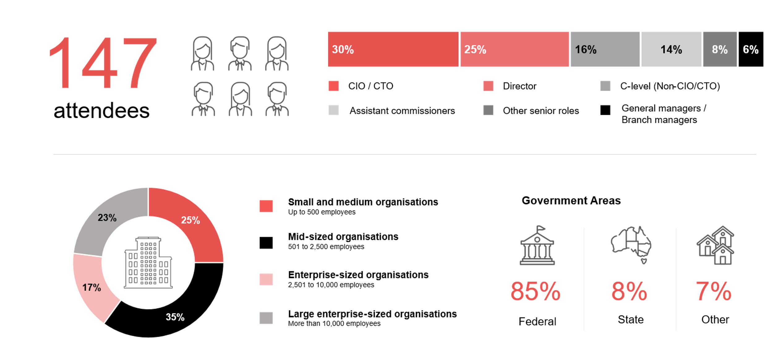
Survey demographics: Australian government leaders in 2025

Slide 13

For sector, segment and persona comparisons
Central limit theorem a fundamental concept in statistics that determines when a sample size is large enough
to be considered reliable. There are different formulas and some debate amongst statisticians about the appropriate sample size. For industry comparisons or other subset analyses, a sample size of ( n > 20 ) is generally considered acceptable for drawing meaningful insights. This threshold aligns with common statistical practices, where a
sample size of 20 to 30 is generally the minimum needed to assume a normal distribution of the data.
Sample sizes below 20, but equal to or greater than 15
When the sample size is between 15 and 20, while not fully representative, it can still offer valuable insights
into trends. These statistics should be viewed as indicative, highlighting general directions in industry efforts
or barriers to investment but treated with some caution due to the smaller number of observations.
Sample sizes less than 15, but greater or equal to 10
For samples between 10 and 15, the data provides a snapshot guideline only. While such small samples can
show early trends, it's important to recognise that this doesn't guarantee future respondents will reflect the same trends. For instance, while 100% of respondents in a sample of 10 might invest in AI, it'd be unrealistic to assume
this pattern will hold as the sample size grows. However, if the sample size increases to 20, it's unlikely
that the trend will change drastically, and the next 10 respondents will have no investment.
ADAPT Data Analytics:
Notes on sample sizes
Why does sample size matter?
Each set of statistics is unique with measures,
distribution, variance and sample size. It is generally accepted in statistics that as sample size increases, analysts make fewer assumptions about the data, resulting in statistics that more accurately represent the truth.
ADAPT endeavours to provide transparency of sample size, whereby we provide a source on data slides with
the number of respondents and the survey where those respondents come from. In data and insights slide decks, ADAPT usually provides some insight on the breakdown
of the demographics at the end of the slide deck.
To protect privacy, ADAPT does not release lists
of individual respondents to surveys.

Slide 14


Written by
Gabby Fredkin
Head of Data and Analytics at ADAPT
Honey Mari Gay
Junior Data Analyst at ADAPT
Gabby’s primary role is managing ADAPT’s overall strategy for Data Analytics. He has extensive experience in using data to identify trends in technology that help shape Australian organisations. Using modern data science techniques, he ensures the accuracy and validity of the information that supports ADAPT’s research, advisory services, and events, giving both ADAPT and its customers greater confidence in the insights provided.
With a passion for creating stories with data, Gabby is consistently rated as one of the top speakers at ADAPT Events. In round table discussions, he specialises in using statistics to initiate thought-provoking discussions. Gabby is effective in translating information into insights, enabling ADAPT’s customers to become more data-driven.
As a Junior Data Analyst at ADAPT, Mari enables the discovery and definition of market trends through visually meaningful statistics. She ensures data presentations are accurate and aligned with modern statistical standards.
Mari is passionate about data and transforming it into actionable insights. With over three years of experience in project management and academic research, she has led end-to-end survey and research projects, processed and analysed data using a range of statistical tools and techniques, and provided clients with statistical
consultation and insights.

Slide 15

About ADAPT
ADAPT is a specialist Research & Advisory firm providing local market insights and benchmarking data
to Australia and New Zealand’s senior technology and business community.
Since 2011, we’ve been empowering the leaders of the region’s top enterprise and government organisations
to stay at the forefront of modern trends and build for the future. Our industry leading conferences, private roundtable events and custom research projects equip business leaders with the knowledge, relationships, inspiration and tools they need to make better strategic decisions.
adapt.com.au | hello@adapt.com.au
Data Validation
Results contained in this report (Report) are based on survey responses as provided by our clients and publicly available information. ADAPT does not subject the data contained in the Report to audit or review procedures or any other testing to validate the accuracy or reasonableness of the data provided by the participating clients. While we do not manipulate the survey responses, we do make an effort to identify outlier data or conflicting results that could lead to misinterpretations before the preparation of the Report.
Intended Use of the Report
The Report is designed to help technology executives in Australia and New Zealand make independent decisions regarding financial, resourcing and operational performance matters. The information and data contained in the Report are provided as is and are for information purposes only. They are not intended or implied to be recommendations and in no event will ADAPT be liable for any decisions or actions taken in reliance of the results obtained through the use of the information and/or data contained in the Report.
Research MSA and Privacy Policy
The Report and any other information provided by ADAPT is subject to the Research and Advisory Master Services Agreement and the ADAPT Privacy Policy.

Slide 16




Additional resources you can access
Members of ADAPT’s Research & Advisory platform have access to an entire suite of market leading content, insights and resources to help you execute in your role. For any assistance contact your Account Manager in the help section.
Community case studies and interviews
Case studies detailing the successes
and challenges of projects and initiatives.
Market Trend Reports Access a library of fact-based actionable insights, deep dives on ANZ business & IT trends.
Live access to ADAPT analysts
Through live ADAPT analyst market briefings and Q&A sessions
Downloadable data and insights
Elevate your business cases with downloadable market and industry data.
Industry expert presentations
Watch keynotes or read distilled 1-page executive summaries from our Edge Events.
Bespoke analysis of ADAPT data
Receive custom cuts and analysis of ADAPT proprietary data.
Premier executive community
Unlock access to our exclusive network of Australia’s leading technology and business executives.
Dedicated account manager and impact assessments
Your Account Manager will ensure you and your team are getting the most out of your subscription.
Dedicated analyst briefing
Leverage a dedicated briefing with an ADAPT analyst to help validate your strategies.
*Inclusions may vary depending on subscription level.

