Slide 1

ADAPT Technology Trends
Maturity of Australian Organisations Exploring Agentic AI

Slide 2
Organisations’ maturity in agentic AI
No organisation reported that they have optimised value from the use of agentic AI.
Only 2% have successfully scaled operations using it.
Low maturity is largely due to limited deployment of generative AI use cases
and a lack of workforce upskilling.
Agentic AI product metrics
The leading metric for agentic AI products is agents’ ability to modify organisational data.
Other critical metrics include:
  data storage practices and data integrity monitoring
  human oversight of agents’ decisions to ensure accountability.
Top use cases focus on enhancing customer and employee experiences.
Significant factors for agentic AI success
  Organisations recognise that modernising workforce skills is critical to strengthen AI capabilities. Operating in real-time with trusted data is also essential to scale operations and optimise value from agentic AI.
  Maturity of agentic AI as a driver of agents’ high data access
    Organisations that have scaled and optimised agentic AI possess strong access to data, enabling scalable, secure, and auditable automation. High agent data access is also driven
    by alignment of finance when evaluating tech spend, reliance on external models,
    strong data storage practices and high auditability on agents' decisions.
Technology Trends: AI
Key takeaways
ADAPT’s CIO Edge Survey (Aug 2025), reveals that 86% of organisations are still monitoring and exploring the potential benefits of agentic AI.
The top agentic AI metric is the level of access organisations have to modify their data.
ADAPT’s correlation analysis identifies key factors that enable organisations to scale operations
and maximise value through agentic AI.
These include:
  advanced modernisation initiatives,
  particularly upskilling
  real-time operational processes
  sufficient access to real-time data.
  High maturity in agentic AI use strongly predicts greater data access for agents.

Slide 3
Maturity of agentic AI,
its evaluation metrics
and use cases

Slide 4
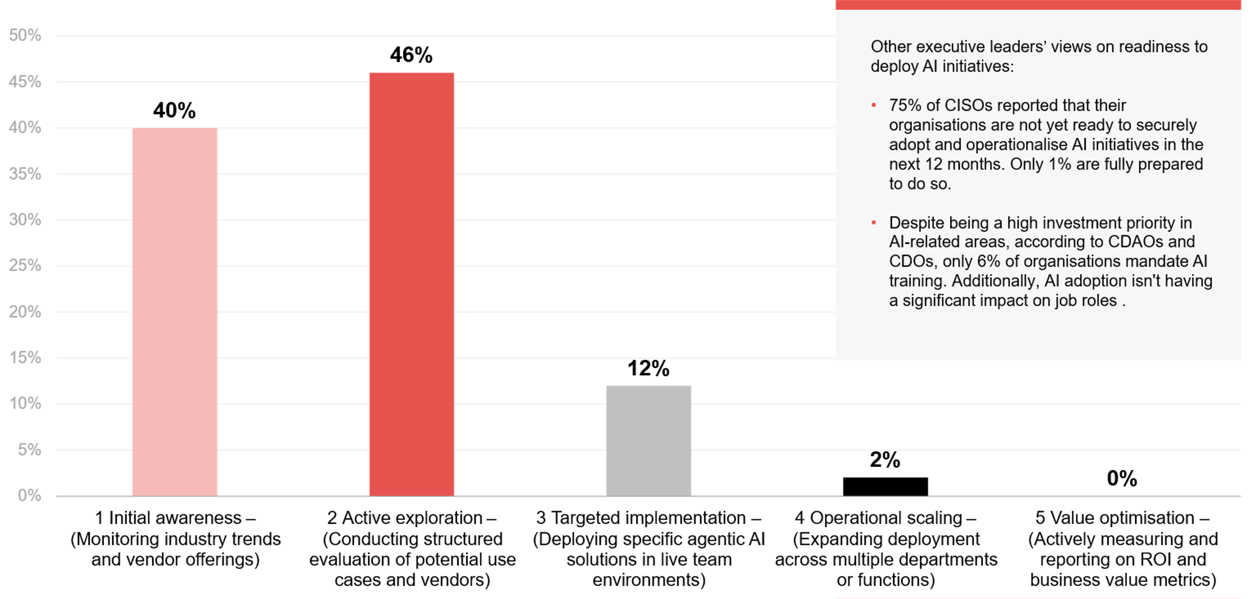
How mature is your organisation’s use of agentic AI?
Source : ADAPT CIO Edge Survey in Aug 2025. Sample size : 151 Australian CIOs

Slide 5
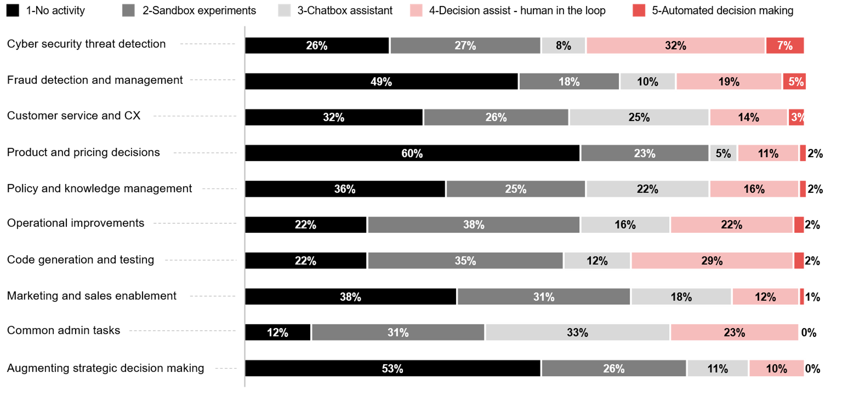
What are your primary generative AI use cases and the maturity of their deployment?
Please note that the percentages shown are rounded to the nearest whole number.
As a result, the total may appear slightly above or below 100% due to rounding.
Source : ADAPT CIO Edge Survey in Aug 2025. Sample size : 130 Australian CIOs

Slide 6
Agentic AI is still an emerging technology
Legacy systems continue to be a major barrier, slowing full operational rollout.
Agentic AI depends on large volumes of high quality, real-time data. However, less than 50%, on average, of processes operate in real-time (ADAPT Tech Trend report, Nov 2025), and just 4% of organisations
have a fully unified multi-cloud unification approach (ADAPT Tech Trend report, Sep 2025).
Impact of generative AI deployment
The limited use of generative AI for automated decision-making impacts organisations' confidence in adopting autonomous agentic AI.
Human-in-the-loop assistance is essential for cyber security. Chatbot assistants are mainly used for common admin tasks. Other applications are either still in sandbox experiments or inactive.
Upskilling as a critical barrier
ADAPT’s CIO Edge Survey (Aug 2025) shows modernisation in upskilling averages only 39%. This lack of workforce readiness aligns with the limited use of automated decision-making across generative AI use cases. AI adoption requires not just technology, but a skilled workforce capable of understanding, operating, and optimising AI.
Path to success
As CIOs plan significant investment in agentic AI and GenAI, they should focus on identifying high-impact use cases that align with their goals and demonstrate measurable ROI. An ADAPT Market Pulse (Jul 2025) lists four things to focus on for achieving success in agentic AI: having well-prepared and integrated data, clear business processes, strong governance frameworks and workforce preparedness.
Technology Trends
Agentic AI
About 86% of organisations remain in the early stages of agentic AI adoption, focusing primarily on exploring and evaluating its potential use cases.
Fewer than 10% of Australian CIOs have implemented automated decision-making across most generative AI use cases. No organisation reported using automation for routine admin tasks or strategic decisions augmentation.
Low modernisation and workforce upskilling limits organisations from scaling AI adoption.
To achieve success with agentic AI, organisations must ensure preparedness in: data readiness, business process optimisation, governance frameworks and workforce skills development.

Slide 7
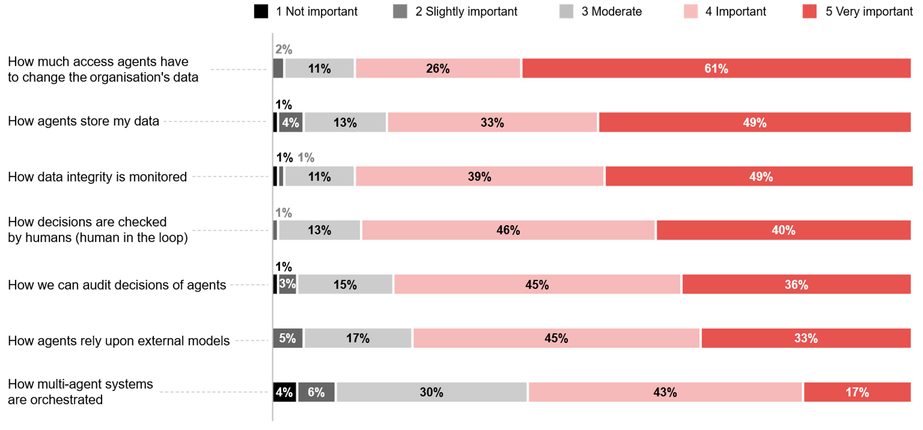
How important are the following areas when evaluating agentic AI products?
¹Please note that the percentages shown are rounded to the nearest whole number.
As a result, the total may appear slightly above or below 100% due to rounding.
Source : ADAPT CIO Edge Survey in Aug 2025. Sample size : 143 Australian CIOs

Slide 8
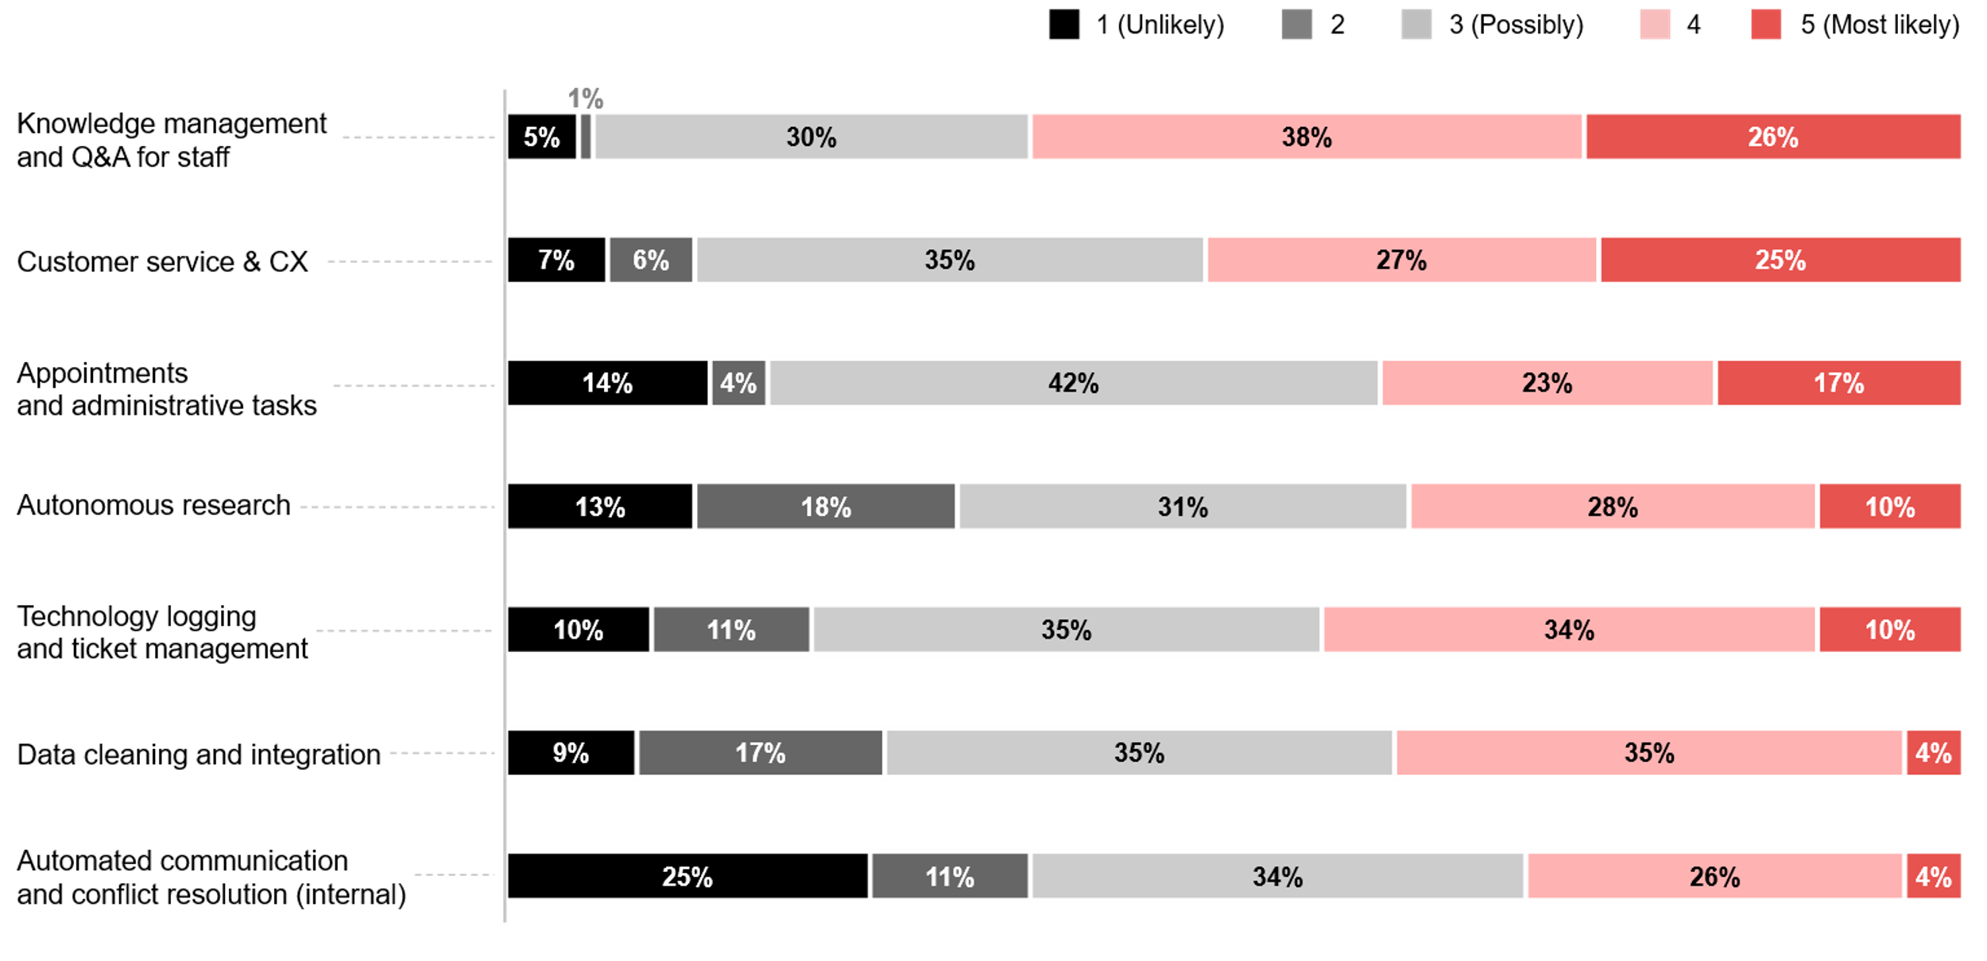
What are the main use cases for agentic AI?
Source : ADAPT Digital Edge Survey in June 2025. Sample size : 82 Australian CDOs

Slide 9
Data access and modification control
As data access and modification are linked to risk and trust, there’s a greater need to limit or monitor modification rights to prevent unintended damage. This is one reason why cyber security ranks as their #3 initiative priority, after GenAI adoption and core systems modernisation.
To guarantee agent actions remain within legal and policy constraints, strong data governance (#3 investment priority) is crucial.
Data storage and integrity
CIOs consider agent data storage and data integrity monitoring highly important because agentic AI systems can introduce new risks around data security, governance and compliance.
This shows that CIOs aim for transparency and trustworthiness across data handling to ensure safe agentic AI autonomy, and guarantee actions taken by agents are reliable, auditable and secure.
Other emerging priorities
Organisations view human oversight mechanisms as crucial to validate decisions made by agentic AI products. The auditability of agent decisions and agents’ reliance on external models are also important for building trust in AI systems.
While most CIOs consider multi-agent orchestration important, it is notably lower than all other metrics, suggesting a high priority on governance over technical orchestration complexity.
Top use cases according to CDOs
According to CDOs, the top two use cases for agentic AI focus on enhancing employee and customer experiences. Given CIOs’ emphasis on data access, security, and integrity, these experience-driven use cases remain a priority. Agentic AI is less likely to be deployed for automated communication, as human-in-the-loop decision-making remains important.
Technology Trends
Agentic AI top metrics and use cases
The top 3 metrics highlight the importance of data access, security and integrity. Australian CIOs are prioritising secure and responsible adoption of agentic AI technologies.
Data storage practices and data integrity are the second most important evaluation metric for agentic AI, following data access control.
Other areas such as human oversight of agents, audibility of agent decisions and reliance on external models are becoming more important.
While most CIOs believe agentic AI could be applied across many use cases, actual deployments remain low.

Slide 10
Significant factors that drive agentic AI maturity

Slide 11
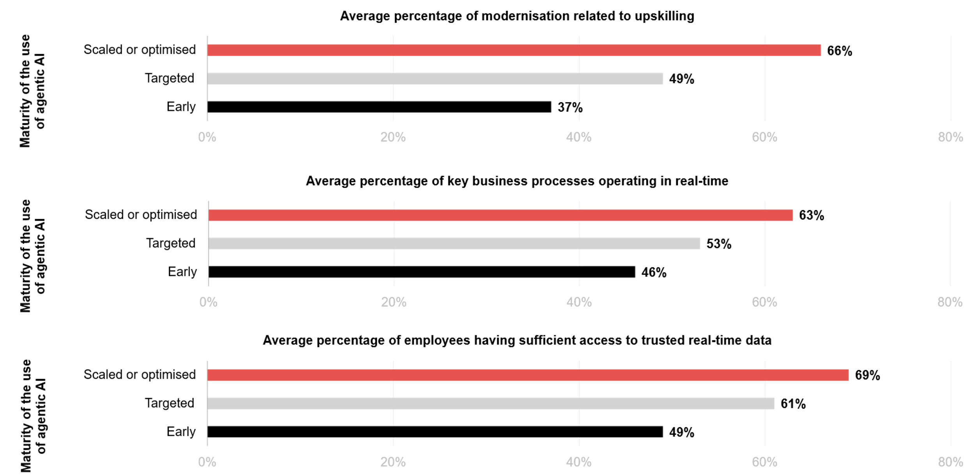
Agentic AI maturity: Modernisation and workforce upskilling
Source: ADAPT CIO Edge Survey in Aug 2025: Sample size: 151 Australian CIOs

Slide 12
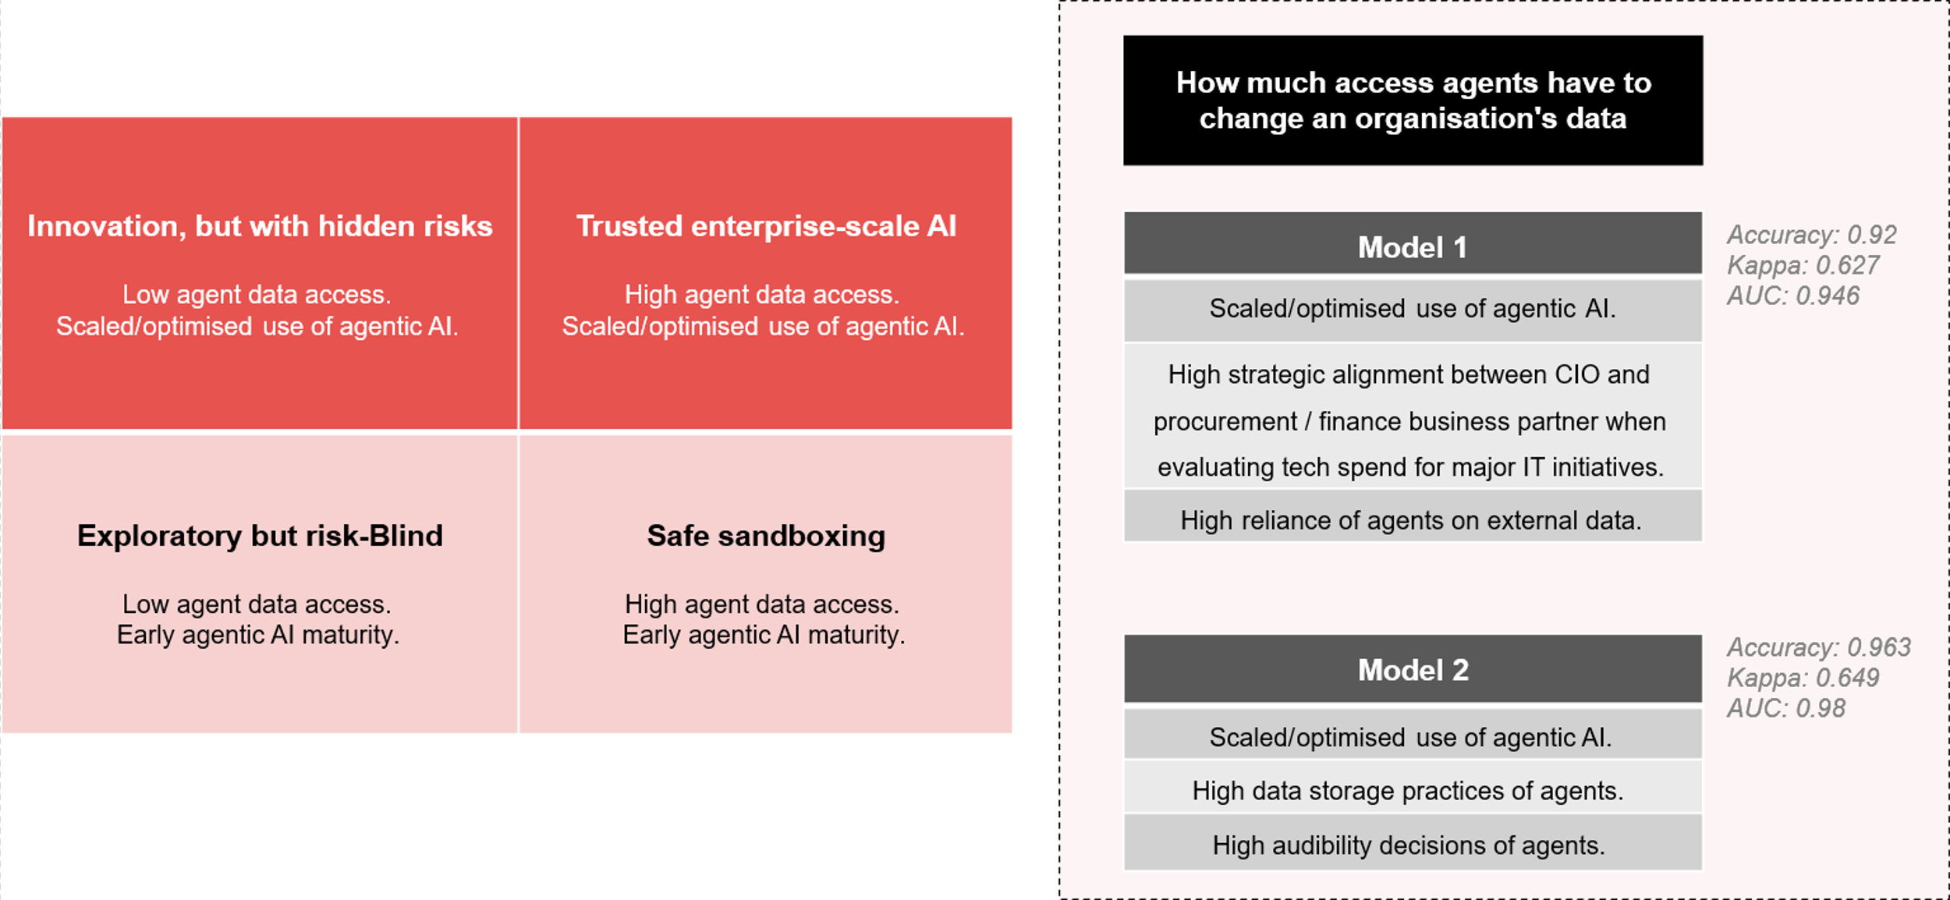
Agentic AI maturity as a driving factor of agents’ ability to change an organisation’s data
Source: ADAPT CIO Edge Survey in Aug 2025: Sample size: 140 Australian CIOs

Slide 13
Modernising skills to improve AI capability without increasing human oversight
Organisations with modernised skills are more effective at configuring and monitoring agentic
AI without relying heavily on human oversight.
This capability transforms AI from a cost-saving tool into a growth driver, as scaling requires handling larger and more complex workloads.
Real-time operations and trusted data
Agentic AI delivers value when it can act in the moment. Delays caused by batch updates hinder optimisation, making employee access to trusted, real-time data critical for seamless collaboration with AI.
Scaling and optimising agentic AI
As organisations move from initial awareness, active exploration and target implementation to value optimisation with agentic AI, the focus shifts from ‘Can we use agents?' to ‘How do we maximise ROI while managing risks?” To optimise value, agents require deeper process integration, greater data access and high-trust, real-time operations for safe, rapid execution.
2x2 Matrix: Scaled/optimised use of agentic AI vs agent data access
Exploratory but risk-blind:. Piloting AI agents without considering data modification risks.
Safe sandboxing: Building a foundation for responsible scaling.
Innovation, but with hidden risks: Embedding AI agents in operations but with weak data controls on data access.
Trusted enterprise-scale AI: High maturity paired with strong governance of agent data access, enabling secure, auditable automation.
Technology Trends
Driving maturity on agentic AI
Correlation analysis from ADAPT's CIO Edge Survey (Aug 2025) identifies 3 significant factors that scale operations and optimise value when using agentic AI:
  modernisation related to workforce upskilling
  real-time operating capability
  access to trusted real-time data.
ADAPT findings also reveal that organisations with scaled/optimised agentic AI use are more likely to grant agents greater data access, enabling them to modify organisational data securely and effectively.

Slide 14
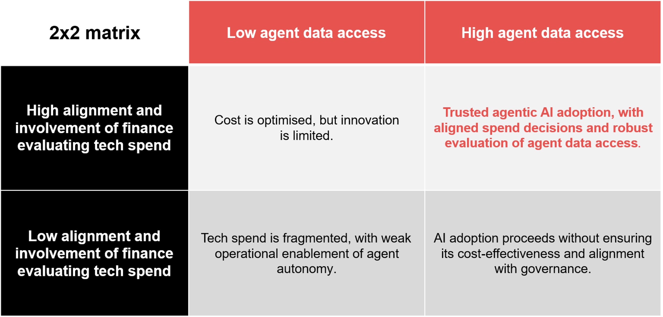
What makes an agent's ability to change organisational data an important metric for evaluating agentic AI products?
Alignment and involvement of finance when evaluating tech spend.
Source: ADAPT CIO Edge Survey in Aug 2025: Sample size: 140 Australian CIOs

Slide 15

What makes an agent's ability to change organisational data an important metric for evaluating agentic AI products?
How agents rely upon external models.
Source: ADAPT CIO Edge Survey in Aug 2025: Sample size: 140 Australian CIOs

Slide 16
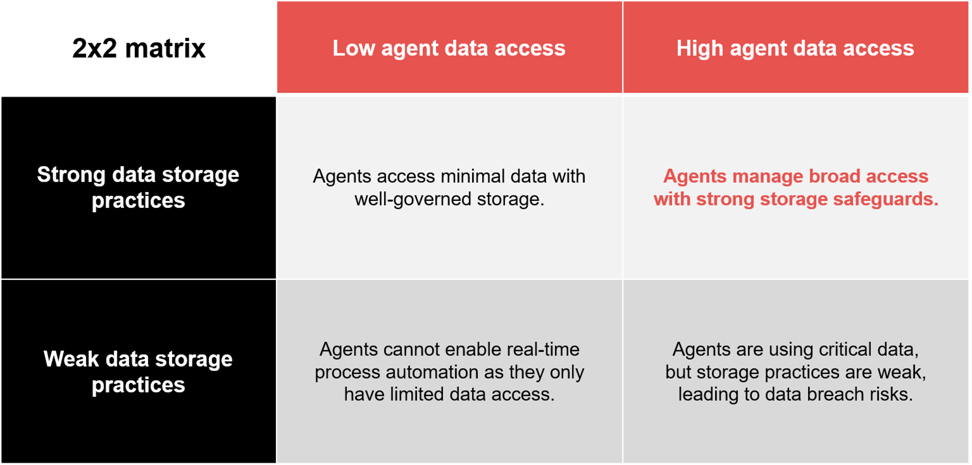
What makes an agent's ability to change organisational data an important metric for evaluating agentic AI products?
How agents store organisations’ data.
Source: ADAPT CIO Edge Survey in Aug 2025: Sample size: 140 Australian CIOs

Slide 17
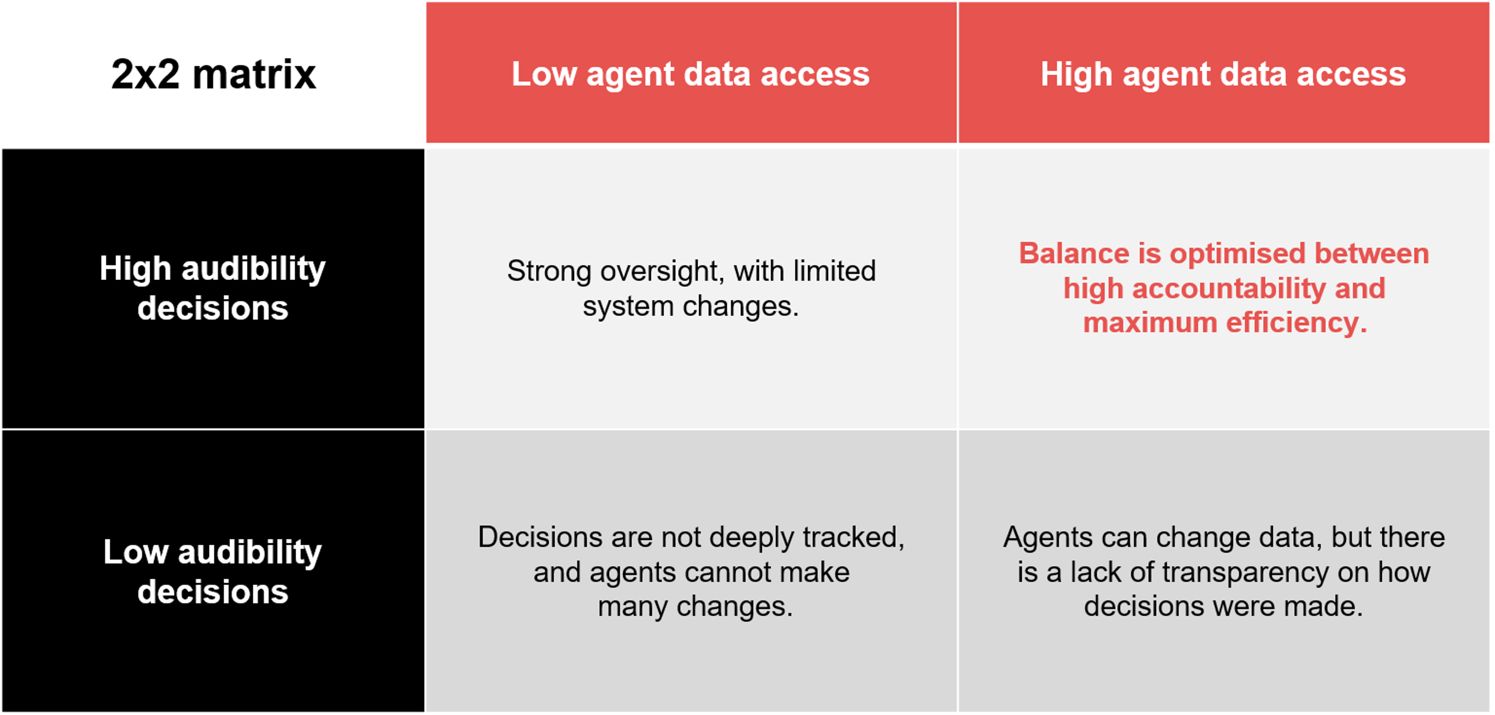
What makes an agent's ability to change organisational data an important metric for evaluating agentic AI products?
How organisations can audit decisions of agents.
Source: ADAPT CIO Edge Survey in Aug 2025: Sample size: 140 Australian CIOs

Slide 18
Technology Trends
What makes agent data access important?
Key insights: Drivers of agent data access
ADAPT’s analysis identifies several factors that make agent data access critical:
High strategic alignment with procurement and finance partners. Strategic involvement of these teams in tech spend evaluation ensures risk-adjusted data access aligned with financial policies.
Other important agentic AI product metrics
High reliance on external models: Organisations that depend heavily on external models and grant high data access operate in a high-risk, high-reward zone. They can secure full automation but require strong governance and close collaboration between CIOs and CFOs.
Strong data storage practices: This maximises AI-driven business value with a secure and trusted data foundation. As CIOs ensure IT governance, CDAOs focus on data ethics and model accountability. This collaboration enables organisations to pass audits while enabling agent autonomy.
High auditability: This leads to maximum efficiency with greater accountability, which is the target state for CIOs and CISOs.
Beyond value optimisation of agentic AI, ADAPT’s correlation analysis highlights 4 key factors that make agent data access critical:
  strong alignment between the CIO and procurement / finance business-partner
  when evaluating tech spend
  high reliance upon external models for advanced capabilities
  robust data storage practices to ensure security and integrity
  high auditability of agent actions for compliance and trust.

Slide 19
Survey demographics

Slide 20
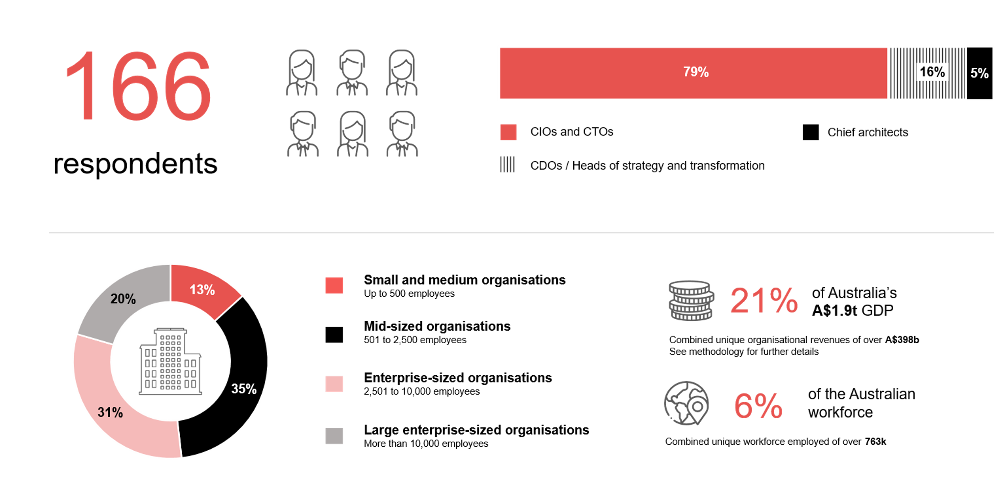
Survey demographics: Australian CIOs in 2025

Slide 21

For sector, segment and persona comparisons
Central limit theorem a fundamental concept in statistics that determines when a sample size is large enough
to be considered reliable. There are different formulas and some debate amongst statisticians about the appropriate sample size. For industry comparisons or other subset analyses, a sample size of ( n > 20 ) is generally considered acceptable for drawing meaningful insights. This threshold aligns with common statistical practices, where a
sample size of 20 to 30 is generally the minimum needed to assume a normal distribution of the data.
Sample sizes below 20, but equal to or greater than 15
When the sample size is between 15 and 20, while not fully representative, it can still offer valuable insights
into trends. These statistics should be viewed as indicative, highlighting general directions in industry efforts
or barriers to investment but treated with some caution due to the smaller number of observations.
Sample sizes less than 15, but greater or equal to 10
For samples between 10 and 15, the data provides a snapshot guideline only. While such small samples can
show early trends, it's important to recognise that this doesn't guarantee future respondents will reflect the same trends. For instance, while 100% of respondents in a sample of 10 might invest in AI, it'd be unrealistic to assume this pattern will hold as the sample size grows. However, if the sample size increases to 20, it's unlikely
that the trend will change drastically, and the next 10 respondents will have no investment.
ADAPT Data Analytics:
Notes on sample sizes
Why does sample size matter?
Each set of statistics is unique with measures,
distribution, variance and sample size. It is generally accepted in statistics that as sample size increases, analysts make fewer assumptions about the data, resulting in statistics that more accurately represent the truth.
ADAPT endeavours to provide transparency of sample size, whereby we provide a source on data slides with
the number of respondents and the survey where those respondents come from. In data and insights slide decks, ADAPT usually provides some insight on the breakdown
of the demographics at the end of the slide deck.
To protect privacy, ADAPT does not release lists
of individual respondents to surveys.

Slide 22


Written by
Gabby Fredkin
Head of Data and Analytics at ADAPT
Honey Mari Gay
Junior Data Analyst at ADAPT
Gabby’s primary role is managing ADAPT’s overall strategy for Data Analytics. He has extensive experience in using data to identify trends in technology that help shape Australian organisations. Using modern data science techniques, he ensures the accuracy and validity of the information that supports ADAPT’s research, advisory services, and events, giving both ADAPT and its customers greater confidence in the insights provided.
With a passion for creating stories with data, Gabby is consistently rated as one of the top speakers at ADAPT Events. In round table discussions, he specialises in using statistics to initiate thought-provoking discussions. Gabby is effective in translating information into insights, enabling ADAPT’s customers to become more data-driven.
As a Junior Data Analyst at ADAPT, Mari enables the discovery and definition of market trends through visually meaningful statistics. She ensures data presentations are accurate and aligned with modern statistical standards.
Mari is passionate about data and transforming it into actionable insights. With over three years of experience in project management and academic research, she has led end-to-end survey and research projects, processed and analysed data using a range of statistical tools and techniques, and provided clients with statistical
consultation and insights.

Slide 23

About ADAPT
ADAPT is a specialist Research & Advisory firm providing local market insights and benchmarking data
to Australia and New Zealand’s senior technology and business community.
Since 2011, we’ve been empowering the leaders of the region’s top enterprise and government organisations
to stay at the forefront of modern trends and build for the future. Our industry leading conferences, private roundtable events and custom research projects equip business leaders with the knowledge, relationships, inspiration and tools they need to make better strategic decisions.
adapt.com.au | hello@adapt.com.au
Data Validation
Results contained in this report (Report) are based on survey responses as provided by our clients and publicly available information. ADAPT does not subject the data contained in the Report to audit or review procedures or any other testing to validate the accuracy or reasonableness of the data provided by the participating clients. While we do not manipulate the survey responses, we do make an effort to identify outlier data or conflicting results that could lead to misinterpretations before the preparation of the Report.
Intended Use of the Report
The Report is designed to help technology executives in Australia and New Zealand make independent decisions regarding financial, resourcing and operational performance matters. The information and data contained in the Report are provided as is and are for information purposes only. They are not intended or implied to be recommendations and in no event will ADAPT be liable for any decisions or actions taken in reliance of the results obtained through the use of the information and/or data contained in the Report.
Research MSA and Privacy Policy
The Report and any other information provided by ADAPT is subject to the Research and Advisory Master Services Agreement and the ADAPT Privacy Policy.

Slide 24




Additional resources you can access
Members of ADAPT’s Research & Advisory platform have access to an entire suite of market leading content, insights and resources to help you execute in your role. For any assistance contact your Account Manager in the help section.
Community case studies and interviews
Case studies detailing the successes
and challenges of projects and initiatives.
Market Trend Reports Access a library of fact-based actionable insights, deep dives on ANZ business & IT trends.
Live access to ADAPT analysts
Through live ADAPT analyst market briefings and Q&A sessions
Downloadable data and insights
Elevate your business cases with downloadable market and industry data.
Industry expert presentations
Watch keynotes or read distilled 1-page executive summaries from our Edge Events.
Bespoke analysis of ADAPT data
Receive custom cuts and analysis of ADAPT proprietary data.
Premier executive community
Unlock access to our exclusive network of Australia’s leading technology and business executives.
Dedicated account manager and impact assessments
Your Account Manager will ensure you and your team are getting the most out of your subscription.
Dedicated analyst briefing
Leverage a dedicated briefing with an ADAPT analyst to help validate your strategies.
*Inclusions may vary depending on subscription level.

