Slide 1

ADAPT Sector Analysis
Financial Services Industry (FSI):
CISO Insights

Slide 2
CISO Insights: FSI Sector
Document description
This document outlines insights from CISOs within the financial services industry (FSI).
Organisations in the ADAPT sample include:
Banks
Insurers
Superannuation and investment firms
Trading platforms (including stock exchanges)
Fintech companies (e.g., payment providers)
The statistics shown in this report cover:
Essential Eight framework maturity and cyber resilience.
SOC approach, mean time to detect (MTTD) and mean time to respond (MTTR).
Security surveys were received in April and October 2025.
Cyber resiliency and security maturity
ADAPT’s Security surveys in 2025 asked these questions:
How would you rate your organisation’s maturity in the ‘Essential Eight’ (E8) –
based on the ASD 0-3 maturity definitions?
Based on your evaluation of the questions in this section, how would you rate your organisation's overall cyber resilience?
Does your organisation have an in-house Security Operations Centre (SOC)?
What is the average mean time to detect (MTTD) a security incident in your organisation?
What is the average mean time to respond (MTTR) to a security incident once detected?
ADAPT analysts use automated data processing. The final stage of analysis is human quality assurance to ensure accuracy of categorisations.

Slide 3
FSI: Security maturity
and cyber resilience

Slide 4
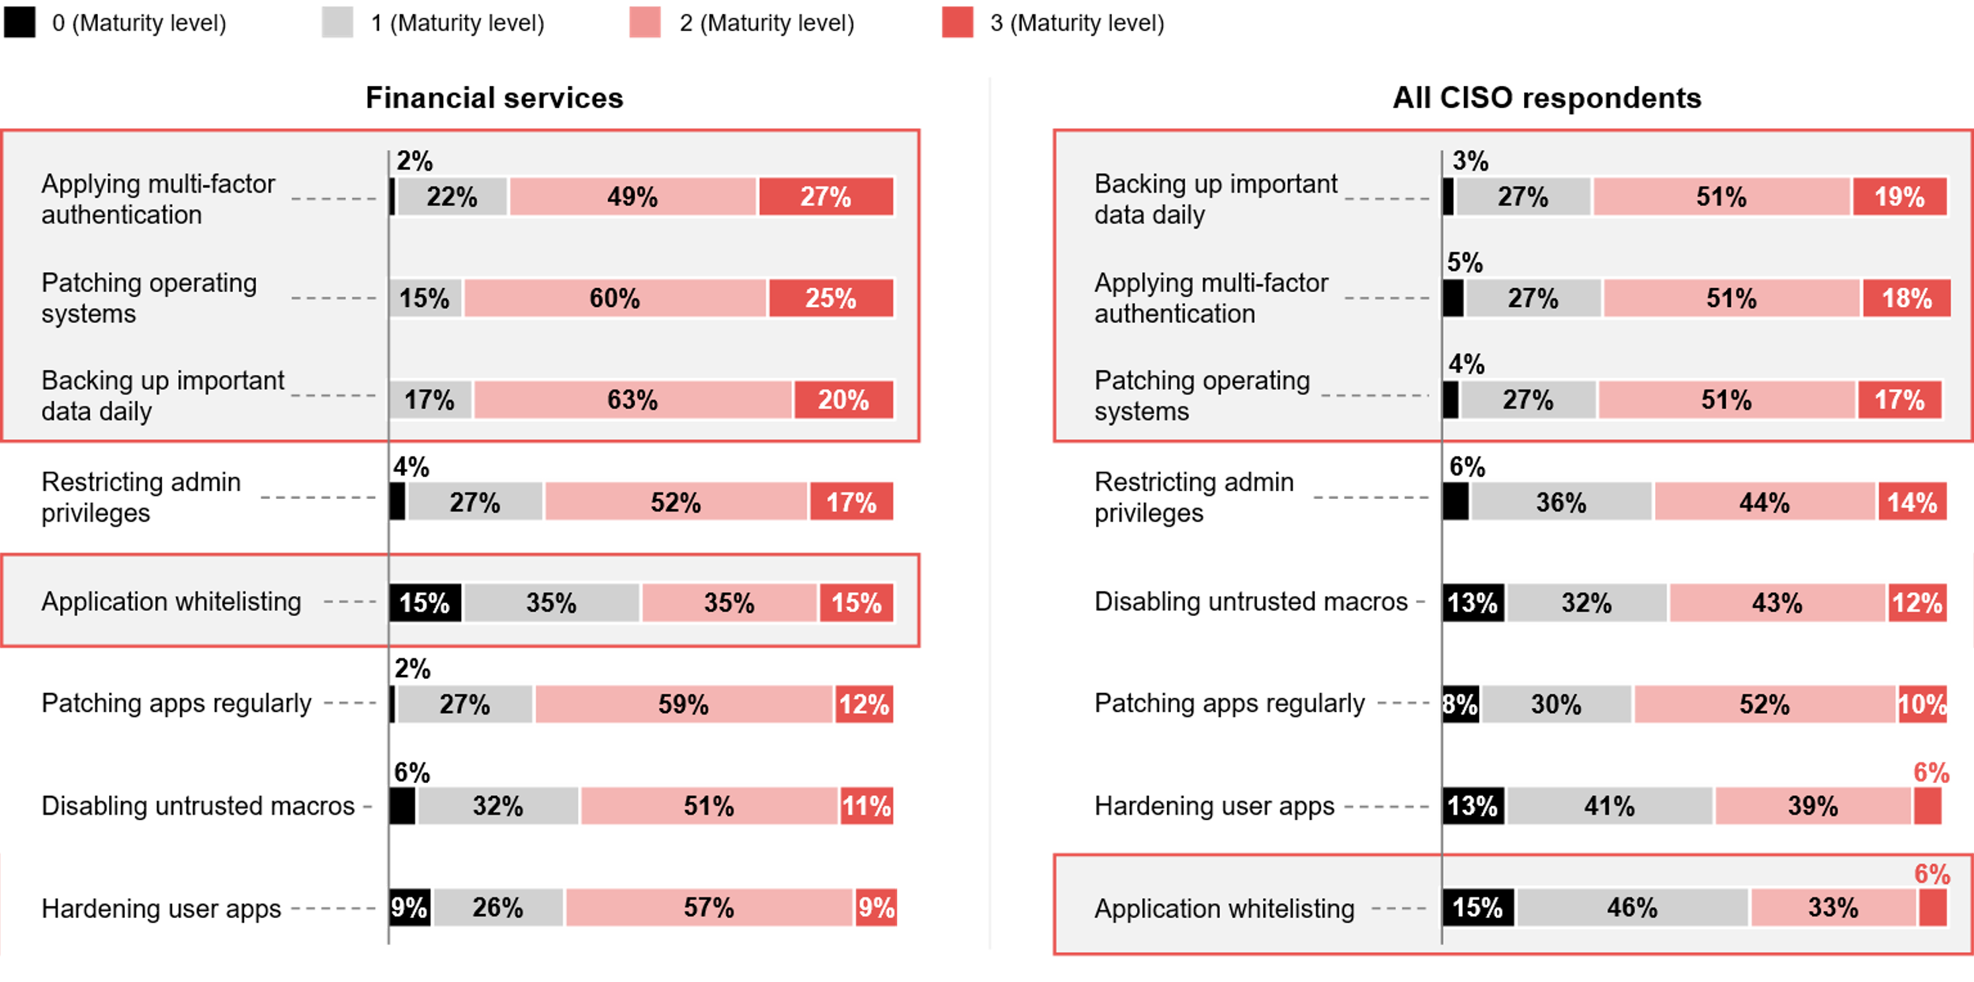
FSI’s maturity in the ‘Essential Eight’ – based on the ASD 0-3 maturity definitions
ADAPT Security Edge Surveys in Apr and Oct 2025. Sample size: 194 Australian CISOs, 49 from financial services

Slide 5
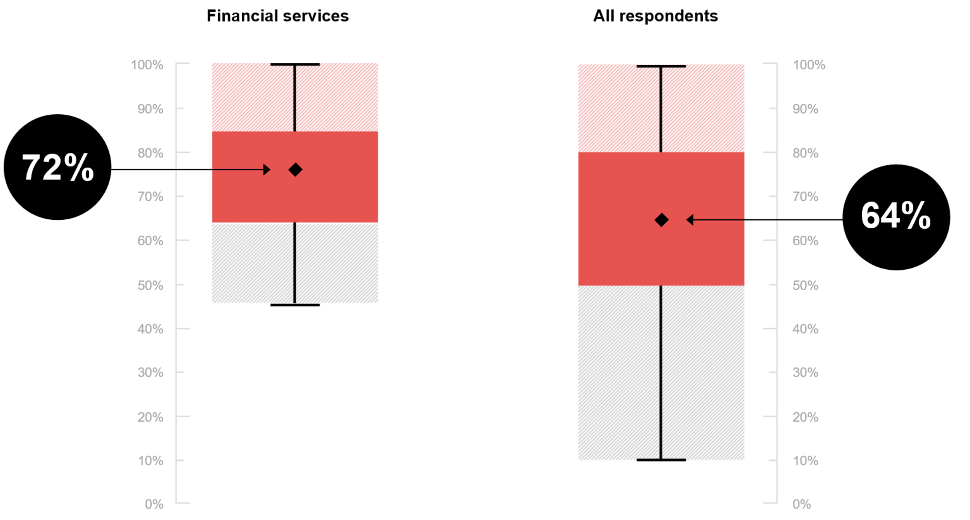
FSI’s average cyber resilience
ADAPT Security Edge Survey in Apr and Oct 2025. Sample size: 195 Australian CISOs, 51 from financial services

Slide 6
FSIs show strong maturity in core security controls
FSI CISOs invest heavily in MFA, OS patching, backups, and privileged access management because they handle high-value assets, sensitive customer data, and regulated transactions. FSIs are also obliged to comply with the regulations required for operational resilience. In an ADAPT Best Practices report, these frameworks are considered operational hygiene, not optional projects.
Overall, FSI organisations demonstrate higher maturity than other sectors across the E8 areas.
Low maturity in other E8 frameworks
Both FSI and other sectors show low maturity in application whitelisting, patching, and hardening applications, underscoring the need for continuous improvement and monitoring.
These gaps indicate a need to prioritise resources to achieve full alignment with remaining E8 frameworks.
Higher cyber resilience maturity in FSI than in other sectors
FSIs’ stronger E8 maturity translates into a better understanding of cyber risk and its financial impact.
They must ensure cyber resilience is deeply integrated into systems and operations.
How FSIs secure mature security and resilience
FSIs are prime targets for cyber security incidents as they sit at the centre of financial transactions.
These risks push CISOs to invest aggressively in baseline controls and advanced security capabilities.
In an ADAPT Community Interview (Sep 2025), Andrew Cresp, CIO of Bendigo and Adelaide Bank, emphasises the importance of consolidating and optimising tech environments to strengthen security
and enhance resilience, while freeing up innovation resources.
CISO Insights: FSI Sector
Security maturity
and cyber resilience
Key takeaways from CISO respondents
in the FSI:
FSI organisations, like those in other sectors, operate at above maturity level 2 in multi-factor authentication (MFA), patching operating systems (OS), backups and privileged access.
Both FSI and other sectors have low maturity on application whitelisting.
FSI organisations show higher-than-average cyber resilience compared to other sectors.

Slide 7
FSI: SOC, MTTD
and MTTR

Slide 8
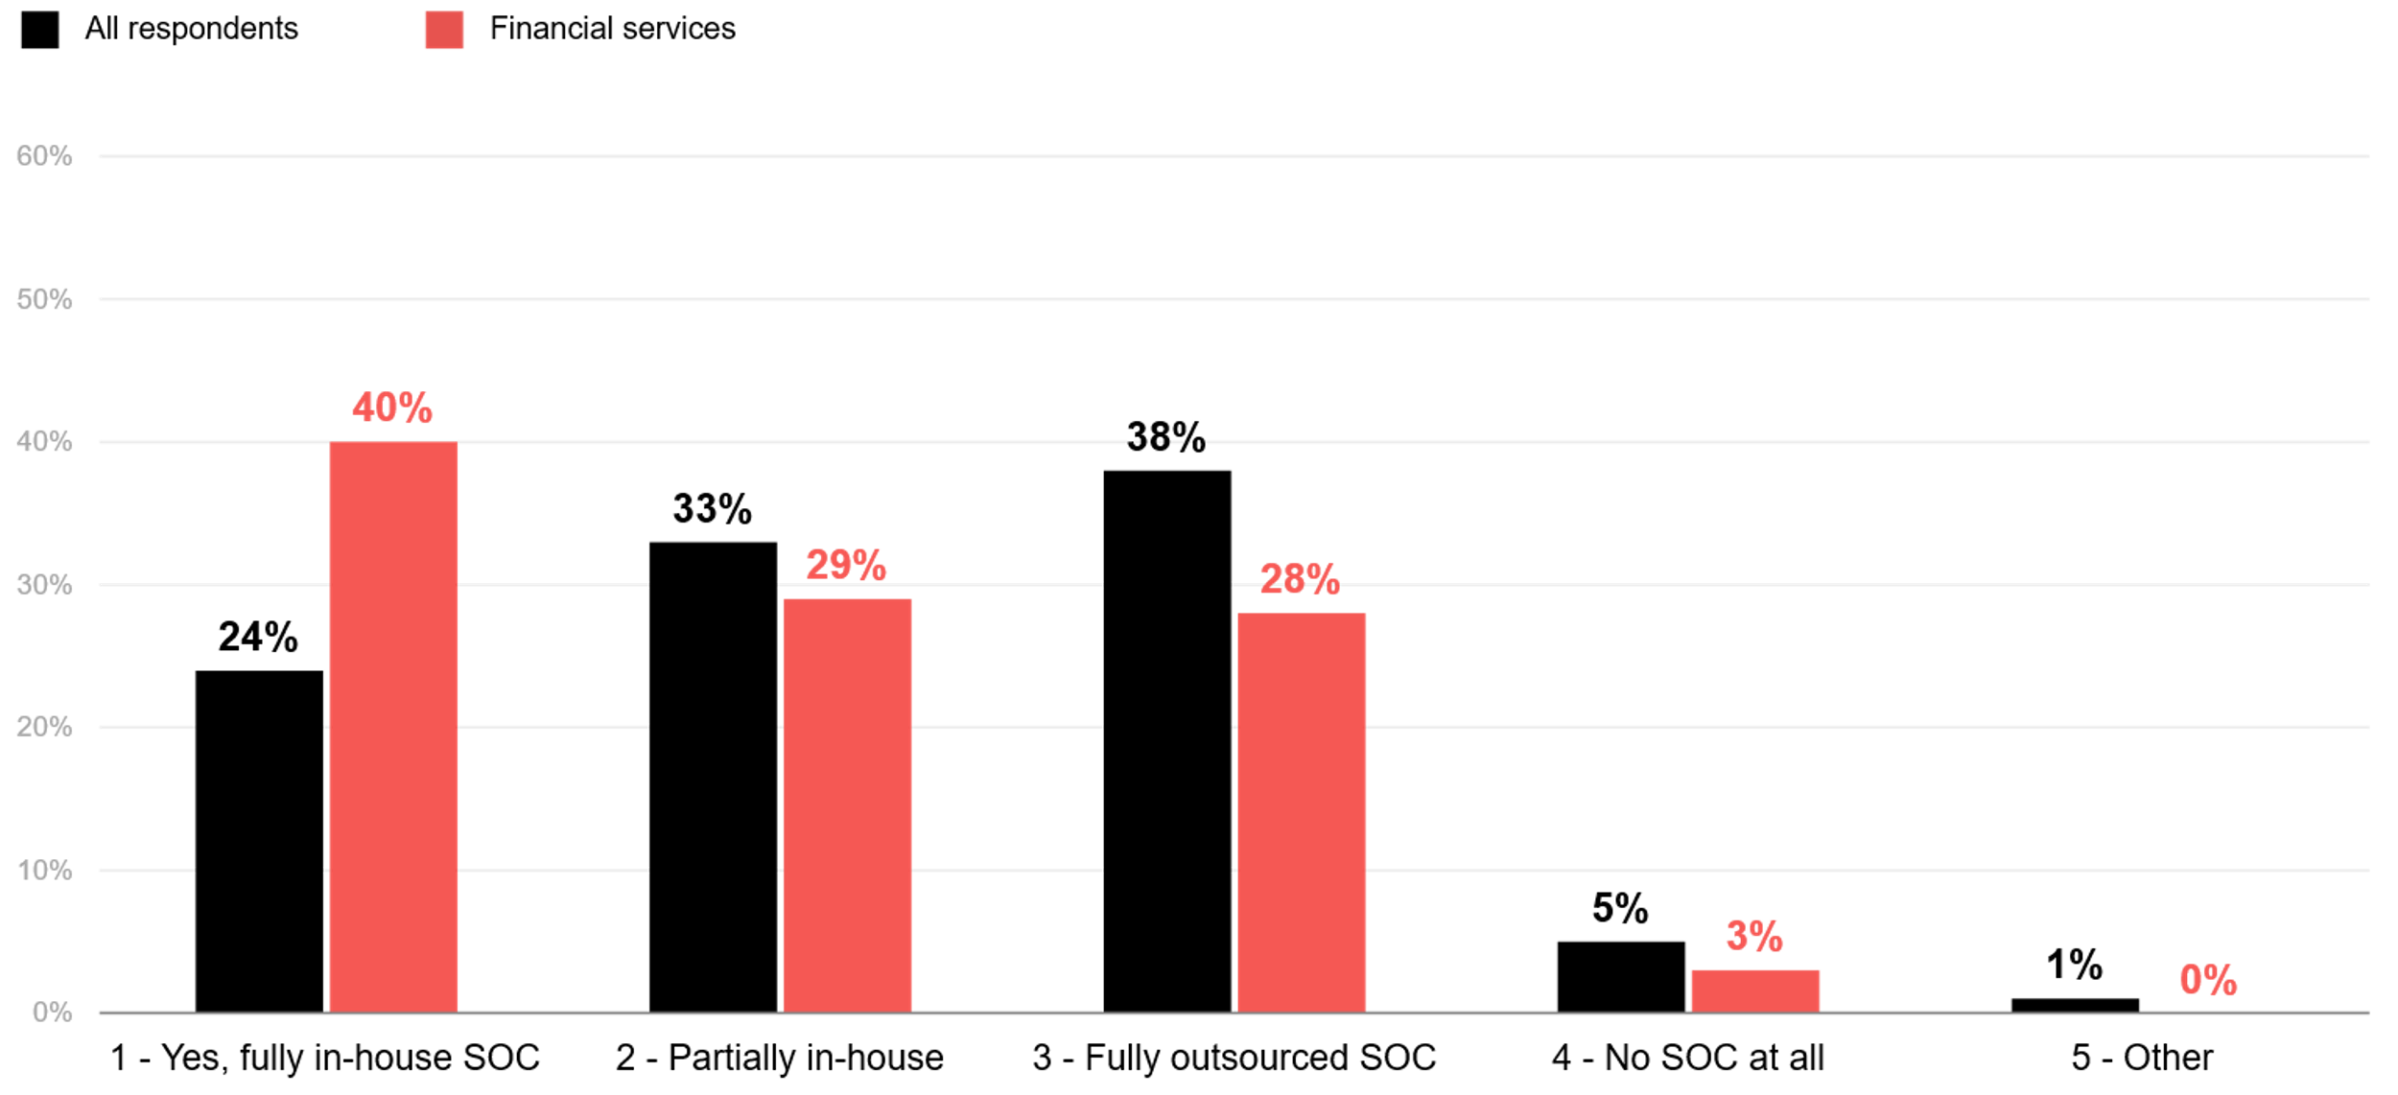
Does your organisation have an in-house security operations centre (SOC)?
ADAPT Security Edge Surveys Edge Survey in Apr and Oct 2025. Sample size: 221 Australian CISOs, 58 from financial services

Slide 9
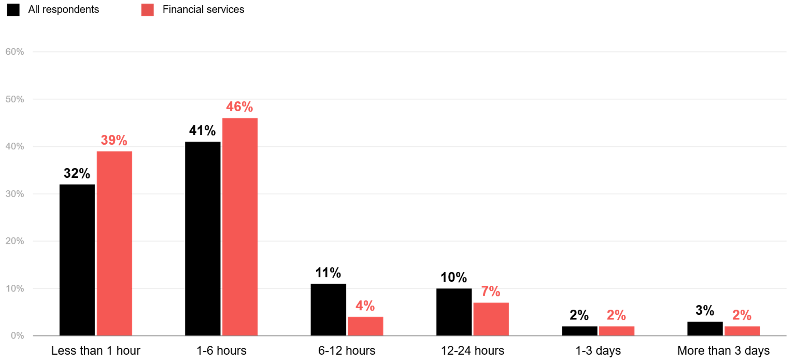
What is the average mean time to detect (MTTD) a security incident in your organisation?
ADAPT Security Edge Surveys Edge Survey in Apr and Oct 2025. Sample size: 203 Australian CISOs, 56 from financial services

Slide 10
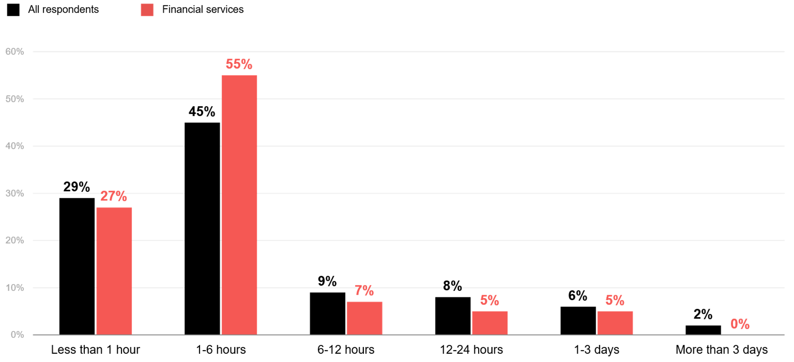
What is the average mean time to respond (MTTR) to a security incident once detected?
ADAPT Security Edge Surveys Edge Survey in Apr and Oct 2025. Sample size: 201 Australian CISOs, 55 from financial services

Slide 11
FSI maintains mostly fully in-house SOCs
FSIs face strong obligations under the Australian Prudential Regulation Authority (APRA). FSIs favour in-house SOCs for full visibility and strong governance. APRA mandates accountability, incident response readiness and control over critical security functions. Regulators expect FSIs to maintain 24/7 monitoring and rapid incident escalation, which is easier to achieve internally.
Driving cyber resilience outcomes
Organisations with fully in-house SOCs show high commitment to cyber resilience. They tend to respond faster and integrate more closely with IT, cloud and business operations.
With stronger E8 maturity and cyber resilience, FSIs are better positioned than other sectors to sustain long-term resilience by maintaining internal SOCs.
Faster threat detection and response
With most FSIs having in-house SOC, they typically have a more mature approach to cyber resilience. Higher cyber resilience progress in FSI organisations indicates an advanced ability to detect and respond to any threat vectors.
Other sectors take more than 6 hours to detect and respond to any security incidents
This stems from lower security investment and resourcing than FSIs (ADAPT FSI Sector report, June 2025). By contrast, FSI organisations invest heavily in these areas due to customer trust expectations.
As non-FSIs have weaker cyber governance structures, they experience limited incident simulation and slower decision-making during security incidents.
CISO Insights: FSI Sector
SOC, MTTD and MTTR
Key takeaways from FSI CISO respondents:
SOC structure: Most FSI organisations operate fully in-house SOCs, unlike other sectors that often use partially in-house or fully outsourced SOCs.
Incident response speed: FSIs detect and respond to security incidents faster than other sectors.
Response time: The majority resolve incidents in under 6 hours.
Comparison: Only 15% of FSIs take more than 6 hours, compared to 26% in other sectors.

Slide 12
Survey demographics

Slide 13
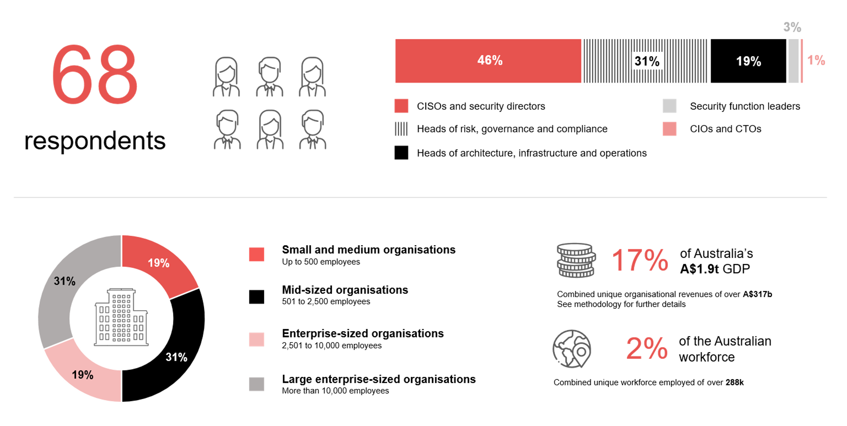
Survey demographics: Australian FSI CISOs in 2025

Slide 14

For sector, segment and persona comparisons
Central limit theorem a fundamental concept in statistics that determines when a sample size is large enough
to be considered reliable. There are different formulas and some debate amongst statisticians about the appropriate sample size. For industry comparisons or other subset analyses, a sample size of ( n > 20 ) is generally considered acceptable for drawing meaningful insights. This threshold aligns with common statistical practices, where a
sample size of 20 to 30 is generally the minimum needed to assume a normal distribution of the data.
Sample sizes below 20, but equal to or greater than 15
When the sample size is between 15 and 20, while not fully representative, it can still offer valuable insights
into trends. These statistics should be viewed as indicative, highlighting general directions in industry efforts
or barriers to investment but treated with some caution due to the smaller number of observations.
Sample sizes less than 15, but greater or equal to 10
For samples between 10 and 15, the data provides a snapshot guideline only. While such small samples can
show early trends, it's important to recognise that this doesn't guarantee future respondents will reflect the same trends. For instance, while 100% of respondents in a sample of 10 might invest in AI, it'd be unrealistic to assume
this pattern will hold as the sample size grows. However, if the sample size increases to 20, it's unlikely
that the trend will change drastically, and the next 10 respondents will have no investment.
ADAPT Data Analytics:
Notes on sample sizes
Why does sample size matter?
Each set of statistics is unique with measures,
distribution, variance and sample size. It is generally accepted in statistics that as sample size increases, analysts make fewer assumptions about the data, resulting in statistics that more accurately represent the truth.
ADAPT endeavours to provide transparency of sample size, whereby we provide a source on data slides with
the number of respondents and the survey where those respondents come from. In data and insights slide decks, ADAPT usually provides some insight on the breakdown
of the demographics at the end of the slide deck.
To protect privacy, ADAPT does not release lists
of individual respondents to surveys.

Slide 15


Written by
Gabby Fredkin
Head of Data and Analytics at ADAPT
Honey Mari Gay
Junior Data Analyst at ADAPT
Gabby’s primary role is managing ADAPT’s overall strategy for Data Analytics. He has extensive experience in using data to identify trends in technology that help shape Australian organisations. Using modern data science techniques, he ensures the accuracy and validity of the information that supports ADAPT’s research, advisory services, and events, giving both ADAPT and its customers greater confidence in the insights provided.
With a passion for creating stories with data, Gabby is consistently rated as one of the top speakers at ADAPT Events. In round table discussions, he specialises in using statistics to initiate thought-provoking discussions. Gabby is effective in translating information into insights, enabling ADAPT’s customers to become more data-driven.
As a Junior Data Analyst at ADAPT, Mari enables the discovery and definition of market trends through visually meaningful statistics. She ensures data presentations are accurate and aligned with modern statistical standards.
Mari is passionate about data and transforming it into actionable insights. With over three years of experience in project management and academic research, she has led end-to-end survey and research projects, processed and analysed data using a range of statistical tools and techniques, and provided clients with statistical
consultation and insights.

Slide 16

About ADAPT
ADAPT is a specialist Research & Advisory firm providing local market insights and benchmarking data
to Australia and New Zealand’s senior technology and business community.
Since 2011, we’ve been empowering the leaders of the region’s top enterprise and government organisations
to stay at the forefront of modern trends and build for the future. Our industry leading conferences, private roundtable events and custom research projects equip business leaders with the knowledge, relationships, inspiration and tools they need to make better strategic decisions.
adapt.com.au | hello@adapt.com.au
Data Validation
Results contained in this report (Report) are based on survey responses as provided by our clients and publicly available information. ADAPT does not subject the data contained in the Report to audit or review procedures or any other testing to validate the accuracy or reasonableness of the data provided by the participating clients. While we do not manipulate the survey responses, we do make an effort to identify outlier data or conflicting results that could lead to misinterpretations before the preparation of the Report.
Intended Use of the Report
The Report is designed to help technology executives in Australia and New Zealand make independent decisions regarding financial, resourcing and operational performance matters. The information and data contained in the Report are provided as is and are for information purposes only. They are not intended or implied to be recommendations and in no event will ADAPT be liable for any decisions or actions taken in reliance of the results obtained through the use of the information and/or data contained in the Report.
Research MSA and Privacy Policy
The Report and any other information provided by ADAPT is subject to the Research and Advisory Master Services Agreement and the ADAPT Privacy Policy.

Slide 17




Additional resources you can access
Members of ADAPT’s Research & Advisory platform have access to an entire suite of market leading content, insights and resources to help you execute in your role. For any assistance contact your Account Manager in the help section.
Community Case Studies & Interviews
Case studies detailing the successes and challenges of projects and initiatives.
Market Trend Reports Access a library of fact-based actionable insights, deep dives on ANZ business & IT trends.
Live Access to ADAPT Analysts
Through live ADAPT analyst market briefings and Q&A sessions
Downloadable Data & Insights
Elevate your business cases with downloadable market and industry data.
Industry Expert Presentations
Watch keynotes or read distilled 1-page executive summaries from our Edge Events.
Bespoke Analysis of ADAPT Data
Receive custom cuts and analysis of ADAPT proprietary data.
Premier Executive Community
Unlock access to our exclusive network of Australia’s leading technology and business executives.
Dedicated Account Manager & Impact Assessments
Your Account Manager will ensure you and your team are getting the most out of your subscription.
Dedicated Analyst Briefing
Leverage a dedicated briefing with an ADAPT analyst to help validate your strategies.
*Inclusions may vary depending on subscription level.

