Slide 1


ADAPT Sector Analysis
Government: CISO insights

Slide 2
CISO Insights: Government Sector
Document description
This document outlines insights from CIOs
within government.
Government organisations in the ADAPT sample consist of:
Federal run agencies
State agencies and government-owned services
(e.g., state and local health organisations, ambulance)
Local government entities
The statistics shown in this report cover:
Essential Eight framework maturity and cyber resilience.
SOC approach, mean time to detect (MTTD) and mean time to respond (MTTR).
Security surveys were received in April and October 2025.
Cyber resiliency and security maturity
ADAPT’s Security surveys in 2025 asked:
How would you rate your organisation’s maturity in the ‘Essential Eight’ (E8) –
based on the ASD 0-3 maturity definitions?
Based on your evaluation of the questions in this section, how would you rate your organisation's overall Cyber Resilience?
Does your organisation have an in-house Security Operations Centre (SOC)?
What is the average mean time to detect (MTTD) a security incident in your organisation?
What is the average mean time to respond (MTTR) to a security incident
once detected?
ADAPT analysts use automated data processing. The final stage of analysis is human quality assurance to ensure accuracy of categorisations.

Slide 3

Government: Security maturity and cyber resilience

Slide 4
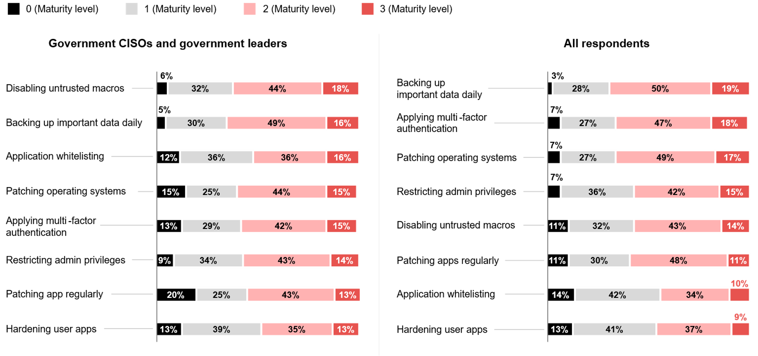
Government’s maturity in the ‘Essential Eight’ (E8) – based on the ASD 0-3 maturity definitions
ADAPT Security and Government Edge Surveys in Apr and Oct 2025. Sample size: 255 Australian CISOs and government leaders, 81 from government

Slide 5
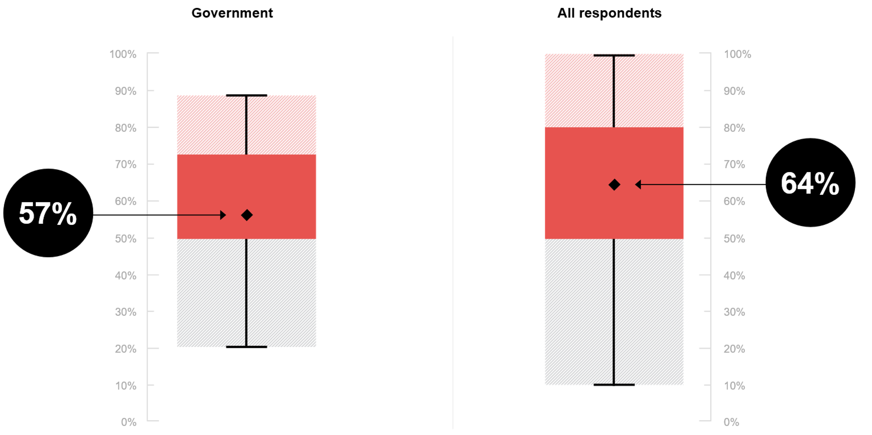
Government’s average cyber resilience
ADAPT Security Edge Survey in Apr and Oct 2025. Sample size: 195 Australian CISOs, 19 government

Slide 6
CISO Insights: Government Sector
High maturity in macros, backups and whitelisting
Government agencies often score higher maturity in macros, backups, and whitelisting because these deliver early, strong returns for cyber resilience.
In the Essential Eight Maturity Model, these areas provide a strong baseline defence for typical government IT estates (such as desktop OS, Microsoft Office and standard applications).
E8 limitations at maturity level 3
Even at level 3, E8 does not guarantee protection against all government threat vectors. Based on the Essential Eight Maturity Model, E8 was designed for internet-connected IT networks, not for enterprise mobility or operational technology. This requires agencies to layer additional controls beyond E8, such as incident detection and response.
Achieving and maintaining maturity level 2 across E8
With AI strategy as the #1 government goal, leaders emphasise responsible AI adoption within a security-first culture. In an ADAPT Community Interview (Nov 2025), the Attorney-General's Department operates a protected network, ensuring security and trust are central to tech strategy.
Sector comparison
Private sectors, such as finance, prioritise MFA and fast patching due to regulatory risks to customers and revenues, moving faster to cloud-native tooling that supports these E8 areas (ADAPT Security Edge Surveys, Apr and Oct 2025).
Government’s lower cyber resilience
Most government agencies remain below level 2 across all E8 compared with other sectors.
This affects their ability to strengthen their cyber resilience maturity.
Despite this, government shows relatively stronger maturity in cyber security for key digital functions,
though still far from optimal (ADAPT Tech Trend report, Dec 2025).
Security maturity and cyber resilience
Key takeaways from government respondents:
Government agencies are mostly mature in disabling untrusted macros, backing up important data, and application whitelisting.
Except for application whitelisting, most agencies remain at maturity level 2 across other Essential Eight (E8) areas, compared
to higher levels in other sectors.
Other sectors prioritise multi-factor authentication (MFA) and patching operating systems (OS).
On a scale of 1 to 100, the government sector averages 57 in cyber resilience, which is lower than other sectors.

Slide 7
Government:
SOC, MTTD and MTTR

Slide 8
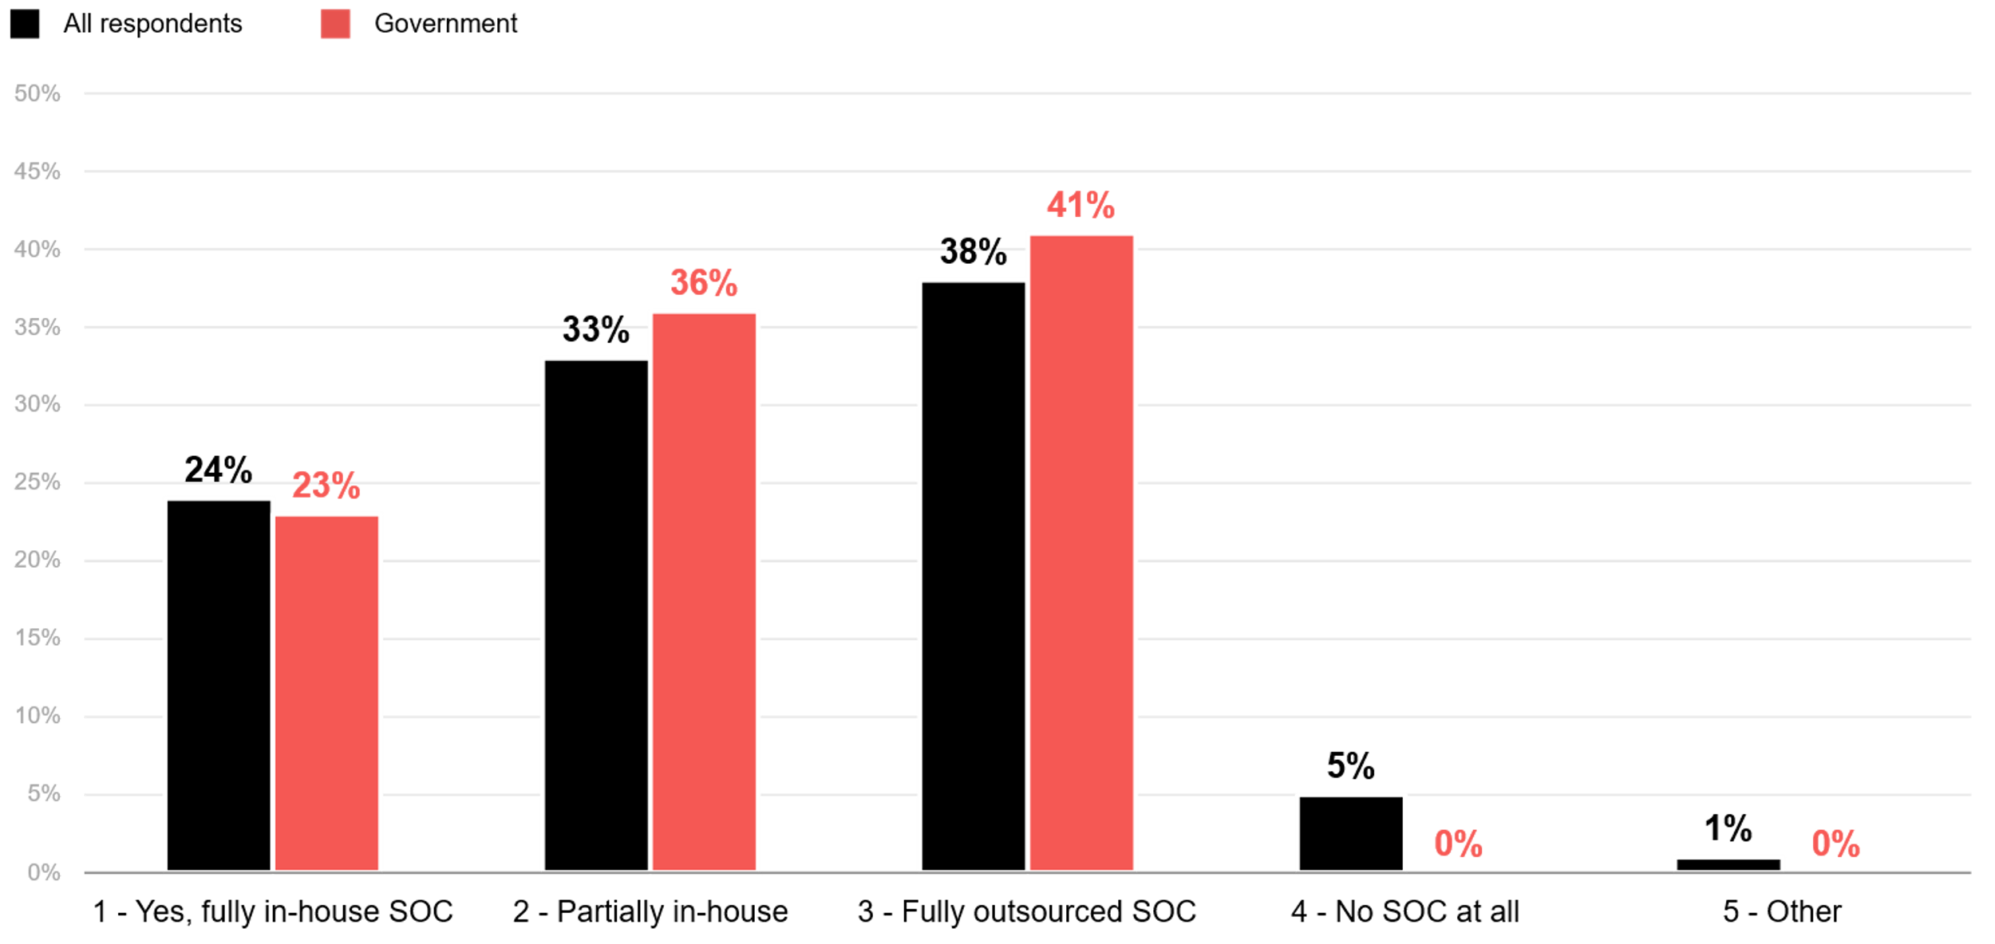
Does your organisation have an in-house Security Operations Centre (SOC)?
ADAPT Security Edge Surveys Edge Survey in Apr and Oct 2025. Sample size: 221 Australian CISOs, 22 from government

Slide 9
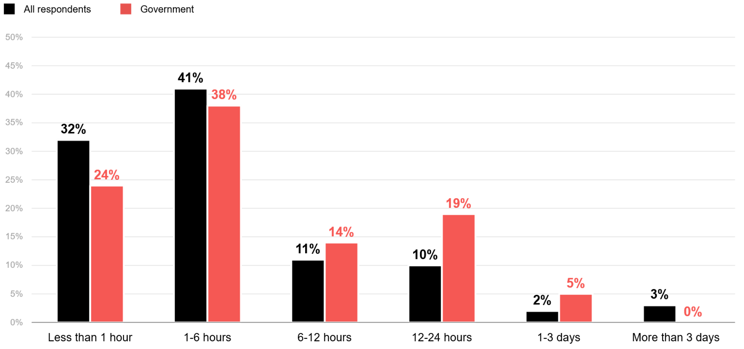
What is your average ‘mean time to detect’ (MTTD) a security incident?
ADAPT Security Edge Surveys Edge Survey in Apr and Oct 2025. Sample size: 203 Australian CISOs, 21 from Government

Slide 10
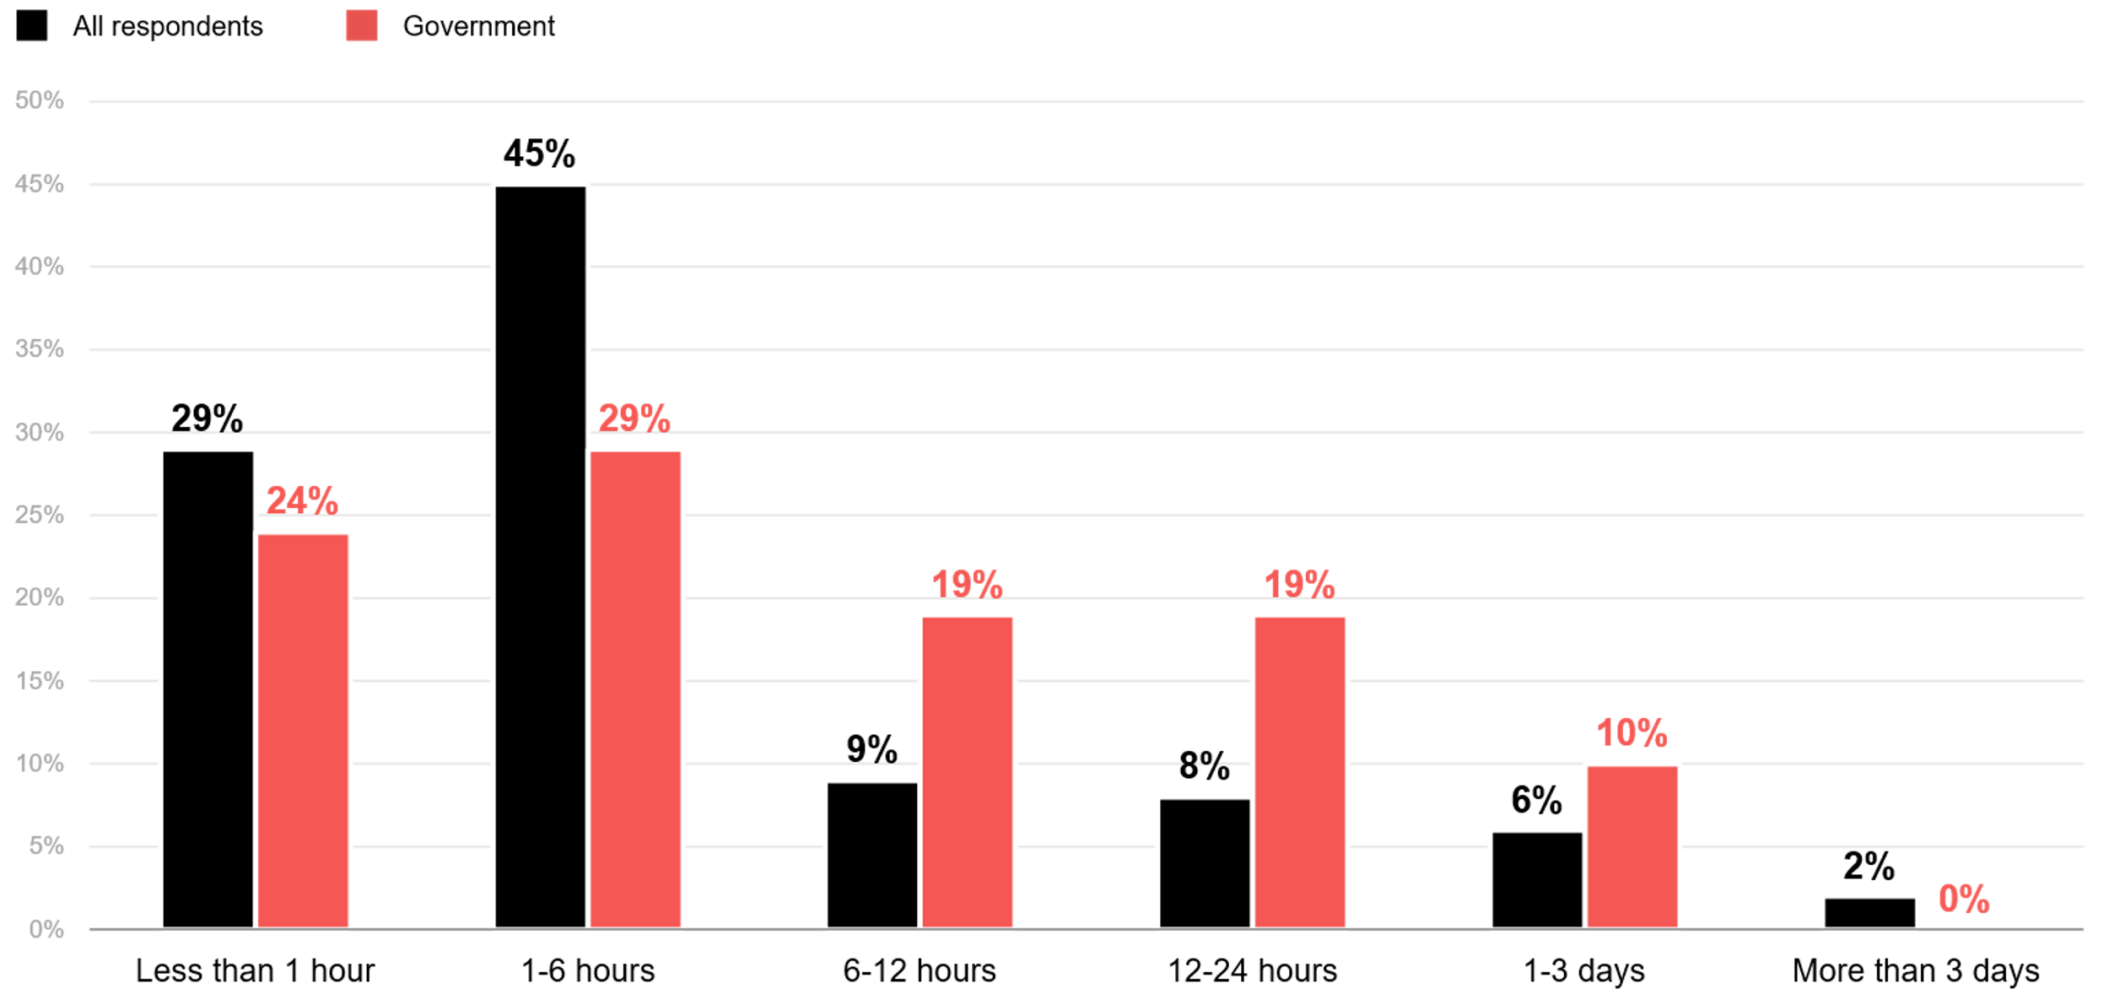
What is your average ‘mean time to respond’ (MTTR) to an incident once detected?
ADAPT Security Edge Surveys Edge Survey in Apr and Oct 2025. Sample size: 203 Australian CISOs, 21 from Government

Slide 11
CISO Insights: Government Sector
Government organisations mostly rely on outsourced vendors
Organisations lacking skilled cyber staff in-house tend to outsource their SOCs.
According to ADAPT CIO Edge Survey (Feb 2025), government agencies operate with more legacy
on-premises environments, limited data integration and basic governance controls. Outsourcing SOC enables faster improvement in E8 maturity and cyber security capabilities
Government lags behind in security capability
Government agencies show significant performance gaps in cyber resilience.
While some agencies respond promptly (within 1-6 hours), many lag far behind, underscoring
the urgent need to strengthen cyber security frameworks.
Detection and response times
Most government agencies take more than 12 hours to detect and respond to threats.
Heavy reliance on outsourced SOCs contributes to inconsistent performance, placing more agencies in the >12-hour category. This underscores the need for whole-of-government shared SOC services and uplifting E8 maturity.
Private sector comparison
CISOs in the private sector prioritises threat defence and rapid recovery, supported by greater automations in SOC operations.
Government leaders prioritise keeping their operational systems stable and compliant, while CISOs
focus more on detecting and responding immediately to security incidents. For further insights,
view an ADAPT Tech Trend report (Dec 2025).
SOC, MTTD
and MTTR
Key takeaways from government respondents:
SOC structure: Like other sectors,
most government agencies have a partial in-house and fully outsourced SOC.
Detection and response speed: Government agencies are slower on average than other sectors at both
detection and response.
Detection time: About 24% of government agencies take over 12 hours to detect a security incident, compared to 15% in
other sectors.
Response time: 29% of agencies take more than 12 hours to respond, while only 16% of other sectors do the same.

Slide 12
Survey demographics

Slide 13
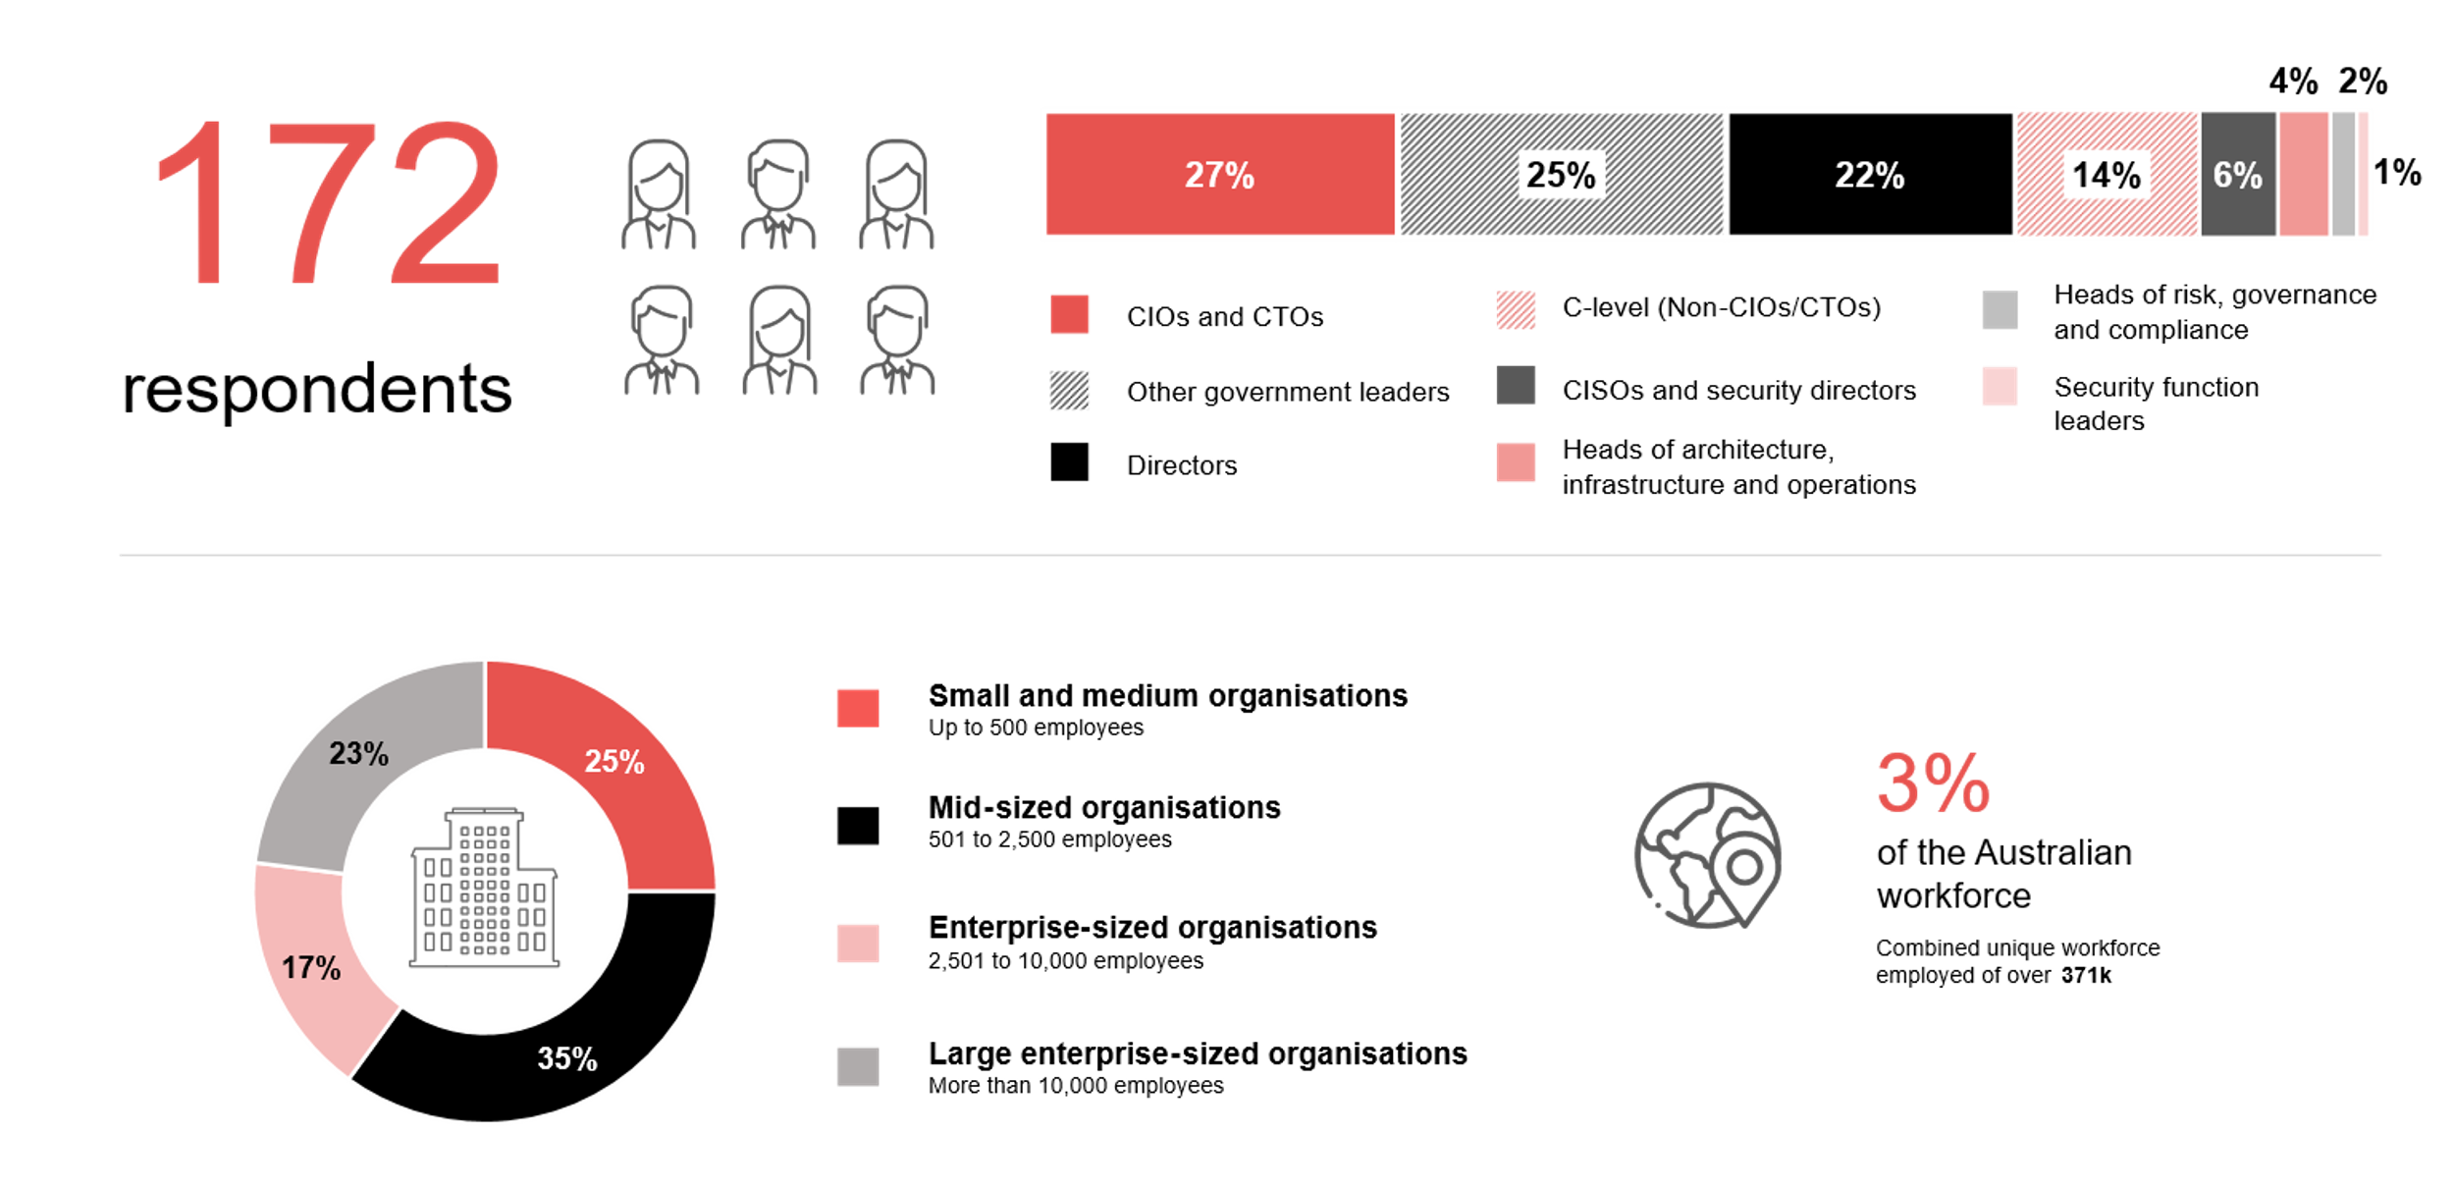
Survey demographics: Australian Government CISOs and Government Leaders in 2025

Slide 14

For sector, segment and persona comparisons
Central limit theorem a fundamental concept in statistics that determines when a sample size is large enough
to be considered reliable. There are different formulas and some debate amongst statisticians about the appropriate sample size. For industry comparisons or other subset analyses, a sample size of ( n > 20 ) is generally considered acceptable for drawing meaningful insights. This threshold aligns with common statistical practices, where a
sample size of 20 to 30 is generally the minimum needed to assume a normal distribution of the data.
Sample sizes below 20, but equal to or greater than 15
When the sample size is between 15 and 20, while not fully representative, it can still offer valuable insights
into trends. These statistics should be viewed as indicative, highlighting general directions in industry efforts
or barriers to investment but treated with some caution due to the smaller number of observations.
Sample sizes less than 15, but greater or equal to 10
For samples between 10 and 15, the data provides a snapshot guideline only. While such small samples can
show early trends, it's important to recognise that this doesn't guarantee future respondents will reflect the same trends. For instance, while 100% of respondents in a sample of 10 might invest in AI, it'd be unrealistic to assume
this pattern will hold as the sample size grows. However, if the sample size increases to 20, it's unlikely
that the trend will change drastically, and the next 10 respondents will have no investment.
ADAPT Data Analytics:
Notes on sample sizes
Why does sample size matter?
Each set of statistics is unique with measures,
distribution, variance and sample size. It is generally accepted in statistics that as sample size increases, analysts make fewer assumptions about the data, resulting in statistics that more accurately represent the truth.
ADAPT endeavours to provide transparency of sample size, whereby we provide a source on data slides with
the number of respondents and the survey where those respondents come from. In data and insights slide decks, ADAPT usually provides some insight on the breakdown
of the demographics at the end of the slide deck.
To protect privacy, ADAPT does not release lists
of individual respondents to surveys.

Slide 15


Written by
Gabby Fredkin
Head of Data and Analytics at ADAPT
Honey Mari Gay
Junior Data Analyst at ADAPT
Gabby’s primary role is managing ADAPT’s overall strategy for Data Analytics. He has extensive experience in using data to identify trends in technology that help shape Australian organisations. Using modern data science techniques, he ensures the accuracy and validity of the information that supports ADAPT’s research, advisory services, and events, giving both ADAPT and its customers greater confidence in the insights provided.
With a passion for creating stories with data, Gabby is consistently rated as one of the top speakers at ADAPT Events. In round table discussions, he specialises in using statistics to initiate thought-provoking discussions. Gabby is effective in translating information into insights, enabling ADAPT’s customers to become more data-driven.
As a Junior Data Analyst at ADAPT, Mari enables the discovery and definition of market trends through visually meaningful statistics. She ensures data presentations are accurate and aligned with modern statistical standards.
Mari is passionate about data and transforming it into actionable insights. With over three years of experience in project management and academic research, she has led end-to-end survey and research projects, processed and analysed data using a range of statistical tools and techniques, and provided clients with statistical
consultation and insights.

Slide 16

About ADAPT
ADAPT is a specialist Research & Advisory firm providing local market insights and benchmarking data
to Australia and New Zealand’s senior technology and business community.
Since 2011, we’ve been empowering the leaders of the region’s top enterprise and government organisations
to stay at the forefront of modern trends and build for the future. Our industry leading conferences, private roundtable events and custom research projects equip business leaders with the knowledge, relationships, inspiration and tools they need to make better strategic decisions.
adapt.com.au | hello@adapt.com.au
Data Validation
Results contained in this report (Report) are based on survey responses as provided by our clients and publicly available information. ADAPT does not subject the data contained in the Report to audit or review procedures or any other testing to validate the accuracy or reasonableness of the data provided by the participating clients. While we do not manipulate the survey responses, we do make an effort to identify outlier data or conflicting results that could lead to misinterpretations before the preparation of the Report.
Intended Use of the Report
The Report is designed to help technology executives in Australia and New Zealand make independent decisions regarding financial, resourcing and operational performance matters. The information and data contained in the Report are provided as is and are for information purposes only. They are not intended or implied to be recommendations and in no event will ADAPT be liable for any decisions or actions taken in reliance of the results obtained through the use of the information and/or data contained in the Report.
Research MSA and Privacy Policy
The Report and any other information provided by ADAPT is subject to the Research and Advisory Master Services Agreement and the ADAPT Privacy Policy.

Slide 17




Additional resources you can access
Members of ADAPT’s Research & Advisory platform have access to an entire suite of market leading content, insights and resources to help you execute in your role. For any assistance contact your Account Manager in the help section.
Community Case Studies & Interviews
Case studies detailing the successes and challenges of projects and initiatives.
Market Trend Reports Access a library of fact-based actionable insights, deep dives on ANZ business & IT trends.
Live Access to ADAPT Analysts
Through live ADAPT analyst market briefings and Q&A sessions
Downloadable Data & Insights
Elevate your business cases with downloadable market and industry data.
Industry Expert Presentations
Watch keynotes or read distilled 1-page executive summaries from our Edge Events.
Bespoke Analysis of ADAPT Data
Receive custom cuts and analysis of ADAPT proprietary data.
Premier Executive Community
Unlock access to our exclusive network of Australia’s leading technology and business executives.
Dedicated Account Manager & Impact Assessments
Your Account Manager will ensure you and your team are getting the most out of your subscription.
Dedicated Analyst Briefing
Leverage a dedicated briefing with an ADAPT analyst to help validate your strategies.
*Inclusions may vary depending on subscription level.

