Slide 1
ADAPT Sector Analysis
Healthcare Industry:
Data and AI Maturity Insights

Slide 2
Data maturity
ADAPT’s CIO Edge Survey in February 2025 asked the following questions:
Data infrastructure: Which of the following best describes your primary data storage
and processing environment?
Data access and integration: Rate the level of integration across your data sources.
Data governance and security: Do you have data governance, compliance, and security frameworks in place?
Advanced analytics and AI readiness: Has your data environment enabled the adoption
of advanced analytics, AI, or machine learning?
AI maturity
ADAPT’s CIO Edge Survey in August 2025 asked the following questions:
How mature is your organisation’s use of agentic AI?
How important do you think the following areas are when evaluating agentic AI products?
AI use cases
ADAPT’s CIO, Data and AI, and Digital Edge surveys in February, May and June 2025 asked
the following questions:
What are your primary AI (Generative AI, agentic AI, and others) use cases so far?
And the maturity of their deployment?
Data and AI Insights: Healthcare Sector
Document description
This document outlines insights from CIOs,
CDAOs and CDOs within the healthcare industry.
Organisations in the ADAPT sample include:
Private hospitals
Aged care operators
Pharmaceutical companies
Centrally operated large medical specific chains
(such as optometrists and chemists)
Health insurers
The statistics shown in this report cover:
Data and AI maturity
AI use cases
Surveys were received in February, May,
June and August 2025.

Slide 3
Healthcare: Data maturity

Slide 4
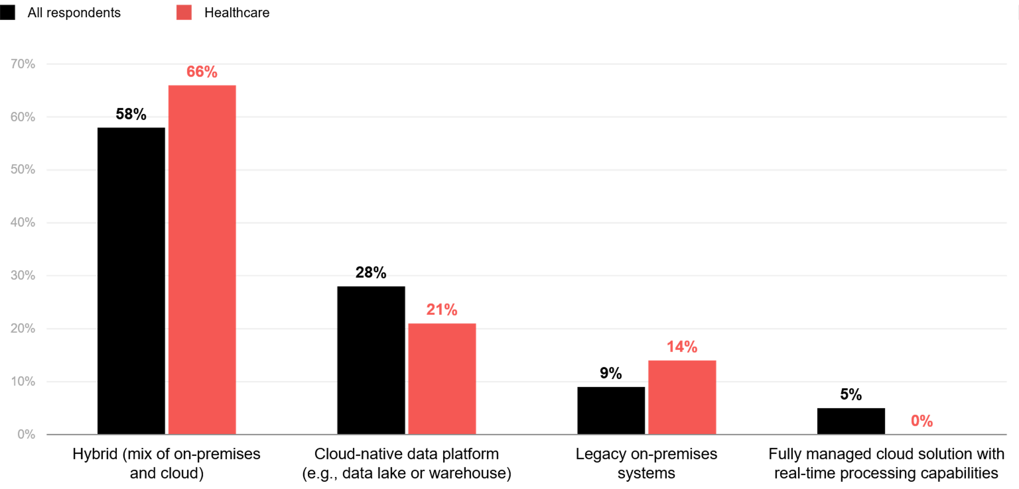
Which of the following best describes your primary data storage and processing environment?
ADAPT CIO Edge Survey in Feb 2025. Sample size: 204 Australian CIOs, 29 from healthcare

Slide 5
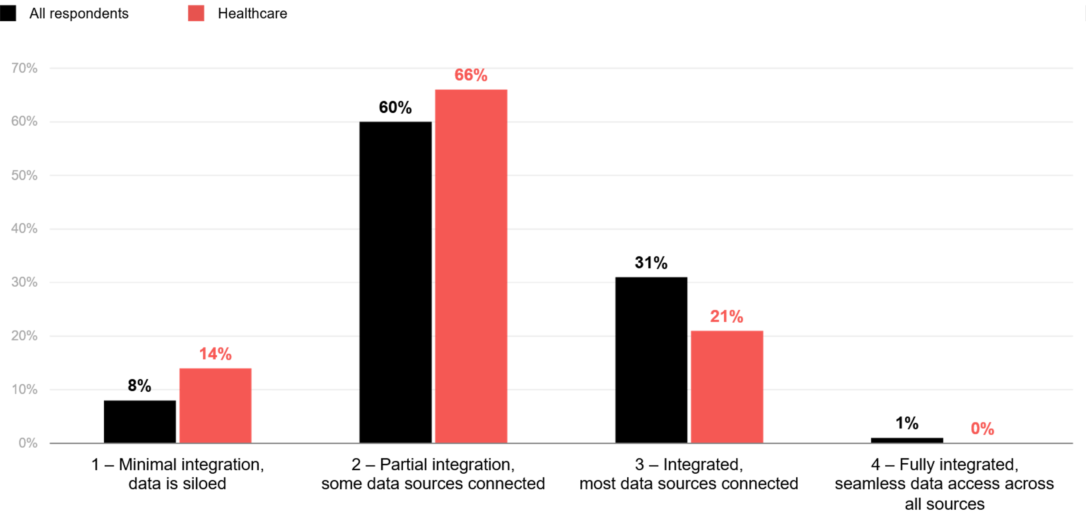
Level of integration across data sources
ADAPT CIO Edge Survey in Feb 2025. Sample size: 202 Australian CIOs, 29 from healthcare

Slide 6

Do you have data governance, compliance, and security frameworks in place?
ADAPT CIO Edge Survey in Feb 2025. Sample size: 202 Australian CIOs, 29 from healthcare

Slide 7
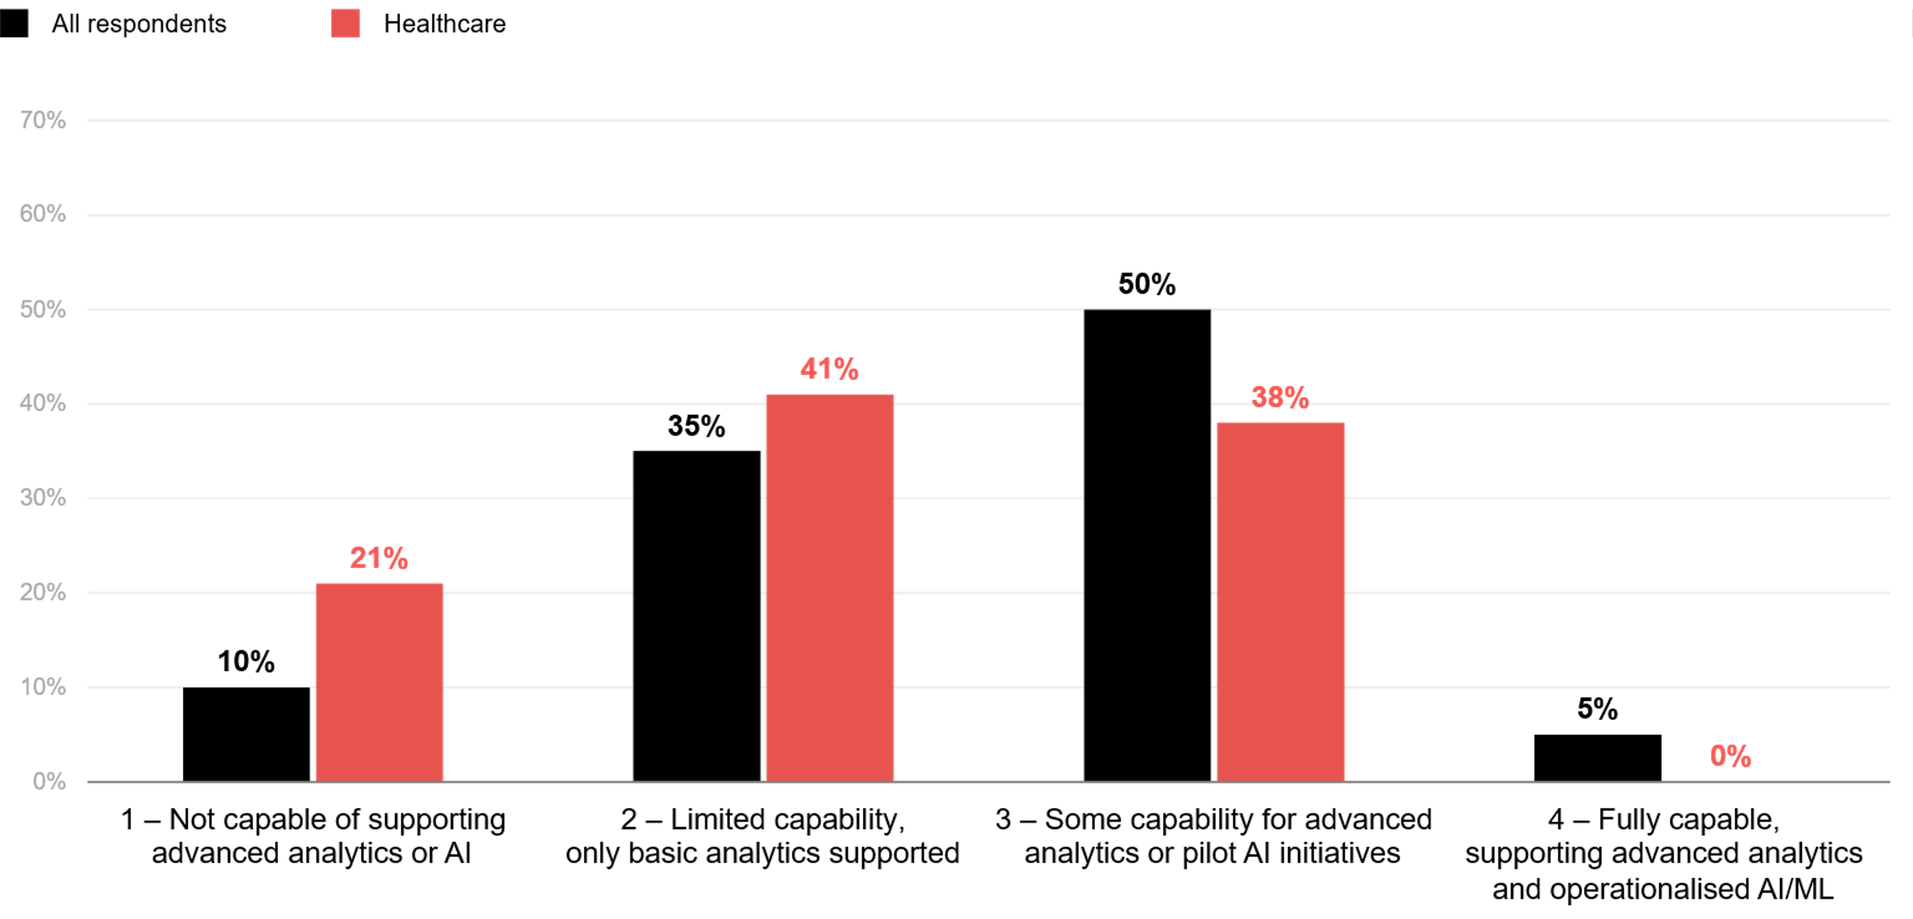
Has your data environment enabled the adoption of advanced analytics, AI, or machine learning?
ADAPT CIO Edge Survey in Feb 2025. Sample size: 200 Australian CIOs, 29 from healthcare

Slide 8
Data and AI Insights: Healthcare Sector
Healthcare’s data foundations lag behind cloud-enabled industries
Healthcare organisations are using hybrid environments more than other industries,.
However, far fewer use cloud-native platforms, and none have real-time, fully managed cloud solutions.
A higher proportion of legacy on-prem systems creates bottlenecks for interoperability
and AI integration.
Data in healthcare is siloed, and only some data sources are integrated
Healthcare data integration levels are lower than in other sectors due to reliance on legacy systems
not designed for API-driven architectures.
Siloed data limits clinical and operational outcomes. Weak data integration also reduces
the effectiveness of AI and analytics tools, leading to poor experiences.
Governance in healthcare is adequate, but not AI ready
While governance policies exist, they lag behind industries with stricter compliance demands.
Many organisations have only basic frameworks; none have comprehensive governance.
These governance gaps reduce confidence in deploying AI for diagnostics, automation
or patient engagement.
Data environment in healthcare is not fully AI-ready
Most healthcare organisations have partial integration and basic governance controls,
limiting their ability to support advanced analytics.
AI tools remain stuck in pilot phases and fail to migrate into clinical workflows.
Data maturity
Key takeaways from CIO respondents
in the healthcare sector:
Primary data environment: Hybrid (a mix of on-premises and cloud) is the dominant
choice for storage and processing.
Integration level: Ranges from minimal to partial; no healthcare organisation has achieved seamless data integration.
Governance and security: Most organisations have only basic data governance, compliance, and security
controls in place.
Support capability: Many have limited support resources, which hinders adoption of advanced analytics, AI, and machine learning.

Slide 9
Healthcare: AI maturity

Slide 10
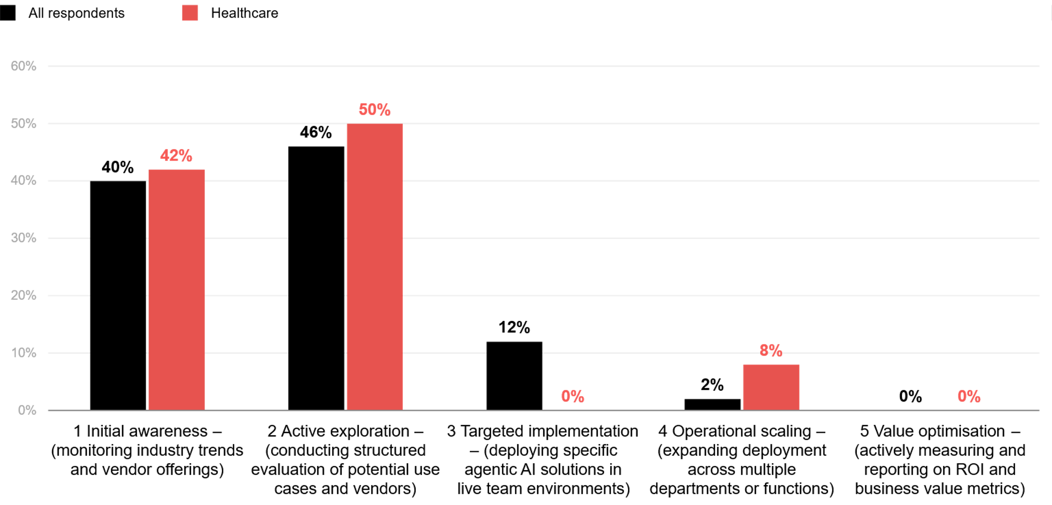
How mature is your organisation’s use of agentic AI?
ADAPT CIO Edge Survey in Aug 2025. Sample size: 151 Australian CIOs, 12 from healthcare

Slide 11
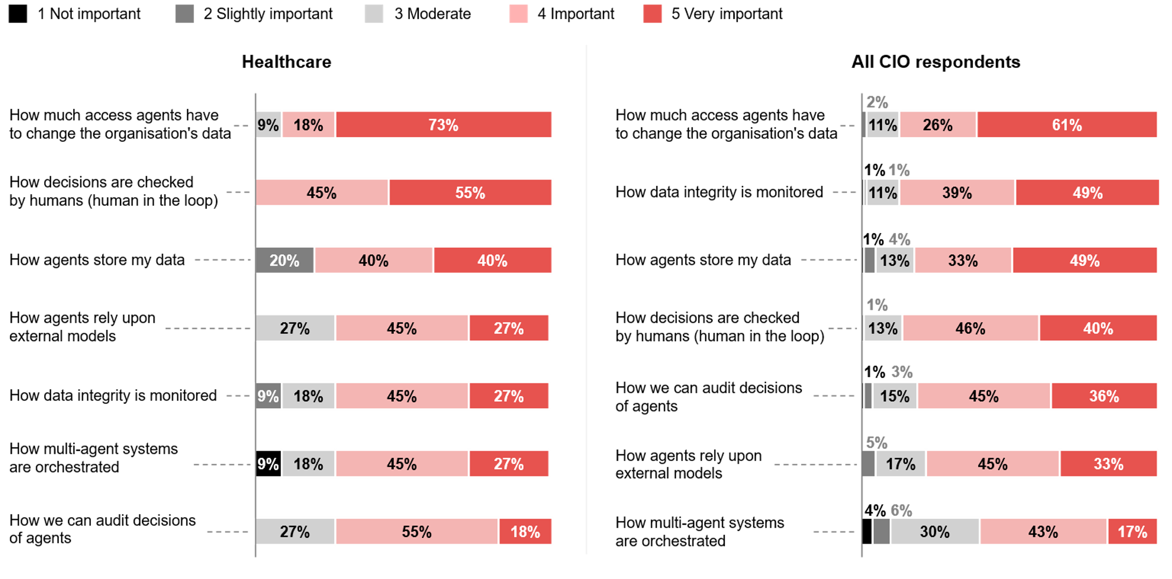
Healthcare CIOs top areas when evaluating agentic AI products
ADAPT CIO Edge Surveys in Aug 2025. Sample size: 143 Australian CIOs, 11 from healthcare

Slide 12
Awareness and exploration dominate healthcare's agentic AI maturity
Healthcare organisations remain largely in awareness or active exploration stages, similar to other industries, but with zero targeted implementations (vs. 12% in other sectors). In contrast with other sectors, 8% of healthcare organisations have already expanded agentic AI deployments across multiple departments or functions.
This indicates a modest increase in readiness for AI-driven workflow automation.
Focus on minimising data disruption before scaling AI
Both healthcare and other industries face foundational data challenges at this stage. As a result,
the top evaluation metric is “how much agents change organisational data”.
With healthcare’s partial integration, any AI-driven data modification could introduce errors into
clinical workflows.
Human-in-the-loop as a critical safeguard
Many healthcare organisations, including aged care, diagnostic centres and health insurers, require strong human oversight as AI-driven outputs impact safety, compliance and patient outcomes.
Whether in image interpretation, fraud detection or drug development, human experts validate AI decisions due to limited AI-ready environments. In contrast, industries with robust cloud foundations and governance prioritise automated data integrity and storage controls over human review.
Early maturity limits deployment
Because healthcare is still in awareness and exploration stages, deploying agents in live environments is premature. Advanced capabilities like data integrity monitoring, complex orchestration, and audit trails are not yet practical.
Data and AI Insights: Healthcare Sector
AI maturity
Key takeaways from CIO respondents
in the healthcare sector.
Like the other sectors, healthcare organisations are still in the initial exploratory stages of agentic AI maturity.
Both healthcare and other sectors list data access control as the #1 metric when evaluating agentic AI products.
The next healthcare priority is human decision oversight, while other sectors focus on data integrity checks and data storage controls.
Moreover, data integrity checks, multi-agent orchestration, and auditing of agent decisions rank as lower evaluation priorities for healthcare.

Slide 13
Healthcare: AI use cases

Slide 14
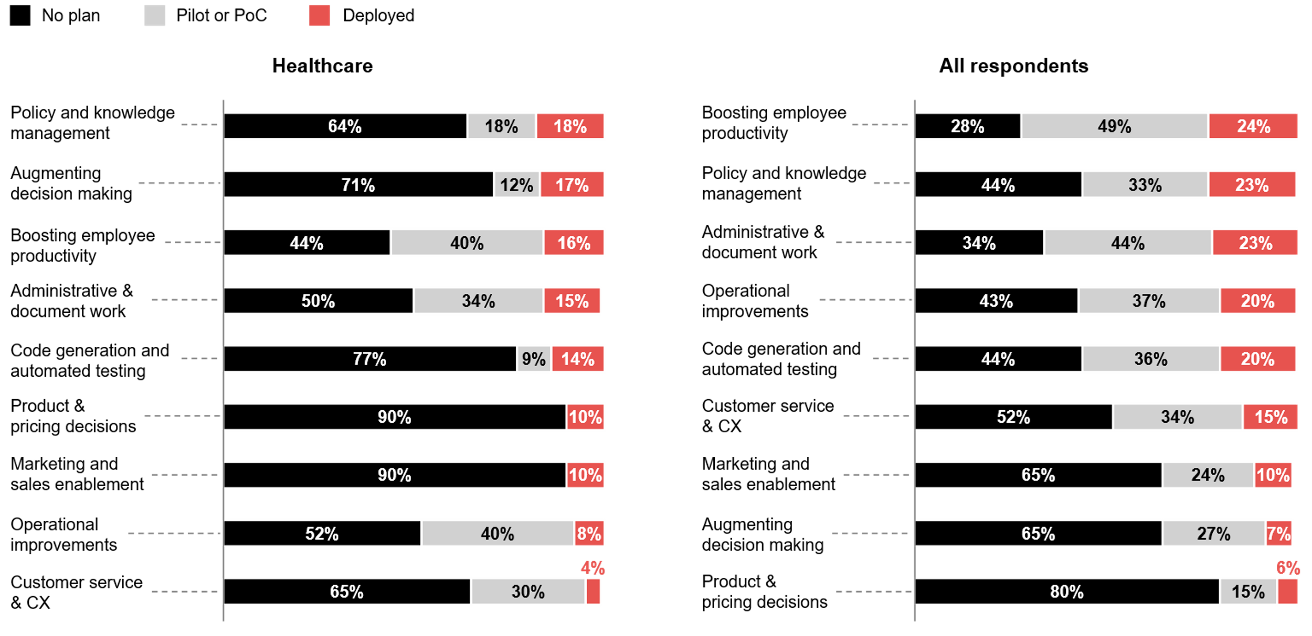
CIOs' generative AI use cases
ADAPT CIO Edge Surveys in Feb 2025. Sample size: 160 Australian CIOs, 26 from healthcare

Slide 15
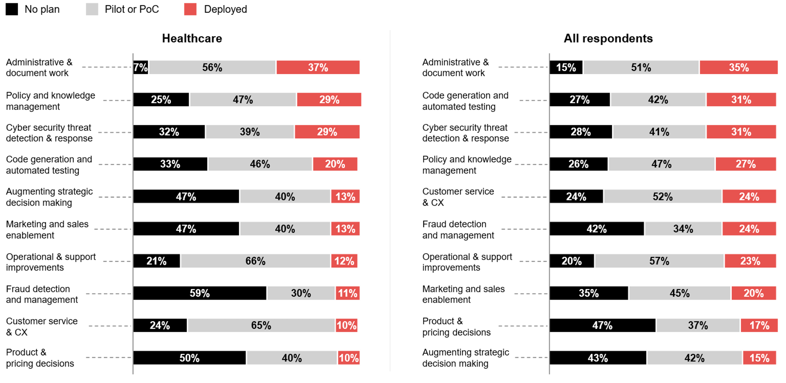
Primary AI (gen AI, agentic AI, and others) use cases: CDAOs and CDOs
ADAPT Data and AI, and Digital Edge Surveys Edge Surveys in May and June 2025. Sample size: 226 Australian CDAOs and CDOs, 33 from Healthcare

Slide 16
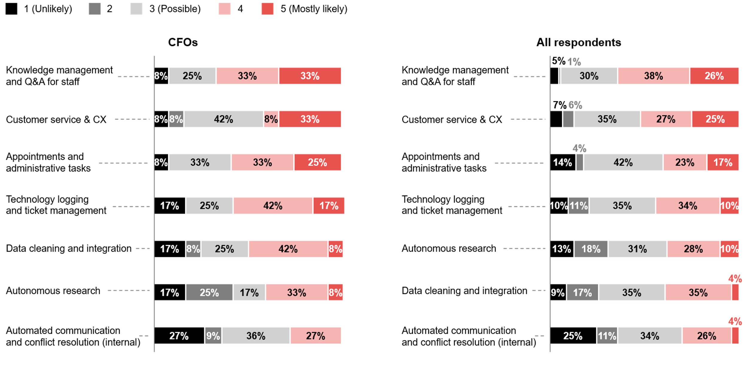
CDOs' top agentic AI use cases
ADAPT Digital Edge Survey in Jun 2025. Sample size: 82 Australian CDOs, 12 from healthcare

Slide 17
Data and AI Insights: Healthcare Sector
Healthcare CIOs prioritise lower-risk, knowledge-heavy use cases
With early AI maturity and limited governance controls, healthcare CIOs focus on safe, high-value wins
that minimize risk. Generative AI is well-suited for automating routine tasks. For example, in an ADAPT Community Interview (Nov 2025), ResMed's reported using co-pilot and agentic AI to reshape its finance function, improving efficiency and strategic value.
Decision augmentation over full automation
Healthcare CIOs use generative AI to augment, not automate, decisions. This reflects the sector’s emphasis on human oversight rather than automated integrity monitoring.
Other sectors are further ahead in generative AI adoption. Other sectors have more cloud-native platforms, integrated data environments and mature governance.
CDAOs and CDOs align with CIOs on AI deployment maturity
Like CIOs, healthcare CDAOs and CDOs deploy low-risk AI use cases first. In other sectors, low deployment areas include product and pricing decisions, augmenting decisions, and fraud and detection management.
Workforce pressure and patient care drive automation focus
Healthcare CDOs face chronic staff shortages and competing priorities. Agentic AI that automates tasks helps reduce overload and administrative friction.
Improving patient experience through automation is both operational and clinical. With early AI maturity, CDOs choose agentic AI use cases that deliver immediate relief without depending heavily on data.
AI use cases
Key takeaways from CIO, CDAO and CDO respondents in the healthcare sector.
Healthcare CIOs: Most report deploying generative AI to manage policies, augment decisions and boost productivity.
Other sectors: Use similar use cases but have low maturity in decision augmentation.
CDAOs and CDOs: Across industries,
GenAI is primarily used for administrative tasks, policy management, and cyber security threat detection and response.
Agentic AI focus: Both healthcare CDOs and other sectors are most likely to deploy agentic AI to improve employee and customer experiences (EX and CX).

Slide 18
Survey demographics

Slide 19
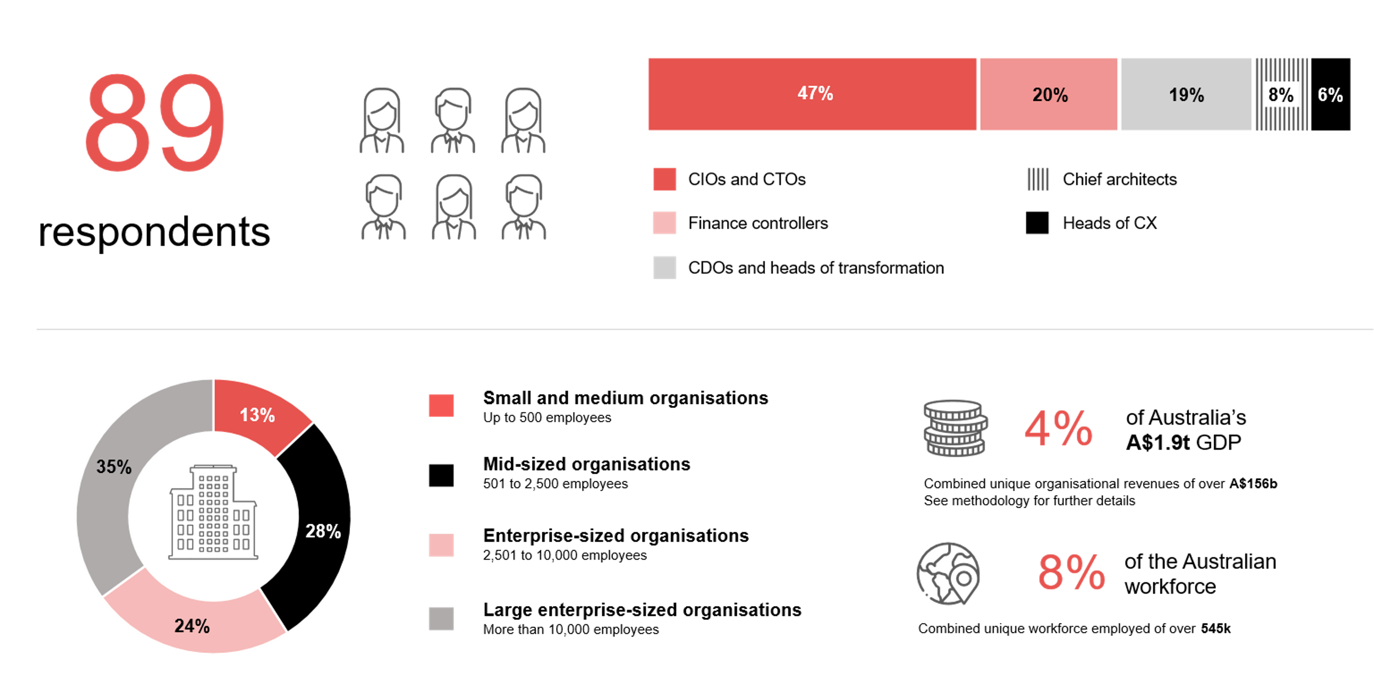
Survey demographics: Australian Healthcare CIOs, CDAOs and CDOs in 2025

Slide 20

For sector, segment and persona comparisons
Central limit theorem a fundamental concept in statistics that determines when a sample size is large enough
to be considered reliable. There are different formulas and some debate amongst statisticians about the appropriate sample size. For industry comparisons or other subset analyses, a sample size of ( n > 20 ) is generally considered acceptable for drawing meaningful insights. This threshold aligns with common statistical practices, where a
sample size of 20 to 30 is generally the minimum needed to assume a normal distribution of the data.
Sample sizes below 20, but equal to or greater than 15
When the sample size is between 15 and 20, while not fully representative, it can still offer valuable insights
into trends. These statistics should be viewed as indicative, highlighting general directions in industry efforts
or barriers to investment but treated with some caution due to the smaller number of observations.
Sample sizes less than 15, but greater or equal to 10
For samples between 10 and 15, the data provides a snapshot guideline only. While such small samples can
show early trends, it's important to recognise that this doesn't guarantee future respondents will reflect the same trends. For instance, while 100% of respondents in a sample of 10 might invest in AI, it'd be unrealistic to assume
this pattern will hold as the sample size grows. However, if the sample size increases to 20, it's unlikely
that the trend will change drastically, and the next 10 respondents will have no investment.
ADAPT Data Analytics:
Notes on sample sizes
Why does sample size matter?
Each set of statistics is unique with measures,
distribution, variance and sample size. It is generally accepted in statistics that as sample size increases, analysts make fewer assumptions about the data, resulting in statistics that more accurately represent the truth.
ADAPT endeavours to provide transparency of sample size, whereby we provide a source on data slides with
the number of respondents and the survey where those respondents come from. In data and insights slide decks, ADAPT usually provides some insight on the breakdown
of the demographics at the end of the slide deck.
To protect privacy, ADAPT does not release lists
of individual respondents to surveys.

Slide 21


Written by
Gabby Fredkin
Head of Data and Analytics at ADAPT
Honey Mari Gay
Junior Data Analyst at ADAPT
Gabby’s primary role is managing ADAPT’s overall strategy for Data Analytics. He has extensive experience in using data to identify trends in technology that help shape Australian organisations. Using modern data science techniques, he ensures the accuracy and validity of the information that supports ADAPT’s research, advisory services, and events, giving both ADAPT and its customers greater confidence in the insights provided.
With a passion for creating stories with data, Gabby is consistently rated as one of the top speakers at ADAPT Events. In round table discussions, he specialises in using statistics to initiate thought-provoking discussions. Gabby is effective in translating information into insights, enabling ADAPT’s customers to become more data-driven.
As a Junior Data Analyst at ADAPT, Mari enables the discovery and definition of market trends through visually meaningful statistics. She ensures data presentations are accurate and aligned with modern statistical standards.
Mari is passionate about data and transforming it into actionable insights. With over three years of experience in project management and academic research, she has led end-to-end survey and research projects, processed and analysed data using a range of statistical tools and techniques, and provided clients with statistical
consultation and insights.

Slide 22

About ADAPT
ADAPT is a specialist Research & Advisory firm providing local market insights and benchmarking data
to Australia and New Zealand’s senior technology and business community.
Since 2011, we’ve been empowering the leaders of the region’s top enterprise and government organisations
to stay at the forefront of modern trends and build for the future. Our industry leading conferences, private roundtable events and custom research projects equip business leaders with the knowledge, relationships, inspiration and tools they need to make better strategic decisions.
adapt.com.au | hello@adapt.com.au
Data Validation
Results contained in this report (Report) are based on survey responses as provided by our clients and publicly available information. ADAPT does not subject the data contained in the Report to audit or review procedures or any other testing to validate the accuracy or reasonableness of the data provided by the participating clients. While we do not manipulate the survey responses, we do make an effort to identify outlier data or conflicting results that could lead to misinterpretations before the preparation of the Report.
Intended Use of the Report
The Report is designed to help technology executives in Australia and New Zealand make independent decisions regarding financial, resourcing and operational performance matters. The information and data contained in the Report are provided as is and are for information purposes only. They are not intended or implied to be recommendations and in no event will ADAPT be liable for any decisions or actions taken in reliance of the results obtained through the use of the information and/or data contained in the Report.
Research MSA and Privacy Policy
The Report and any other information provided by ADAPT is subject to the Research and Advisory Master Services Agreement and the ADAPT Privacy Policy.

Slide 23




Additional resources you can access
Members of ADAPT’s Research & Advisory platform have access to an entire suite of market leading content, insights and resources to help you execute in your role. For any assistance contact your Account Manager in the help section.
Community Case Studies & Interviews
Case studies detailing the successes and challenges of projects and initiatives.
Market Trend Reports Access a library of fact-based actionable insights, deep dives on ANZ business & IT trends.
Live Access to ADAPT Analysts
Through live ADAPT analyst market briefings and Q&A sessions
Downloadable Data & Insights
Elevate your business cases with downloadable market and industry data.
Industry Expert Presentations
Watch keynotes or read distilled 1-page executive summaries from our Edge Events.
Bespoke Analysis of ADAPT Data
Receive custom cuts and analysis of ADAPT proprietary data.
Premier Executive Community
Unlock access to our exclusive network of Australia’s leading technology and business executives.
Dedicated Account Manager & Impact Assessments
Your Account Manager will ensure you and your team are getting the most out of your subscription.
Dedicated Analyst Briefing
Leverage a dedicated briefing with an ADAPT analyst to help validate your strategies.
*Inclusions may vary depending on subscription level.

